Slide 1

Eric Prebys
5/26/09

Slide 2
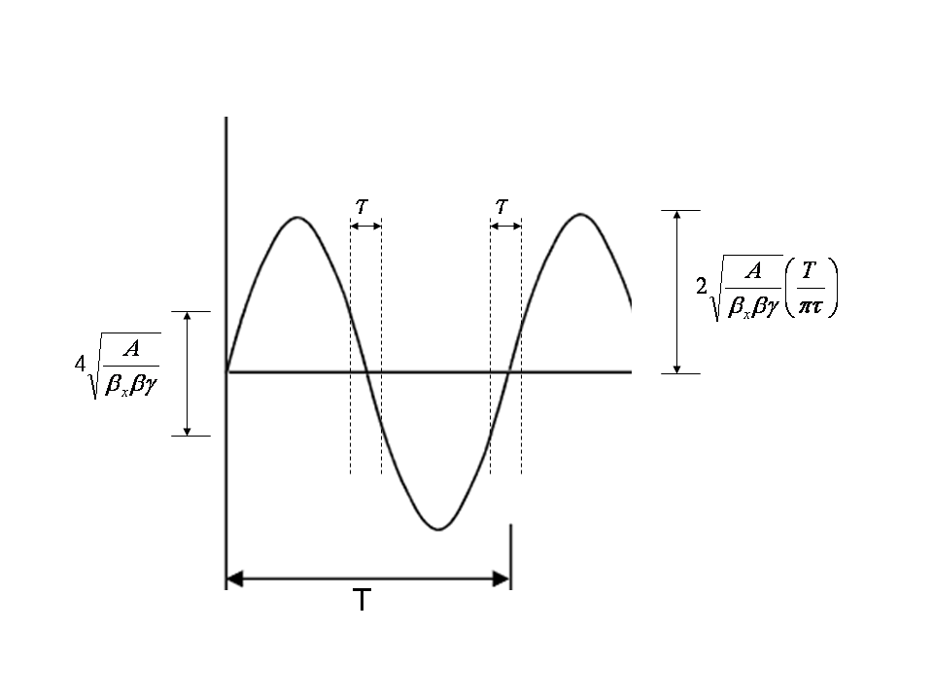
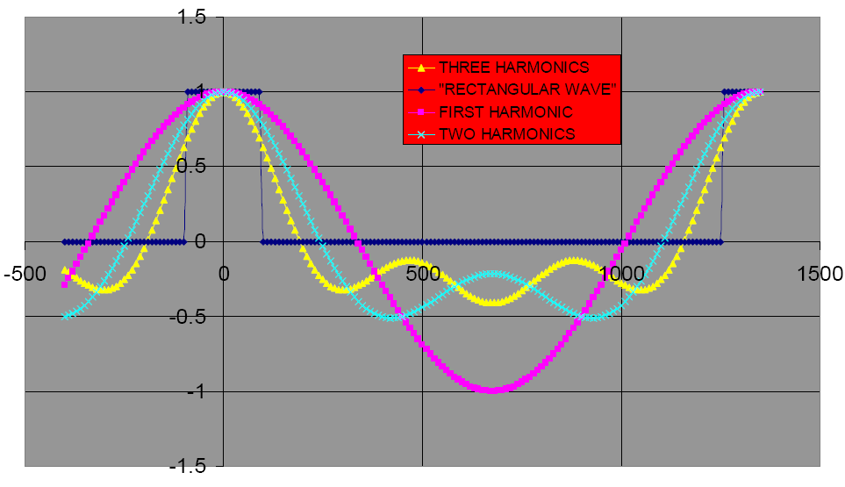
MECO believed that because dθ/dt goes to zero at time of the pulse, you did not need a compensating magnet.
Mu2e
MECO
Rely on a second magnet to compensate for beam slewing at transmission
E. Prebys – Mu2e beam meeting
5/26/09

Slide 3
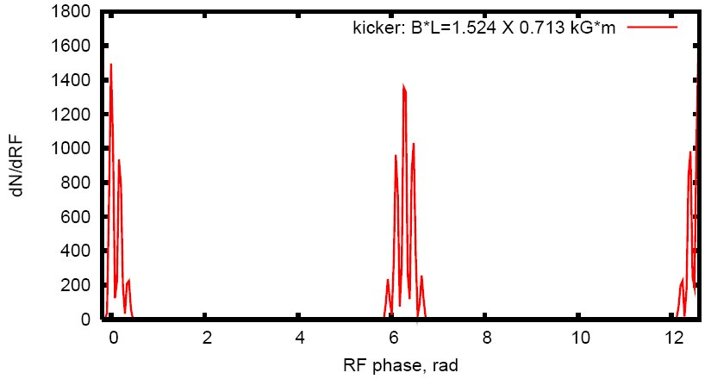
Start with a uniform (in time) beam distribution.
~50 ns bins
E. Prebys – Mu2e beam meeting
5/26/09

Slide 4
For the purposes of calculating beam loss, it’s probably reasonable to use a gaussian or similar distribution.
However, all proton beams will have non-gaussian tails at the level we’re concerned about, and these will probably change with accelerator conditions, etc.
Assume there will be some beam at all points within the admittance of the beam line.
Therefore, consider it axiomatic
  The admittance of the beam line should be well defined by a collimation system (not simply magnet apertures)
  This should be matched to the admittance of the extinction collimation system*
*in the MECO scheme, the target itself can be represented by an admittance.
E. Prebys – Mu2e beam meeting
5/26/09

Slide 5
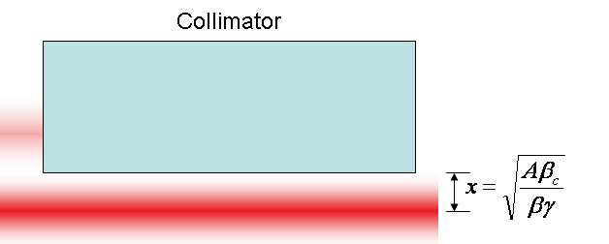
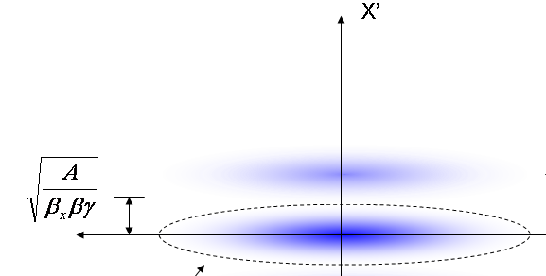
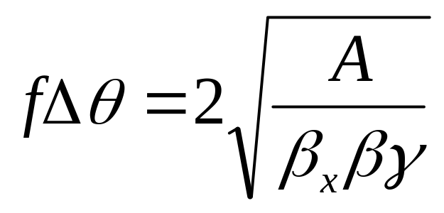
At collimator:
Beam fully extinguished when deflection equals twice full admittance (A) amplitude
Full scale deflection
At kicker:
Fraction of FS to extinguish
*al la FNAL-BEAM-DOC-2925
E. Prebys – Mu2e beam meeting
5/26/09

Slide 6


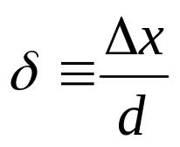
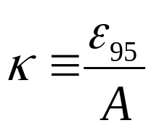
The amount of beam transmitted (or which hits the target) is given by
This can be expressed in a generic way as
Where
Lateral displacement
emittance
Half-aperture
admittance
E. Prebys – Mu2e beam meeting
5/26/09

Slide 7
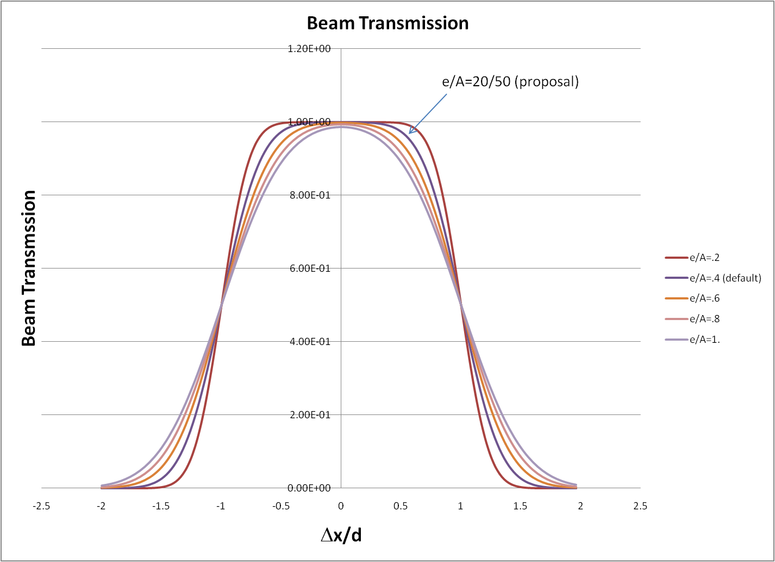
E. Prebys – Mu2e beam meeting
5/26/09

Slide 8
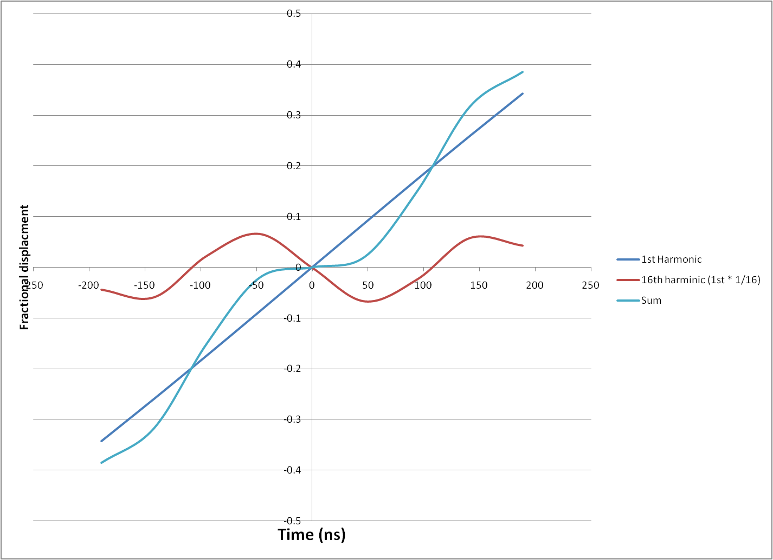
Add a small amount of 16th harmonic (~5MHz) to node transmission scheme.
Might eliminate the need for compensating dipole
E. Prebys – Mu2e beam meeting
5/26/09

Slide 9
Convoluting transmission calculation with waveforms of the three extinction schemes to calculate beam loss.
Working on note comparing magnet/beamline needs of the various schemes.
E. Prebys – Mu2e beam meeting
5/26/09

