Slide 1

Eric Prebys
*Mu2e-DOC-550-v1
6/2/2009

Slide 2
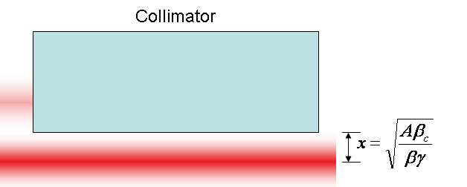
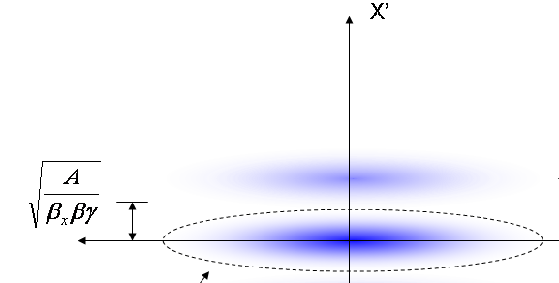
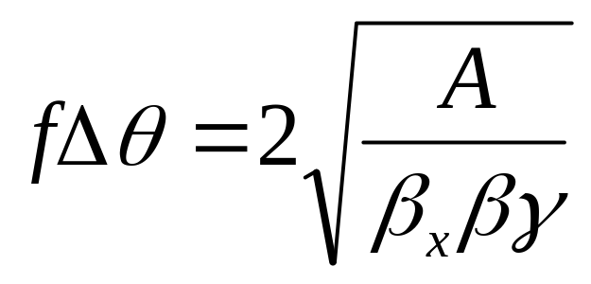
At collimator:
Beam fully extinguished when deflection equals twice full admittance (A) amplitude
Full scale deflection
At kicker:
Fraction of FS to extinguish
*al la FNAL-BEAM-DOC-2925
E. Prebys – Mu2e beam meeting
6/2/2009

Slide 3


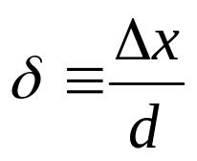
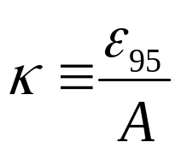
The amount of beam transmitted (or which hits the target) is given by
This can be expressed in a generic way as
Where
Lateral displacement
emittance
Half-aperture
admittance
E. Prebys – Mu2e beam meeting
6/2/2009

Slide 4
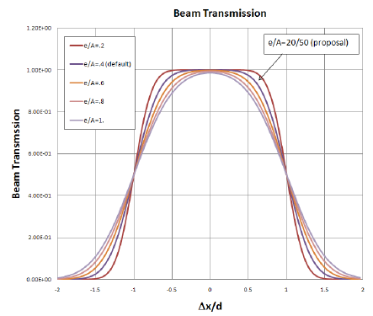
E. Prebys – Mu2e beam meeting
6/2/2009

Slide 5
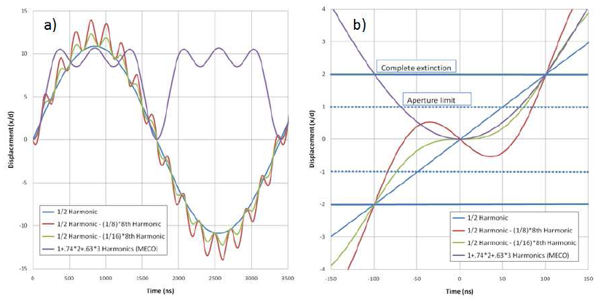
E. Prebys – Mu2e beam meeting
6/2/2009

Slide 6
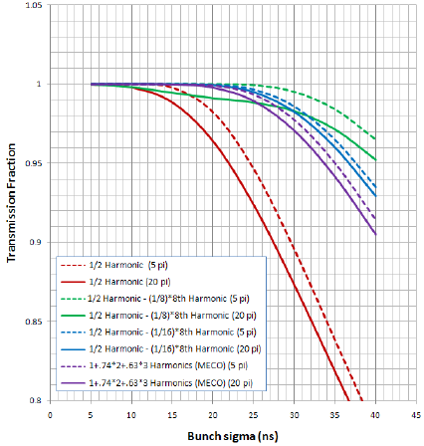
E. Prebys – Mu2e beam meeting
6/2/2009

Slide 7
Our baseline design has significant issues with transmission efficiency unless bunches are very short (~10ns).
The MECO design is markedly superior in this regard.
A new proposal involving a small amount of 4.8MHz harmonic looks very promising.
In comparing the two proposals, consideration will be given to
  Higher harmonic rate vs
  Reduced number of harmonics and lower magnetic field.
E. Prebys – Mu2e beam meeting
6/2/2009

