Slide 1

Eric Prebys
Accelerator Physics Center
Fermilab
7/30/09

Slide 2
Consider it axiomatic that some beam may be present anywhere in the admittance of the beam line
  Historically very hard to predict or model.
Therefore, it’s important to have the beam admittance well defined by a collimation system, rather than rely on the limiting aperture of magnets, beam pipes, etc.
For the moment, assume that the defining admittance of the beam line is equal to the defining admittance of the collimation channel.
Assume gaussian shape for majority of beam
  Usual FNAL 95% definition of emittance
  Calculation not very sensitive to this
Mu2e Meeting
7/30/09

Slide 3
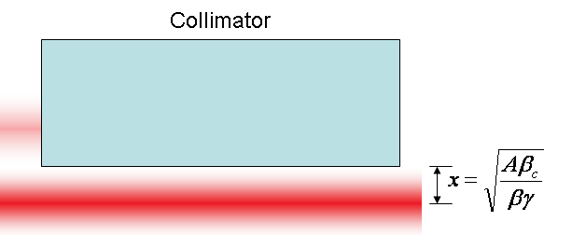
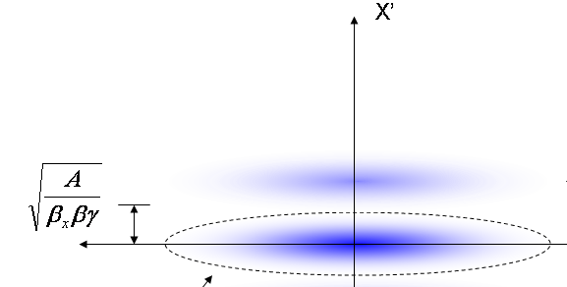
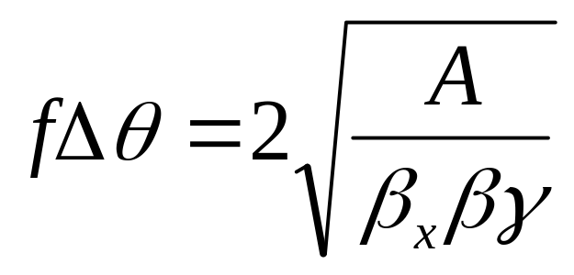
At collimator:
Beam fully extinguished when deflection equals twice full admittance (A) amplitude
Full scale deflection
At kicker:
Fraction of FS to extinguish
*al la FNAL-BEAM-DOC-2925
Mu2e Meeting
7/30/09

Slide 4
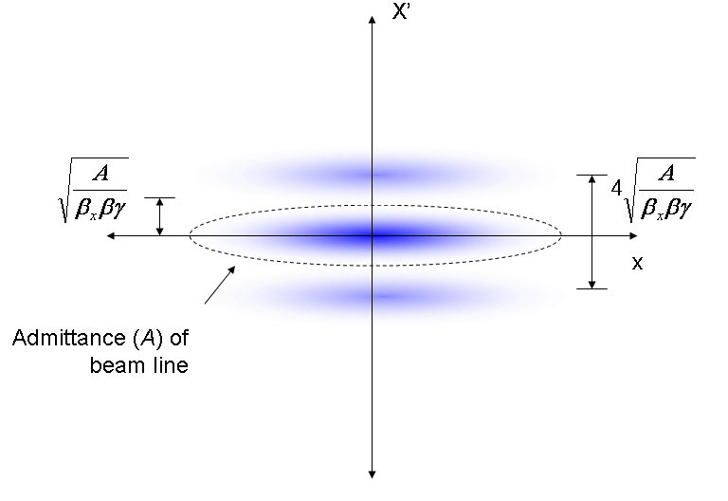
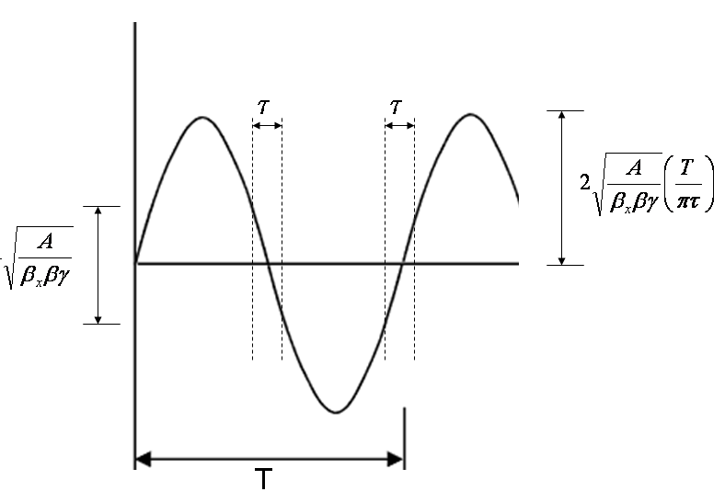
Phase space (live window τ):
Full amplitude:
Short live window -> large “extra” amplitude
Mu2e Meeting
7/30/09

Slide 5


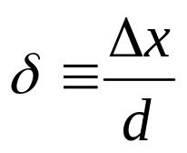
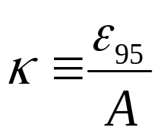
The amount of beam transmitted (or which hits the target) is given by
This can be expressed in a generic way as
Where
Lateral displacement
emittance
Half-aperture
admittance
Mu2e Meeting
7/30/09

Slide 6
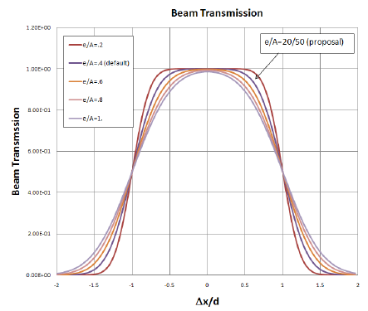
Mu2e Meeting
7/30/09

Slide 7
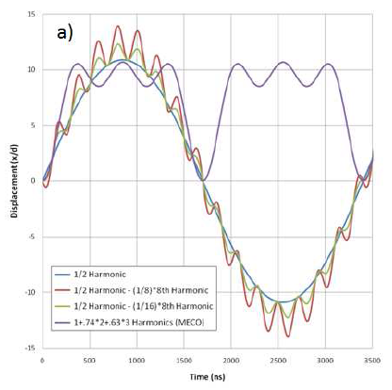
3 harmonic design of MECO
  3 harmonics (1x, 2x, and 3x bunch rate) generate ~square wave.
  Transmits at peak
Single harmonic design
as in proposal
  Runs at half of bunch rate
  Transmits on the null
Modified sine wave
  Add high harmonic to reduce
  slewing in transmission window.
Important questions
  Transmission during 200 ns
  live window
  Magnet design
  Is second magnet necessary?
200 ns transmission window
Mu2e Meeting
7/30/09

Slide 8
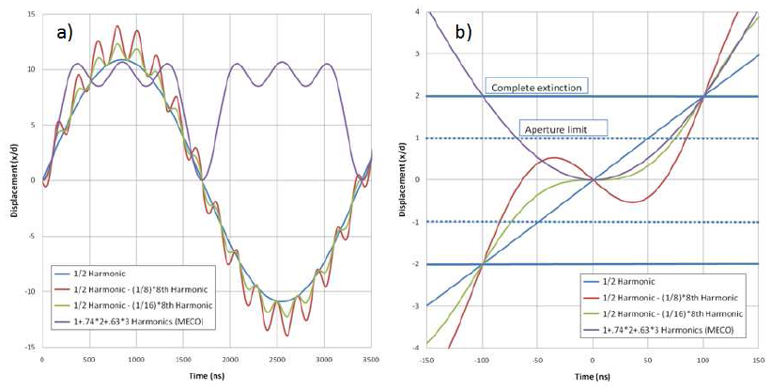
Normalized all waveforms to complete extinction at ±100 ns
Mu2e Meeting
7/30/09

Slide 9
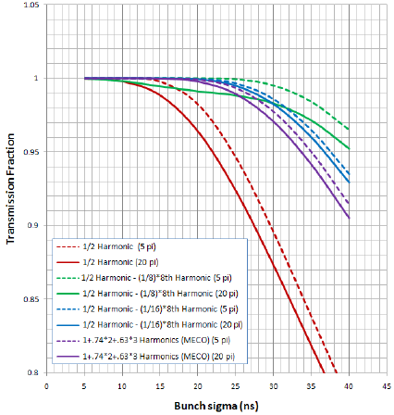
Mu2e Meeting
7/30/09

Slide 10
Our baseline design has significant issues with transmission efficiency unless bunches are very short (~10ns).
The MECO design is markedly superior in this regard.
A new proposal involving a small amount of 4.8MHz harmonic looks very promising.
In comparing the two proposals, consideration will be given to
  Higher harmonic rate vs
  Reduced number of harmonics and lower magnetic field.
Mu2e Meeting
7/30/09

