Slide 1

Eric Prebys
11/12/2009

Slide 2
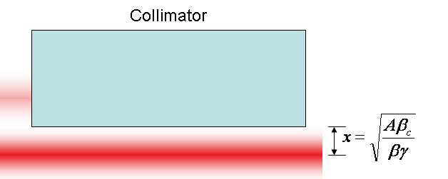
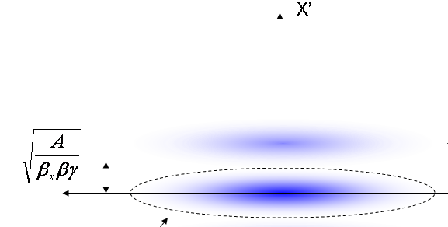
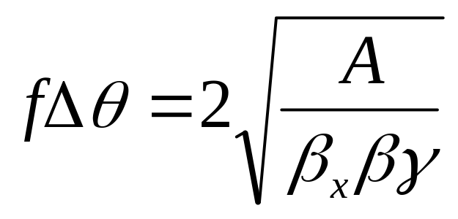
At collimator:
Beam fully extinguished when deflection equals twice full admittance (A) amplitude
Full scale deflection
At kicker:
Fraction of FS to extinguish
*al la FNAL-BEAM-DOC-2925
E. Prebys – Mu2e meeting
11/12/2009

Slide 3
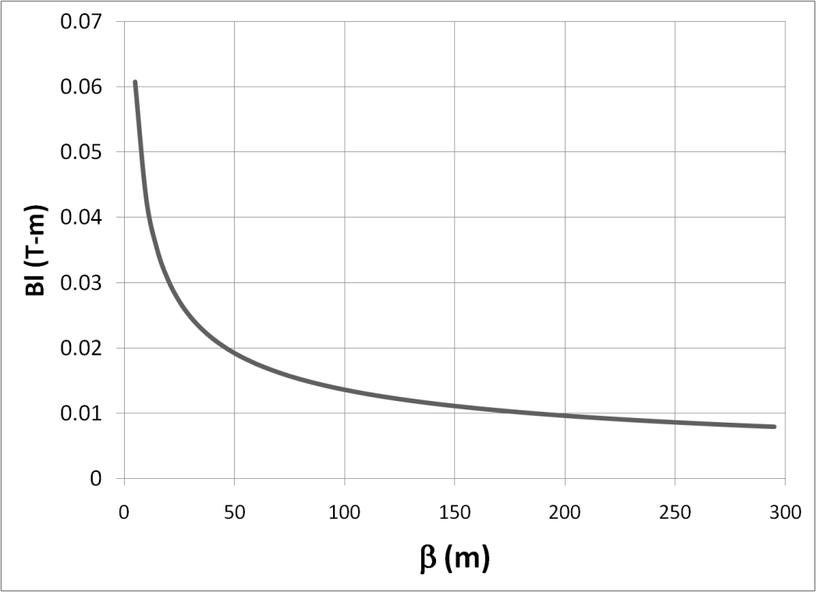

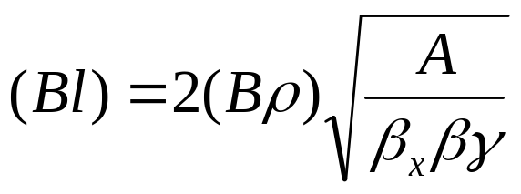

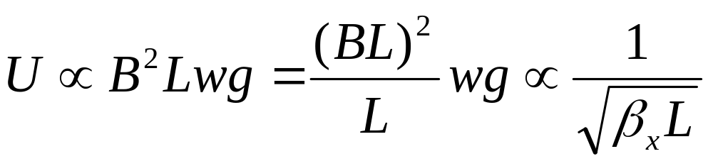
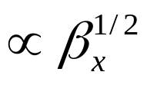

Bend strength to extinguish:
Stored Energy:
⇒Large β_{x}, long weak magnets
- Assume β_{x}=250m, L=6m
E. Prebys – Mu2e meeting
11/12/2009

Slide 4
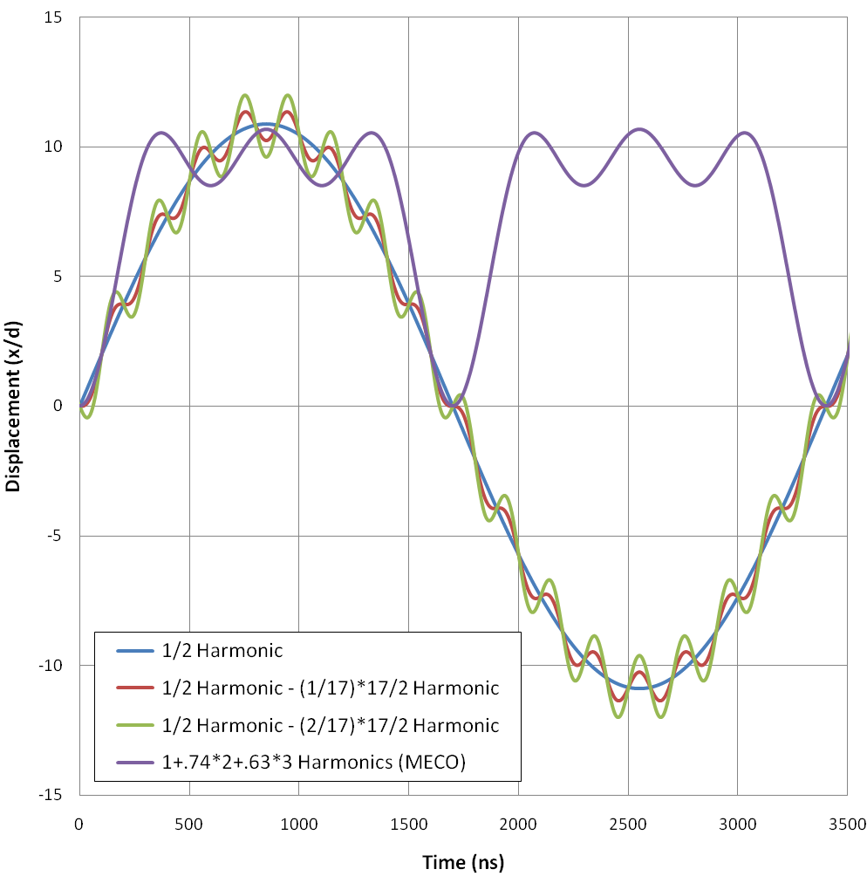
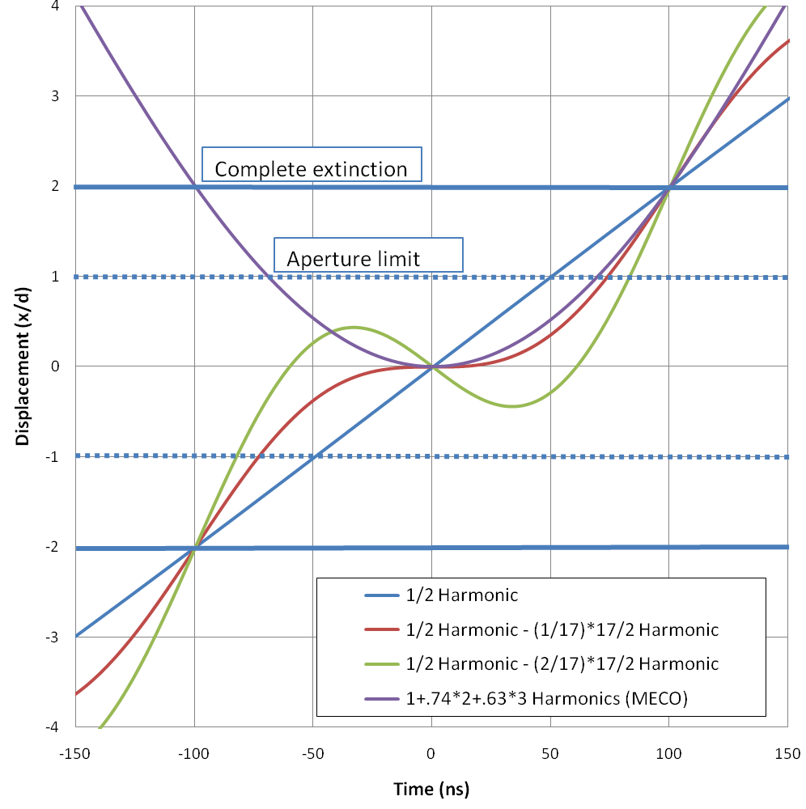
a)
b)
E. Prebys – Mu2e meeting
11/12/2009

Slide 5
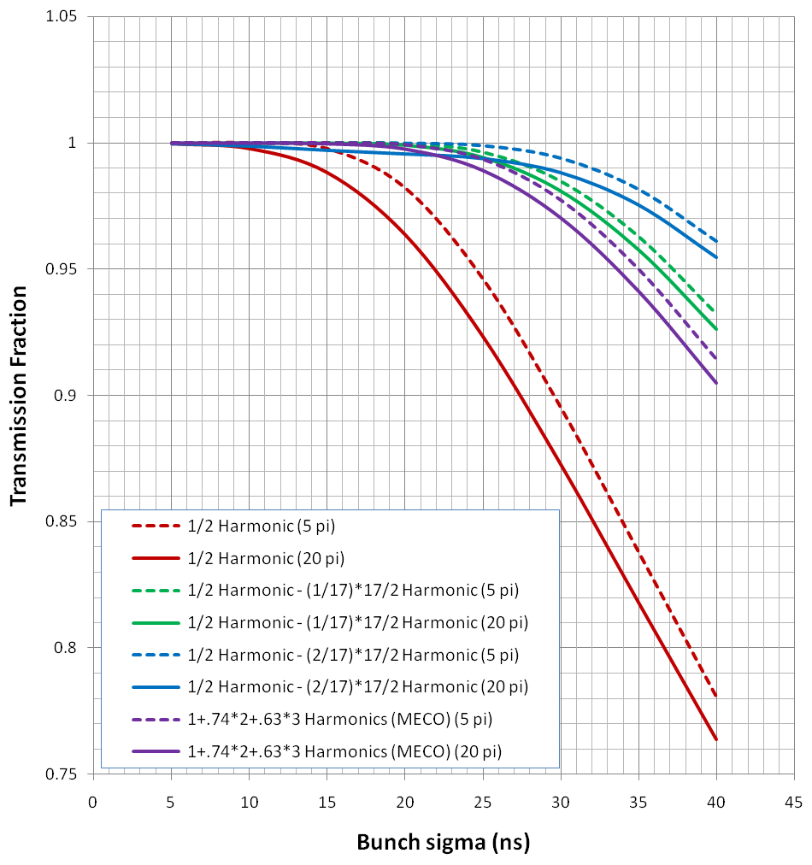
E. Prebys – Mu2e meeting
11/12/2009

Slide 6
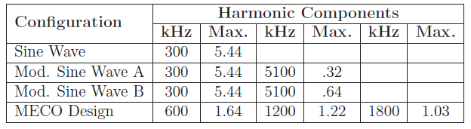
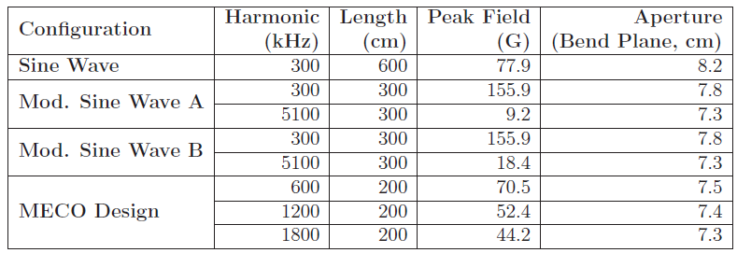
Peak component strength (relative to total extinction strength)
Magnet specifications (assuming equal length/harmonic)
E. Prebys – Mu2e meeting
11/12/2009

Slide 7
High frequency the challenge
  Compare
    Mod Sine A
      Frequency: 5.1 MHz
      Length: 3 m
      Peak field: 9.2 Gauss
    MECO (3rd magnet)
      Frequency: 1.8 MHz
      Length: 2 m
      Peak field: 44.2 Gauss
Generally at about .5-1MHz
  EE -> RF (switching supply -> linear supply)
  $$ -> $$$
  Both schemes in that realm
Other issues
  Magnet easier if we can keep V to ground < 1kV
E. Prebys – Mu2e meeting
11/12/2009

Slide 8
Magnet specs given to TD to generate a conceptual design.
Once we know the approximate inductance, we’ll talk to the EE (for 300 kHz) and RF (for >1 MHz) people.
E. Prebys – Mu2e meeting
11/12/2009

