Slide 1

Eric Prebys
*Mu2e-DOC-709
11/19/2009

Slide 2
Out of time beam will likely have a very different transverse distribution than in time beam.
  Assume out of time beam may be present anywhere within the transverse admittance of the beam line.
Beam line admittances should be well-defined by a collimation system.
  Don’t rely on pole faces, magnetic coils, beam pipes or other aperture restrictions, because they’re difficult to model properly.
The extinction system should be designed such that ALL beam which is outside the specified time window (±100 ns) hits the extinction collimator
  Assume admittance of extinction channel equals admittance of beam line.
General features
  Two collimators upstream of AC dipole to define beam line admittance
  Two collimators downstream of AC dipole to define extinction admittance
  (pairs of collimators separated by 90° in phase advance.
E. Prebys – Mu2e meeting
11/19/2009

Slide 3
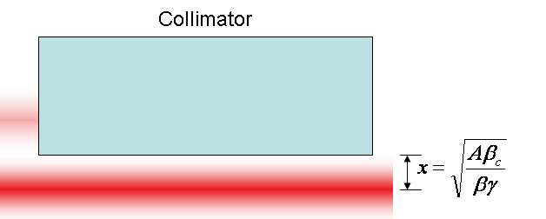
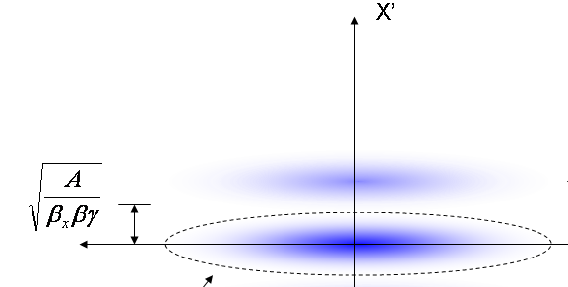
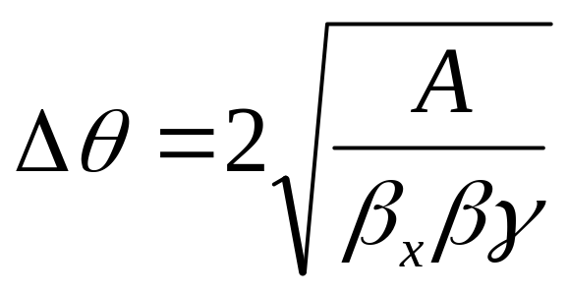
At collimator:
Beam fully extinguished when deflection equals twice full admittance (A) amplitude
At kicker:
Angle to extinguish beam
*al la FNAL-BEAM-DOC-2925
E. Prebys – Mu2e meeting
11/19/2009

Slide 4
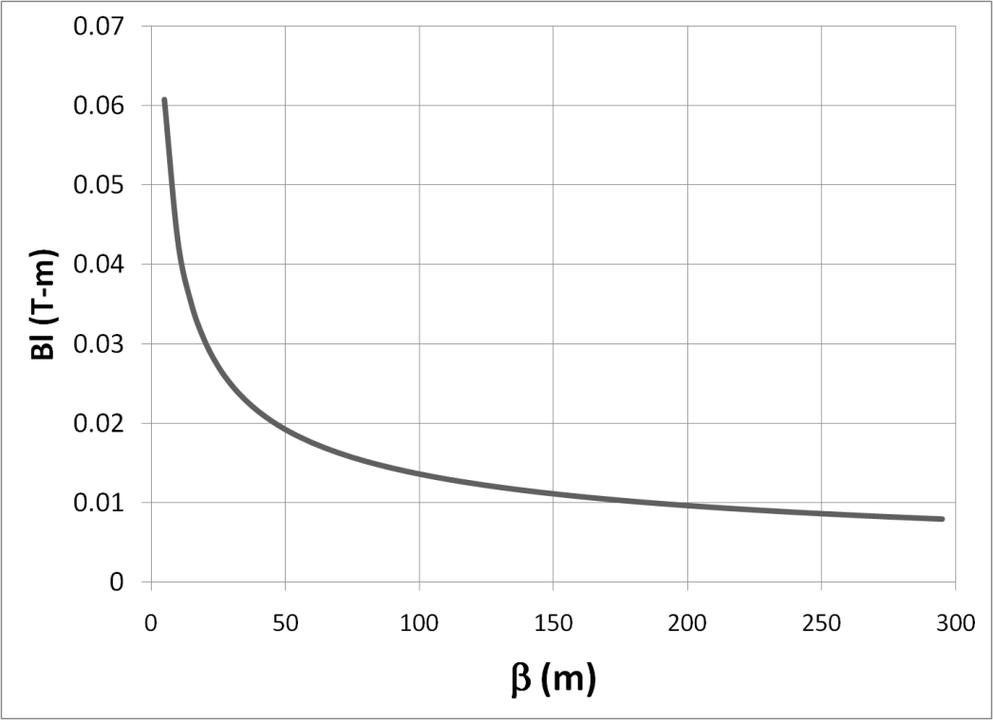

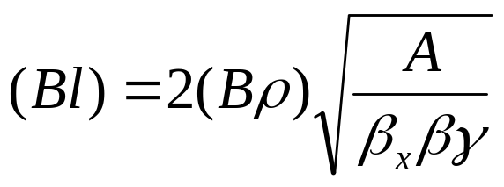

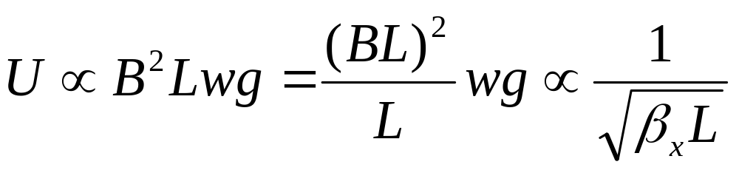
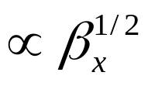

Bend strength to extinguish:
Stored Energy:
⇒Large β_{x}, long weak magnets
- Assume β_{x}=250m, L=6m
- Factor of 4 better than β_{x}=50m, L=2m
E. Prebys – Mu2e meeting
11/19/2009

Slide 5
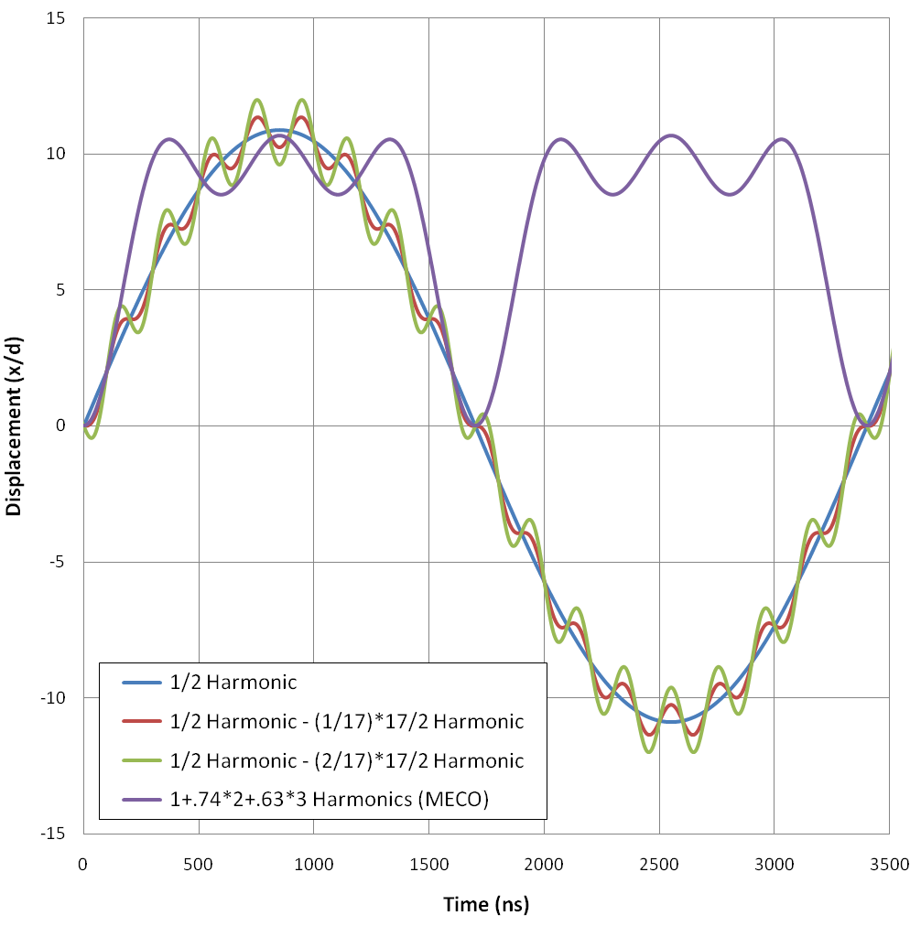
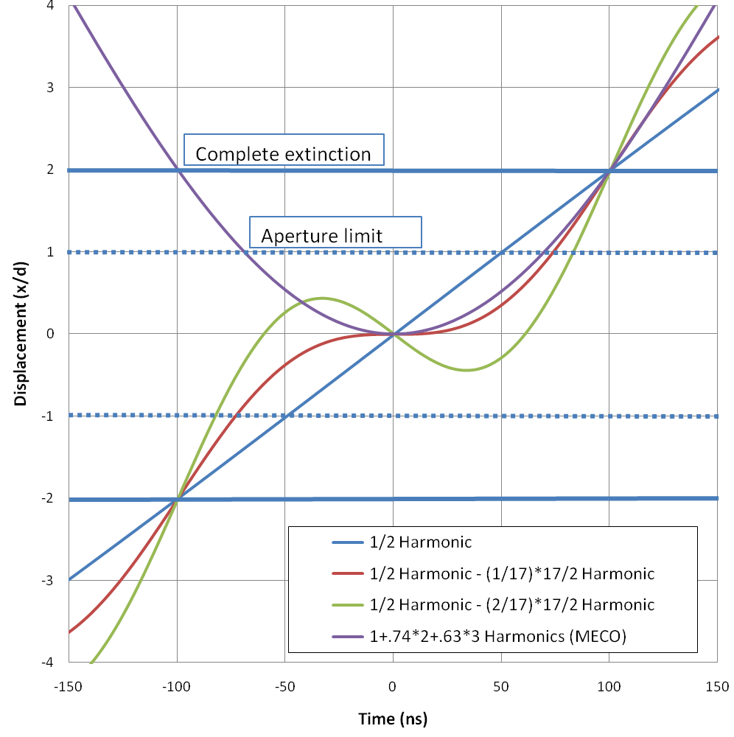
a)
b)
*Mu2e-DOC-552
E. Prebys – Mu2e meeting
11/19/2009

Slide 6
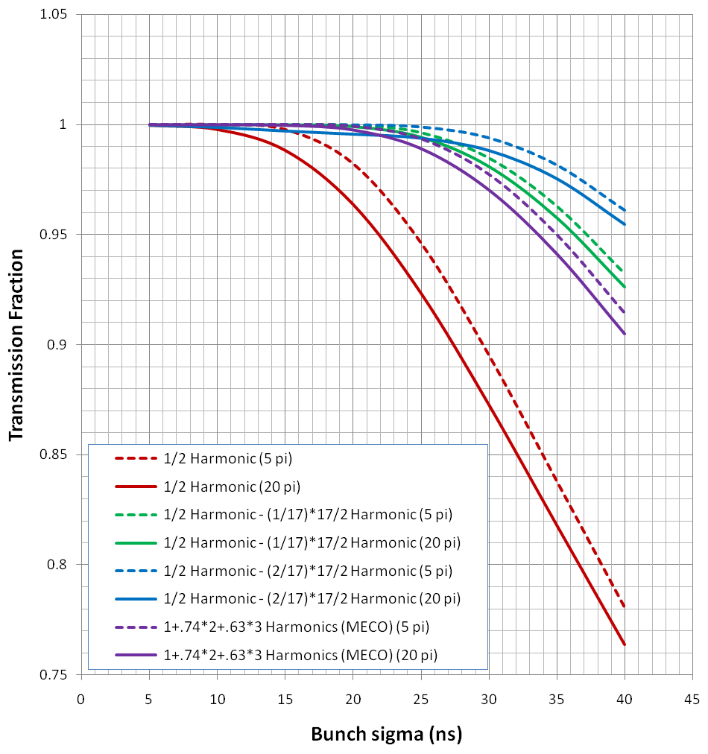
E. Prebys – Mu2e meeting
11/19/2009

Slide 7
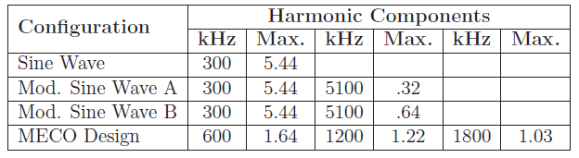
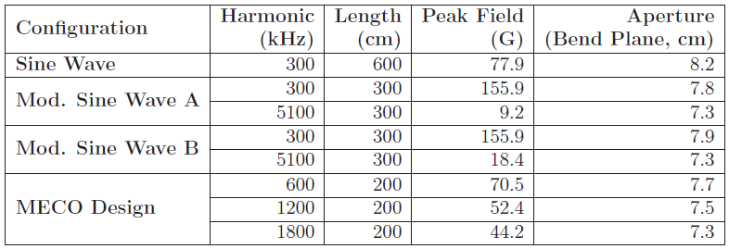
Peak component strength (relative to total extinction strength)
Magnet specifications (assuming equal length/harmonic)
E. Prebys – Mu2e meeting
11/19/2009

Slide 8
High frequency is the challenge
  Compare
    Mod Sine A
      Frequency: 5.1 MHz
      Length: 3 m
      Peak field: 9.2 Gauss
    MECO (3rd magnet)
      Frequency: 1.8 MHz
      Length: 2 m
      Peak field: 44.2 Gauss
Generally, at about f=.5-1MHz
  EE -> RF (switching supply -> linear supply)
  $$ -> $$$
  Both schemes in that realm
Other issues
  Magnet easier if we can keep V to ground < 1kV
E. Prebys – Mu2e meeting
11/19/2009

Slide 9
Magnet specs given to TD to generate a conceptual design.
Once we know the approximate inductance, we’ll talk to the EE (for 300 kHz) and RF (for >1 MHz) people.
E. Prebys – Mu2e meeting
11/19/2009

