Slide 1
Revised Beam Delivery Plan for the Mu2e Experiment*
Eric Prebys
Representing the “Mu2e Task Force”:
Steve Werkema
Jim Morgan
Vladimir Nagaslaev
Chuck Ankenbrandt
Vladimir Shiltsev
Ioanis Kourbanis
*Mu2e-doc-1911

Slide 2
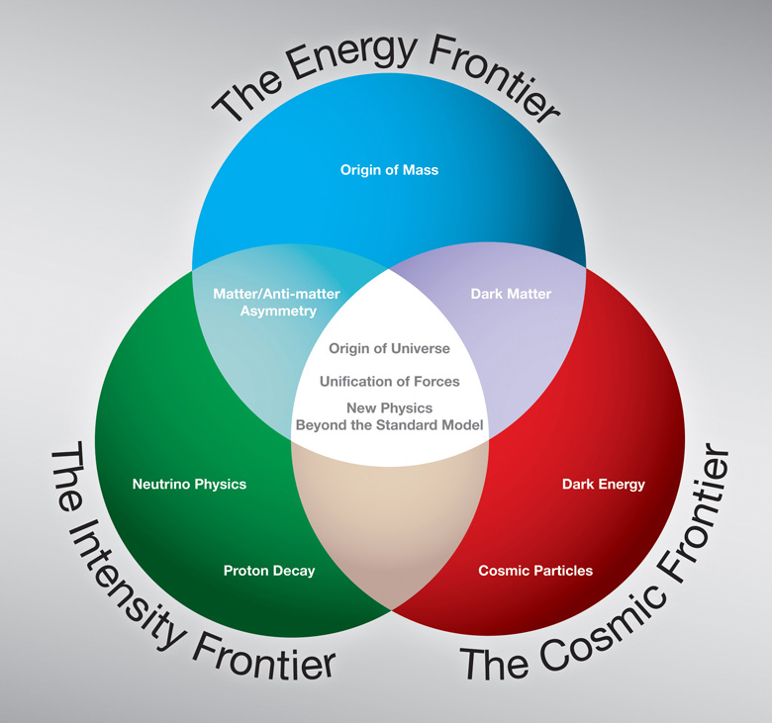

Motivation

Slide 3
Background and Mandate
The total project cost (TPC) of Mu2e at CD-0 was $200M
The cost grew for both the detector and (particularly) the accelerator to >$300M
It’s was unambiguously stated if the cost could not be reduced, Mu2e would be canceled and the physics deferred to the Project X era.
“Mu2e Task Force” formed by Stuart Henderson in September, 2011 to address the problem
Our goal was to reduce the TPC to “something like $200M” through
De-scoping the beam delivery plan, considering up to an order of magnitude reduction in beam flux.
Associated reduction in detector and building costs
Concurrent saving from reducing the magnet costs (Mike Lamm, last week’s AEM)
Moving the cost of things that are of general use off project
In particular, exploit synergy with g-2

Slide 4
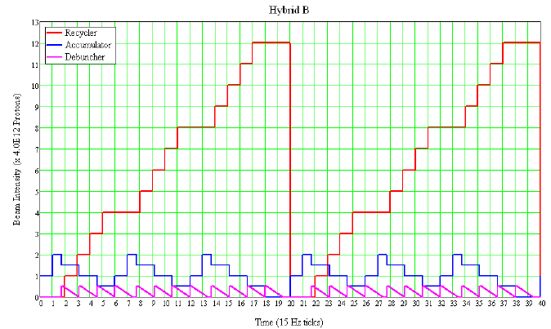
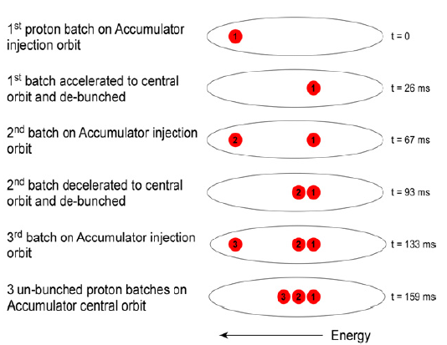
Review: Original Baseline Scheme
Three Booster batches at time are momentum stacked in the Accumulator
They are rebunched into 4 bunches, which are transferred 1 at a time to the Debuncher
In the Debuncher it is slow extracted, generating the required beam structure of the experiment.
In order to deliver the Booster batches (6 per MI super cycle) we have to “thread” them through the Recycler while NOvA batches are there:
This requires extremely fast and expensive kickers in the Recycler, to “sneak” the bunch through in the empty slot.

Slide 5
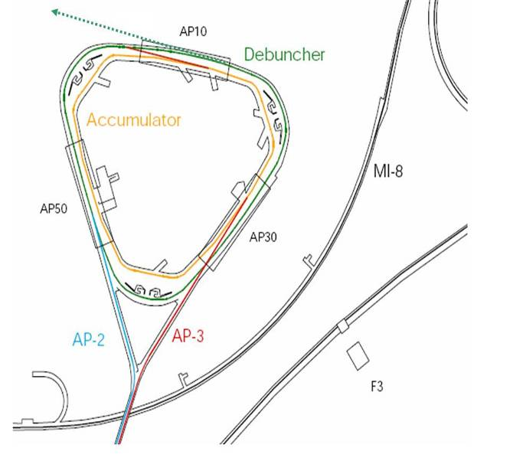
Mu2e: Resonant Extraction
A resonance is driven to slowly extract the single bunch which is circulating around the Debuncher.
The result is a train of bunches separated by the period of the Debuncher (~1.7 μs)
~100 ns
~1.6 μs

Slide 6
Working Assumptions of Task Force
We can’t save significant money without eliminating something major from the proposed configuration
Focus on eliminating Accumulator
Saves a lot of $$ directly
Frees up magnets and power supplies to use elsewhere
Consider whether there’s a way to possibly extract directly from the Recycler
Knee-jerk reaction is no, but
There are (too many?) smart people around here.

Slide 7
Front Running Alternate Proposals
“Pass-through”
A single batch is passed through the Recycler straight to the Debuncher, where it is bunched
“g-2”
A Booster batch is sent to the Recycler, where
It’s divided into 4 2.5 MHz bunches, just like g-2
These are individually extracted to the Debuncher
In both cases, beam is slow-extracted from the Debuncher, as before.
In both cases, one and two batch variations appear feasible
1/6 and 1/3 of nominal average flux, respectively.
Note, the ratio of Debuncher bunch sizes is
(original):(pass-through):(g-2) = 3:4:1

Slide 8
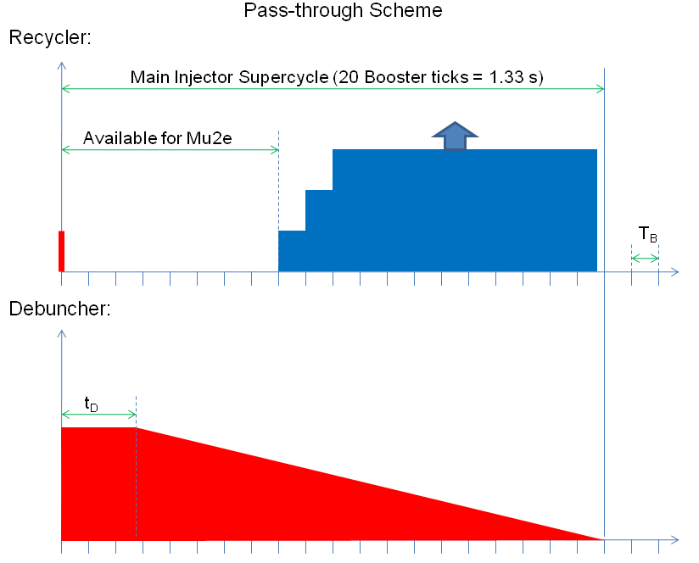
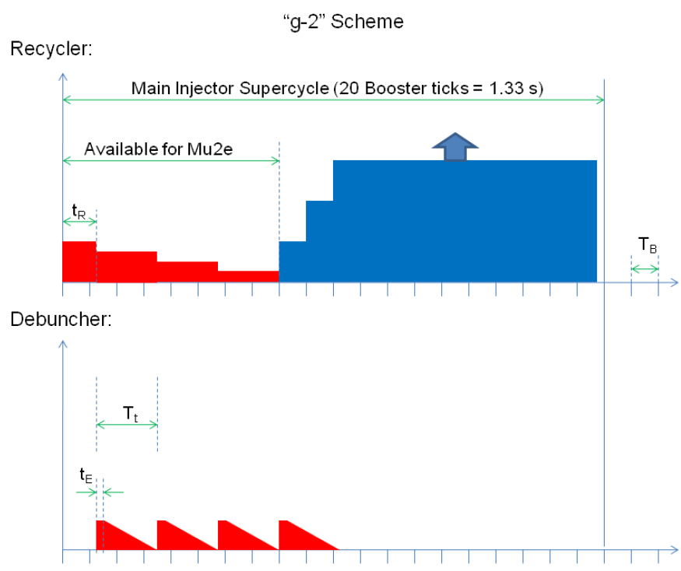



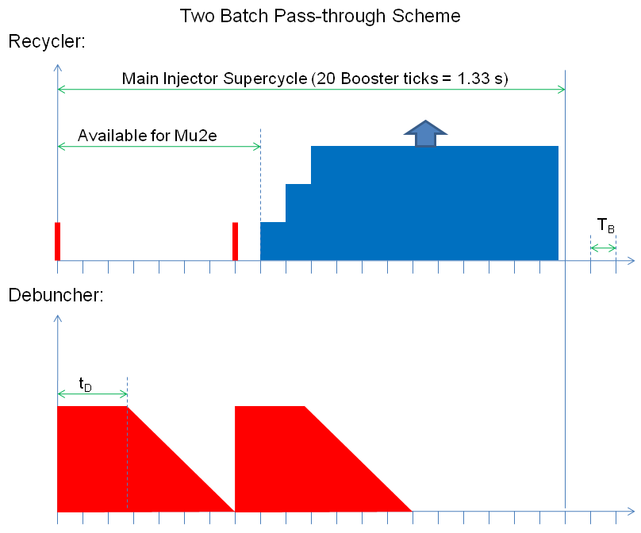
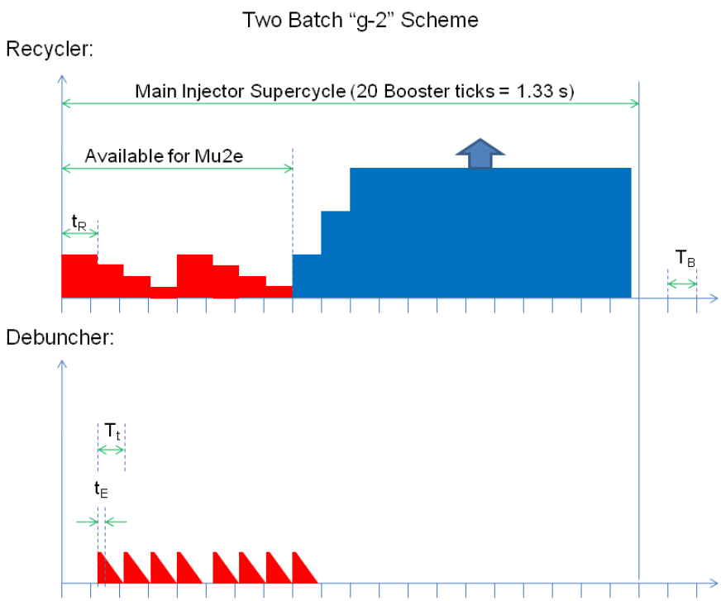




Slide 9
Pros and cons
Pass-through schemes
Pros:
extremely simple in the Recycler (can be done with pulsed magnet instead of kicker).
Very low duty factor
Can use an existing injection kicker for Debuncher (one batch scheme only)
Cons
RF manipulations complicated in Debuncher
Requires 8 separate harmonics
Leads to out of time satellite bunches
Give up synergy with g-2
g-2 schemes
Pros:
Synergy with g-2 (declare Recycler work an AIP?)
Extremely simple RF in Debuncher
Needs extraction kicker in Recycler, but not super kicker ($5M->$1M)
Cons:
Not sure about momentum aperture of line from Recycler to Debuncher
Conclusion: this wins

Slide 10
Mu2e and g-2 Common Ground: Bunch Formation in the Recycler
Booster batch Injected
Split into 4 bunches with 2.5 MHz RF
During the 8 Booster ticks which are not used by NOvA, Booster batches are injected into Recycler
2.5 MHz RF is used to divide these into 4 bunches of ~1x10¹² each
Subsequent handling
g-2
Bunches are extracted individually to the muon production target
Mu2e
Individual bunches are extracted to the pBar Debuncher ring
Each is resonantly extracted to produce the required Mu2e time structure.

Slide 11
Technical Risk
The g-2 scheme represents significantly less technical risk than the baseline scheme
In addition, the baseline scheme assumes the Booster will run at 15 Hz during the NOvA era

Slide 12
Recycler Only?
Is there a way to eliminate the pBar enclosure entire and extract directly from the Recycler?
Potential for large savings
No pBar ring mods
No shielding issues
Possible to re-site the experiment in a location that also works for Project X
Even if we build a new experiment, using the same building is attractive.
Problems
Bunching and slow extracting a la the Debuncher simply won’t work.
Too much momentum spread
As far as we can tell, this would require a new technique which has never been used before.

Slide 13
Options for slow extracting from the Recycler
We considered numerous options, and several appear promising.
As a straw man, we are focusing on the “Local Resonance” scheme (Shiltsev&Marriner, Nagaslaev, Lebedev, Nagaitsev)
Don’t rebunch the beam, but establish a separatrix and selectively extract a small portion (the length of a mu2e bunch) with a combination of tune shift and RF knockout
Tune shift produced by pulsed stripline quadrupole
RF knockout produced by digital damping system
This scheme and several of the alternates depend on the ability to resonantly extract beam from the Recycler with the initial longitudinal and transverse emittance of the Booster.
If that isn’t feasible, then the only schemes remaining involve even more speculative technology.
Preliminary conclusion
Local resonance schemes cannot be proven not to work at this point, BUT
Lot’s of R&D work
At least a year delay
Might still be a show stopper.

Slide 14
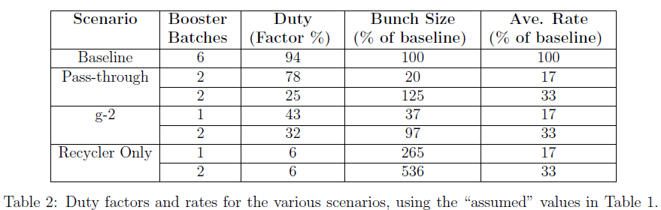
Rates and Bunch Sizes
One proposed solution solves this problem

Slide 15
Managing expectations: Recycler-only
Eliminating the Accumulator saves a great deal of money
Complex RF systems
Fast kickers
Re-using Accumulator magnets and power supplies for extraction line
The incremental savings of eliminating Debuncher is much less
Biggest savings comes from eliminating shielding.
The Recycler-only option is not free
R&D costs
Production costs
Tunnel shielding
Cost of delaying CD-1 by ~1 year

Slide 16
(Outdated) Direct Cost Comparison*
Separate line item
Move to AIP
Use Accumulator magnets and power supplies to build extraction line
Guess based on initial estimates of R&D, construction and tunnel shielding.
Save ~$70M
*S. Werkema, J. Morgan, et al

Slide 17
Recommendations and Summary
Pursue “g-2” option as the new baseline for the experiment.
Make all accelerator modifications compatible with 2 batch operation
~1/3 of original beam delivery scheme, BUT
Less demanding on Booster
Simplicity may lead to faster ramp up
-> real time to get data set may not be that much more
Ultimately, 2 vs 1 will depend on shielding and radiation issues
This is the scheme which is currently in preparation for CD-1 review
Director’s review tomorrow
Lehman review in June

