Slide 1

Eric Prebys
2/23/2010

Slide 2
Out of time beam will likely have a very different transverse distribution than in time beam.
  Assume out of time beam may be present anywhere within the transverse admittance of the beam line.
Beam line admittances should be well-defined by a collimation system.
  Don’t rely on pole faces, magnetic coils, beam pipes or other aperture restrictions, because they’re difficult to model properly.
The extinction system should be designed such that ALL beam which is outside the specified time window (±100 ns) hits the extinction collimator
  Assume admittance of extinction channel equals admittance of beam line.
General features
  Two collimators upstream of AC dipole to define beam line admittance
  Two collimators downstream of AC dipole to define extinction admittance
  (pairs of collimators separated by 90° in phase advance.
E. Prebys – Mu2e meeting
2/23/2010

Slide 3
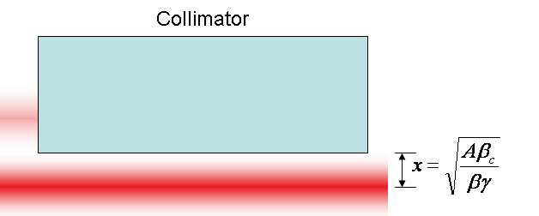
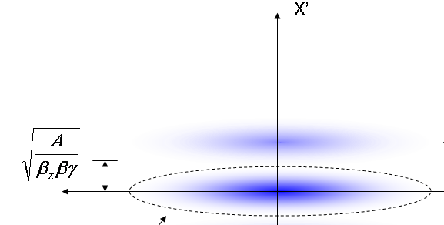
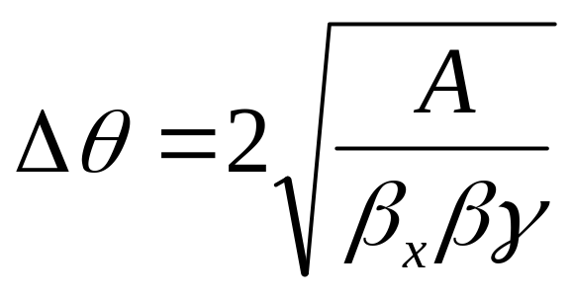
At collimator:
Beam fully extinguished when deflection equals twice full admittance (A) amplitude
At kicker:
Angle to extinguish beam
*al la FNAL-BEAM-DOC-2925
E. Prebys – Mu2e meeting
2/23/2010

Slide 4
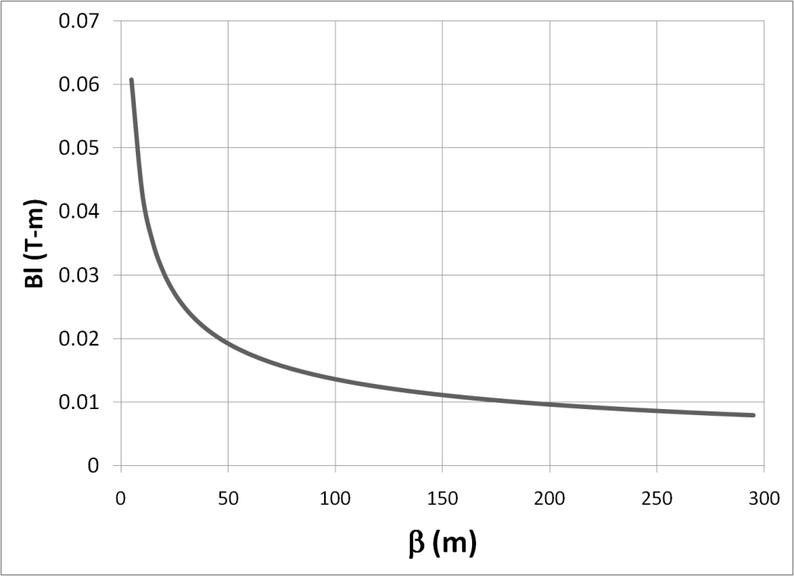

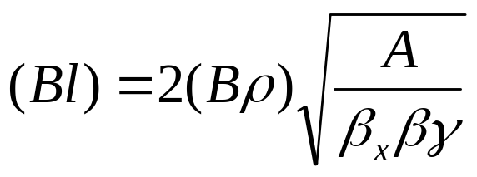

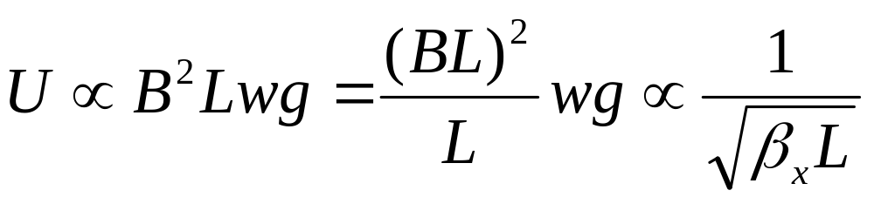
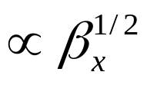

Bend strength to extinguish:
Stored Energy:
⇒Large β_{x}, long weak magnets
- Assume β_{x}=250m, L=6m
- Factor of 4 better than β_{x}=50m, L=2m
E. Prebys – Mu2e meeting
2/23/2010

Slide 5
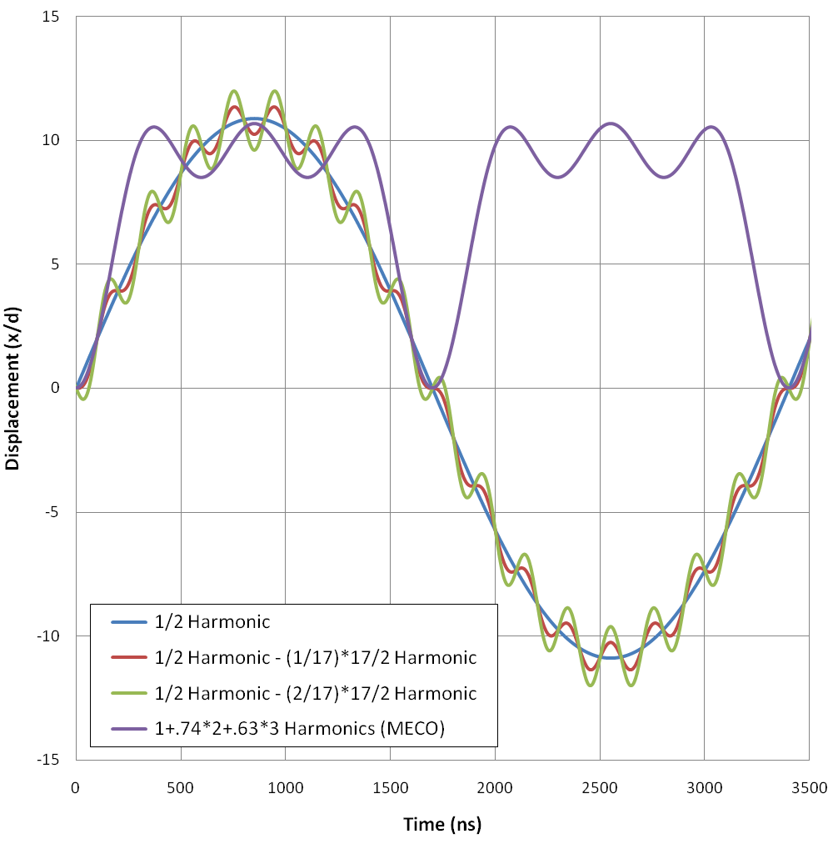
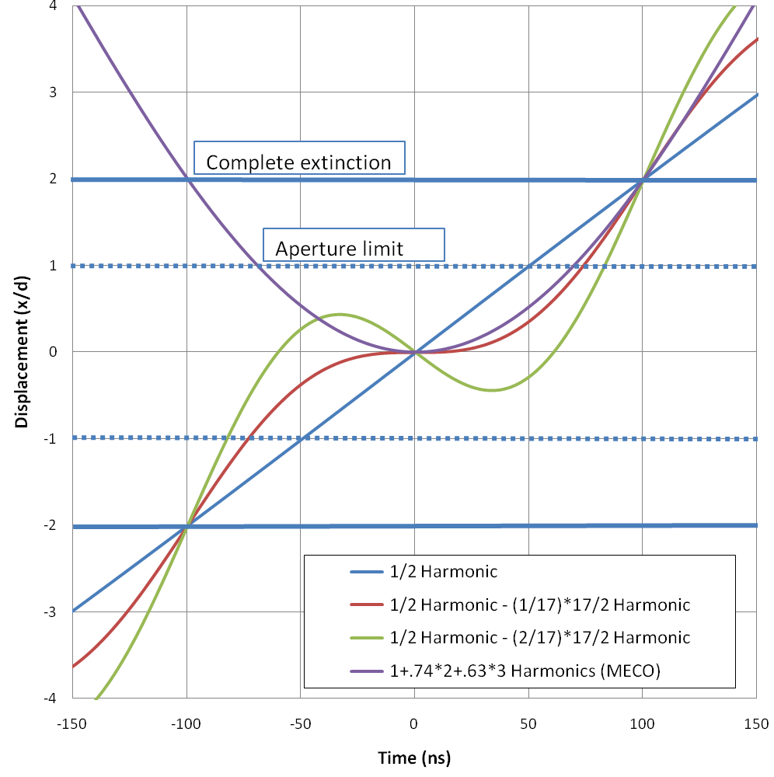
a)
b)
*Mu2e-DOC-552
E. Prebys – Mu2e meeting
2/23/2010

Slide 6
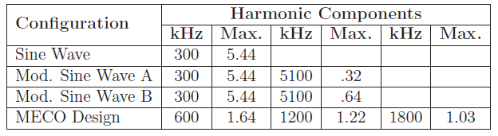
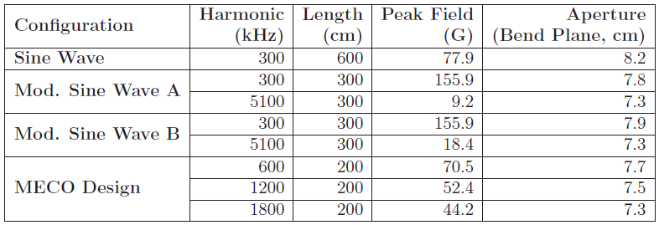
Peak component strength (relative to total extinction strength)
Magnet specifications (assuming equal length/harmonic)
Gap in non-bend plane: as small as possible. 1.2 cm for 6m magnet with 50 π-mm-mr beam with no chromatic effects. Assuming 2 cm. Is this reasonable?
E. Prebys – Mu2e meeting
2/23/2010

Slide 7
Want high rejection for particles “just hitting” collimator.
Leakage will be distributed between two extrema
Small angle scatters
Will lose energy through dE/dx
Reject with momentum collimation after extinction.
Preliminary MARS modeling shows it would be ideal to reject particles that lose more than 200 MeV of energy (2.5%)
Is this reasonable?
Large angle scatters:
Reject by putting collimators in reasonably high β region (assume 50 m)
E. Prebys – Mu2e meeting
2/23/2010

Slide 8
Upstream of extinction dipole
  Collimation to define beam line admittance to 50 π-mm-mr
AC dipole region
  Bend plane: b=250m
  Non-bend plane: waist
    Key question: how small?
Extinction collimation
  Minimize transmission of scraping particles
Post-extinction
  High dispersion region for momentum collimation.
E. Prebys – Mu2e meeting
2/23/2010

