Slide 1
Input parameters
mass [MeV/c²] | 935
Kinetic energy [MeV] | 8000
momentum [MeV/c] | 8886
beta | 0.995
gamma | 9.556
Batch size [protons] | 4.0E+12
n batches | 6
total load | 2.4E+13
transverse emittance [π-mm-mr] | 20.0
long. Emittance [ev-s/bunch] | 0.08
Accelerator Parameters*
 | Accumulator | Debuncher
Circumference [m] | 474 | 504
β_{max} (x/y) [m] | 61/38 | 19.8/17
tunes (x/y) | 6.7/8.67 | 9.66/9.76
admittance (x/y) [π-mm-mr] | 285/240 | 63/63
transverse emittance [π-mm-mr] | 20 | 20
long emittance [eV-s] | 48 | 53
ΔE_{rms} [eV] | 12 | 71
Period [ns] | 1589 | 1689
Average current [A] | 2.4 | 2.3
min. bunch length (σ_{t}) [ns] | 250 | 40
Bunch factor (B_{F}) | 0.39 | 0.06
Space charge tune shift (dν) | 0.02 | 0.16
Peak current [A] | 6.2 | 38.5
*MU2E-DOC-72
E. Prebys – mu2e beam meeting
5/22/08

Slide 2
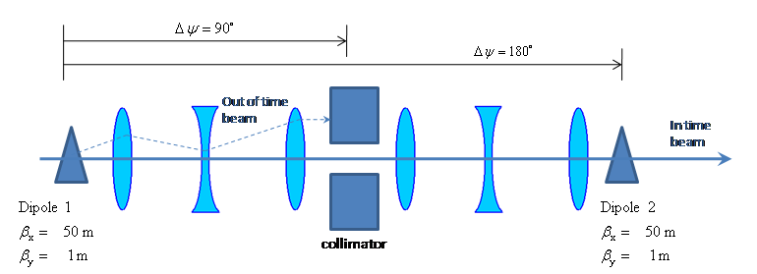
Parameter | Value | Comment
Kinetic Energy | 8 GeV
Emittance (95%) | 20 π-mm-mr
ΔE_{rms} | 71 MeV
Beam line admittance | 50 π-mm-mr | Set by collimators
Parameter | Value | Comment
β_{x} | 50 m | Typical beam line beta max
β_{y, min} | 1m | Waist (=L/2)
Effective length (L) | 2 m
Full width (w) | 5 cm
Vertical gap (g) | 1 cm | Scaled up for practicality
Peak field (B₀) | 600 Gauss
Peak stored energy (U) | 1.43 J | A little over twice the minimum
*MU2E-DOC-74
E. Prebys – mu2e beam meeting
5/22/08

Slide 3
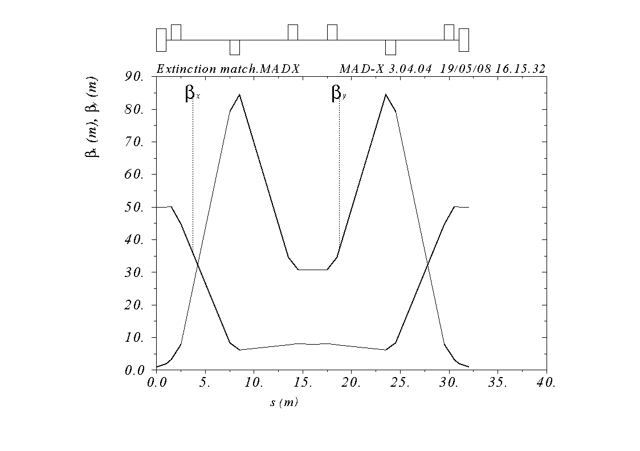
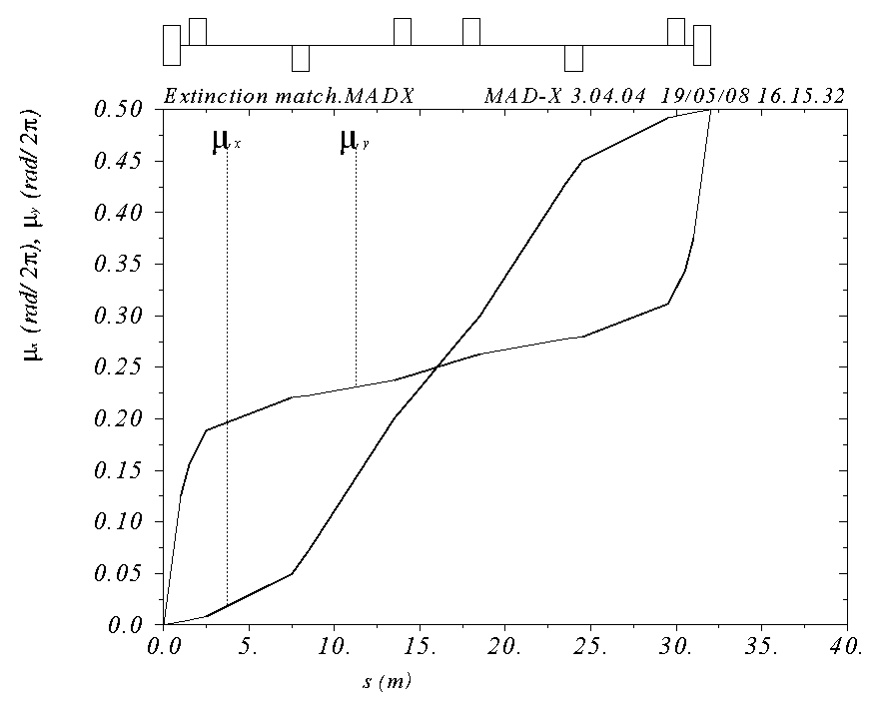
Symmetric about 2m collimator with
  β_{x} = 50m, β_{y}= 1m, μ_{x} = .25 (at collimator center)
Shortest line which fits constraints (32 m)
Small β_{x} (7.9 m) means small hole (x/y = 1.29 x 2.54 cm)
E. Prebys – mu2e beam meeting
5/22/08

Slide 4
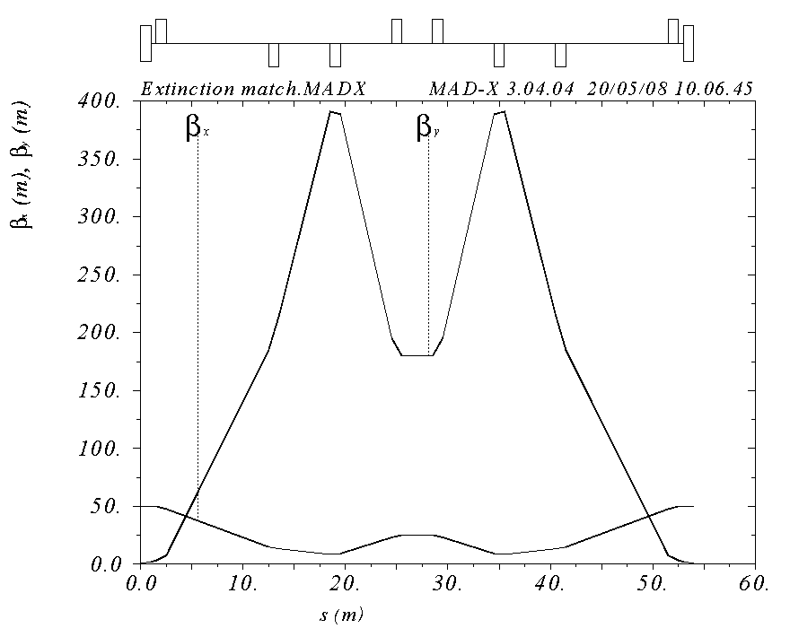
If studies show that we need more parallel region at collimator, we will need a longer line and more magnets. Example:
  β_{x}=25m, L=54m
E. Prebys – mu2e beam meeting
5/22/08

