Slide 1
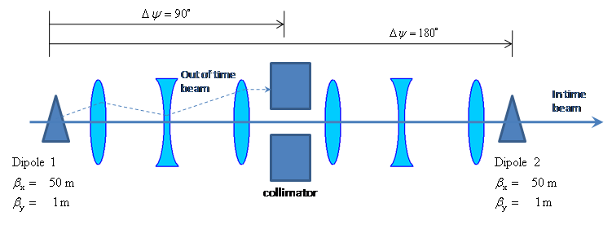
Two matched dipoles at 180° phase separation
Collimation channel at 90°
Beam is transmitted at node
  System resonant at half bunch frequency (~300 kHz)
Note: preliminary modeling calculations show this is overkill.
E. Prebys – mu2e beam meeting
3/10/09

Slide 2
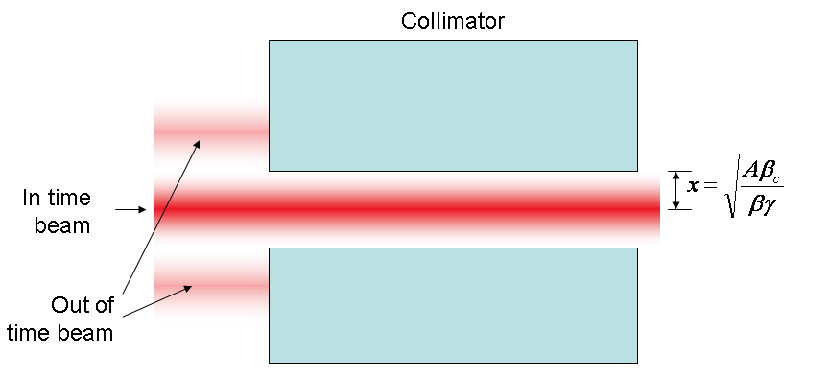
At collimator:
E. Prebys – mu2e beam meeting
3/10/09

Slide 3
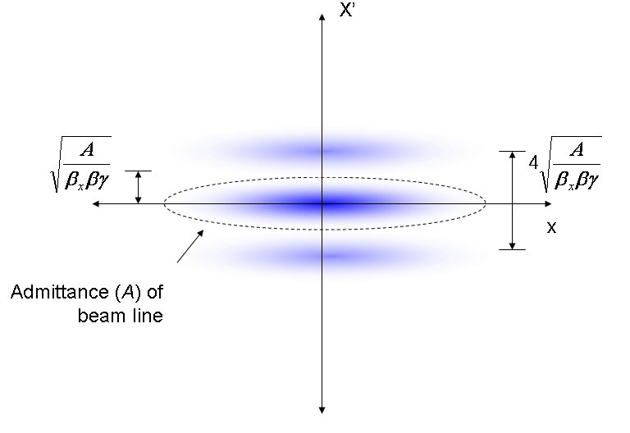
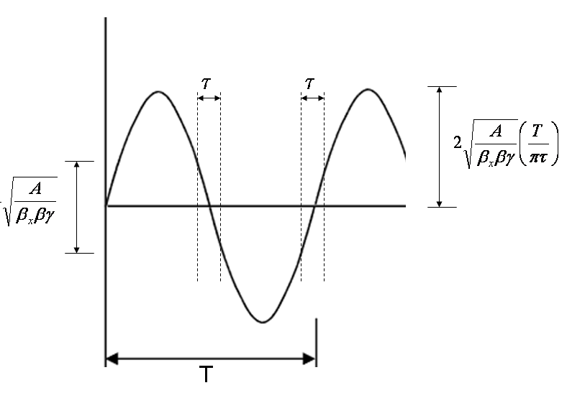
Phase space (live window τ):
Full amplitude:
E. Prebys – mu2e beam meeting
3/10/09

Slide 4
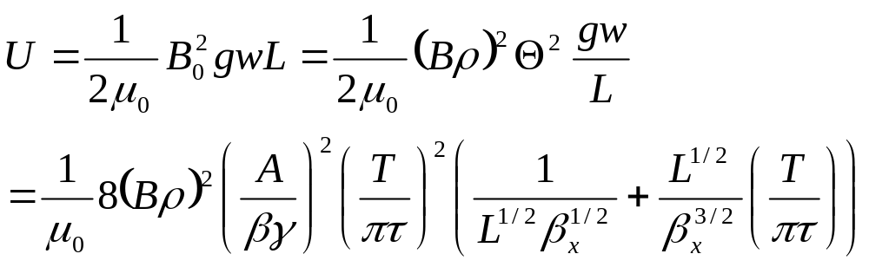
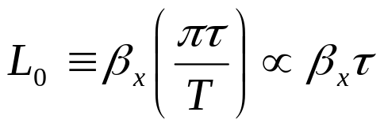
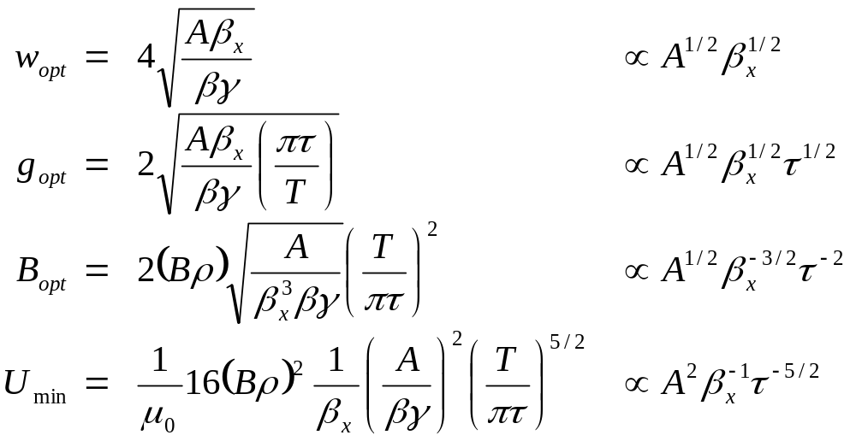
Falls with β_{x}
For a particular β_{x}, there is an optimum length L₀:
For which the optimized parameters are:
E. Prebys – mu2e beam meeting
3/10/09

Slide 5
Parameter | Value | Comment
β_{x} | 50 m | Typical beam line beta max
Effective length (L) | 2 m
Full width (w) | 5 cm
Vertical gap (g) | 1 cm | Scaled up for practicality
Peak field (B₀) | 600 Gauss
Peak stored energy (U) | 1.43 J | A little over twice the minimum
Working to develop a magnet based on this design
  See Harding talk
E. Prebys – mu2e beam meeting
3/10/09

Slide 6
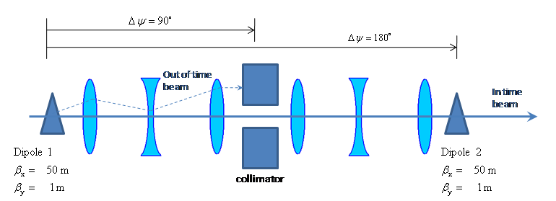
Parameter | Value | Comment
Kinetic Energy | 8 GeV
Emittance (95%) | 20 π-mm-mr
ΔE_{rms} | 71 MeV
Beam line admittance | 50 π-mm-mr | Set by collimators
Parameter | Value | Comment
β_{x} | 50 m | Typical beam line beta max
β_{y, min} | 1m | Waist (=L/2)
Effective length (L) | 2 m
Full width (w) | 5 cm
Vertical gap (g) | 1 cm | Scaled up for practicality
Peak field (B₀) | 600 Gauss
Peak stored energy (U) | 1.43 J | A little over twice the minimum
*MU2E-DOC-74
E. Prebys – mu2e beam meeting
3/10/09

Slide 7
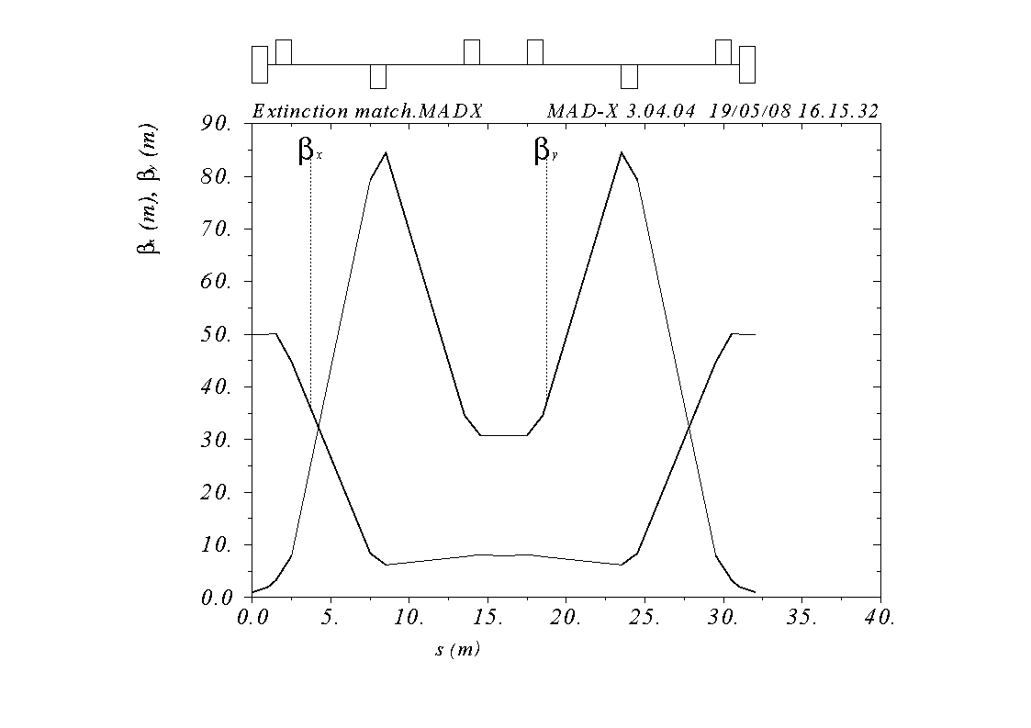
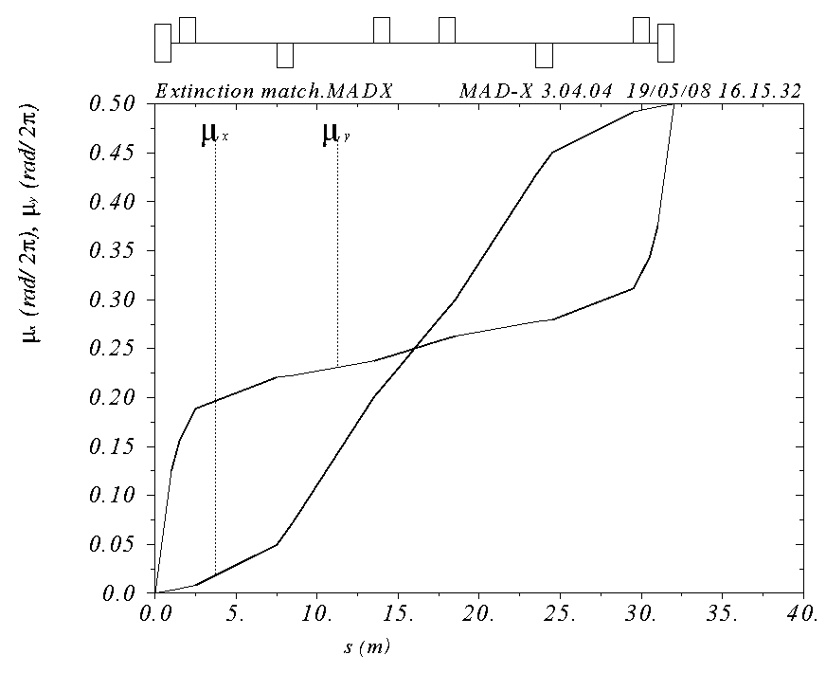
Symmetric about 2m collimator with
  β_{x} = 50m, β_{y}= 1m, μ_{x} = .25 (at collimator center)
Shortest line which fits constraints (32 m)
Small β_{x} (7.9 m) means small hole (x/y = 1.29 x 2.54 cm)
E. Prebys – mu2e beam meeting
3/10/09

Slide 8
Preliminary calculations by Mokhov and Drozhdin show that the parallel collimation channel is probably overkill.
Carol has suggested a 360 degree phase advance between the two dipoles, with collimators at 90 and 180. This is certainly better that the base line design.
The choice of collimation is largely independent of the details of the magnet, so we should investigate alternate magnet options.
E. Prebys – mu2e beam meeting
3/10/09

