Slide 1

Eric Prebys
3/240/09

Slide 2
Mu2e design
  Pair of resonant dipoles separated by nπ phase advance
    Collimator(s) in between at π/2 (and π?)
    Second magnet cancels kick of first for transmitted beam
  Frequency = ½ pulse frequency
  Beam transmitted on null (rising and falling)
Meco design
  Single magnet
    Collimator(s) π/2 (and π?) later
    No compensation for beam slewing in transmission window
  Three harmonic circuit
  Fundamental frequency = pulse frequency
  Beam transmitted at maximum
Comment
  Two designs not fundamentally different (collimation should be essentially the same)
  Should be a clear optimum between the two
E. Prebys – mu2e beam meeting
3/240/09

Slide 3
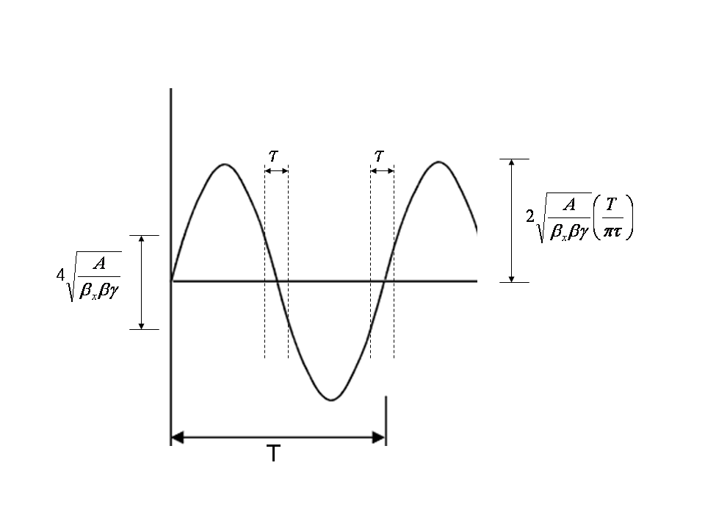
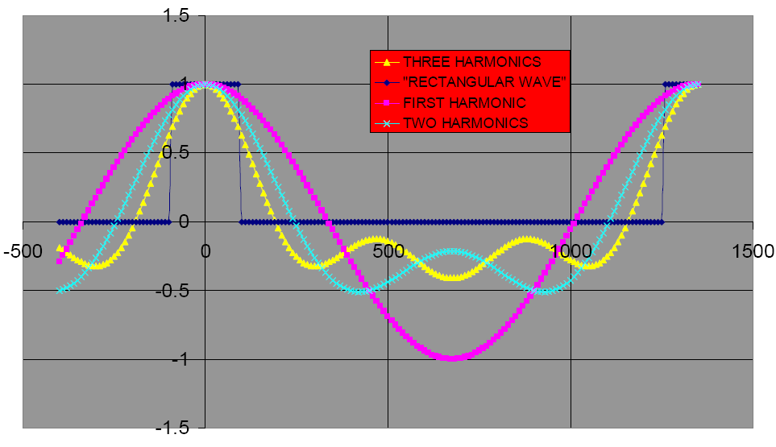
MECO believed that because dθ/dt goes to zero at time of the pulse, you did not need a compensating magnet.
Mu2e
MECO
Rely on a second magnet to compensate for beam slewing at transmission
E. Prebys – mu2e beam meeting
3/240/09

Slide 4
Requirements (no motivation given)
I will analyze this using Mu2e parameters
  P=8.9 GeV/c, A=50πmm-mr
Parameter | Value | Comment
Kick | 12 MeV/c | Full scale kick difference between “in time” and “out of time” 2 mrad @ 8 GeV/c (huh?)
Windows | 20% of full scale at +- 100ns | Implies 2.4 MeV/c kick to extinguish beam.
Length | 6m
Field | 75 G | =12 MeV/c kick = 1.5 mrad Sagitta = 4.5 cm Scale up to 85 G for us.
Aperture | 5x7 cm² | Why so big in non-bend plane?
Frequency | 731+1462+2193 kHz | Triple harmonic to approximate square wave
E. Prebys – mu2e beam meeting
3/240/09
*from MECO-EXT-05-002

Slide 5
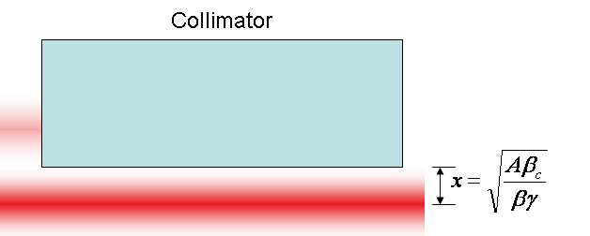
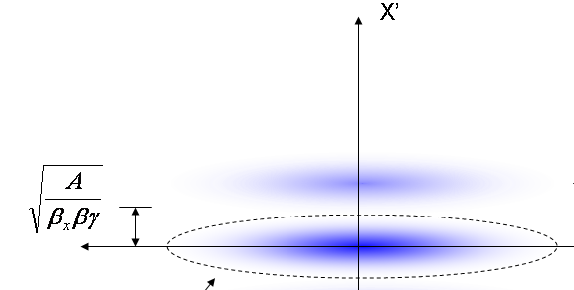
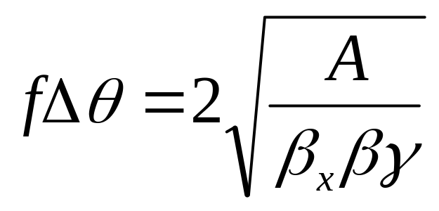
At collimator:
Beam fully extinguished when deflection equals twice full admittance (A) amplitude
Full scale deflection
At kicker:
Fraction of FS to extinguish
*al la FNAL-BEAM-DOC-2925
E. Prebys – mu2e beam meeting
3/240/09

Slide 6
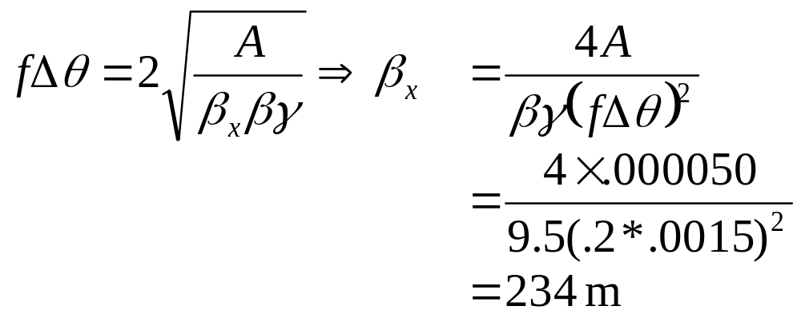
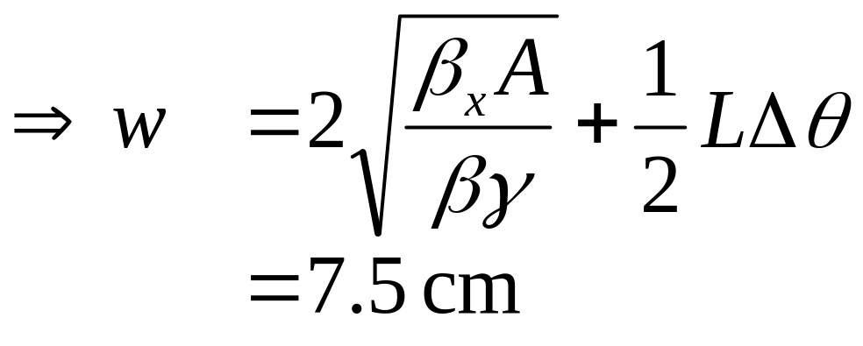
Beta function at magnet in bend plane
50πmm-mr
Required aperture in bend plane
E. Prebys – mu2e beam meeting
3/240/09

Slide 7
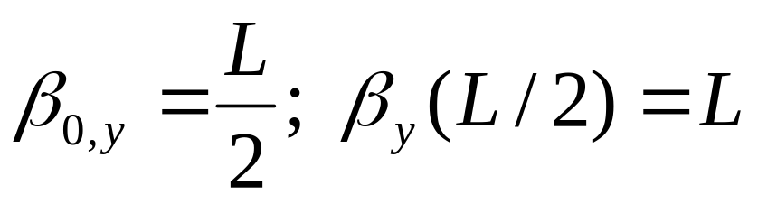
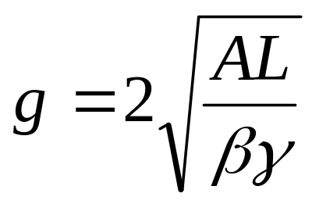
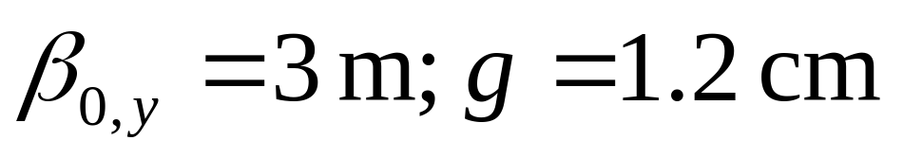
What to minimize gap in non-bend plane
  Put waist in center
  Optimize for minimum size at ends
E. Prebys – mu2e beam meeting
3/240/09

Slide 8
Modify MECO aperture to new optimization
  Bend plane: 7cm->~10 cm
  Non-bend plane: 5cm -> ~2 cm (why make it so big?)
Comparison of stored energy
  Mu2e (2m x 5cm x 1cm x 600G) = 1.43J
  MECO (6m x 10cm x 2 cm x 85G) = .37J
  HOWEVER, Mu2e w/ β=234m, L=6m ~ .30J
E. Prebys – mu2e beam meeting
3/240/09

Slide 9
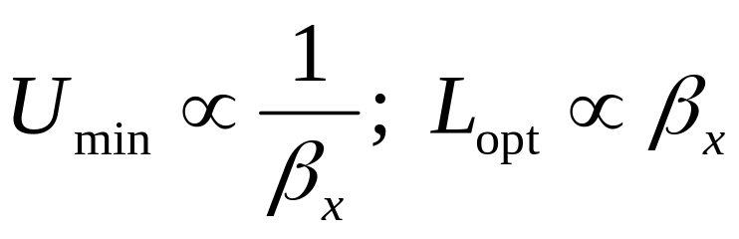
As pointed out in BEAMS-DOC-2925, the minimization of stored energy pushes toward high betas and long magnets, and never converges:
Actual values must be chosen with practicalities of magnet and beam line design in mind.
  Do 234 m beta and a 6 m magnet work?
In MU2E-DOC-253, I consider a design where the beam is transmitted at the maximum, rather than the null, and conclude that this is inferior for a single harmonic
  Higher harmonics not considered.
  It appears the higher harmonics make the two approximately equivalent, in terms of stored energy.
E. Prebys – mu2e beam meeting
3/240/09

Slide 10
Null transmission
  Pros
    Single harmonic
    Frequency ½ pulse rate
  Cons
    Linear sweep during transmission period means some beam extinguished too soon.
Peak transmission
  Pros
    dθ/dt ~0 at pulse time
    Full beam transmission time longer
    Possible to live without a second magnet?
  Cons
    Three harmonics (how big a deal is this)
    Fundamental frequency = pulse rate (twice null solution)
E. Prebys – mu2e beam meeting
3/240/09

Slide 11
The MECO design is not fundamentally different from the Mu2e concept.
  With a little optimization, it would work in our beam line with a larger β and a longer magnet.
  The collimation and modeling is largely independent for the two.
  NB: The design would not quite have worked at MECO
The key questions raised
  Is a bigger beta/longer magnet
    Advantageous in terms of magnet design?
    Practical in terms of beam line design?
    This question is generic for both cases and I can’t answer it.
  Can we live without a second magnet in the peak transmission case?
  How much do multiple harmonics complicate the design?
E. Prebys – mu2e beam meeting
3/240/09

