Slide 1
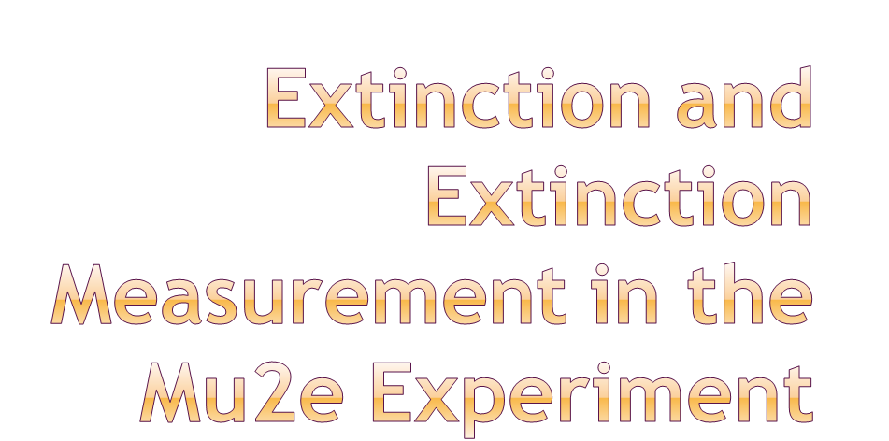
Eric Prebys
Accelerator Physics Center
Fermilab
8/8/09

Slide 2
Eliminate prompt beam backgrounds by using a primary beam with short proton pulses with separation on the order of a muon life time
Design a transport channel to optimize the transport of right-sign, low momentum muons from the production target to the muon capture target.
Design a detector to strongly suppress electrons from ordinary muon decays
~100 ns
~1.5 μs
Prompt backgrounds
live window
E. Prebys, Mu2e Extinction, Collaboration Meeting
8/8/09

Slide 3
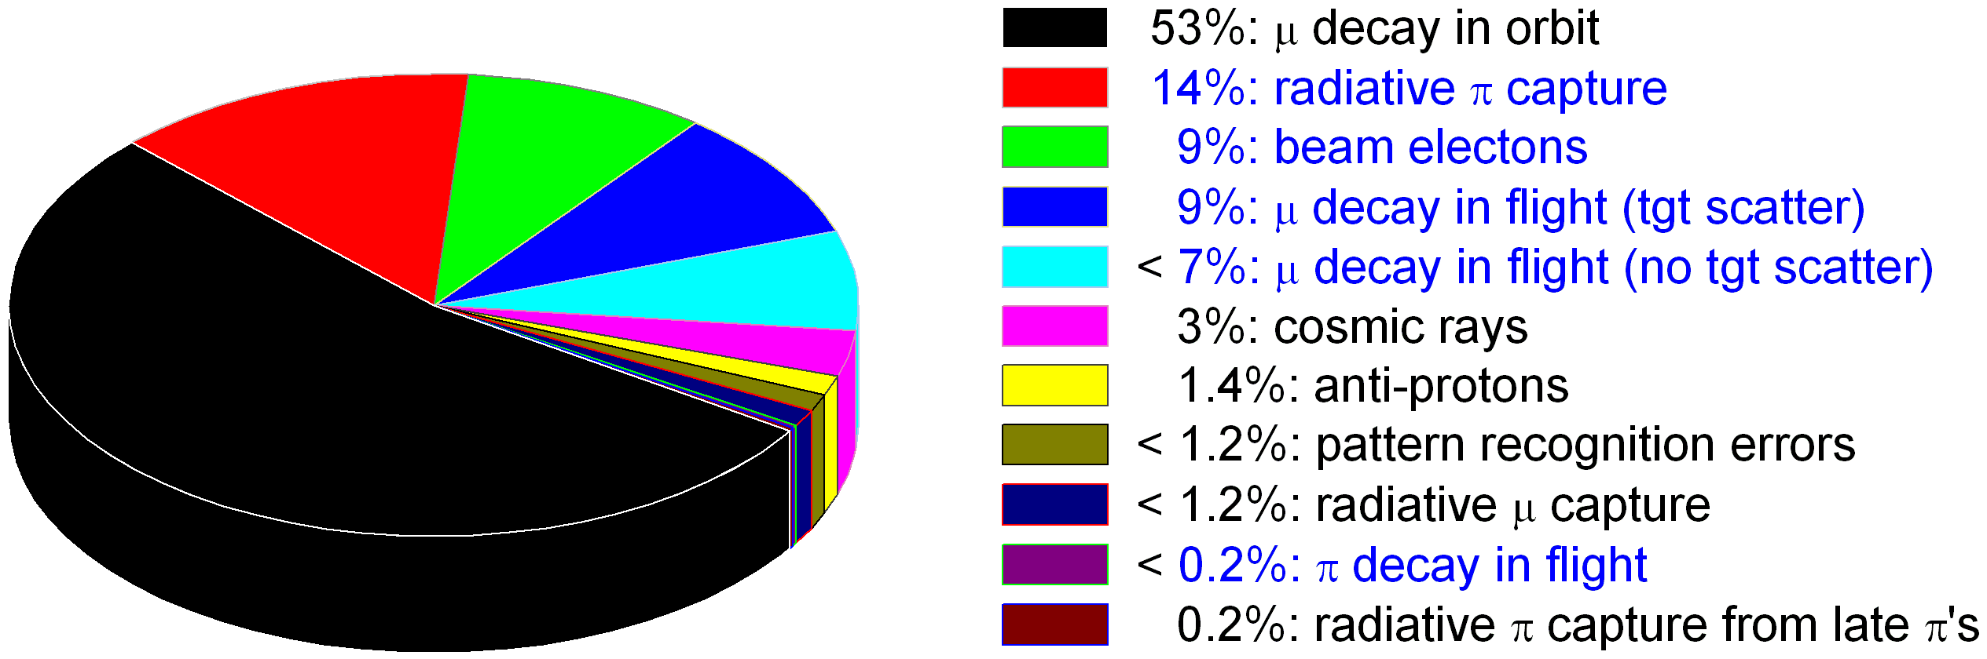
Blue text: beam related.
Goal: make total backgrounds related to inter-bunch beam roughly equal to other backgrounds.
Need extinction at a level of 10⁻⁹ or better!
E. Prebys, Mu2e Extinction, Collaboration Meeting
8/8/09

Slide 4
In ring
  Momentum scraping
  Gap-clearing kicker
  10⁻⁴ to 10⁻⁵?
In beam line
  System of AC dipoles and collimators
    Think minature golf
  10⁻⁵ to 10⁻⁶ (at least)
Monitoring
  Very important to measure extinction
  Big question
    Can we measure inter-bunch contamination bunch by bunch, or only statistically?
E. Prebys, Mu2e Extinction, Collaboration Meeting
8/8/09

Slide 5
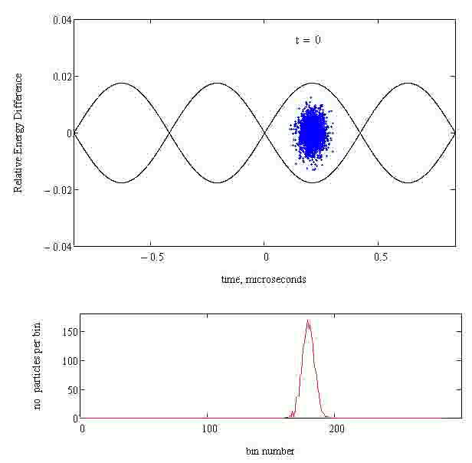
During h=4 capture, some beam may be captured in wrong bucket.
  Install gap cleaning kicker.
  Fire once per cycle, just prior to
  extraction.
RF noise or gas interactions can cause beam to “wander” out of bucket, but tends to be driven well off momentum, as shown at right
  Noise set to 1% to exaggerate effect.
Animations courtesy of Mike Syphers
E. Prebys, Mu2e Extinction, Collaboration Meeting
8/8/09

Slide 6
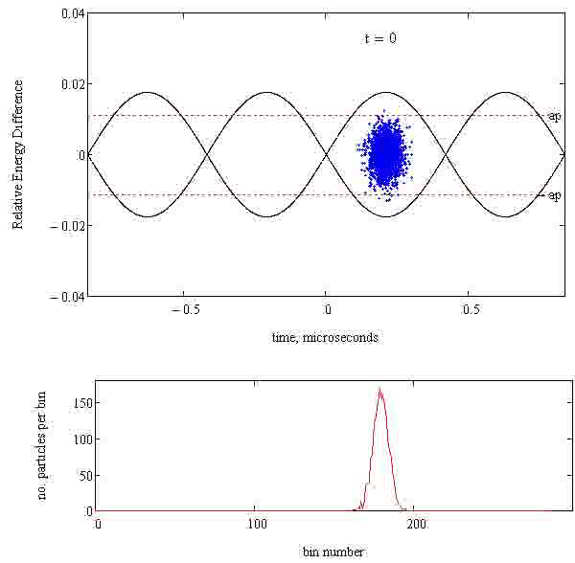
Momentum scraping in high dispersion sections can capture particles lost from bunches.
Still working to understand efficiency.
  In principle can be very high.
Animations courtesy of Mike Syphers
E. Prebys, Mu2e Extinction, Collaboration Meeting
8/8/09

Slide 7
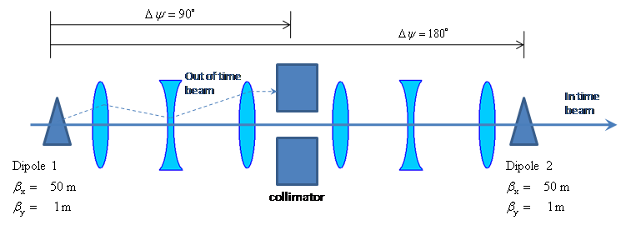
Parameter | Value | Comment
Kinetic Energy | 8 GeV
Emittance (95%) | 20 π-mm-mr
ΔE_{rms} | 71 MeV
Beam line admittance | 50 π-mm-mr | Set by collimators
Two matched dipoles at 180° phase separation
Collimation channel at 90°
Beam is transmitted at node
  System resonant at half bunch frequency (~300 kHz)
E. Prebys, Mu2e Extinction, Collaboration Meeting
8/8/09

Slide 8
Consider it axiomatic that some beam may be present anywhere in the admittance of the beam line
  Historically very hard to predict or model.
Therefore, it’s important to have the beam admittance well defined by a collimation system, rather than rely on the limiting aperture of magnets, beam pipes, etc.
For the moment, assume that the defining admittance of the beam line is equal to the defining admittance of the collimation channel.
E. Prebys, Mu2e Extinction, Collaboration Meeting
8/8/09

Slide 9
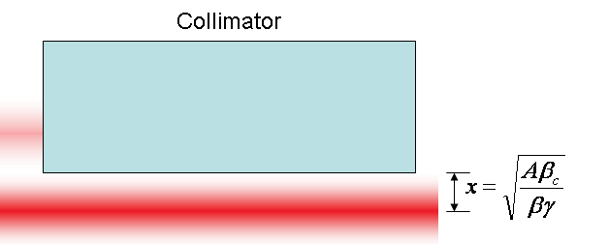
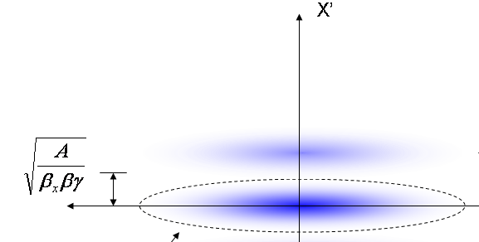
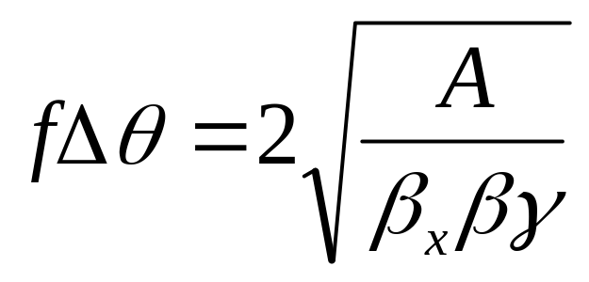
At collimator:
Beam fully extinguished when deflection equals twice full admittance (A) amplitude
Full scale deflection
At kicker:
Fraction of FS to extinguish
*al la FNAL-BEAM-DOC-2925
E. Prebys, Mu2e Extinction, Collaboration Meeting
8/8/09

Slide 10
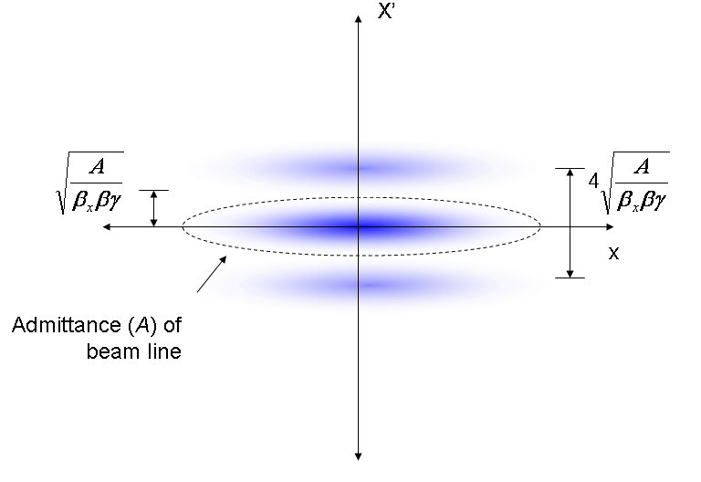
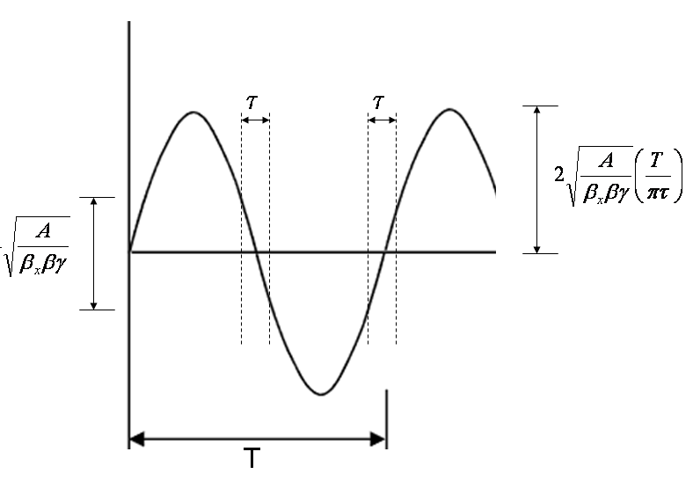
Phase space (live window τ):
Full amplitude:
Short live window -> large “extra” amplitude
E. Prebys, Mu2e Extinction, Collaboration Meeting
8/8/09

Slide 11
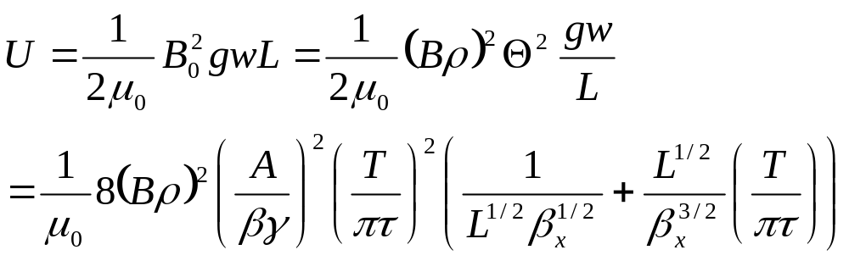
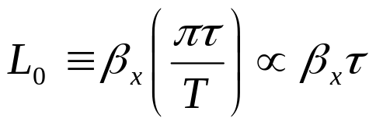
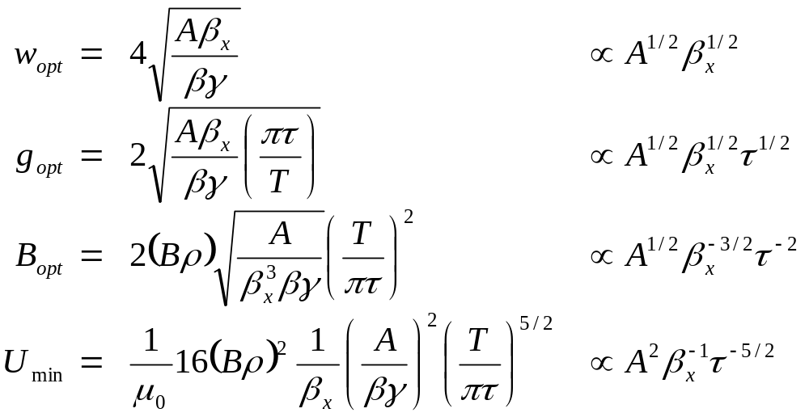
Falls with β_{x}
For a particular β_{x}, there is an optimum length L₀:
For which the optimized parameters are:
E. Prebys, Mu2e Extinction, Collaboration Meeting
8/8/09

Slide 12
Parameter | Value | Comment
β_{x} | 50 m | Typical beam line beta max
Effective length (L) | 2 m
Full width (w) | 5 cm
Vertical gap (g) | 1 cm | Scaled up for practicality
Peak field (B₀) | 600 Gauss
Peak stored energy (U) | 1.43 J | A little over twice the minimum
Recent analyses show that the pararameters are challenging
  Will probably go to larger β, and longer magnets
E. Prebys, Mu2e Extinction, Collaboration Meeting
8/8/09

Slide 13
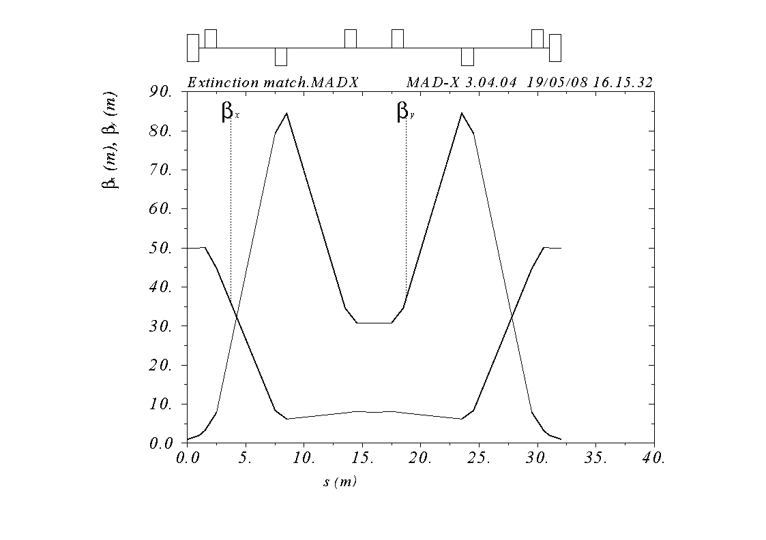
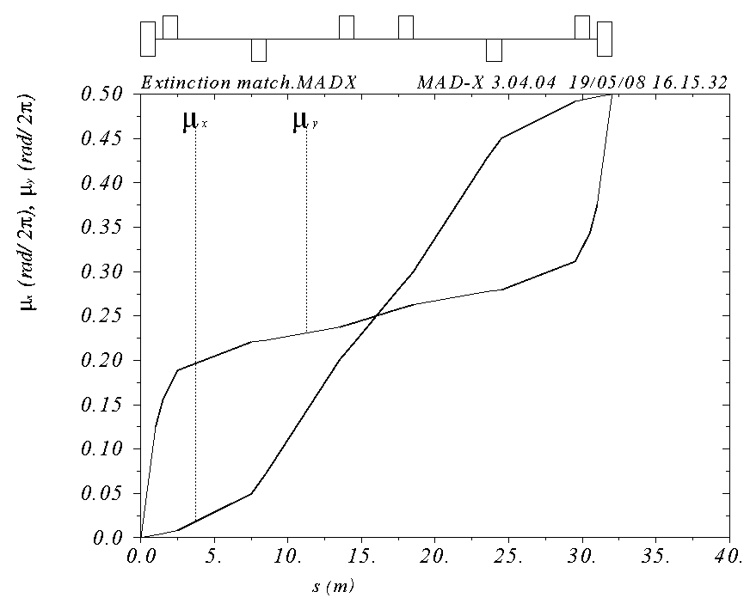
Symmetric about 2m collimator with
  β_{x} = 50m, β_{y}= 1m, μ_{x} = .25 (at collimator center)
Shortest line which fits constraints (32 m)
Small β_{x} (7.9 m) means small hole (x/y = 1.29 x 2.54 cm)
E. Prebys, Mu2e Extinction, Collaboration Meeting
8/8/09

Slide 14
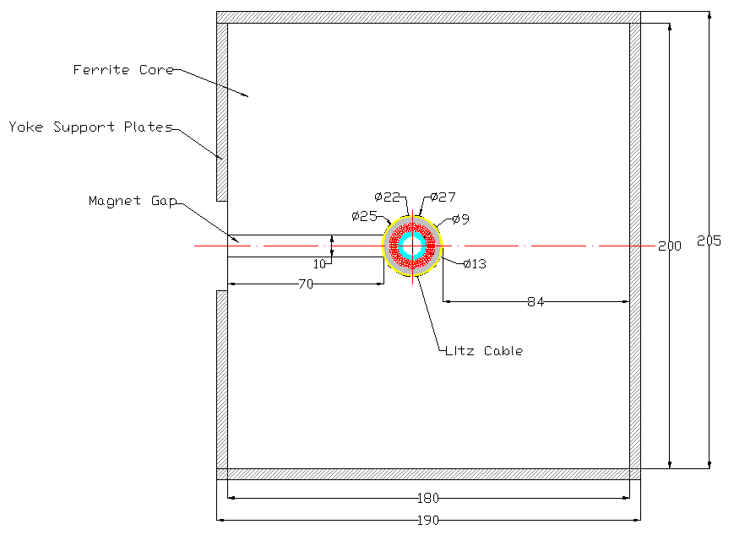
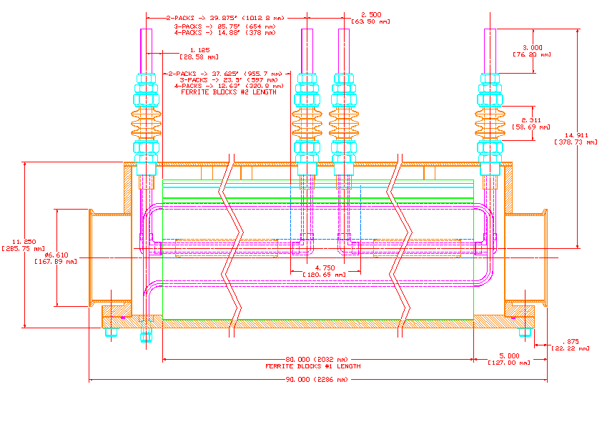
Specified field and frequency leads to high voltages (few kV)
E. Prebys, Mu2e Extinction, Collaboration Meeting
8/8/09

Slide 15


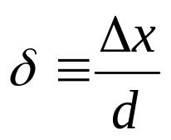
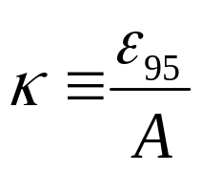
The amount of beam transmitted (or which hits the target) is given by
This can be expressed in a generic way as
Where
Lateral displacement
emittance
Half-aperture
admittance
E. Prebys, Mu2e Extinction, Collaboration Meeting
8/8/09

Slide 16
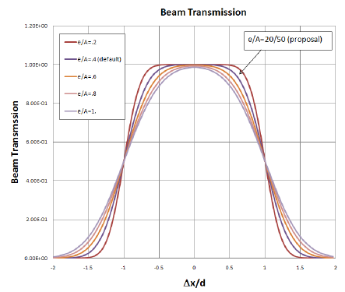
E. Prebys, Mu2e Extinction, Collaboration Meeting
8/8/09

Slide 17
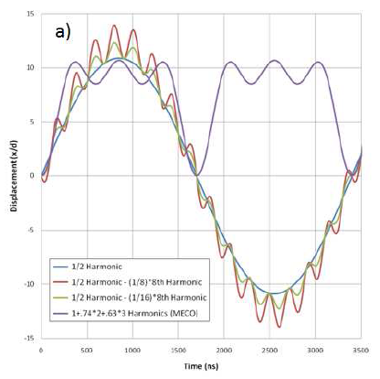
3 harmonic design of MECO
  3 harmonics (1x, 2x, and 3x bunch rate) generate ~square wave.
  Transmits at peak
Single harmonic design
as in proposal
  Runs at half of bunch rate
  Transmits on the null
Modified sine wave
  Add high harmonic to reduce
  slewing in transmission window.
Important questions
  Transmission during 200 ns
  live window
  Magnet design
  Is second magnet necessary?
200 ns transmission window
E. Prebys, Mu2e Extinction, Collaboration Meeting
8/8/09

Slide 18
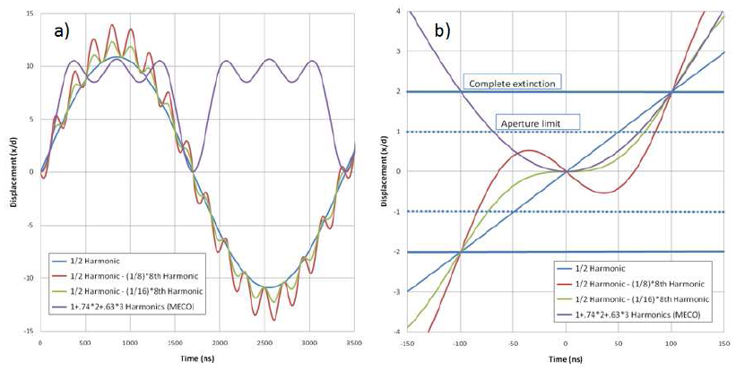
Normalized all waveforms to complete extinction at ±100 ns
E. Prebys, Mu2e Extinction, Collaboration Meeting
8/8/09

Slide 19
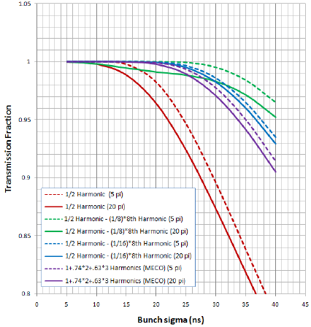
E. Prebys, Mu2e Extinction, Collaboration Meeting
8/8/09

Slide 20
Our baseline design has significant issues with transmission efficiency unless bunches are very short (~10ns).
The MECO design is markedly superior in this regard.
A new proposal involving a small amount of 4.8MHz harmonic looks very promising.
In comparing the two proposals, consideration will be given to
  Higher harmonic rate vs
  Reduced number of harmonics and lower magnetic field.
E. Prebys, Mu2e Extinction, Collaboration Meeting
8/8/09

Slide 21
It’s clear the original proposal parameters raise challenges for magnet and power supply design.
Analyzing switching to a lower field, longer magnet
  MECO design, for example was 6 m, 80 G
  Would required 250m β
Working to balance practicalities of magnet and beam line design.
Also clear single harmonic is impractical unless pulse is extremely short (<10 ns)
Comparing MECO 3 harmonic design to modified sine wave design.
  Lower frequency vs. less harmonics and lower field.
In either case, is compensating dipole needed?
  Perhaps not.
E. Prebys, Mu2e Extinction, Collaboration Meeting
8/8/09

Slide 22
Challenge
  Measuring inter-bunch extinction requires a dynamic range (or effective dynamic range) of at least 10⁹.
Options being considered
  Statistical:
    use either a thin scatterer, or small acceptance target monitor to count a small (10⁻⁷ or 10⁻⁸?) fraction of beam particles.
    Statistically measure inter-bunch beam.
    Pros: straightforward
    Cons: limited sensitivity to fluctuations in extinction (is that important?)
  Single Particle
    Measure inter-bunch beam at the single particle level
    Need something very fast (Cerenkov?)
    Probably have to “blind” detector at bunch time
    Pros: best picture of out of bunch beam
    Cons: hard
E. Prebys, Mu2e Extinction, Collaboration Meeting
8/8/09

Slide 23
Small acceptance proton counter
Primary beam
target
Scattered protons
Example
  Design to count ~10 protons/nominal bunch
    ~1 in 10⁷
  Can build up a 3s 10-9 measurement in 10⁹ bunches
    ~30 minutes
E. Prebys, Mu2e Extinction, Collaboration Meeting
8/8/09

Slide 24
Background rejection
  Need energy threshold
    Sweeping magnet
    Calorimetric
    Cerenkov based
Rad hardness
  If placed after target, access could be difficult.
E. Prebys, Mu2e Extinction, Collaboration Meeting
8/8/09

Slide 25
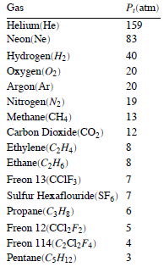
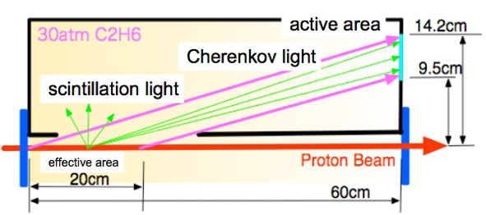
Pros:
  Rad hard
  Variable light yield (pressure)
Cons:
  High pressure -> thick windows
  Scintillation?
  Difficult to gate
E. Prebys, Mu2e Extinction, Collaboration Meeting
8/8/09

Slide 26
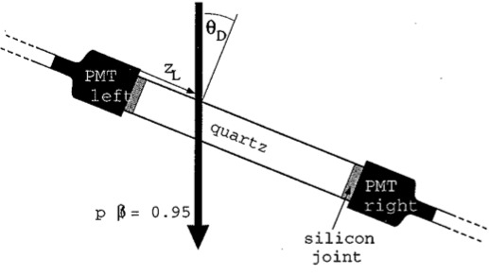
Pros:
  Lots of light
  Coincidence to suppress scintillation
  Potentially gate light with Pockels cell during bunch
Cons:
  Beam scattering?
  Rad harness an issue (Grad ~ few days)
E. Prebys, Mu2e Extinction, Collaboration Meeting
8/8/09

Slide 27
Mu2e is working on all aspects of extinction and extinction measurement.
Still more questions than answers at this point.
E. Prebys, Mu2e Extinction, Collaboration Meeting
8/8/09

