Slide 1

Eric Prebys, FNAL
E. Prebys – Mu2e Collaboration Meeting
6/3/08

Slide 2
Resonant Extraction
Extinction
Radiation Issues
E. Prebys – Mu2e Collaboration Meeting
6/3/08

Slide 3
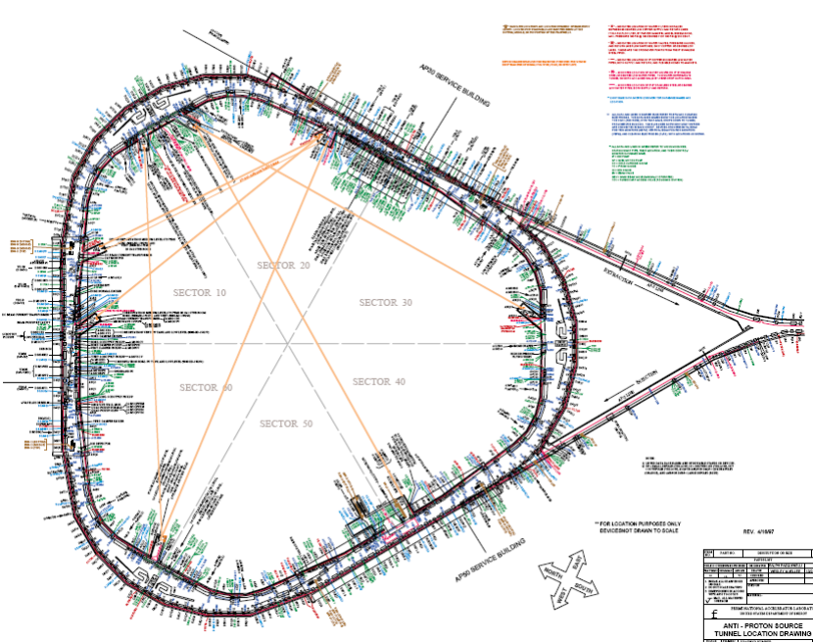
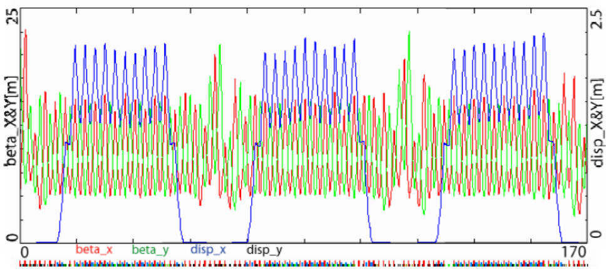
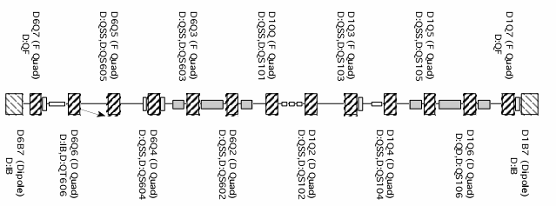
Large Acceptance
Well understood lattice
Long, dispersion-free segments
Lots of open straight sections after cooling hardware removed
E. Prebys – Mu2e Collaboration Meeting
6/3/08

Slide 4
Consideration
  Want to arrange drivers in groups, with the magnets in each group separated by ~multiples of π in 27θ.
Choose
  Six locations just inside of the ’07 quads at the ends of the straight sections
Pairs indicated by color
E. Prebys – Mu2e Collaboration Meeting
6/3/08

Slide 5
Resonant Extraction Parameters
Kinetic Energy (GeV) | 8
Working tune (ν_{x}/ν_{y}) | 9.769/9.783
Resonance (ν_{x}) | 29/3
Normalized acceptance (x/y πmm-mr) | 285/240
Normalized beam emittance (πmm-mr) | 20
β at electrostatic septum (m) | 15
β at Lambertson (m) | 22
β at harmonic quads (m) | 14
Septum Position (mm/σ) | 11/4.8
Septum gap/step size (mm) | 10
Sextupole Drive Strength (T-m/m²) | 473
Initial Tuneshift | .048
Septum field (MV/m) | 8
Septum length (m) | 3
Close to 29/3
Large Acceptance
Reasonable clearance at septum
Similar to Main Injector
E. Prebys – Mu2e Collaboration Meeting
6/3/08

Slide 6
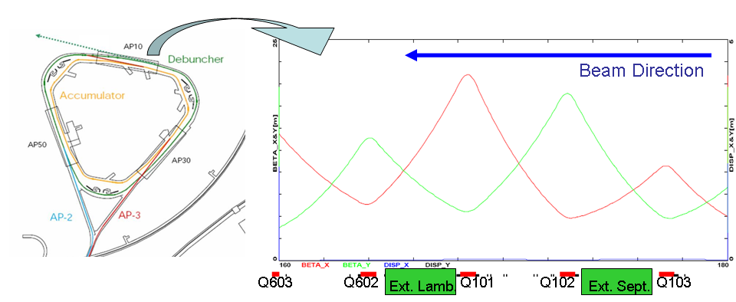
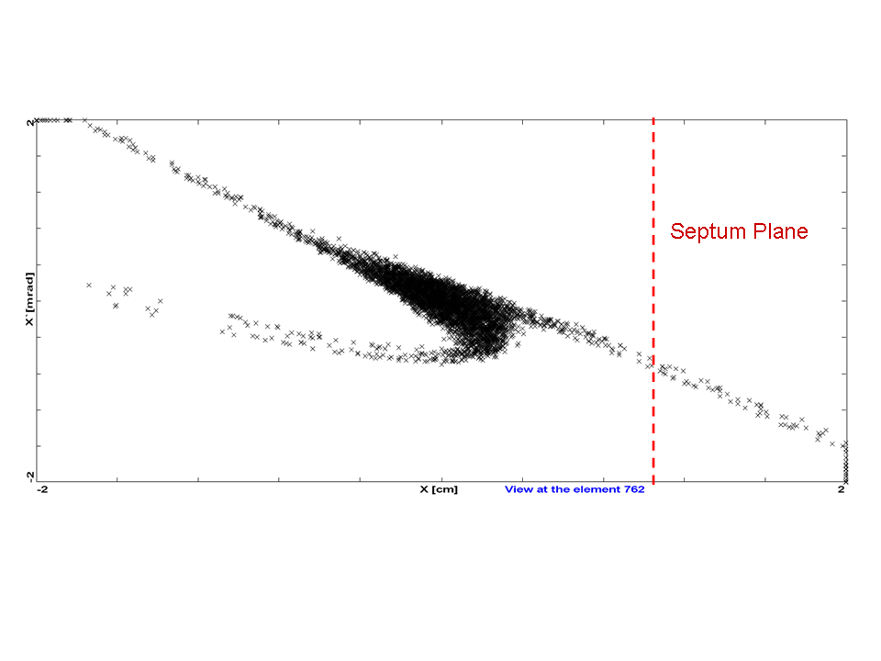
OPTIM turn by turn simulation verifies calculated resonance parameters.
Symmetry of lattice means direction doesn’t matter.
E. Prebys – Mu2e Collaboration Meeting
6/3/08

Slide 7
June PAC
  Include electrostatic septum in OPTIM model
  First pass at measured extraction inefficiencies
Proposal
  Detailed extraction model, including secondaries from septum scatter (hope to enlist help on this).
E. Prebys – Mu2e Collaboration Meeting
6/3/08

Slide 8
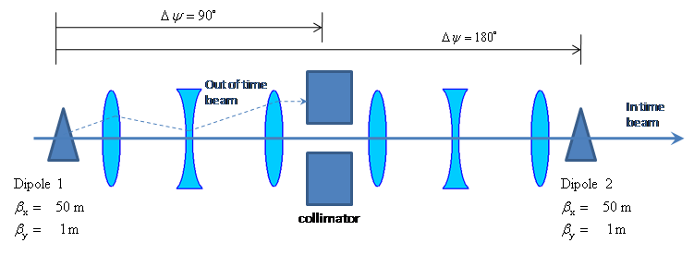
Two matched dipoles at 180° phase separation
Collimation channel at 90°
Beam is transmitted at node
  System resonant at half bunch frequency (~300 kHz)
E. Prebys – Mu2e Collaboration Meeting
6/3/08

Slide 9
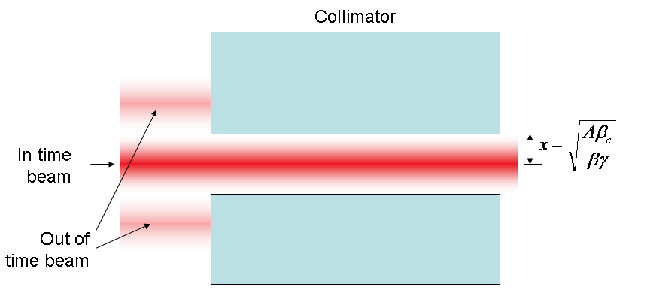
At collimator:
E. Prebys – Mu2e Collaboration Meeting
6/3/08

Slide 10
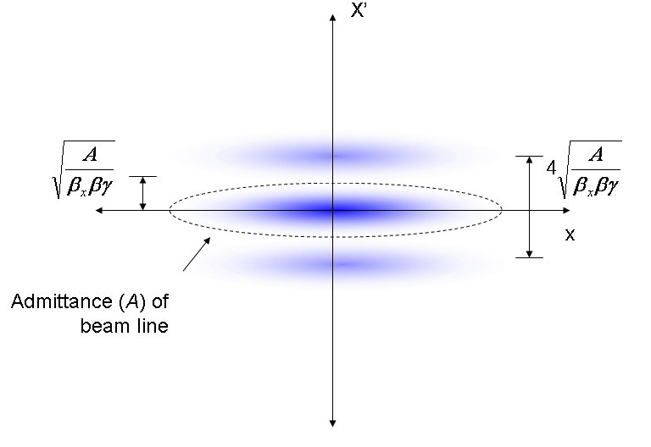
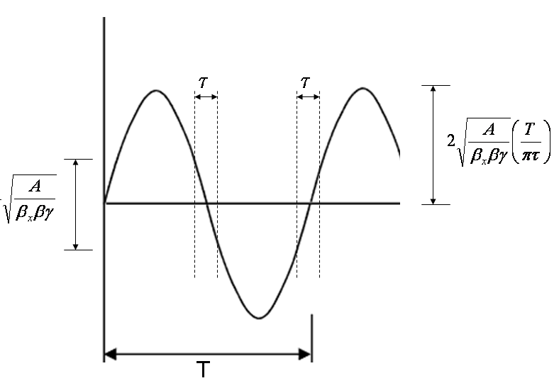
Phase space (live window τ):
Full amplitude:
E. Prebys – Mu2e Collaboration Meeting
6/3/08

Slide 11
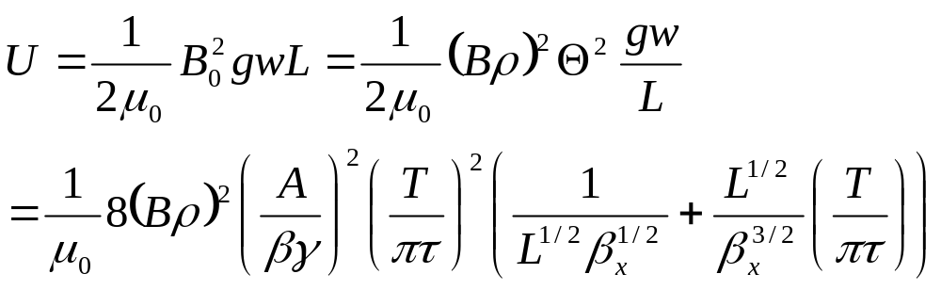
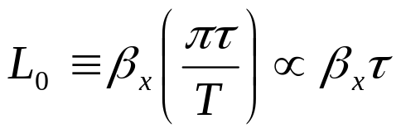
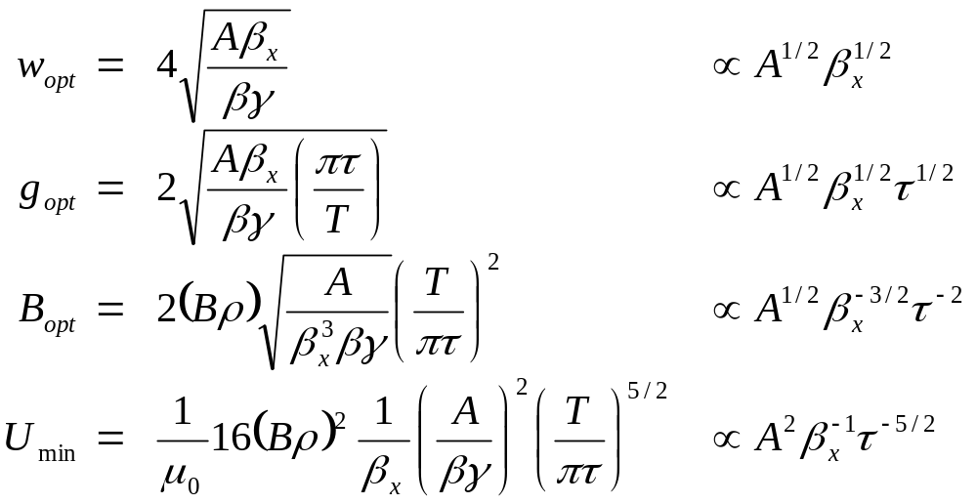
Falls with β_{x}
For a particular β_{x}, there is an optimum length L₀:
For which the optimized parameters are:
E. Prebys – Mu2e Collaboration Meeting
6/3/08

Slide 12
Parameter | Value | Comment
β_{x} | 50 m | Typical beam line beta max
Effective length (L) | 2 m
Full width (w) | 5 cm
Vertical gap (g) | 1 cm | Scaled up for practicality
Peak field (B₀) | 600 Gauss
Peak stored energy (U) | 1.43 J | A little over twice the minimum
Working to develop a magnet based on this design
  See Harding talk
E. Prebys – Mu2e Collaboration Meeting
6/3/08

Slide 13
June PAC
  Continue with modeling of beam line
  Calculate preliminary transmission
  Validate concept
Proposal
  Produce beam line layout
  Proceed with conceptual magnet design
E. Prebys – Mu2e Collaboration Meeting
6/3/08

Slide 14
Present anti-proton rate in pBar tunnel
  ~20e10 pbar/hr
Mu2e protons
  6*4e12/1.33s=1.8e13 p/s=6.5e16 p/hr=23kW
Bad news
  This is about 300,000 times the current antiproton rate in this enclosure!
  An uncontrolled beam loss of 1W/m => 98% efficiency (per ring)
  pBar enclosure was not designed for these rates
Good news
  Can make entire area limited occupancy and buildings controlled access
  We’re NOT talking about SNUMI any more (~4 times the beam)
E. Prebys – Mu2e Collaboration Meeting
6/3/08

Slide 15
All protons going to pBar ring will have gone through Booster
Booster:
  Good
    At least 13.5’ of Earth shielding at all points
  Bad
    13.5’ still well short of passive shielding requirements (more about this later)
    High occupancy areas on surface. All areas kept below 5 mRem/hr
pBar ring:
  Bad
    Berm areas 13’ of earth
    Buildings only 10’
      Should be factor 10 less shielding
      Measurements more like factor 100 (gravel fill?)
  Good
    Should be more efficient than Booster
    Can control access to area
      Entire area can be made “Radiation Area” if necessary (buys factor 20)
      Buildings can be interlocked (although this would be undesirable)
E. Prebys – Mu2e Collaboration Meeting
6/3/08

Slide 16
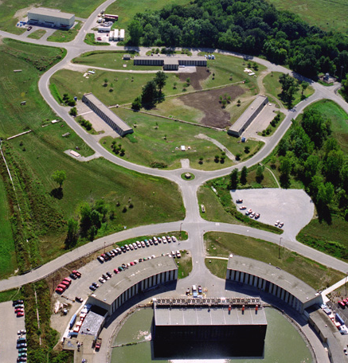
13’ shielding on berm
Location for big fence?? (note lack of cars)
pBar
10’ shielding under enclosures
Booster gallery
(+ offices)
Booster tower office space
Booster
E. Prebys – Mu2e Collaboration Meeting
6/3/08

Slide 17
Fermilab Dugan/Cossairt criteria based on continuous, total, localized beam loss
  If they are satisfied, you can do “whatever you want”
  The pBar ring is far short of these for Mu2e
Hourly dose (mRem) | Passive shielding requirements at 2.4e13/1.33 s (feet of dirt) | Maximum localized beam loss with 13’ of dirt (fraction of total) | Maximum localized beam loss with 10’ of dirt (fraction of total)
D < 1 | 22.1 | 5e-4 | 5e-5
1 < D < 5 | 19.9 | 3e-3 | 3e-4
5 < D < 100 | 16.6 | 5e-2 | 5e-3
100 < D < 500 | 15.1
500 < D < 1000 | 14.8
This is what a simple e-berm (in-out) would have to detect to keep the areas within “Radiation Area” limits
E. Prebys – Mu2e Collaboration Meeting
6/3/08

Slide 18
The Booster is also well short of the passive shielding requirements
Normally, interlocked radiation detectors are tied to specific operating conditions
  Very limiting
In the Booster, we have a system of 52interlocked radiation detectors (“chipmunks”)
  Also, have detailed studies showing that no physical beam configuration could result in a surface radiation situation that did not trip a chipmunk.
  Result: chimpmunk system fully protects Booster.
E. Prebys – Mu2e Collaboration Meeting
6/3/08

Slide 19
A system similar to Booster should work for the accumulator and debuncher
  Energies, sizes, and lattices not all that different
It’s a lot of work
  The Booster shielding assessment and supporting documentation fills seven volumes and 1.5 feet of shelf space
  Need to start worrying about it soon, particularly if additional shielding is needed.
SNuMI II work will necessarily cover total proton rate, but there will be special issues for mu2e, but..
  Have to separately validate chipmunk coverage for beam in debuncher
  Must deal with significant resonant extraction losses
E. Prebys – Mu2e Collaboration Meeting
6/3/08

Slide 20
Need help!!
  This is a big job
  UI has shown some interest
  Need help from ES&H
June PAC
  No more than we have now
Proposal
  Outline scheme for chipmunk protection system
E. Prebys – Mu2e Collaboration Meeting
6/3/08

