Slide 1
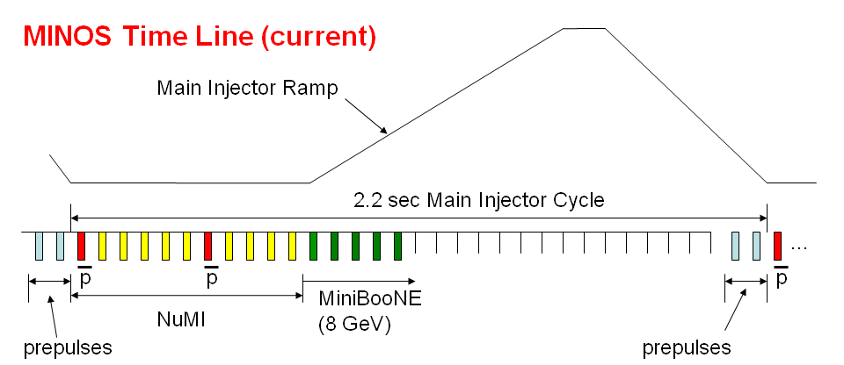
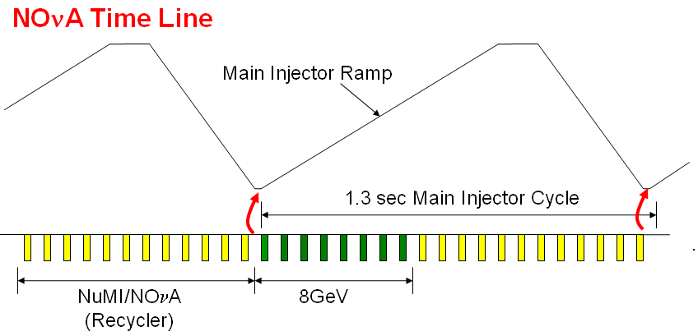
300 kW
700 kW
Eric Prebys, Jefferson Lab Accelerator Seminar
9/18/2008

Slide 2
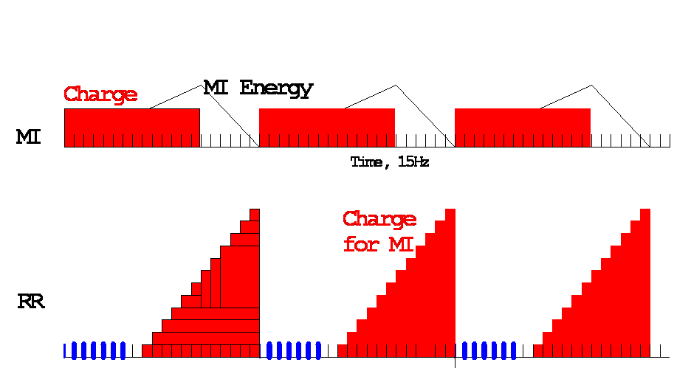
MI uses 12 of 20 available Booster Batches per 1.33 second cycle
Preloading for NOvA
Recycler
Recycler → MI transfer
Available for 8 GeV program
15 Hz Booster cycles
MI NuMI cycle (20/15 s)
Roughly 8*(4x10¹² batch)/(1.33 s)*(2x10⁷ s/year)=4.8x10²⁰ protons/year available
Eric Prebys, Jefferson Lab Accelerator Seminar
9/18/2008

Slide 3
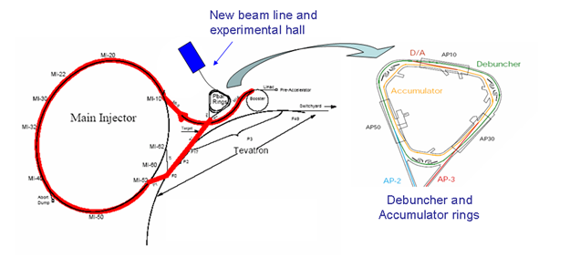
MI-8 -> Recycler done for NOvA
Recycler
(Main Injector Tunnel)
New switch magnet extraction to P150 (no need for kicker)
Deliver beam to Accumulator/Debuncher enclosure with minimal beam line modifications and no civil construction.
Eric Prebys, Jefferson Lab Accelerator Seminar
9/18/2008

Slide 4
Inject a newly accelerated Booster batch every 67 mS onto the low momentum orbit of the Accumulator
The freshly injected batch is accelerated towards the core orbit where it is merged and debunched into the core orbit
Momentum stack 3-4 Booster batches
They are then transferred to the Debuncher, where they can be rebunched, slow extracted according to experimental needs.
Energy
T=0
1st batch is injected onto the injection orbit
T<66ms
1st batch is accelerated to the core orbit
T=67ms
2nd Batch is injected
T<133ms
2nd Batch is accelerated
T=134ms
3rd Batch is injected
Eric Prebys, Jefferson Lab Accelerator Seminar
9/18/2008

Slide 5
Eliminate prompt beam backgrounds by using a primary beam with short proton pulses with separation on the order of a muon life time
Optimum period just happens to be exactly the period of the Debuncher.
Plan: rebunch into into a single bunch and slow extract to experiment.
~100 ns
~1.5 μs
Prompt backgrounds
live window
Eric Prebys, Jefferson Lab Accelerator Seminar
9/18/2008

Slide 6
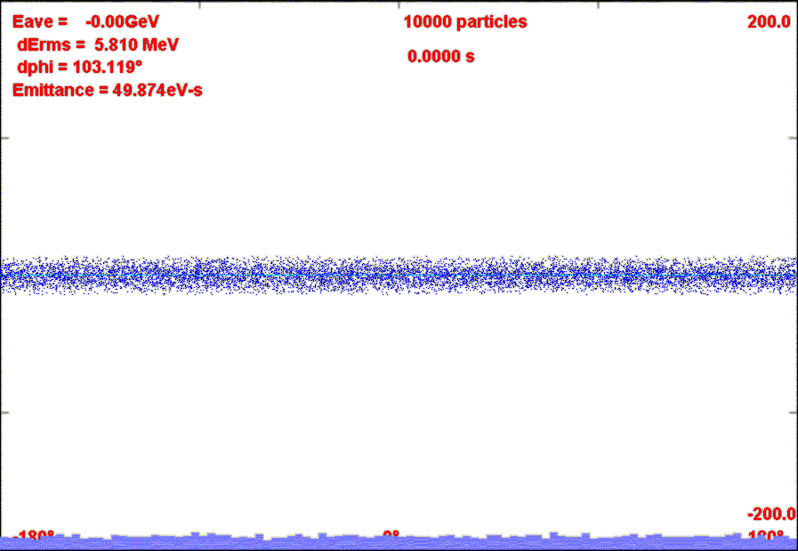
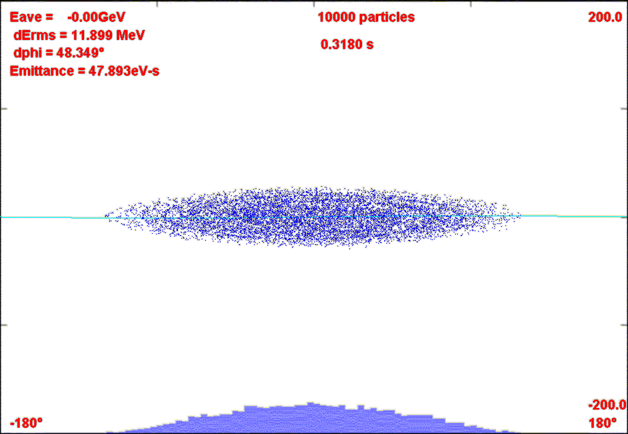
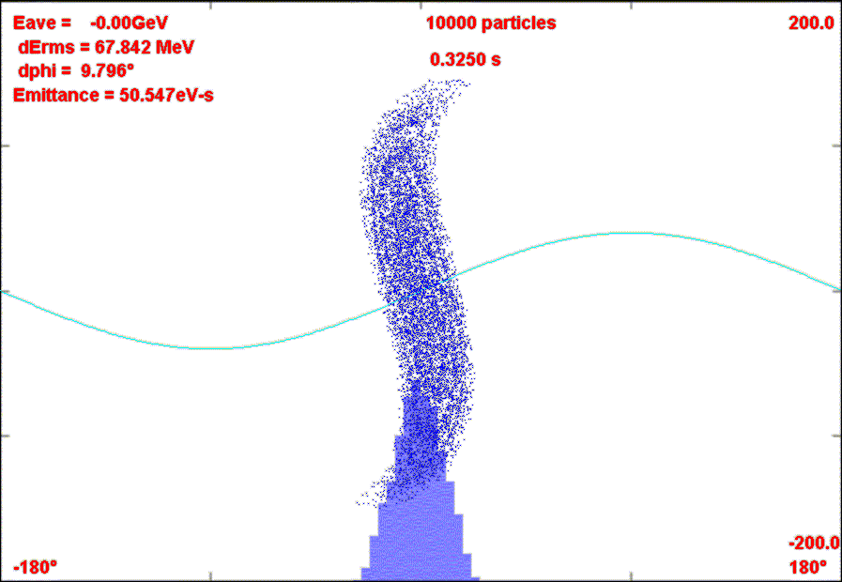
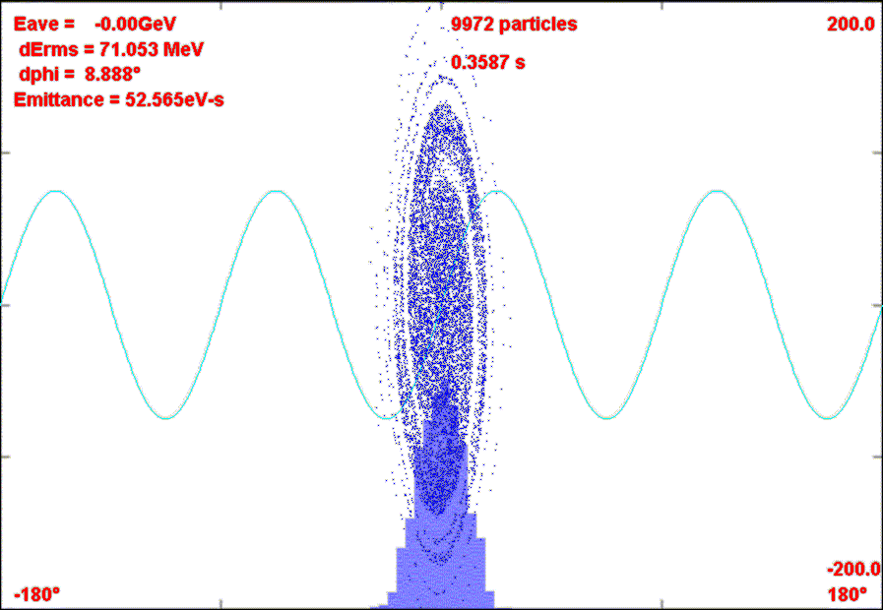
Momentum stack 6 Booster batches directly in Accumulator (i.e. reverse direction)
Capture in 4 kV h=1 RF System.
Transfer to Debuncher
Phase Rotate with 40 kV h=1 RF in Debuncher
Recapture with 200 kV h=4 RF system
σ_{t}~40 ns
Eric Prebys, Jefferson Lab Accelerator Seminar
9/18/2008

Slide 7
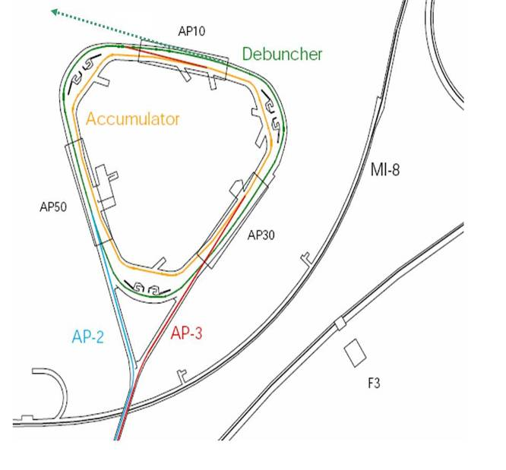
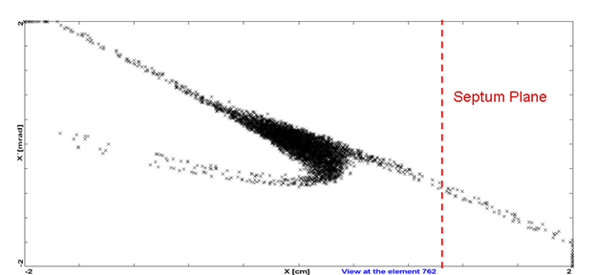
Exploit 29/3 resonance
Extraction hardware similar to Main Injector
  Septum: 80 kV/1cm x 3m
  Lambertson+C magnet ~.8T x 3m
Eric Prebys, Jefferson Lab Accelerator Seminar
9/18/2008

Slide 8
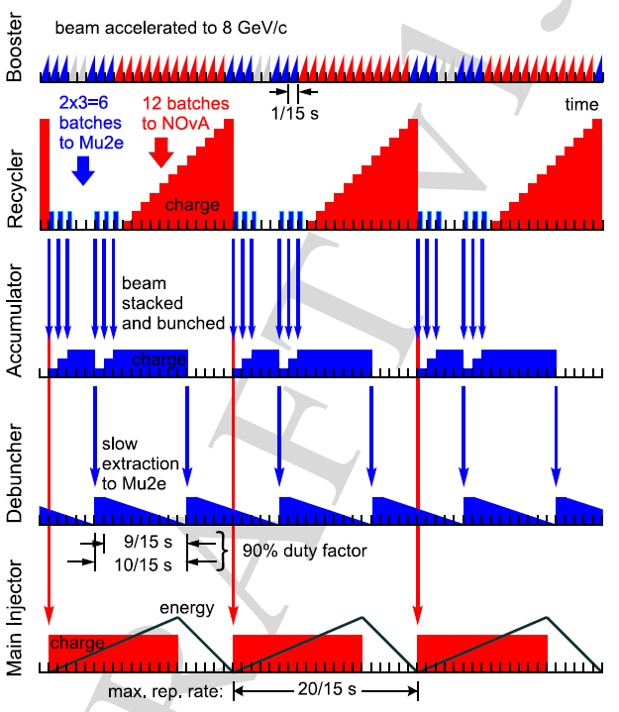
Eric Prebys, Jefferson Lab Accelerator Seminar
9/18/2008

Slide 9
Accelerator Parameters*
 | Accumulator | Debuncher
Circumference [m] | 474 | 504
β_{max} (x/y) [m] | 61/38 | 19.8/17
tunes (x/y) | 6.7/8.67 | 9.66/9.76
admittance (x/y) [π-mm-mr] | 63/63 | 285/240
transverse emittance (95%) [π-mm-mr] | 20 | 20
long emittance [eV-s] | 48 | 53
ΔE_{rms} [MeV] | 12 | 71
Period [ns] | 1589 | 1689
Average current [A] | 2.4 | 2.3
min. bunch length (σ_{t}) [ns] | 250 | 40
Bunch factor (B_{F}) | 0.39 | 0.06
Space charge tune shift (dν) | 0.02 | 0.16
Peak current [A] | 6.2 | 38.5
*based on hybrid option in D. Neuffer, BEAMS-DOC-2787-v1
**all emittances and admittances are normalized
⁺MU2E-DOC-72
E. Prebys – mu2e beam meeting
5/22/08

Slide 10
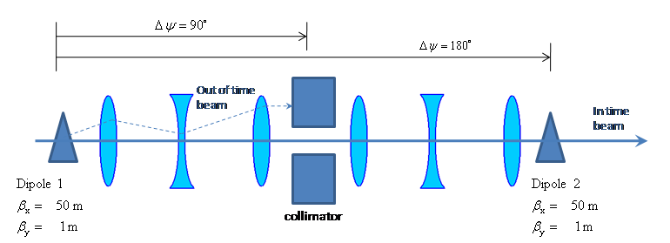
E. Prebys – mu2e beam meeting
5/22/08

Slide 11
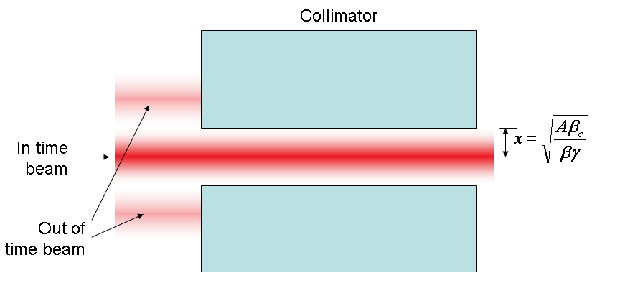
At collimator:

Slide 12
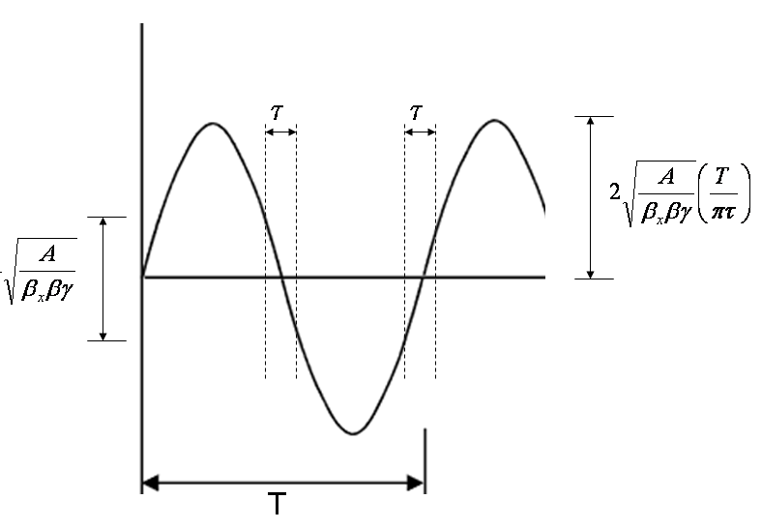
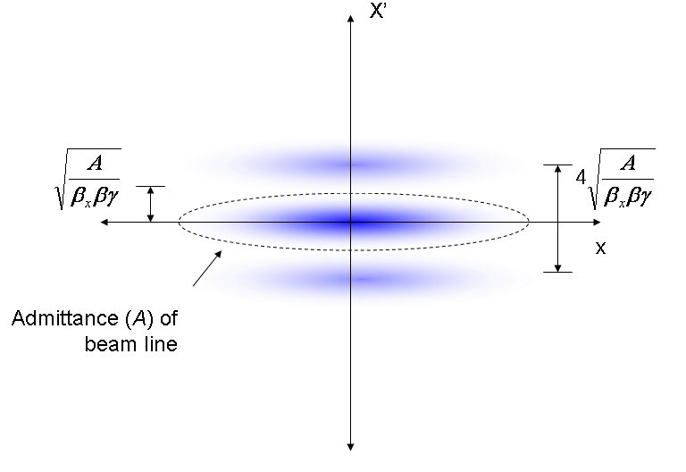
Phase space (live window τ):
Full amplitude:

Slide 13
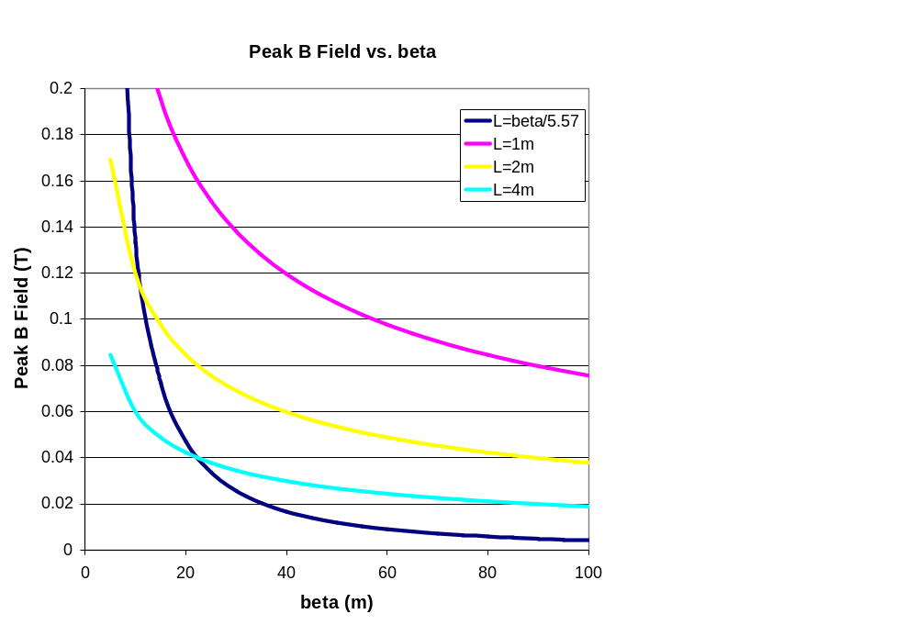
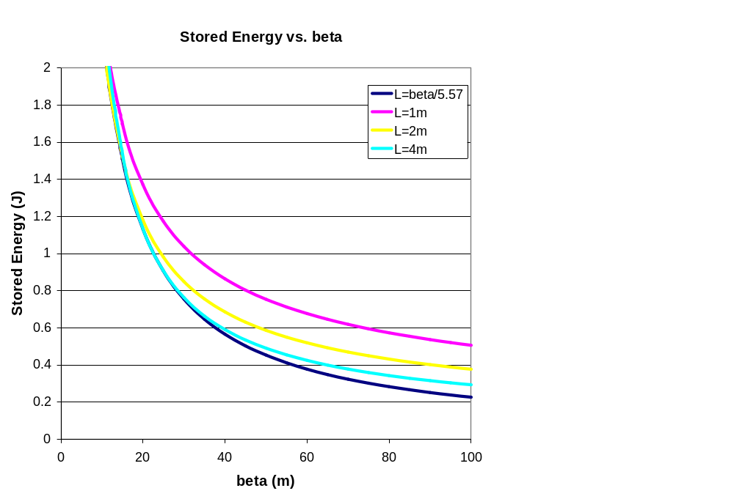
Use A=50π mm-mr, τ=200 ns

Slide 14
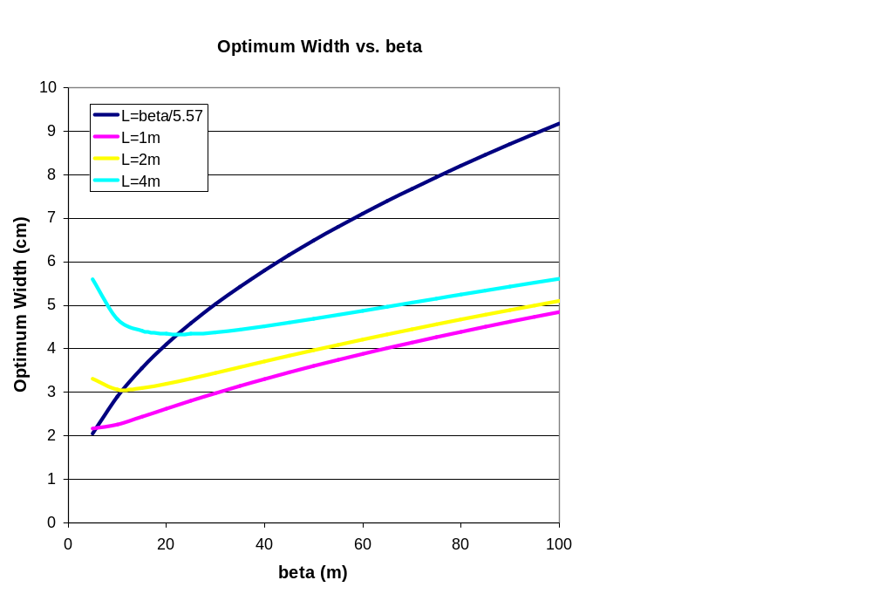
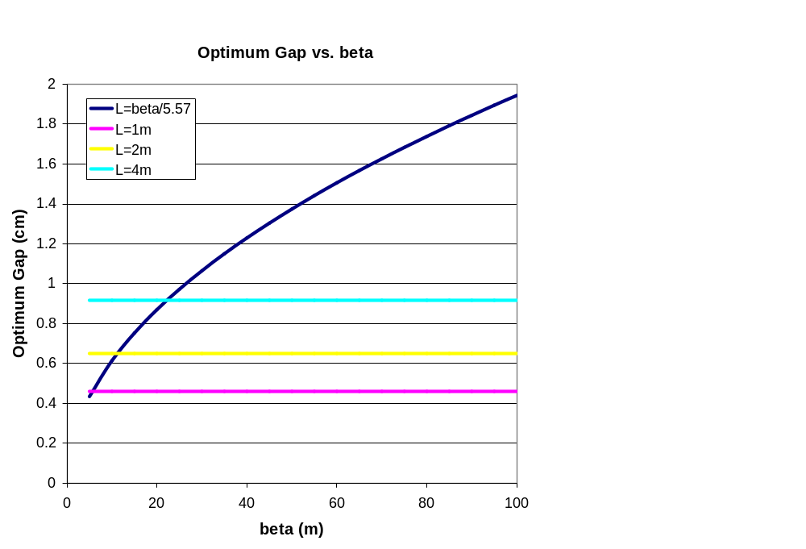

Slide 15
Parameter | Value | Comment
β_{x} | 50 m | Typical beam line beta max
Effective length (L) | 2 m
Full width (w) | 5 cm
Vertical gap (g) | 1 cm | Scaled up for practicality
Peak field (B₀) | 600 Gauss
Peak stored energy (U) | 1.43 J | A little over twice the minimum

Slide 16
Parameter | Value | Comment
Kinetic Energy | 8 GeV
Emittance (95%) | 20 π-mm-mr
ΔE_{rms} | 71 MeV
Beam line admittance | 50 π-mm-mr | Set by collimators
Parameter | Value | Comment
β_{x} | 50 m | Typical beam line beta max
β_{y, min} | 1m | Waist (=L/2)
Effective length (L) | 2 m
Full width (w) | 5 cm
Vertical gap (g) | 1 cm | Scaled up for practicality
Peak field (B₀) | 600 Gauss
Peak stored energy (U) | 1.43 J | A little over twice the minimum
*MU2E-DOC-74
E. Prebys – mu2e beam meeting
5/22/08

Slide 17
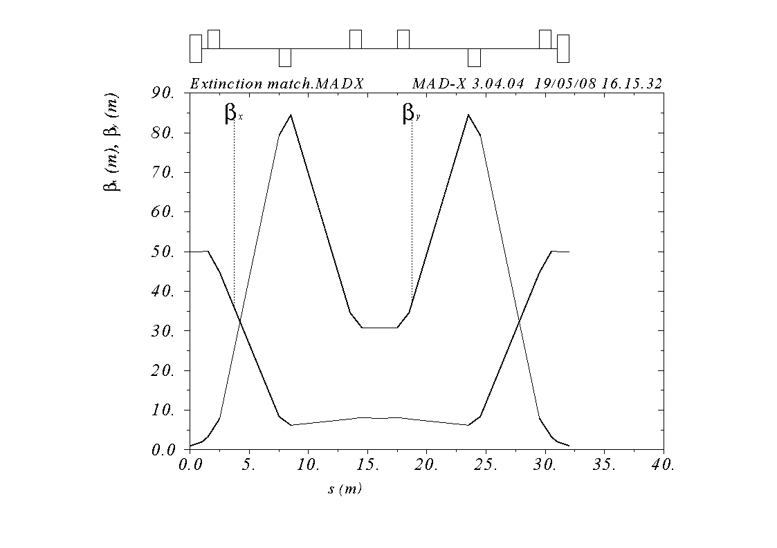
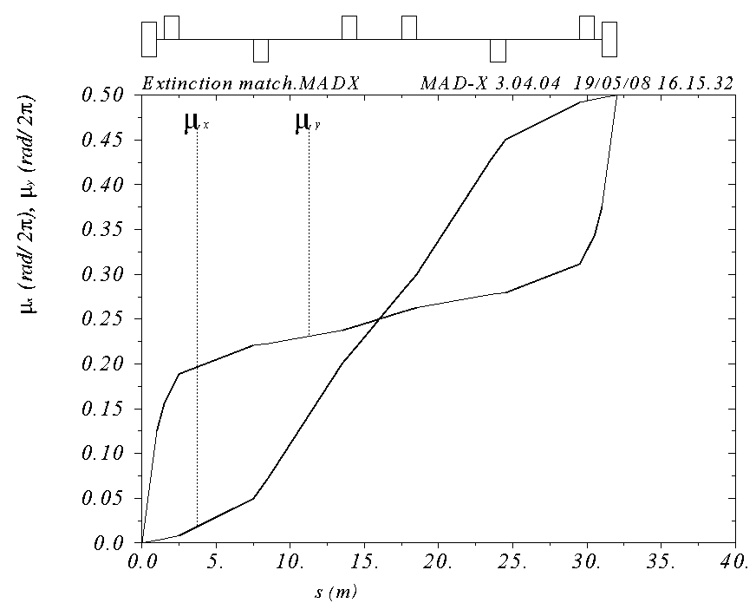
Symmetric about 2m collimator with
  β_{x} = 50m, β_{y}= 1m, μ_{x} = .25 (at collimator center)
Shortest line which fits constraints (32 m)
Small β_{x} (7.9 m) means small hole (x/y = 1.29 x 2.54 cm)
E. Prebys – mu2e beam meeting
5/22/08

