Slide 1

Eric Prebys
3/31/09

Slide 2
Mu2e design
  Pair of resonant dipoles separated by nπ phase advance
    Collimator(s) in between at π/2 (and π?)
    Second magnet cancels kick of first for transmitted beam
  Frequency = ½ pulse frequency
  Beam transmitted on null (rising and falling)
Meco design
  Single magnet
    Collimator(s) π/2 (and π?) later
    No compensation for beam slewing in transmission window
  Three harmonic circuit
  Fundamental frequency = pulse frequency
  Beam transmitted at maximum
Comment
  Two designs not fundamentally different (collimation should be essentially the same)
  Should be a clear optimum between the two
E. Prebys – mu2e magnet
3/31/09

Slide 3
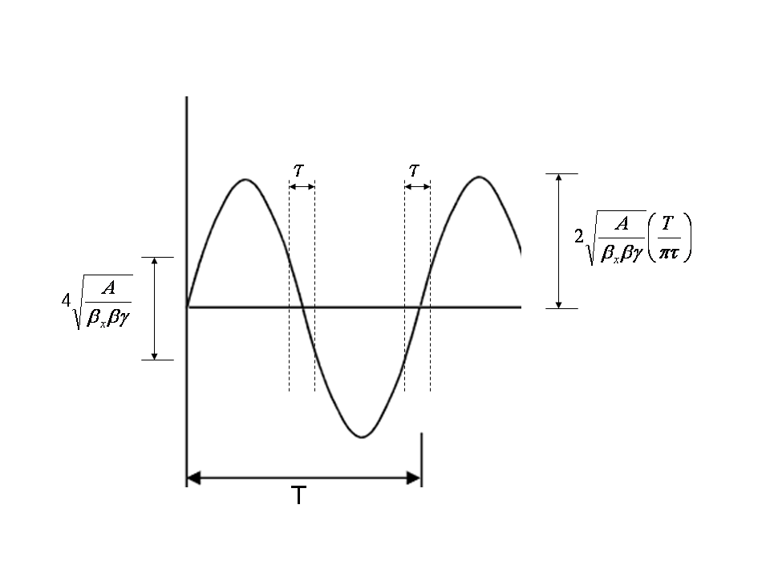
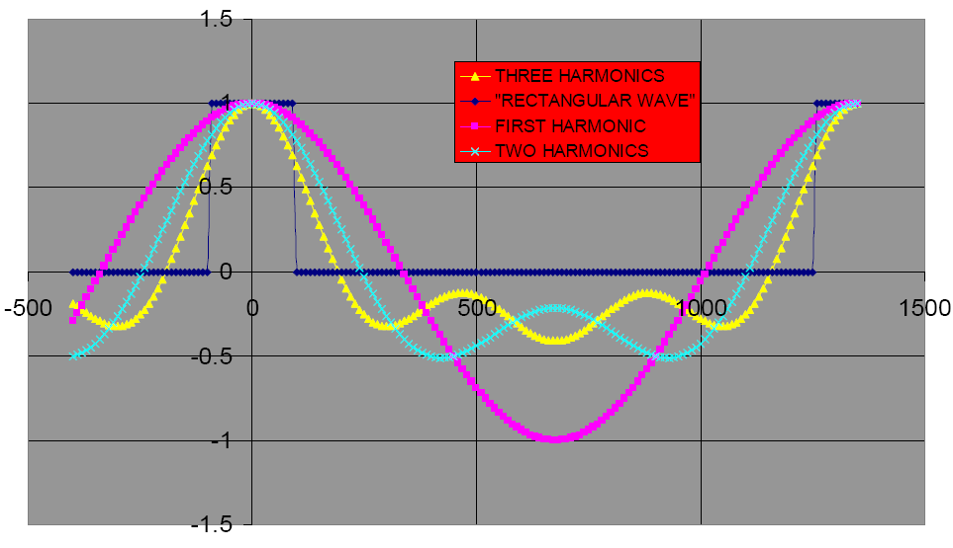
MECO believed that because dθ/dt goes to zero at time of the pulse, you did not need a compensating magnet.
Mu2e
MECO
Rely on a second magnet to compensate for beam slewing at transmission
E. Prebys – mu2e magnet
3/31/09

Slide 4
Requirements (no motivation given)
Parameter | Value | Comment
Kick | 12 MeV/c
Windows | 20% of full scale at +- 100ns | Implies 2.4 MeV/c kick to extinguish beam.
Length | 6m
Field | 75 G | =12 MeV/c kick = 1.5 mrad Sagitta = 4.5 cm Scale up to 85 G for us.
Aperture | 5x7 cm² | Why so big in non-bend plane?
Frequency | 731+1462+2193 kHz | Triple harmonic to approximate square wave
E. Prebys – mu2e magnet
3/31/09
*from MECO-EXT-05-002

Slide 5
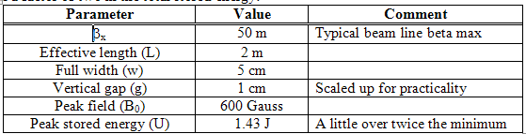
Single harmonic (300 kHz)
E. Prebys – mu2e magnet
3/31/09

Slide 6
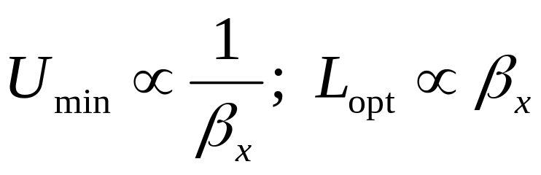
As pointed out in BEAMS-DOC-2925, the minimization of stored energy pushes toward high betas and long magnets, and never converges:
Actual values must be chosen with practicalities of magnet and beam line design in mind.
  Do 234 m beta and a 6 m magnet work?
In MU2E-DOC-253, I consider a design where the beam is transmitted at the maximum, rather than the null, and conclude that this is inferior for a single harmonic
  Higher harmonics not considered.
  It appears the higher harmonics make the two approximately equivalent, in terms of stored energy.
E. Prebys – mu2e magnet
3/31/09

Slide 7
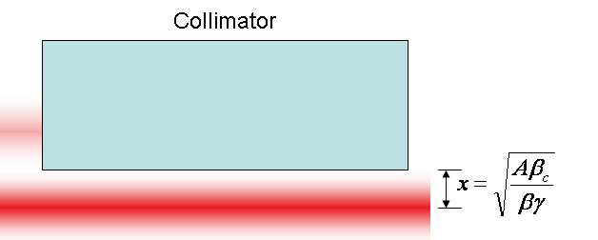
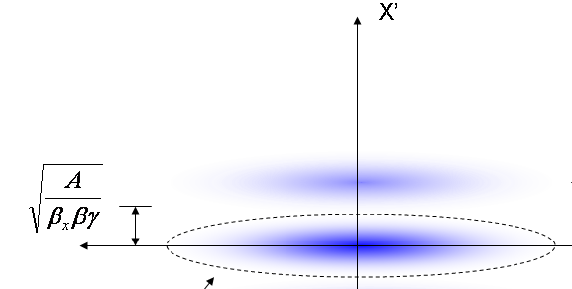
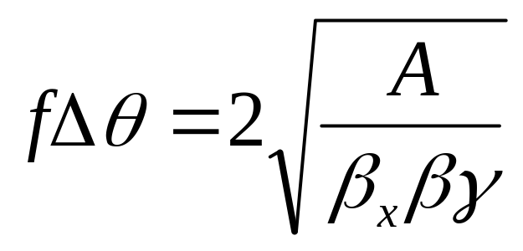
At collimator:
Beam fully extinguished when deflection equals twice full admittance (A) amplitude
Full scale deflection
At kicker:
Fraction of FS to extinguish
*al la FNAL-BEAM-DOC-2925
E. Prebys – mu2e magnet
3/31/09

Slide 8
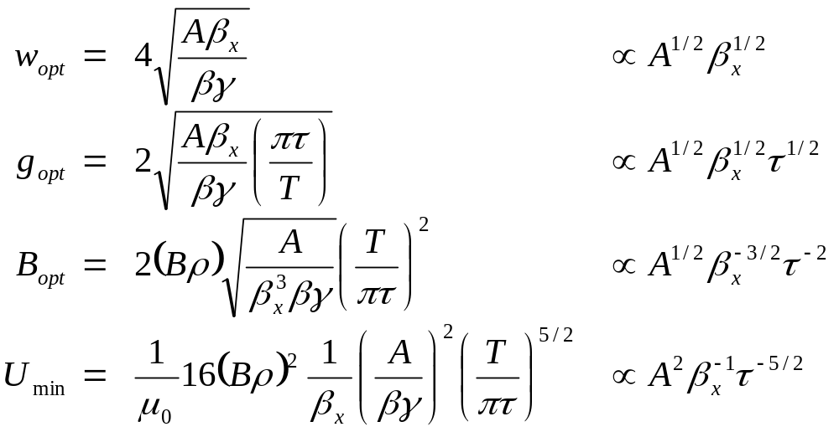
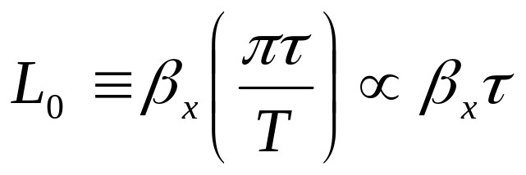
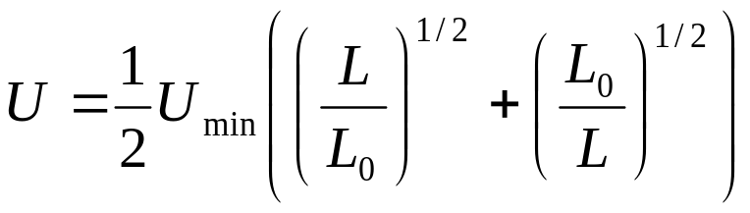
E. Prebys – mu2e magnet
3/31/09

Slide 9
Field and size
  In general stored energy goes down w/ larger β
  Lower field, bigger magnet
  What is the trade-off in terms of magnet design?
Harmonics
  Single harmonic/double magnet -> 300 kHz
  Triple harmonic/single (group) magnet (?)
    Approx same peak field
    600+1200+1800 kHz.
  Again, what are the trade-offs?
E. Prebys – mu2e magnet
3/31/09

