Slide 1
Mu2e Experiment*
Eric Prebys
For the Mu2e Collaboration
*A Letter of Intent to Search for Charged Lepton Flavor Violation in Nuclear Muon Capture

Slide 2
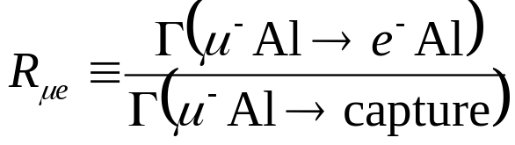
Goals of Experiment
Initial Phase (MECO design, No Project X):
  Exploit NOvA accelerator modifications and post-Run II availability of Accumulator and Debuncher rings to mount a μ->e conversion experiment patterned after MECO
    4x10²⁰ protons in ~2 years
    Measure
    Single event sensitivity of R_{μe}=2x10⁻¹⁷
    90% C.L. limit of R_{μe}<6x10⁻¹⁷
    ANY signal = Beyond Standard Model physics
Ultimate goal
  Exploit Project X and improved muon transport to achieve dramatically increased sensitivity
    If no signal: set limit R_{μe}<1x10⁻¹⁸
    If signal: measure target dependence, etc

Slide 3
Mu2e Collaboration
R.M. Carey, K.R. Lynch, J.P. Miller*, B.L. Roberts
Boston University
W.J. Marciano, Y. Semertzidis, P. Yamin
Brookhaven National Laboratory
Yu.G. Kolomensky
University of California, Berkeley
C.M. Ankenbrandt , R.H. Bernstein, D. Bogert, S.J. Brice, D.R. Broemmelsiek,D.F. DeJongh, S. Geer,
M.A. Martens, D.V. Neuffer, M. Popovic, E.J. Prebys*, R.E. Ray, H.B. White, K. Yonehara, C.Y. Yoshikawa
Fermi National Accelerator Laboratory
D. Dale, K.J. Keeter, J.L. Popp, E. Tatar
Idaho State University
P.T. Debevec, D.W. Hertzog, P. Kammel
University of Illinois, Urbana-Champaign
V. Lobashev
Institute for Nuclear Research, Moscow, Russia
D.M. Kawall, K.S. Kumar
University of Massachusetts, Amherst
R.J. Abrams, M.A.C. Cummings, R.P. Johnson, S.A. Kahn,
S.A. Korenev, T.J. Roberts, R.C. Sah
Muons, Inc.
R.S. Holmes, P.A. Souder
Syracuse University
M.A. Bychkov, E.C. Dukes, E. Frlez, R.J. Hirosky, A.J. Norman, K.D. Paschke, D. Pocanic
University of Virginia
Currently:
50 Scientists
11 Institutions
*Co-contact persons

Slide 4
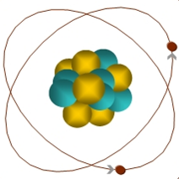
Search for Charged Lepton Flavor Violation (CLFV)
The discovery of neutrino oscillations naturally raises the question:
  What is the rate of charged lepton flavor violation in nature?
CLFV is a powerful probe of multi-TeV scale dynamics: complementary to direct collider searches
Among various possible CLFV modes, rare muon processes offer the best combination of new physics reach and experimental sensitivity
Muon-to-Electron Conversion: μ+N → e+N
Standard Model rate via Dirac neutrino mixing is too small to be observed (~10⁻⁵²)
Very common feature of Beyond Standard Model physics at much larger rates
Similar to μ→eγ, with important advantages:
  No combinatorial background
  Sensitive to other types of BSM physics
  Relative rate depends on details of physics
μ
105 MeV e⁻

Slide 5
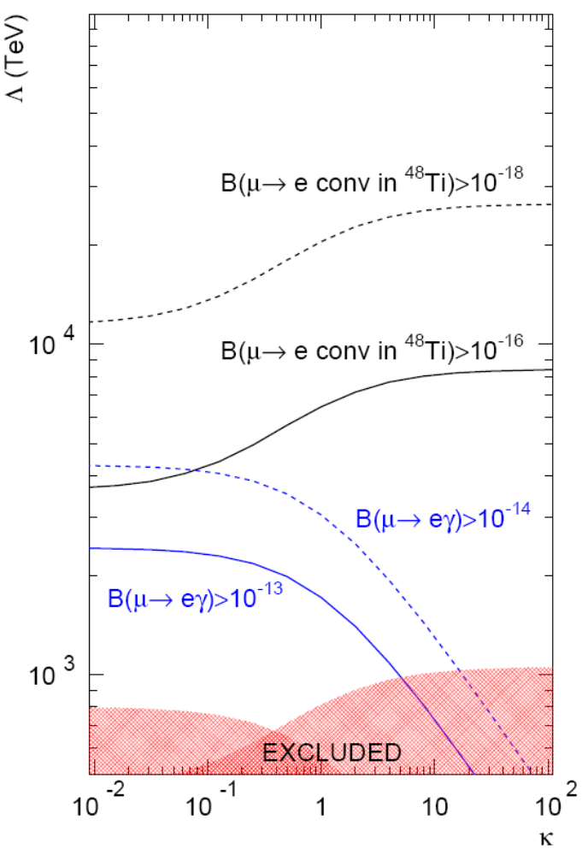
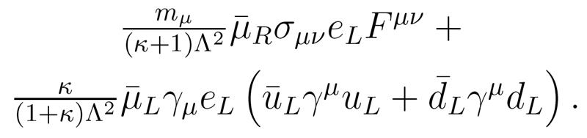
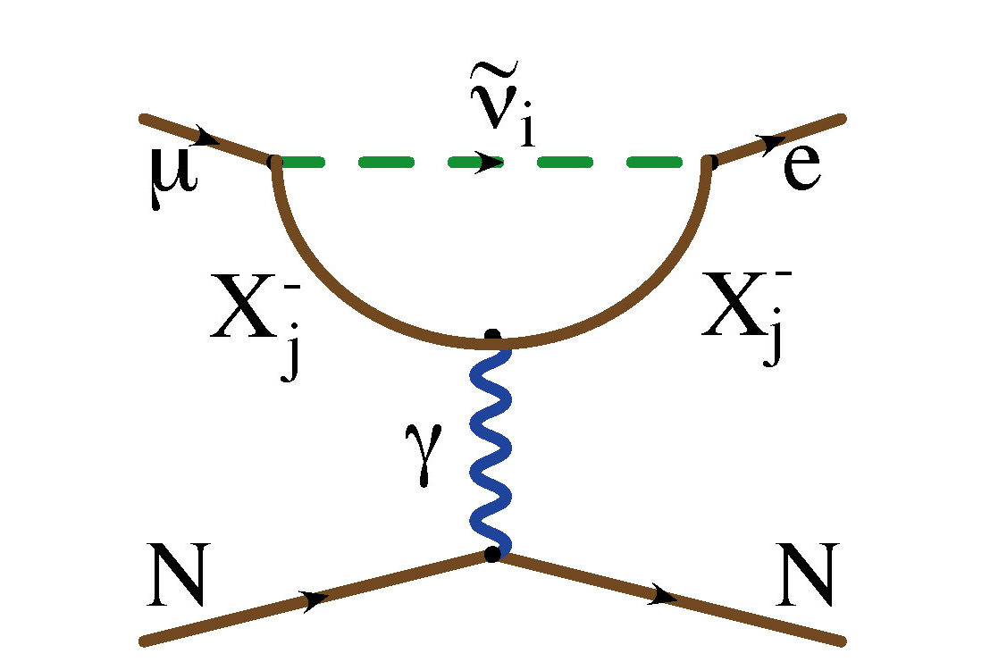
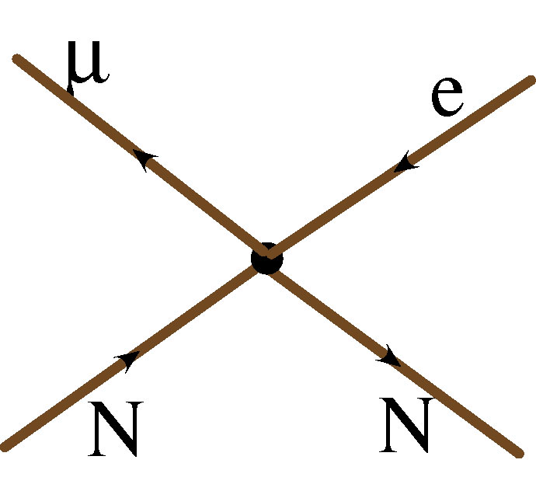
Broadly Sensitive to New High Energy Dynamics
Courtesy: A. de Gouvea
?
?
?
At R_{μe}~10⁻¹⁶ (first phase, this LOI), the sensitivity is already very compelling, well above the reach of colliders
At 10⁻¹⁸ (potentially, with upgraded apparatus and higher muon flux), energy scales probed would be difficult to access by other means
MEGA
Sindrum II

Slide 6
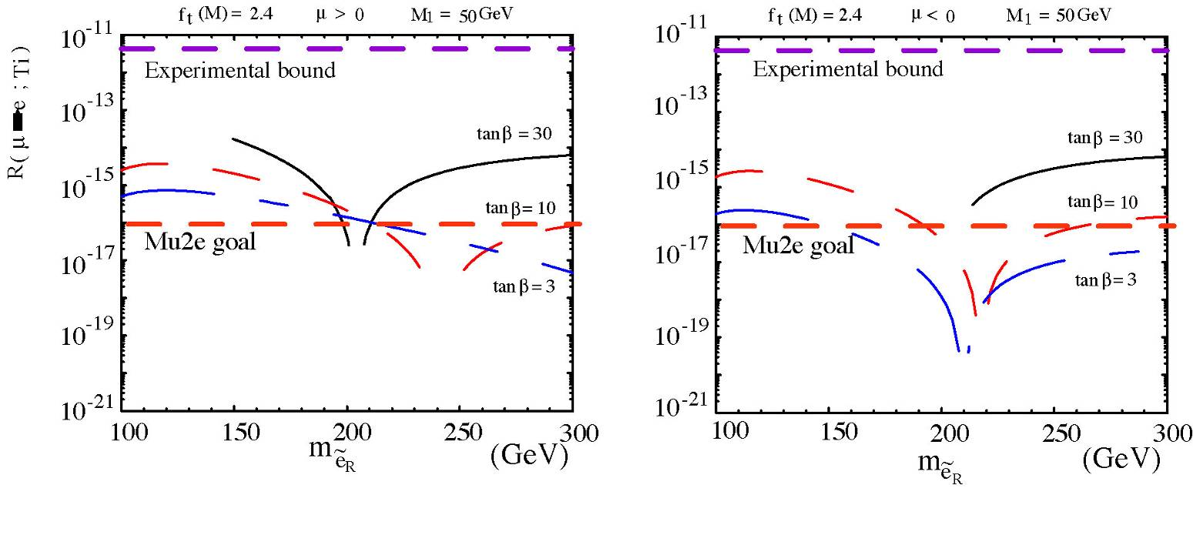
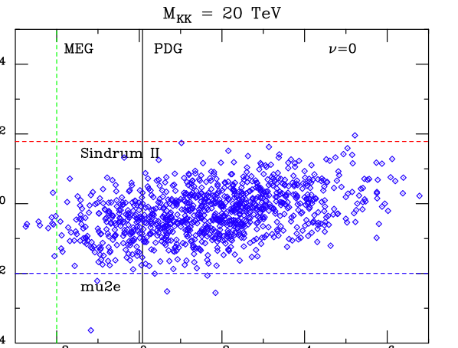
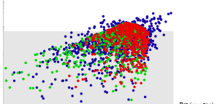
Specific Model Examples
SU(5) GUT Supersymmetry: κ << 1
Littlest Higgs: κ ≈ 1
Randall-Sundrum: κ ≈ 1
R(μTi→eTi)
R(μTi→eTi)
MEG
10⁻¹⁰
Examples with κ>>1 (no μ→eγ signal):
  Leptoquarks
  Z-prime
  Compositeness
  Heavy neutrino
10⁻¹⁰
10⁻¹²
10⁻¹²
10⁻¹⁴
10⁻¹⁴
10⁻¹⁶
10⁻¹⁶
mu2e
10⁻¹⁵
10⁻¹³
10⁻¹¹
10⁻¹³
10⁻¹¹
10⁻⁹
Br(μ→eγ)
Br(μ→eγ)

Slide 7
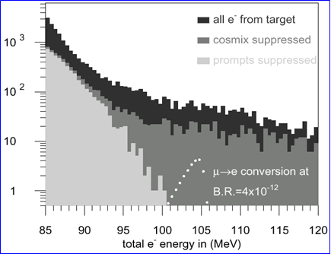
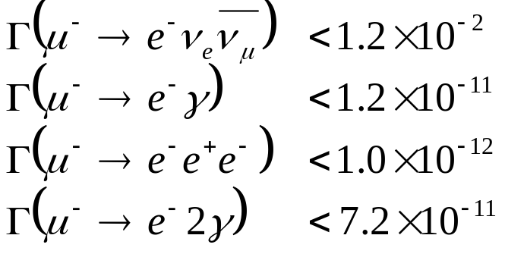
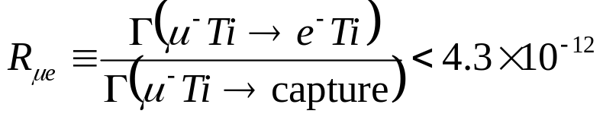
Previous muon decay/conversion limits (90% C.L.)
μ−>e Conversion: Sindrum II
LFV μ Decay:
High energy tail of coherent Decay-in-orbit (DIO)
Rate limited by need to veto prompt backgrounds!

Slide 8
Mu2e (MECO) Philosophy
Eliminate prompt beam backgrounds by using a primary beam with short proton pulses with separation on the order of a muon life time
Design a transport channel to optimize the transport of right-sign, low momentum muons from the production target to the muon capture target.
Design a detector to strongly suppress electrons from ordinary muon decays
~100 ns
~1.5 μs
Prompt backgrounds
live window

Slide 9
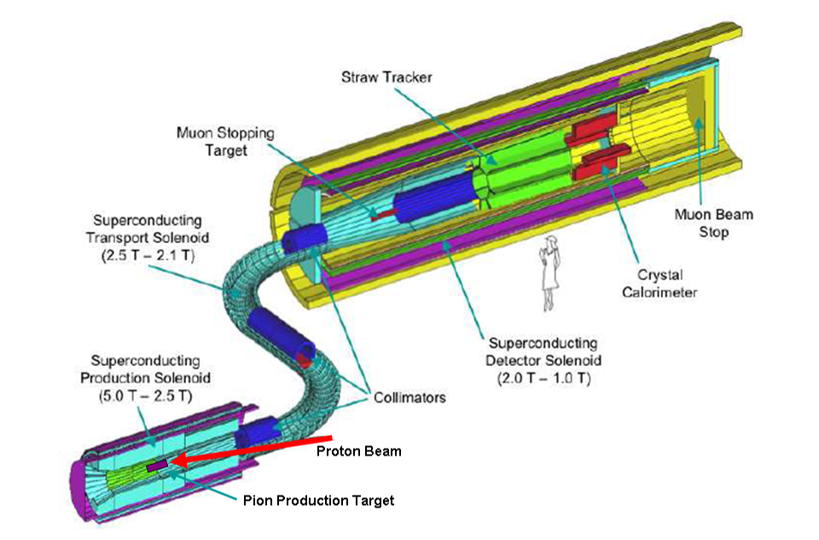
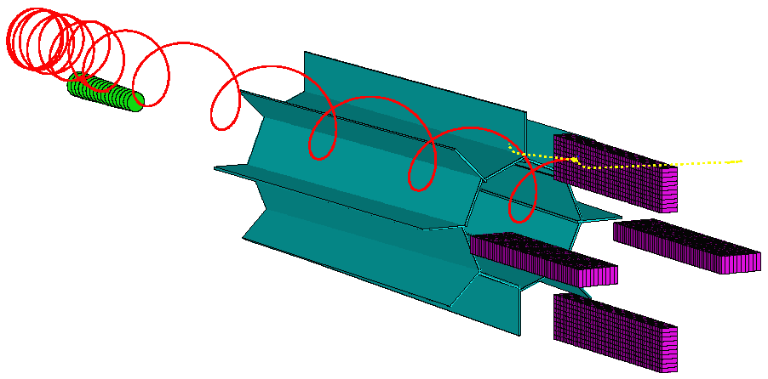
Detector Layout

Slide 10
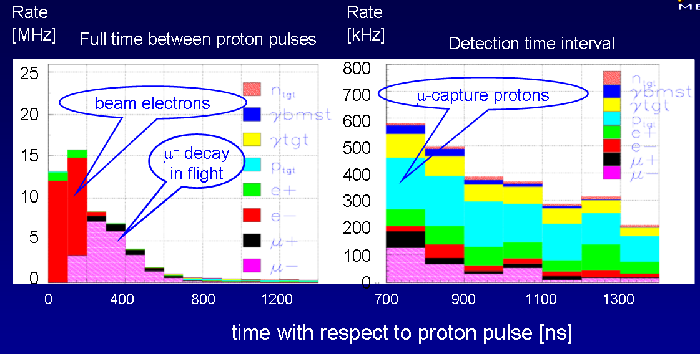
Beam Related Rates
Cut ~700 ns after pulse to eliminate most serious prompt backgrounds.

Slide 11
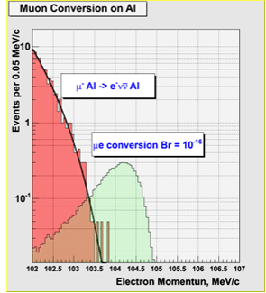
Sensitivity
R_{μe} = 10⁻¹⁶ gives 5 events for 4x10²⁰ protons on target
0.4 events background, half from out of time beam, assuming 10⁻⁹ extinction
  Half from tail of coherent decay in orbit
  Half from prompt
Coherent Decay-in-orbit, falls as (E_{e}-E)⁵

Slide 12
Mu2e History
1997
  MECO proposed for the AGS at Brookhaven
  Approved, along with KOPIO, as part of RSVP program
1998-2005
  Design refined
  Frequent favorable reviews
2005
  June: final reviews, very positive
    Physics goals: HEPAP RSVP Subpanel
    Cost and schedule: “Wojcicki Panel”
  July: RSVP cancelled for financial reasons
    MECO and KOPIO “charged” for entire cost of continued AGS operation.
2006
  January: First informal meeting at BNL
  September: First meeting at Fermilab
2007
  June: Mu2e expression of interest submitted to Fermilab Directorate
  August: First Mu2e collaboration meeting
  October: Letter of Intent submitted to Directorate

Slide 13
Mu2e at Fermilab
If the current suite of proton source upgrades is effective, there should be at least enough excess 8 GeV protons during the NOvA era to do an experiment with similar sensitivity to MECO in a reasonable amount of time.
  The resonant operation of the 8 GeV Booster makes it impossible to directly generate the desired time structure.
  There is a scheme to generate this time structure using the antiproton Accumulator and Debuncher rings, which will become available after the termination of the collider program.
  This scheme requires only modest modifications beyond those planned for NOvA, with which it is fully compatible.

Slide 14
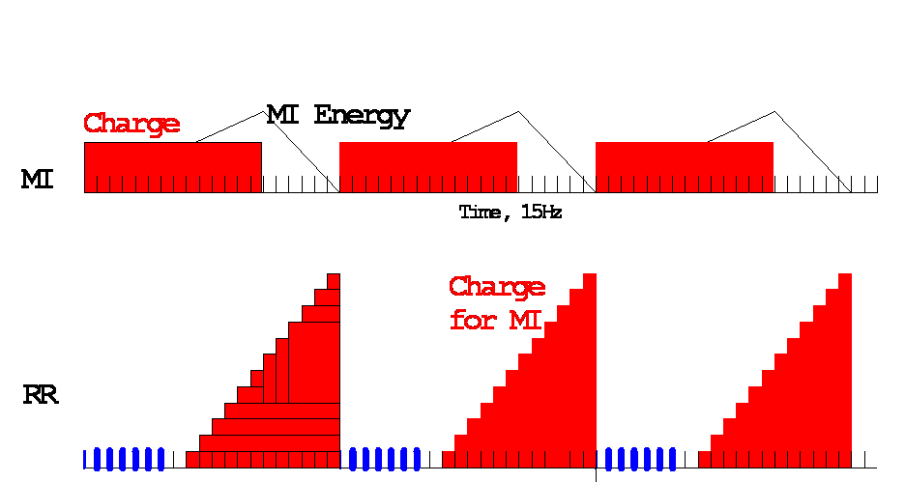
Available Protons: NOvA Timeline
MI uses 12 of 20 available Booster Batches per 1.33 second cycle
Preloading for NOvA
Recycler
Recycler → MI transfer
Available for 8 GeV program
15 Hz Booster cycles
MI NuMI cycle (20/15 s)
Roughly 6*(4x10¹² batch)/(1.33 s)*(2x10⁷ s/year)=3.6x10²⁰ protons per year available

Slide 15
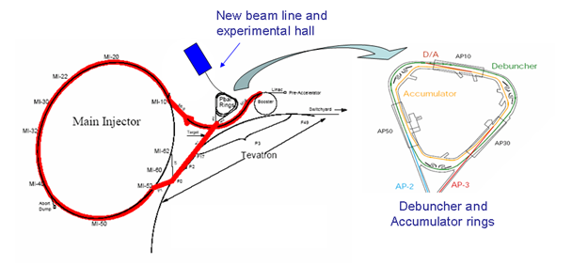
Delivering Protons: “Boomerang” Scheme
MI-8 -> Recycler done for NOvA
Recycler
(Main Injector Tunnel)
New switch magnet extraction to P150 (no need for kicker)
Deliver beam to Accumulator/Debuncher enclosure with minimal beam line modifications and no civil construction.

Slide 16
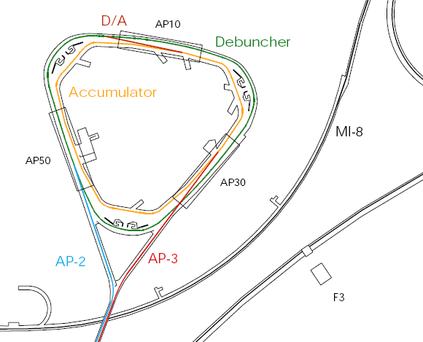
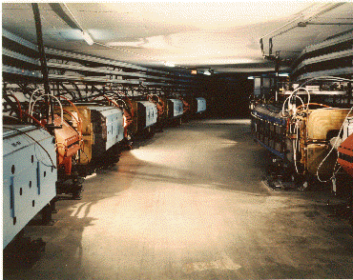
Present Operation of Debuncher/Accumulator
Protons are accelerated to 120 GeV in Main Injector and extracted to pBar target
pBars are collected and phase rotated in the “Debuncher”
Transferred to the “Accumulator”, where they are cooled and stacked
Not used for NOvA

Slide 17
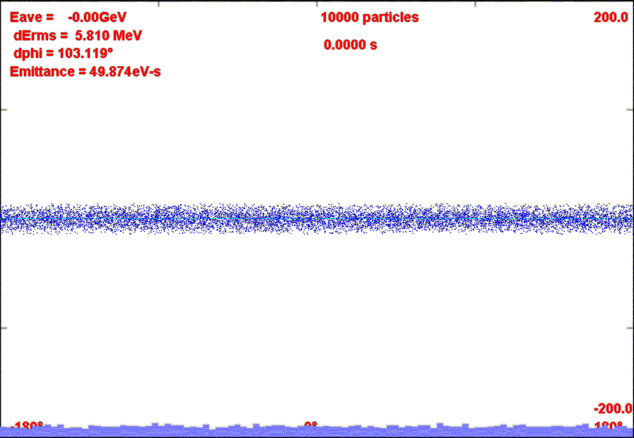
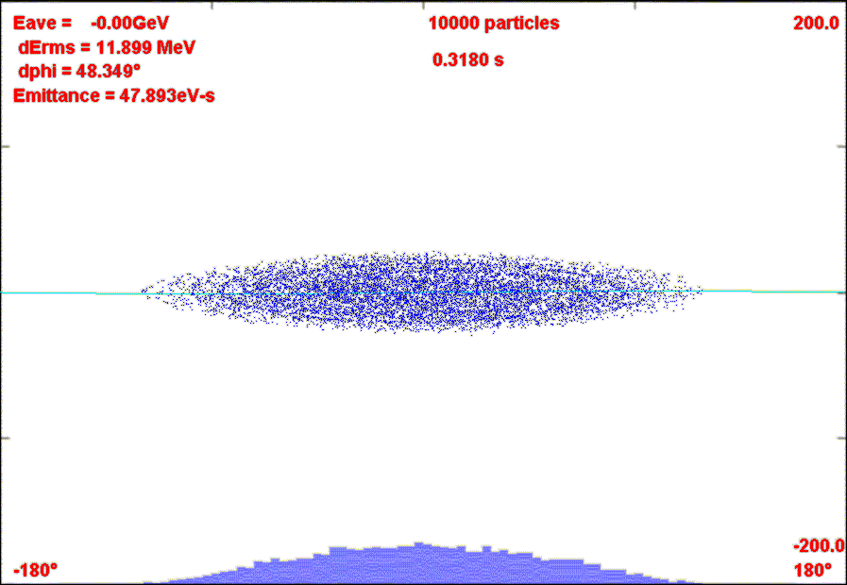
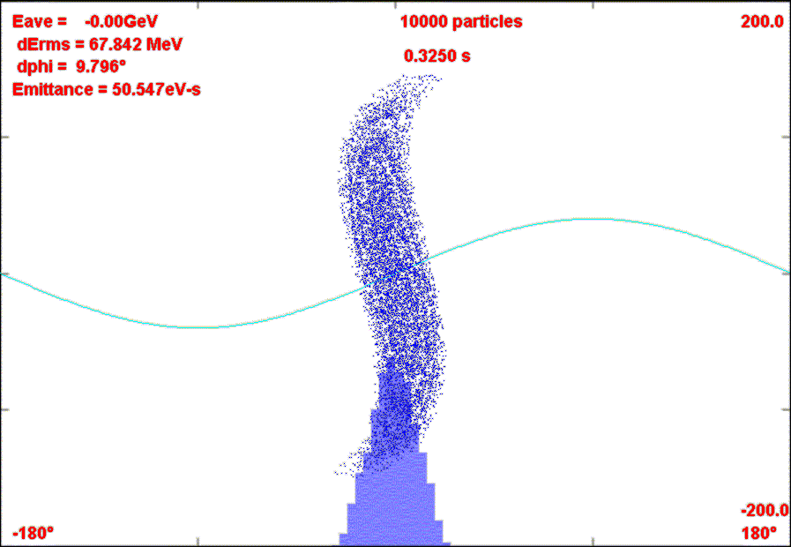
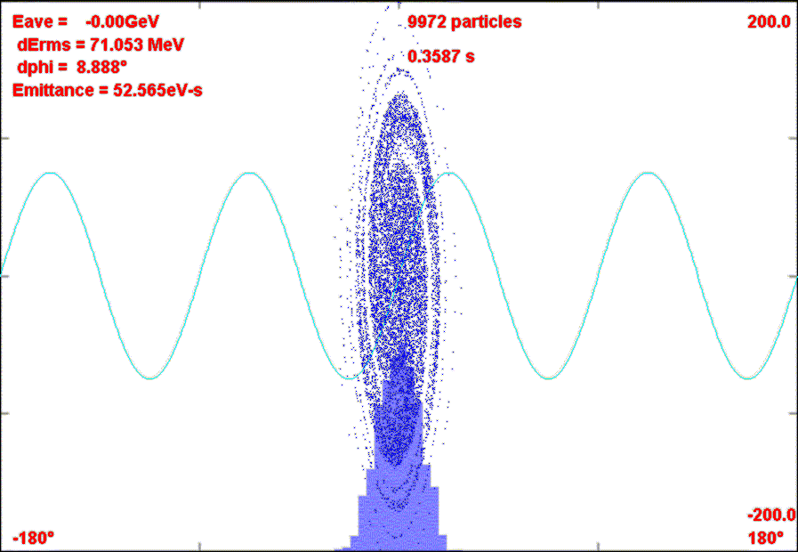
Rebunching in Accumulator/Debuncher
Momentum stack 6 Booster batches directly in Accumulator (i.e. reverse direction)
Capture in 4 kV h=1 RF System.
Transfer to Debuncher
Phase Rotate with 40 kV h=1 RF in Debuncher
Recapture with 200 kV h=4 RF system
σ_{t}~40 ns

Slide 18
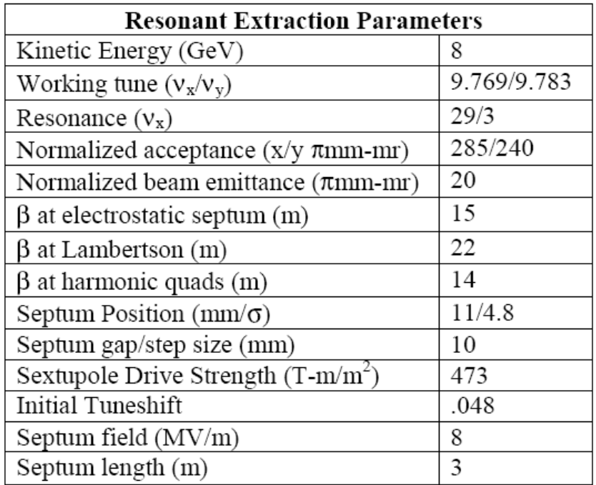
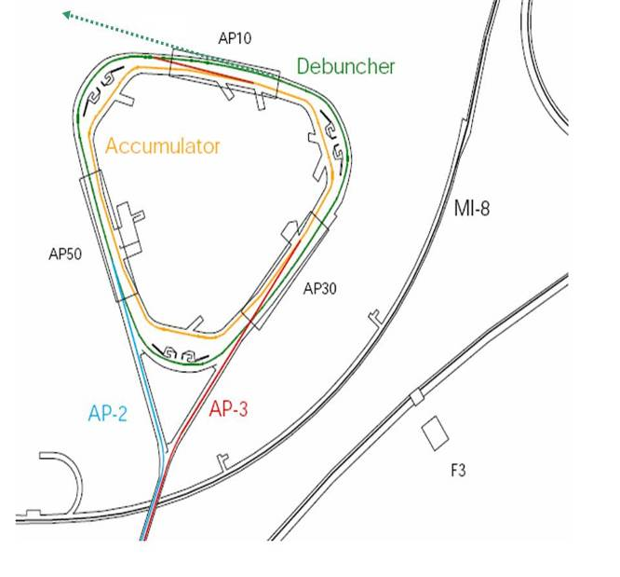
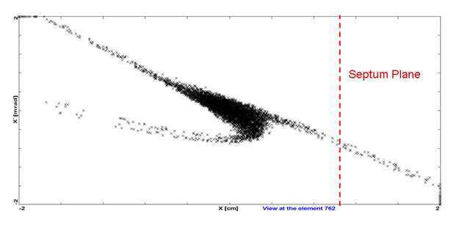
Resonant Extraction
Exploit 29/3 resonance
Extraction septum and Lambertson similar to Main Injector
  Septum: 80 kV/1cm x 3m
  Lambertson+C magnet ~.8T x 3m

Slide 19
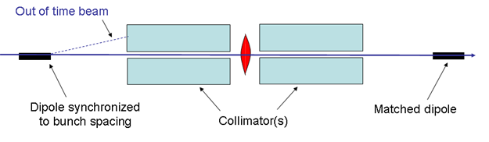
Beam Extinction
Need 10⁻⁹
Get at least ~10⁻³ from beam bunching
Remainder from AC Dipole in beam line
Working with Osaka (FNAL+US-Japan funds) to develop AC dipole design, as well as explore measurement options

Slide 20
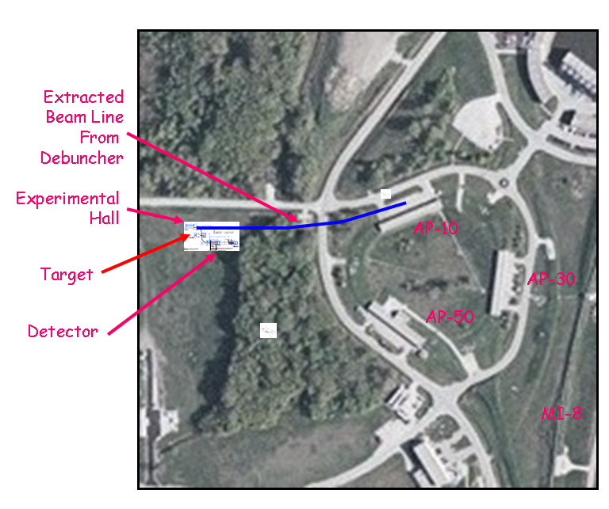
Proposed Location
Requires new building.
Minimal wetland issues.
Can tie into facilities at MiniBooNE target hall.

Slide 21
Cost and Time Scale
A detailed cost estimate of the MECO experiment had been done just before it was cancelled*
  Solenoids and cryogenics: $58M
  Remainder of experimental apparatus: $27M
Additional Fermilab costs have not been worked out in detail, but are expected to be on the order of $10M.
Hope to begin Accelerator work along with NOvA upgrades
  ~2010 (or 2011 if Run II extended)
Based on the original MECO proposal, we believe the experiment could be operational within five years from the start of significant funding
  Driven by magnet construction.
  ~2014
With the proposed beam delivery system, the experiment could collect the nominal 4x10²⁰ protons on target in about one to two years, with no impact on NOvA
  NOvA rate limited by Main Injector
*Costs in 2005 dollars, including contingency

Slide 22
Mu2e and Project X
We have described the initial phase of mu2e, which is based on the proposed data sample of 4x10²⁰ protons.
  90% C.L. limit of R_{μe}<6x10⁻¹⁷ (improvement over existing limit of more than 4 orders of magnitude).
The Project X linac would provide roughly a factor of ten increase in flux.
Slow extraction directly from Recycler ruled out by Project X Working Group
  Will need to load beam from Recycler to Accumulator as we are planning to do for Phase I
A preliminary scheme to exploit this additional flux will be included in our proposal.

Slide 23
Mu2e and Muon Collider/Neutrino Factory
There are a number of synergies between this project and muon cooling efforts
  The Debuncher beam could be extracted in a single turn to produce the short, intense bunch needed by muon production experiments
  Muon cooling studies have increased the understanding of solenoidal transport.
  It is possible that a “helical cooling channel”, of the sort envisioned for muon cooling, could generate a significantly higher muon yield for this experiment.
We will investigate these in more detail for the proposal.
A combination of increased flux from Project X and a more efficient muon transport line could potentially result in a sensitivity as low as 10⁻¹⁸

Slide 24
Experimental Challenges for Increased Flux
Achieve sufficient extinction of proton beam.
  Current extinction goal directly driven by total protons
Upgrade target and capture solenoid to handle higher proton rate
Improve momentum resolution for the ~100 MeV electrons to reject high energy tails from ordinary DIO electrons.
Operate with higher background levels.
Manage high trigger rates
  All of these efforts will benefit immensely from the knowledge and experience gained during the initial phase of the experiment.
If we see a signal a lower flux, can use increased flux to study in detail
  Precise measurement of R_{μe}
  Target dependence
  Comparison with μ→eγ rate

Slide 25
Required Resources for Proposal
~$100K of FESS time
  for a preliminary cost estimate of the experimental facility and beam line civil construction
~1/2 FTE beam line design expert
  to produce a preliminary design of the primary proton line, including extinction channel
~1/2 FTE of ES&H radiation safety expert
  to help us produce a plan to deal with the increased flux in the pBar enclosure (VERY important!)
~1/2 FTE of a TD magnet expert
  to evaluate the MECO magnet design, and advise of possible improvements.
A dedicated postdoc and guest scientist position
  Focus on Monte Carlo work.
  Could also be supplemented with PPD resources

Slide 26
Conclusions
The mu2e experiment is an opportunity for Fermilab to make an important measurement
  In the initial phase (without project X) we would either
    Reduce the limit for R_{μe} by more than four orders of magnitude (R_{μe}<6x10⁻¹⁷ @ 90% C.L.)
    OR
    Discover unambiguous proof of Beyond Standard Model physics
This experiment benefits greatly from both the voluminous work done for the MECO proposal and by fortuitous configuration and availability of Fermilab accelerator components.
With a combination of Project X and/or improved muon transport, we could either
  Extend the limit by up to two orders of magnitude
  OR
  Study the details of new physics

Slide 27
Backup Slides

Slide 28
Momentum Stacking
Inject a newly accelerated Booster batch every 67 mS onto the low momentum orbit of the Accumulator
The freshly injected batch is accelerated towards the core orbit where it is merged and debunched into the core orbit
Momentum stack 3-6 Booster batches
Energy
T=0
1st batch is injected onto the injection orbit
T<66ms
1st batch is accelerated to the core orbit
T=67ms
2nd Batch is injected
T<133ms
2nd Batch is accelerated
T=134ms
3rd Batch is injected

Slide 29
Rebunching Scheme
Accumulator
  Momentum stack 1 to 6 booster batches
  Adiabatically bunch at h=1- 4kV
    500ns gap for kicker
    Some beam/halo cleaning in Acc and transfer
    Adiabatic easier at γ_{T}=5.5
  Transfer to Debuncher
Debuncher
  h=1 90-degree phase rotation at fixed voltage
    40kV - 0.007s
  Capture and store at h=4
    ~200 to 250 kV ~0.02s; σ_{τ} = 42ns
    Beam halo cleaning also ….

Slide 30
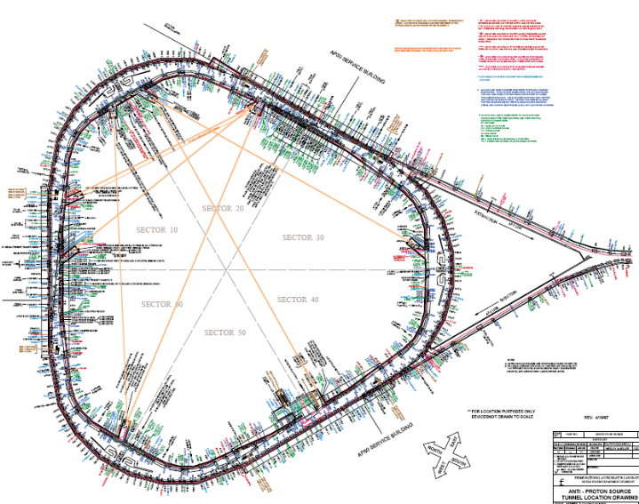
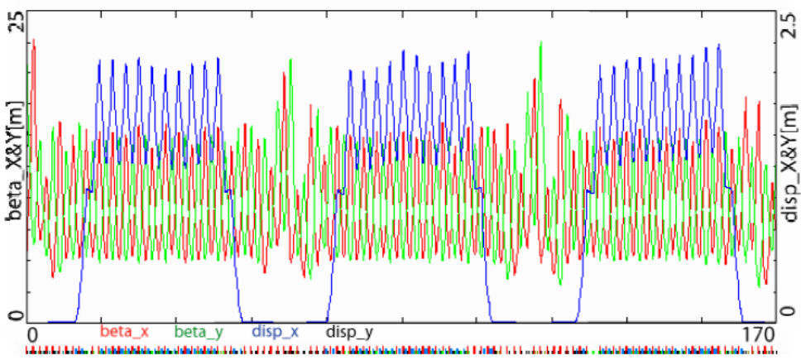
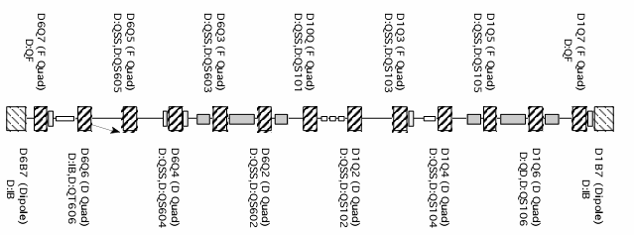
Attractive Features of Debuncher
Large Acceptance
Low chromaticity
Long, dispersion-free segments
Lots of open straight sections after cooling hardware removed
Problem:
  Getting protons there

Slide 31
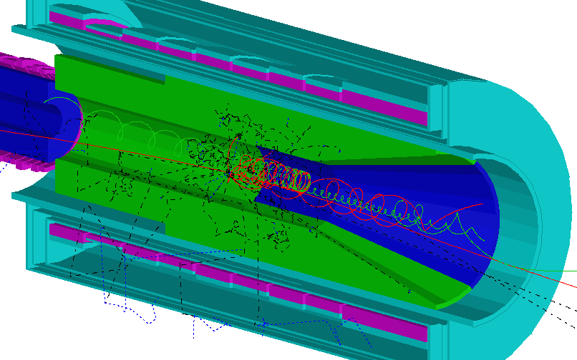
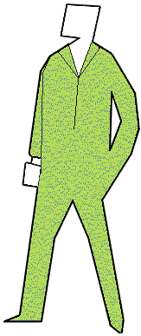
Production Region
Axially graded 5 T solenoid captures pions and muons, transporting them toward the stopping target
Cu and W heat and radiation shield protects superconducting coils from effects of 50kW primary proton beam
Superconducting coils
2.5 T
Proton Beam
Production Target
Heat & Radiation Shield
5 T

Slide 32
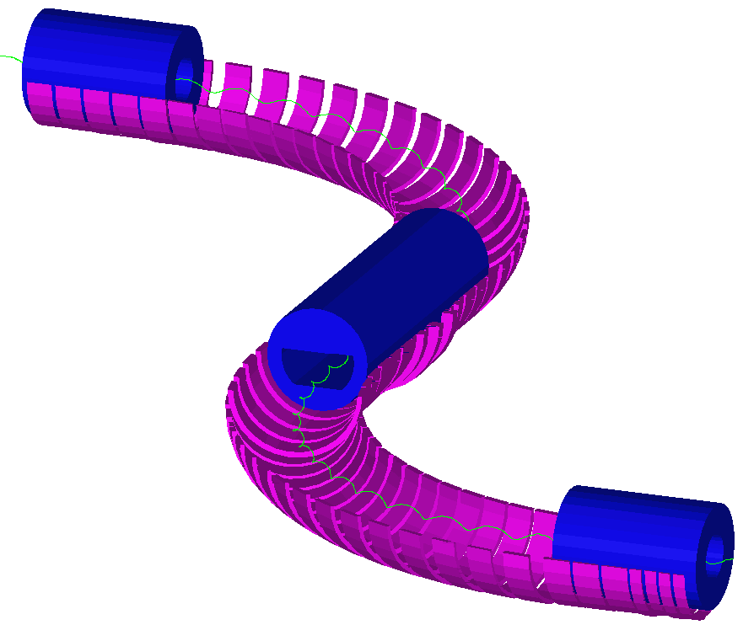
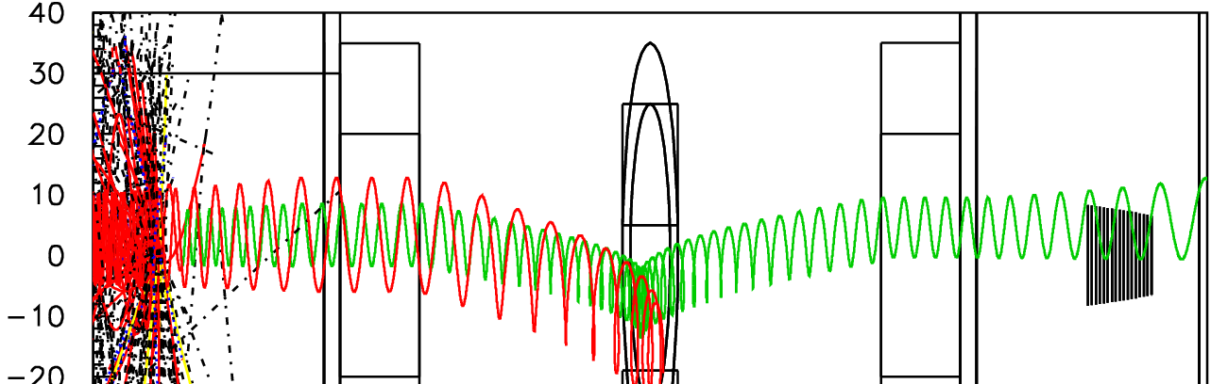
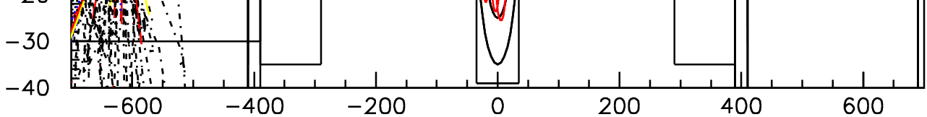
Transport Solenoid
Curved solenoid eliminates line-of-sight transport of photons and neutrons
Curvature drift and collimators sign and momentum select beam
dB/ds < 0 in the straight sections to avoid long transit time trajectories
2.1 T
Collimators
2.5 T
Curvature Drift

Slide 33
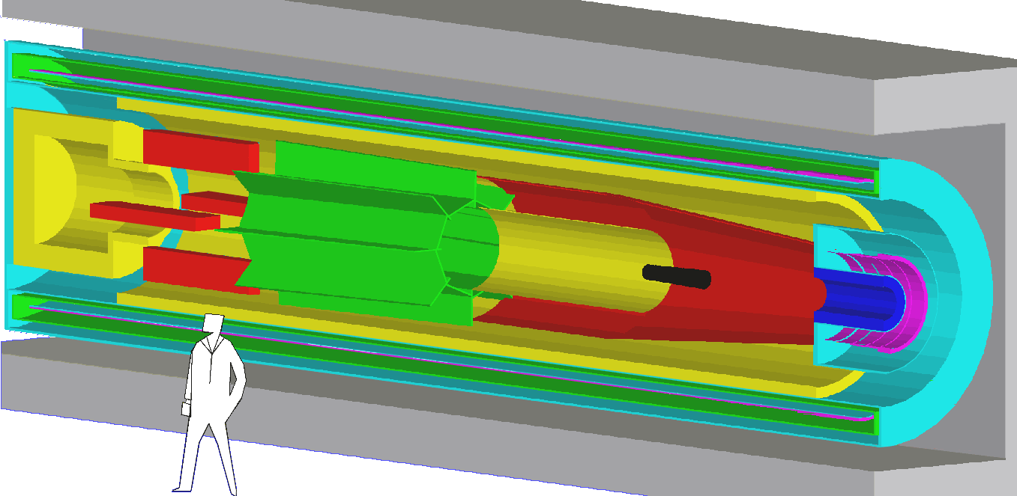
Detector Region
Axially-graded field near stopping target to increase acceptance and reduce cosmic ray background
Uniform field in spectrometer region to simplify momentum analysis
Electron detectors downstream of target to reduce rates from γ and neutrons
Electron Calorimeter
Straw Tracking Detector
Stopping Target Foils
1 T
1 T
2 T

Slide 34
Expected Sensitivity of the MECO Experiment
We expect ~ 5 signal events for 10⁷ s (2800 hours) running if R_{μe} = 10⁻¹⁶
Contributions to the Signal Rate | Factor
Running time (s) | 10⁷
Proton flux (Hz) (50% duty factor, 740 kHz micropulse) | 4 ×10¹³
μ entering transport solenoid / incident proton | 0.0043
μ stopping probability | 0.58
μ capture probability | 0.60
Fraction of μ capture in detection time window | 0.49
Electron trigger efficiency | 0.90
Fitting and selection criteria efficiency | 0.19
Detected events for R_{μe} = 10⁻¹⁶ | 5.0

Slide 35
Expected Background in MECO Experiment
We expect ~ 0.45 background events for 10⁷ s running with sensitivity of ~ 5 signal events for R_{μe} = 10⁻¹⁶
Source | Events | Comments
μ decay in orbit | 0.25 | S/N = 20 for R_{μe} = 10⁻¹⁶
Tracking errors | < 0.006
Radiative μ decay | < 0.005
Beam e⁻ | < 0.04
μ decay in flight | < 0.03 | Without scattering in stopping target
μ decay in flight | 0.04 | With scattering in stopping target
π decay in flight | < 0.001
Radiative π capture | 0.07 | From out of time protons
Radiative π capture | 0.001 | From late arriving pions
Anti-proton induced | 0.007 | Mostly from π⁻
Cosmic ray induced | 0.004 | Assuming 10⁻⁴ CR veto inefficiency
Total Background | 0.45 | Assuming 10⁻⁹ inter-bunch extinction

