Slide 1
Getting Beam to mu2e*
Eric Prebys, AD/Proton Source
*This is essentially a dramatically shortened version of Dave McGinnis’ wine and cheese talk on 9/15 (http://theory.fnal.gov/jetp/talks/mcginnis.pdf)

Slide 2
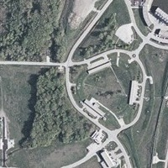
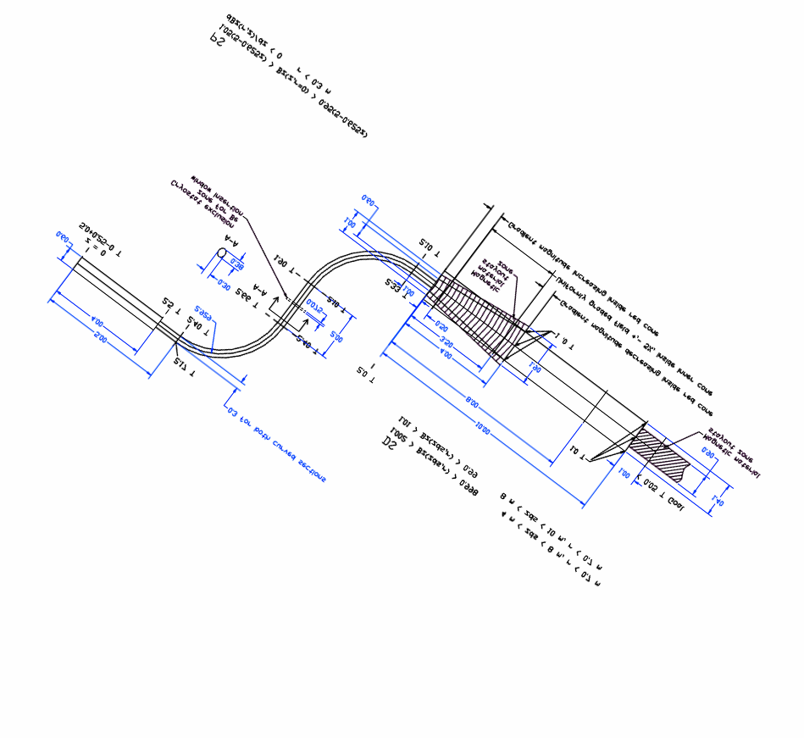
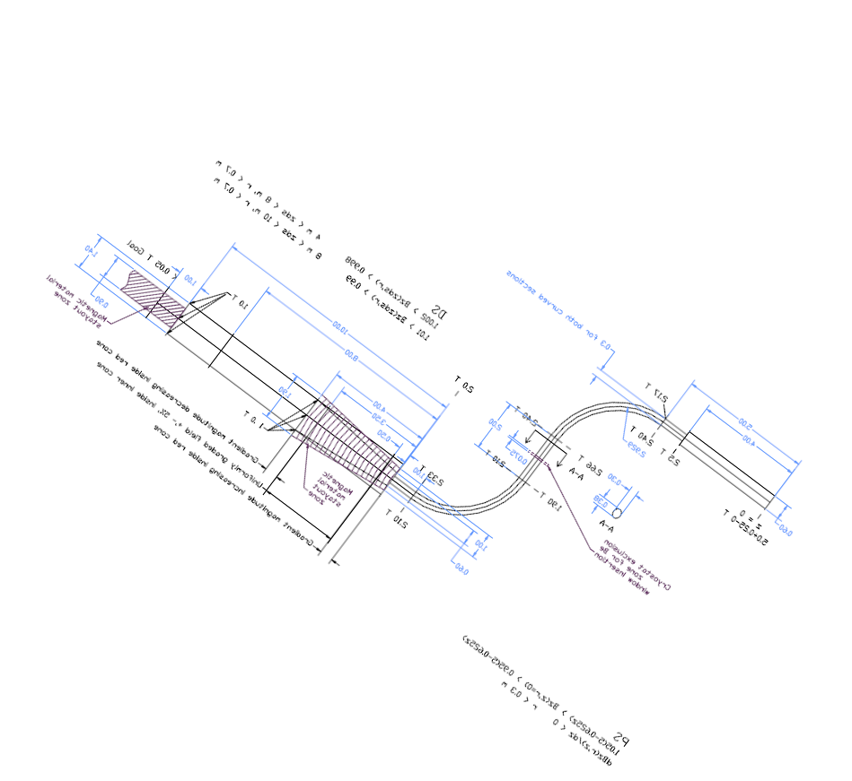
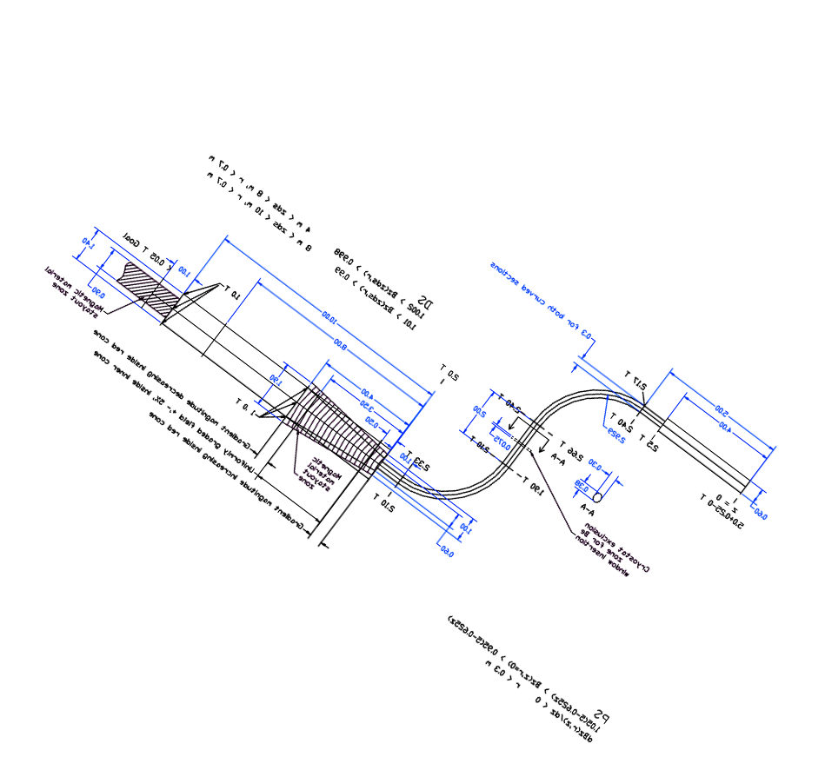
Location of Mu2E target and Detector
Detector
Booster Ring
Giese Road
Target
AP-10
AP-30
AP-50
Extracted
Beam Line
From
Debuncher
Debuncher/
Accumulator
Ring
MI-8

Slide 3
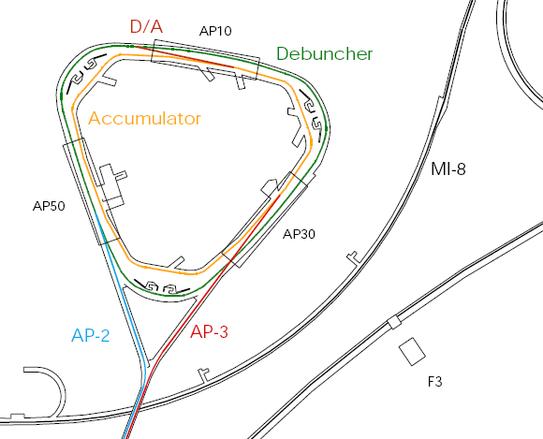
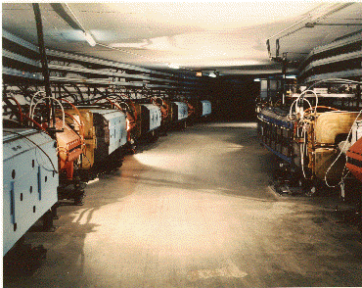
Present Operation of Debuncher/Accumulator
Protons are accelerated to 120 GeV in Main Injector and extracted to pBar target
pBars are collected and phase rotated in the “Debuncher”
Transferred to the “Accumulator”, where they are cooled and stacked
Antiproton capabilities not needed after collider program
Not used in SNuMI I

Slide 4
SNuMI II Operation (“McGinnis scheme”)
New AP4 line built to inject 8 GeV protons directly from Booster to accumulator, where they are momentum stacked.
New AP5 line used to extract protons to Recycler, where they are boxcar stacked while the Main Injector is ramping.
Recycler load transferred to Main Injector, where it is accelerated to 120 GeV for neutrino program.
Debuncher NOT used.
AP4 Line
A-D Line

Slide 5
Momentum Stacking
Inject in a newly accelerated Booster batch every 67 mS onto the low momentum orbit of the Accumulator
The freshly injected batch is accelerated towards the core orbit where it is merged and debunched into the core orbit
Momentum stack 3-4 Booster batches
Energy
T=0
1st batch is injected onto the injection orbit
T<66ms
1st batch is accelerated to the core orbit
T=67ms
2nd Batch is injected
T<133ms
2nd Batch is accelerated
T=134ms
3rd Batch is injected

Slide 6
Mu2e Modification
Momentum stacked beam is transferred from the Accumulator to the Debuncher in a new transfer line (A-D line)
Beams is rebunched in Debuncher into a single, short (~200 ns) bunch.
Beam is slow extracted to experiment
Result: a train of short pulses separated by one Accumulator revolution (~1.6 usec) – perfect for mu2e
AP4 Line
A-D Line
AP5 Line

Slide 7
Mu2e and SNUMI
22 batches = 1. 467s MI cycle
Booster Batches
NEUTRINO PROGRAM
MUONS
4.6×10¹² p/batch
Accumulator
(NuMI +Muons)
Recycler
56 ×10¹² p/sec
(NuMI)
Debuncher
(Muons)
4×4.6×10¹² p/1467ms = 12.5 ×10¹² p/sec
(Alternative: 24 batches=1.6s MI cycle→ 11.5 ×10¹² p/s)
0.1s
1.367s

Slide 8
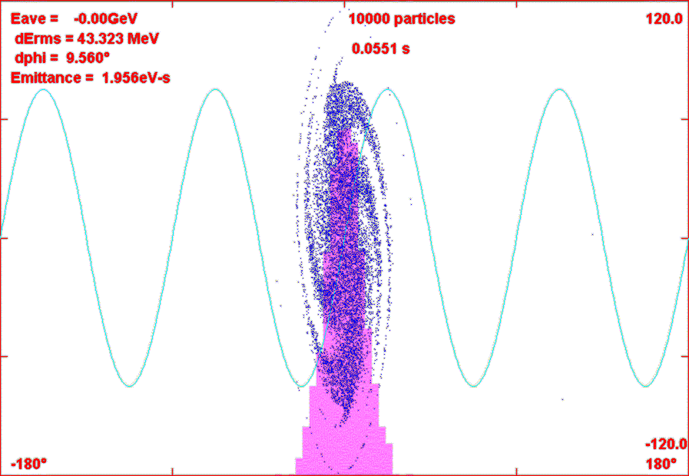
Beam Bunching for mu2e
Bunch beam to a fraction of the Debuncher circumference
  < ~200ns of 1700ns
Keep beam leakage outside that bunch length to a minimum
Debuncher timings are similarto MECO/BNL
Develop most effective/efficient bunching scheme
  barrier bucket
  Multi-harmonic
Will need a fast kicker in the Debuncher ring to further clean gap.
Multi-harmonic example
  rf multi-harmonic buncher
    Example: h=1, V_{rf}=30kV; h=2, Vrf = 15kV, h=3, V_{rf} =10kV
    h=4: 7.5 →50kV (to hold compressed beam)
  0.055s for bunching

Slide 9
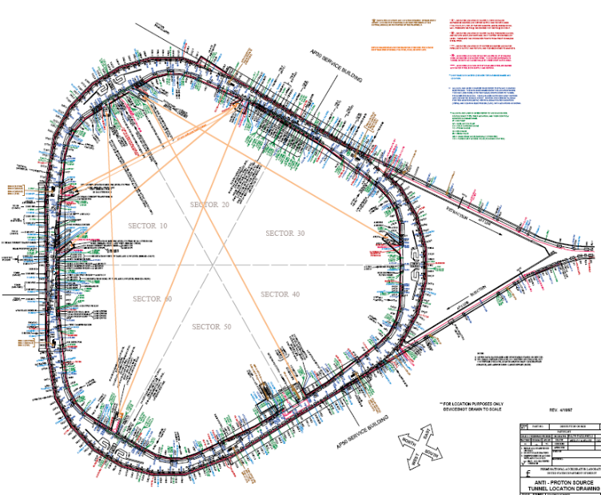
Resonant Slow Extraction
options:
MI/TeV style septum
- 80kV/1cm field region
- 3 m long
Wide aperture C magnet
- ~.8 T
- 2 m
D4Q3
D4Q2
D50Q
D5Q2
Short version of MI style Lambertson
- ~ .8T field region
- +- 5” extraction aperture
- 1 m long
Extraction scheme appears workable
Studying details of resonance generation
  Also comparing 2nd integer vs. 3rd integer
Extraction loss a worry
  ~ 500W loss with typical (2-3%) resonant extraction inefficiencies
  Must be considered from the beginning in the design

Slide 10
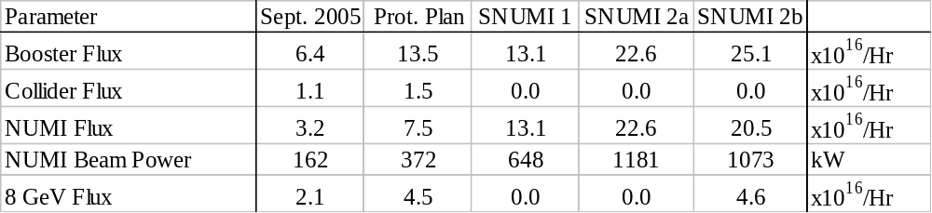
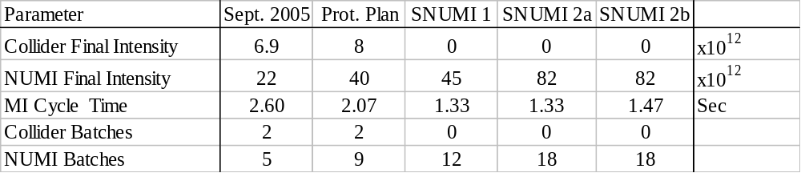
Booster Throughput Scenarios
All the proton upgrades rely on increased Booster throughput
Four years running → 5 × 10²⁰ protons → 1.3 × 10¹⁸ stopped muons

Slide 11
Extinction
The desired extinction factor of 109 is challenging
Still in the brainstorming phase
Probably several stages
  Bunch formation
  Gap cleaning kicker (once?, multiple?)
  Resonant extraction manipulation
    AC quads?
    Electron lens?
  Beamline elements
    RF cavities?
    AC dipoles?
Needs a lot more thought

Slide 12
Shielding Issues
Present anti-proton rate in pBar tunnel
  ~15e10 pbar/hr
Proton rate for SNuMI II
  ~2.3-2.5e17 protons/hr
Mu2e protons
  Additional 15%
  Total protons 15Hz*5e12*3600 = 2.7e17 pph =96 kW
Bad news
  This is almost 2 million times the current antiproton rate in this enclosure!
  An uncontrolled beam loss of 1W/m => 99.5% efficiency!
Good news
  Mu2e represents a fairly small perturbation on SNuMI
  Would definitely implement solution for full 15 Hz Booster output anyway as part of SNuMI II
  There “appears to be a solution” for SNuMI II
    Interlocked radiation detectors
    Area reclassification (fence?)

Slide 13
Conclusions
We have a conceptual scheme to produce an 8 GeV proton beam appropriate for a m to e conversion experiment in the style of MECO.
This scheme assumes that the lab pursues the proposed “SNuMI II” option for the neutrino program.
There is a lot of work to be done!

