Slide 1


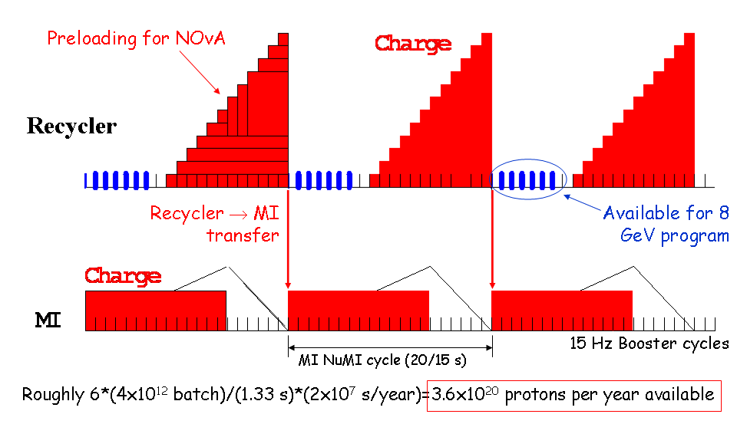
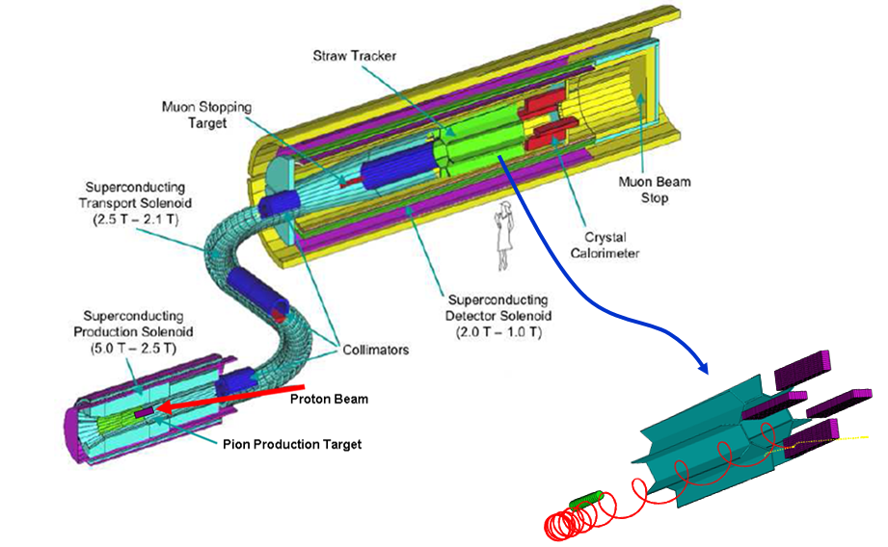
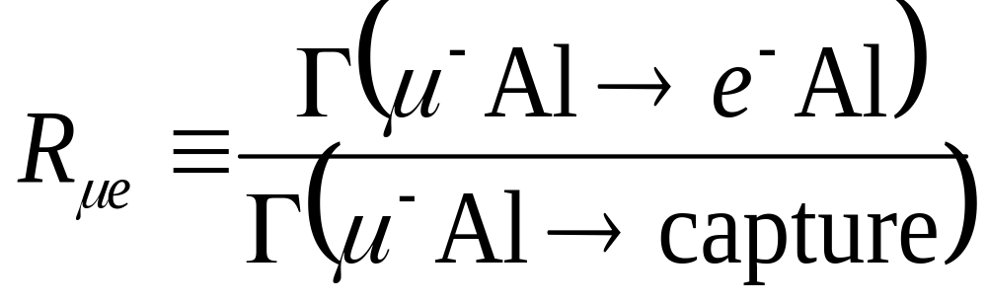
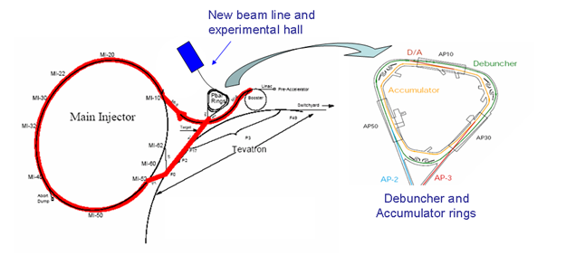
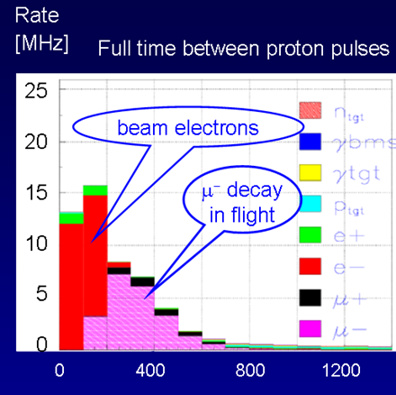
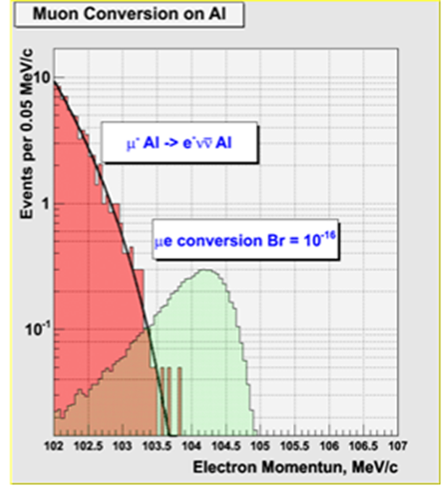
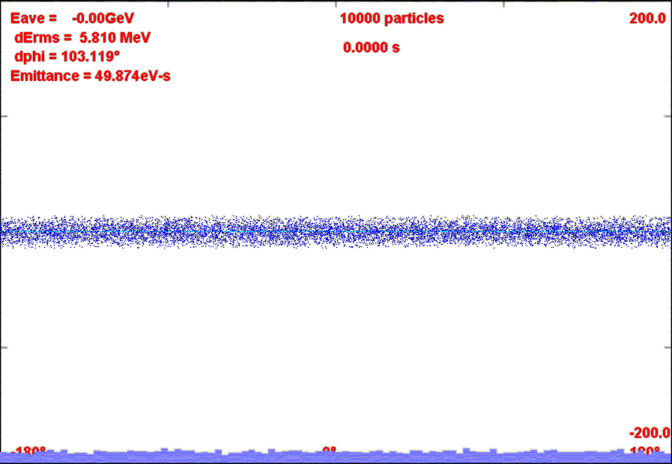
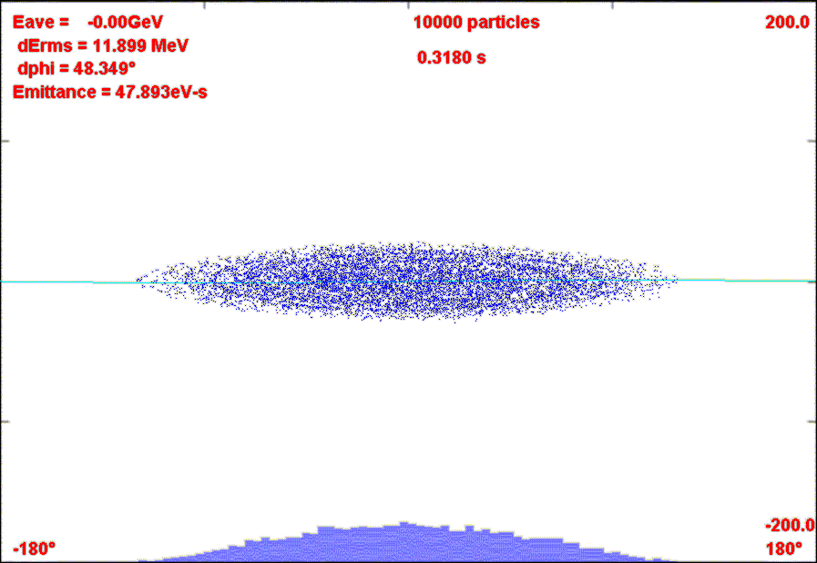
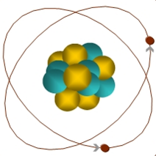
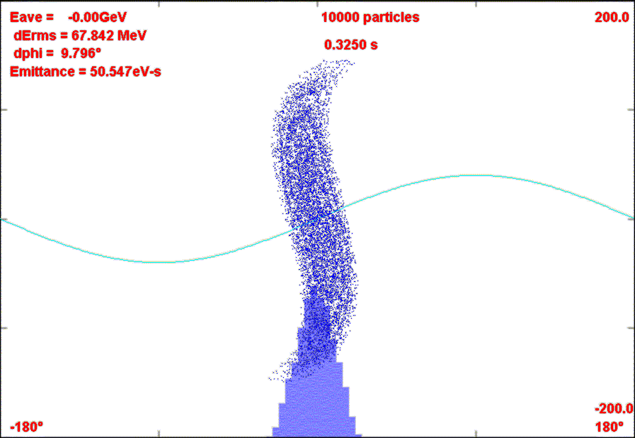
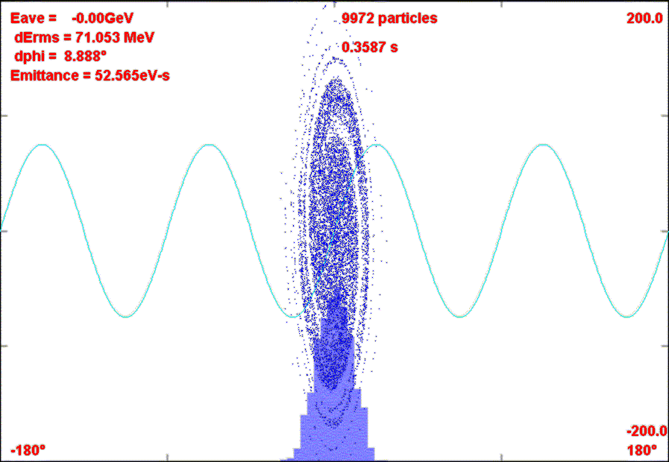
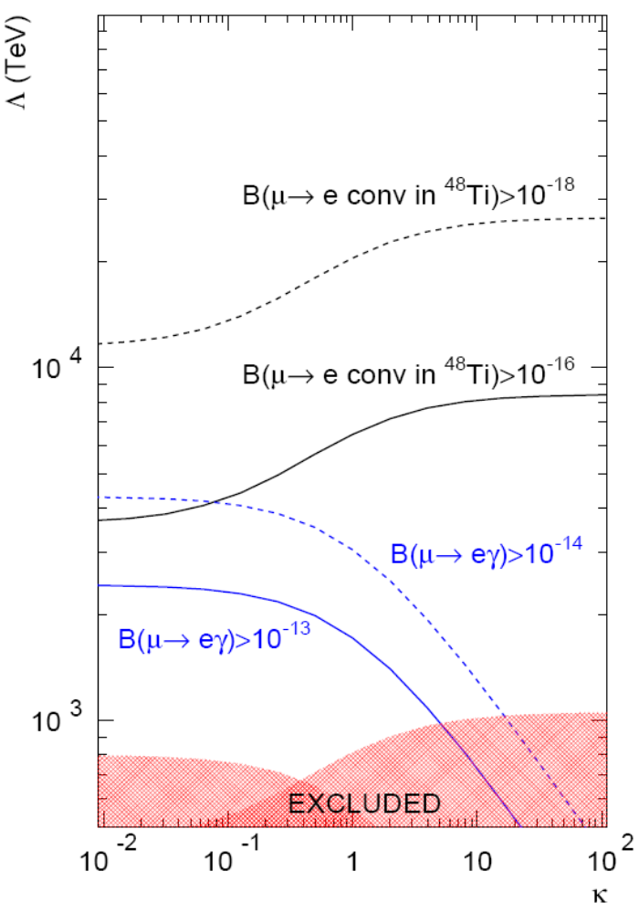
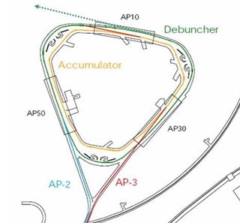
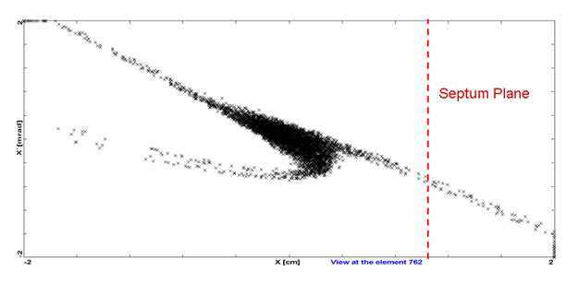
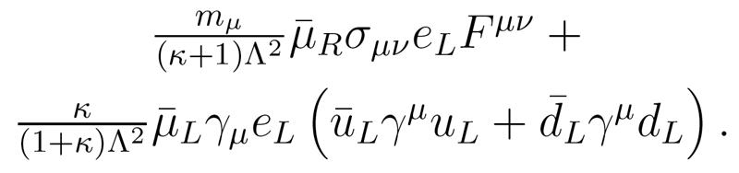
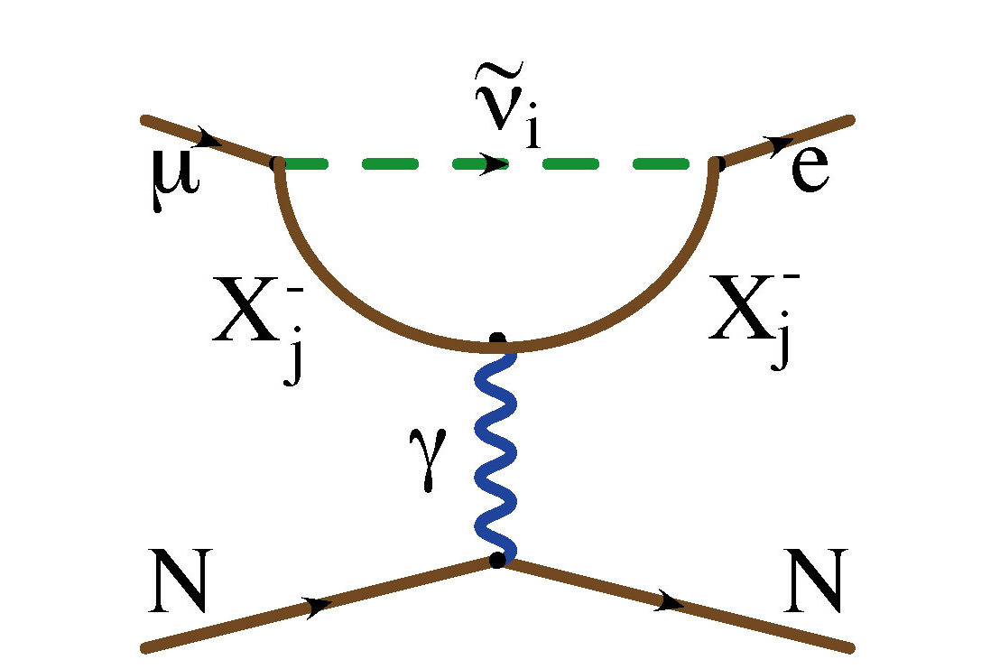
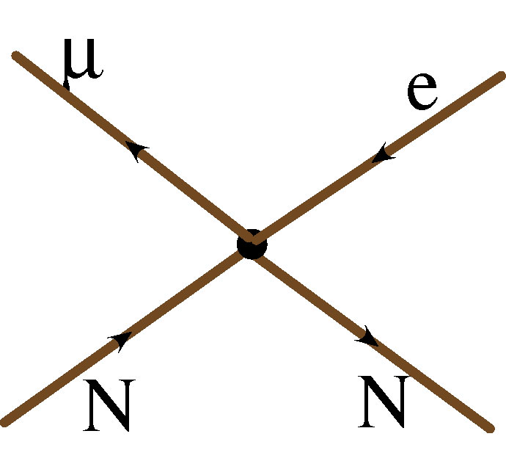
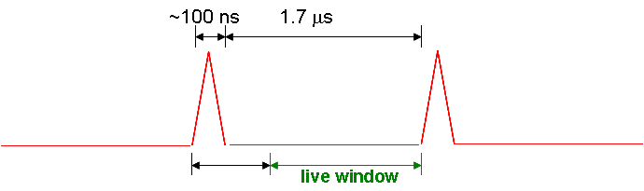
Mu2e Experiment at Fermilab
Mu2e Collaboration: 50 Scientists at
Boston University, Brookhaven National Laboratory, University of California (Berkeley), Fermi National Accelerator Laboratory, Idaho State University, University of Illinois (Urbana-Champaign), Institute for Nuclear Research (Moscow, Russia), University of Massachusetts (Amherst), Muons Inc., Syracuse University, University of Virginia
Goals
Initial Phase (MECO design, No Project X):
  Exploit NOvA accelerator modifications and post-Run II availability of Accumulator and Debuncher rings to mount a μ->e conversion experiment patterned after MECO
    4x10²⁰ protons in ~2 years
    Measure
    Single event sensitivity of R_{μe}=2x10⁻¹⁷
    90% C.L. limit of R_{μe}<6x10⁻¹⁷
    ANY signal = Beyond Standard Model physics
Ultimate goal
  Exploit Project X and improved muon transport to achieve dramatically increased sensitivity
    If no signal: set limit R_{μe}<1x10⁻¹⁸
    If signal: measure target dependence, etc
Beam Delivery
Mu2e (MECO) Detector
Excess Proton Availablity in NOvA Era:
Protons to Accumulator/Debuncher (“Boomerang Scheme”):
MI-8 -> Recycler done for NOvA
Recycler
(Main Injector Tunnel)
New switch magnet extraction to P150 (no need for kicker)
Rebunching in Accumulator/Debuncher:
Muon to Electron Conversion
live window
R_{μe} = 10⁻¹⁶ gives 5 events for 4x10²⁰ protons on target
0.4 events background, half from out of time beam, assuming 10⁻⁹ extinction
  ~Half from tail of coherent decay in orbit
  ~Half from prompt
Occurs in SM through virtual neutrino mixing (R_{μe}~10⁻⁵⁵)
Very common feature of Beyond Standard Model Physics
Similar to μ→eγ, but
  No combinatorial background
  Sensitive to other types of physics
Momentum stack 6 Booster batches directly in Accumulator (i.e. reverse direction)
Capture in 4 kV h=1 RF System.
Transfer to Debuncher
μ
Status and Outlook
Working toward Proposal in Fall ’08
Will consider potential upgrades
  Project X: up to 10 times proton flux.
  Improved muon transport channel based on muon cooling concepts
Challenges
  Increased intensity in Accumulator /Debuncher
  Target heating
  Better beam extinction
  Detector rate and resolution
Potential
  R_{μe} ~ 10⁻¹⁸
  OR
  Study new physics!
105 MeV e⁻
Phase Rotate with 40 kV h=1 RF in Debuncher
Recapture with 200 kV h=4 RF system
σ_{t}~40 ns
Slow Extractions
?
?
?
Delivered Beam
MEGA
Sindrum II
Inter-bunch “extinction” ~10⁻⁹
κ

