Slide 1
Accumulator/Debuncher as Versatile Proton Facility
Eric Prebys/FNAL-AD

Slide 2
Motiviation
If the proposed Proton Source upgrades are moderately successful, there will be excess 8 GeV proton capacity even in the NOvA era
  Up to 33 kW (~5e20 protons/year)
Problem
  because the Booster lattice magnets are in a rapid cycling resonant circuit (i.e. no flat top), we are extremely limited as the beam structure we can provide
    53 MHz with some ability to bunch rotate and control total batch length
Specific need: Muon to Electron Conversion (mu2e, formerly MECO)
  Wants ~4E20 protons
  Short (<200 ns) bunches separated by 1-2 μsec
    Not available from Booster

Slide 3
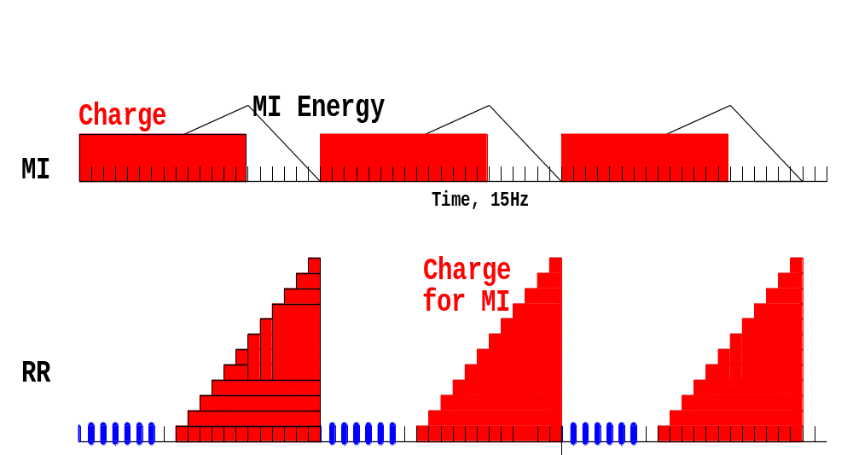
MI 1.33sec=20 Booster Pulses
Notes:
Test

Slide 4
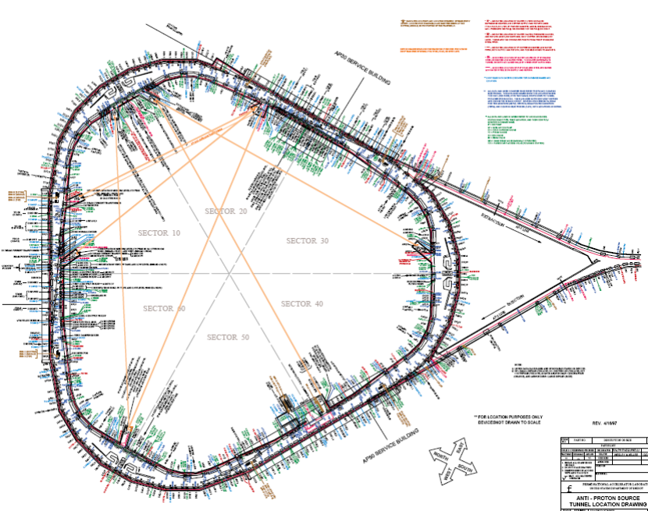
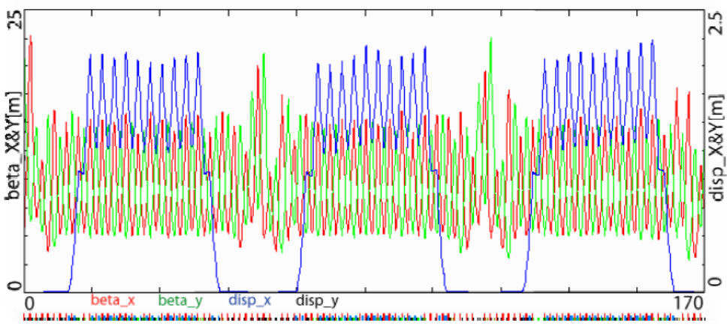
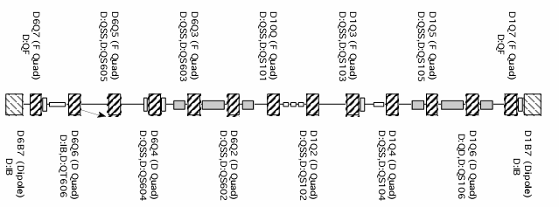
Attractive Features of Debuncher
Large Acceptance
Low chromaticity
Long, dispersion-free segments
Lots of open straight sections after cooling hardware removed
Problem:
  Getting protons there

Slide 5
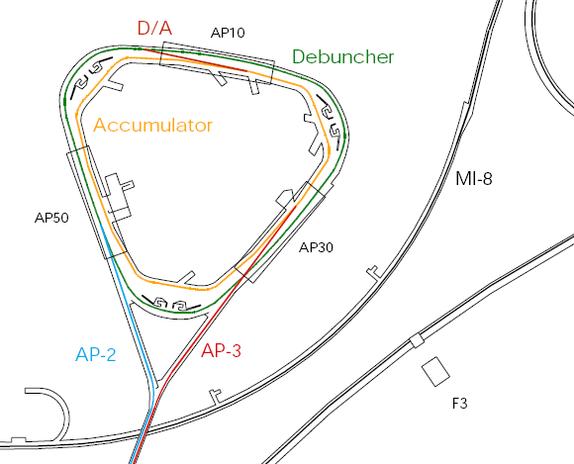
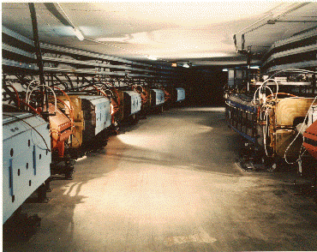
Present Operation of Debuncher/Accumulator
Protons are accelerated to 120 GeV in Main Injector and extracted to pBar target
pBars are collected and phase rotated in the “Debuncher”
Transferred to the “Accumulator”, where they are cooled and stacked
Antiproton capabilities not needed after collider program
Not used in SNuMI I

Slide 6
Original Proposal: Add-on to SNuMI (McGinnis) Scheme
New AP4 line built to inject 8 GeV protons directly from Booster to accumulator, where they are momentum stacked.
New AP5 line used to extract protons to Recycler, where they are boxcar stacked while the Main Injector is ramping.
Recycler load transferred to Main Injector, where it is accelerated to 120 GeV for neutrino program.
Could put some protons in Debuncher
Problems:
  SNuMI not particularly likely at this point
  If SNuMI happens, there won’t be excess protons
AP4 Line
A-D Line

Slide 7
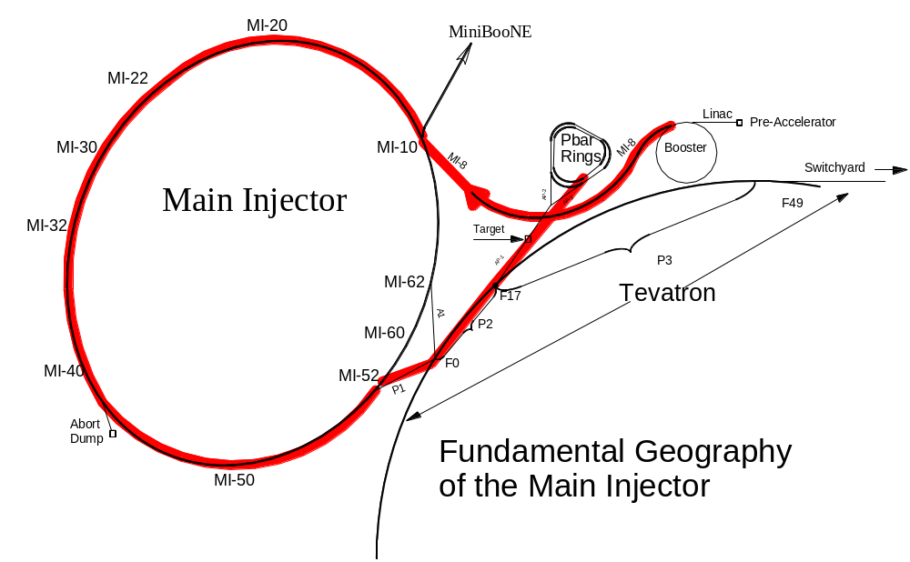
Recycler “Boomerang Scheme” (Ankenbrandt and Popovic)
MI-8 to Recycler will be built for NOvA
Recycler
(Main Injector Tunnel)
Existing “reverse proton” path
Minor beamline modifications
NO civil construction!!
New Extraction (doesn’t need to be fast)
Notes:
Test

Slide 8
Momentum Stacking
Inject in a newly accelerated Booster batch every 67 mS onto the low momentum orbit of the Accumulator
The freshly injected batch is accelerated towards the core orbit where it is merged and debunched into the core orbit
Momentum stack 3-4 Booster batches
Energy
T=0
1st batch is injected onto the injection orbit
T<66ms
1st batch is accelerated to the core orbit
T=67ms
2nd Batch is injected
T<133ms
2nd Batch is accelerated
T=134ms
3rd Batch is injected

Slide 9
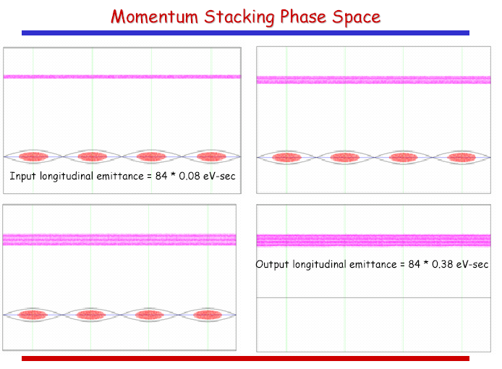
Longitudinal stacking in the Accumulator
ΔE_{full} = 20 MeV

Slide 10
Hybrid scheme
Accumulator
  Momentum stack 1 to 6 booster batches
  Adiabatically bunch at h=1- 4kV
    500ns gap for kicker
    Some beam/halo cleaning in Acc and transfer
    Adiabatic easier at γ_{T}=5.5
  Transfer to Debuncher
Debuncher
  h=1 90-degree phase rotation at fixed voltage
    40kV - 0.007s
  Capture and store at h=4
    ~200 to 250 kV ~0.02s; σ_{τ} = 42ns fairly long bunch
    Beam halo cleaning also ….

Slide 11
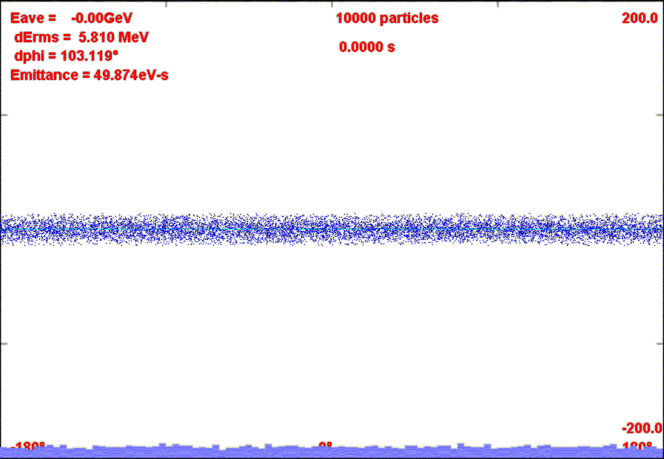
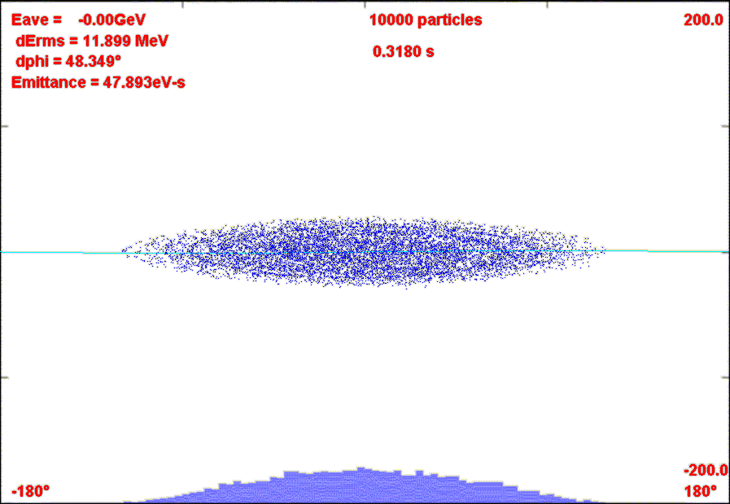
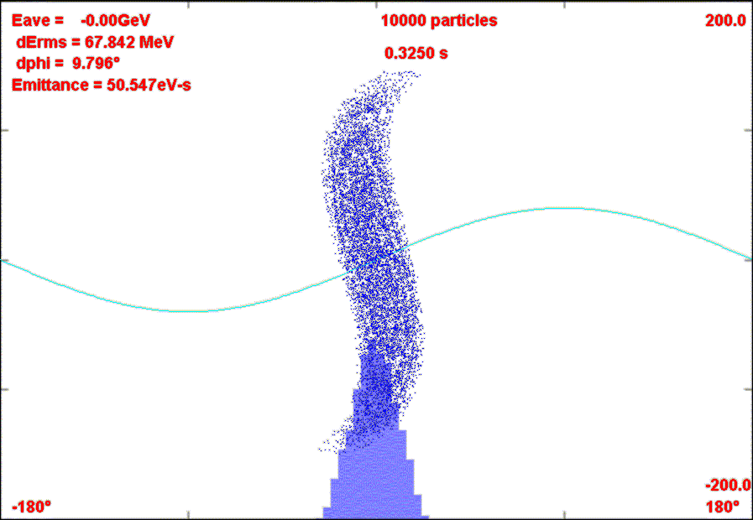
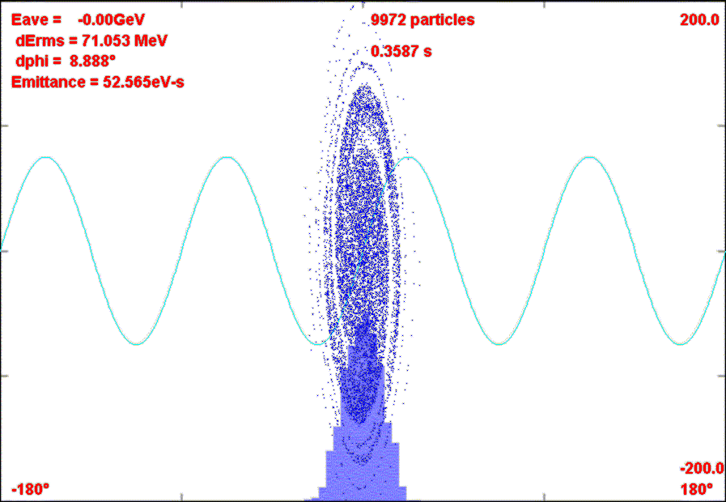
Bunch, Rotate, Store scenario

Slide 12
Resonance driver placement
Consideration
  Want to arrange drivers in groups, with the magnets in each group separated by ~multiples of π in 27θ.
  Really only need two groups, but for the moment will work with three because of the natural symmetry of the Debuncher.
Choose
  Six locations just inside of the ’07 quads at the ends of the straight sections
Pairs indicated by color

Slide 13
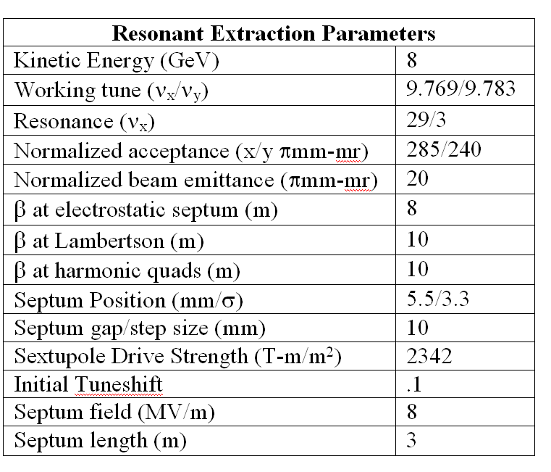
Basic Resonant Extraction Parameters
Close to 29/3
Large Acceptance
A bit tight: will need to bump beam over prior to extraction

Slide 14
Other Possibilities
Single turn extraction for Muon Cooling experiments (mentioned by A. Jansson)
Great flexibility in beam structure for other experiments
Accelerator physics facility, particularly during experiment construction.
In Project X era, can inject protons from Recycler for up to ~5 times more protons.

Slide 15
Summary
With small effort, we can adapt the Accumulator/Debuncher as a versatile proton facility.
This would allow Fermilab to pursue the compelling physics of muon to electron conversion.
Has potential for other uses
Further reading
  Miller, Prebys, et al, “Expression of Interest: Muon to Electron Conversion Experiment at Fermilab”, FERMILAB-TM-2389-AD-E (and supporting references)
  Mu2e Collaboration Meeting talks
    https://indico.fnal.gov/conferenceDisplay.py?confId=1072

