Slide 1
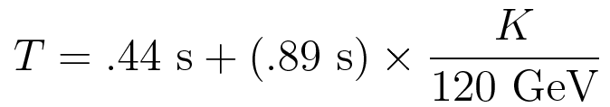
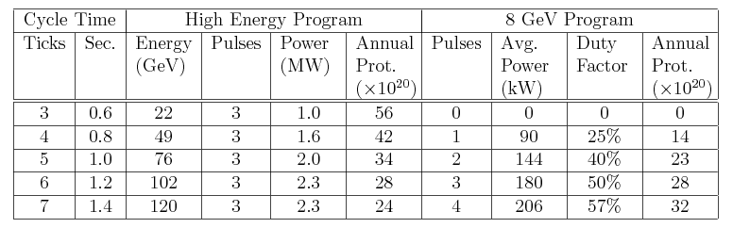
Background: Proton Economics in Project X Era*
Assume
  9mA*1ms = 5.3x10¹³ protons/linac “blast”
  Main Injector ramp time⁺ =
NOT simply linear!
Assuming no stretcher ring
*Prebys and Ankenbrandt, ProdDev-DOC-334
⁺R. Zwaska, FNAL-BEAMDOC-2393

Slide 2
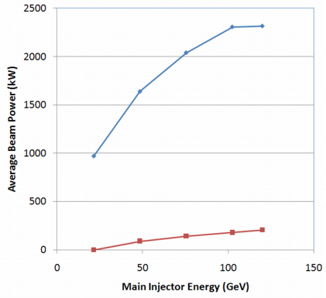
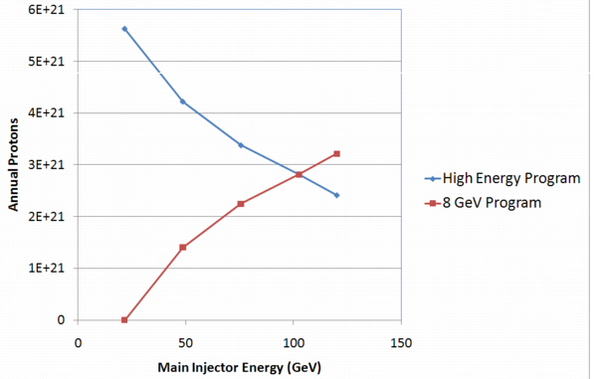
Power and Protons

Slide 3
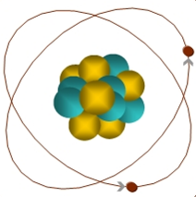
Muon-to-Electron Conversion: μ+N → e+N
When captured by a nucleus, a muon will have an enhanced probability of exchanging a virtual particle with the nucleus.
This reaction recoils against the entire nucleus, producing the striking signature of a mono-energetic electron carrying most of the muon rest energy
μ
105 MeV e⁻
Similar to μ→eγ, with important advantages:
  No combinatorial background
  Because the virtual particle can be a photon or heavy neutral boson, this reaction is sensitive to a broader range of BSM physics
Relative rate of μ→eγ and μN→eN is the most important clue regarding the details of the physics

Slide 4
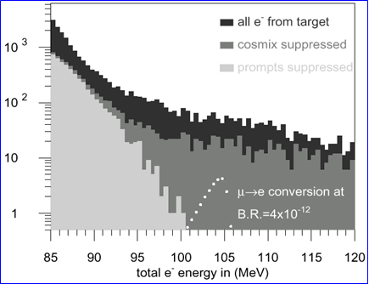
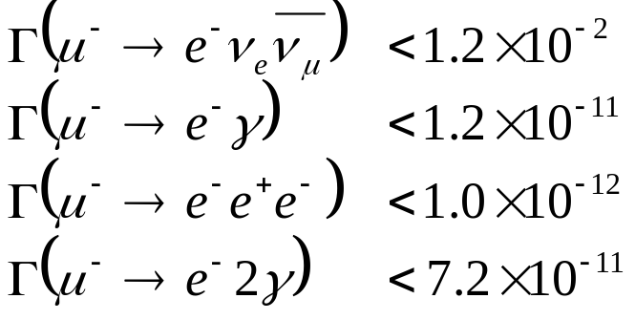
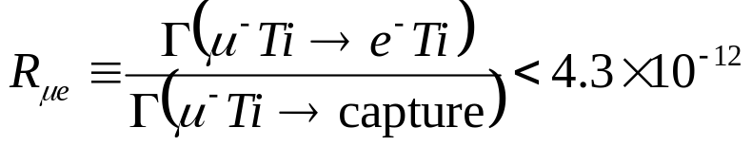
Previous muon decay/conversion limits (90% C.L.)
μ−>e Conversion: Sindrum II
LFV μ Decay:
High energy tail of coherent Decay-in-orbit (DIO)
Rate limited by need to veto prompt backgrounds!

Slide 5
Mu2e (MECO) Philosophy
Eliminate prompt beam backgrounds by using a primary beam with short proton pulses with separation on the order of a muon life time
Design a transport channel to optimize the transport of right-sign, low momentum muons from the production target to the muon capture target.
Design a detector to strongly suppress electrons from ordinary muon decays
~100 ns
~1-2 μs
Prompt backgrounds
live window

Slide 6
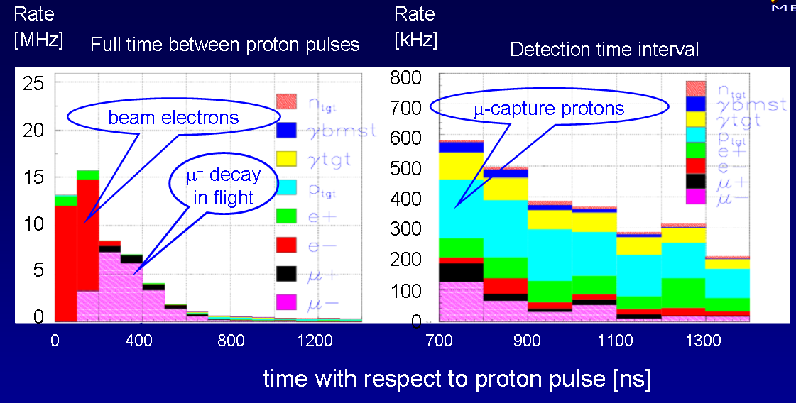
Beam Related Rates
Cut ~700 ns after pulse to eliminate most serious prompt backgrounds.

Slide 7
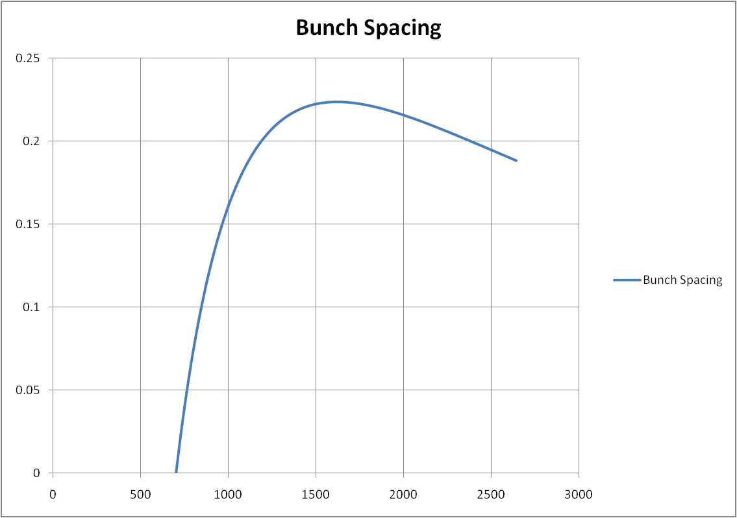
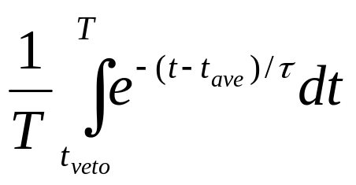
Beam Needs
Bunch spacing
  Veto window: 700 ns
  Captured lifetime: 880 ns (Al target)
  Average arrival time: 300 ns relative to first
Rate:
  Limited by straw chambers
  ~8x10¹³ p/sec
~1.7 μsec
ns

Slide 8
Modes of running project X
Assume slow extraction by “blast”
  1 “blast” = 9mA*1ms = 5.6e13 (protons)/(1.4 s cycle)
  = 4e13 p/s on average (!!)
  = 50 kW average beam power
  = 8e20/yr (2e7 seconds)
Compare to baseline proposal
  6*4e12 protons/(1.33 s NOvA cycle) = 1.8e13 p/s on average
  = 23 kW average beam power = 3.6e20
Modes of operation considered
  All “extra” blasts, extracted one at a time
    1 blast in 200 ms (sharing) = 14% duty factor
    4 in 800 ms = 57% duty factor
    2 blasts in 800 ms (timeline hog) = 57% duty factor, 50% “usage factor”
    1 blast in 800 ms (super hog) = 57% duty factor, 25% usage factor
4/23/08

Slide 9
Rates under various scenarios
Rate limit comes from straw chamber singles rate
Assume we cannot push it much higher than the MECO proposal (500 kHz during live window)
  Assume factor of ~2
Mode | Duty Factor | Peak Rate |  |  |  | Average Rate
 |  | protons/s | kW | rel to MECO | Rel. w/stretch | kW | p/year | rel. to MECO
MECO | 50% | 4.0E+13 | 51 | 1.00 | - | 26 | 4.0E+20 | 1.00
Phase 1 | 100% | 1.8E+13 | 23 | 0.45 | 0.45 | 23 | 3.6E+20 | 0.90
1 in 200ms | 14% | 2.8E+14 | 360 | 7.03 | 0.98 | 51 | 8.0E+20 | 2.01
4 in 800ms | 57% | 2.8E+14 | 360 | 7.03 | 4.01 | 206 | 3.2E+21 | 8.04
2 in 800ms | 57% | 1.4E+14 | 180 | 3.52 | 1.96 | 52 | 1.6E+21 | 4.02
1 in 800ms | 57% | 7.0E+13 | 90 | 1.76 | 1.00 | 51 | 8.0E+20 | 2.01

Slide 10
Conclusion
If we extract beam directly from the Recycler, then only the “super hog” mode appears to obviously benefit Mu2e
  Double the protons/yr rel. to phase 1
With a beam stretcher (assuming we get all of it), we could take an additional blast
  Quadruple rate/yr rel. to phase 1

Slide 11
BACKUP SLIDES

Slide 12
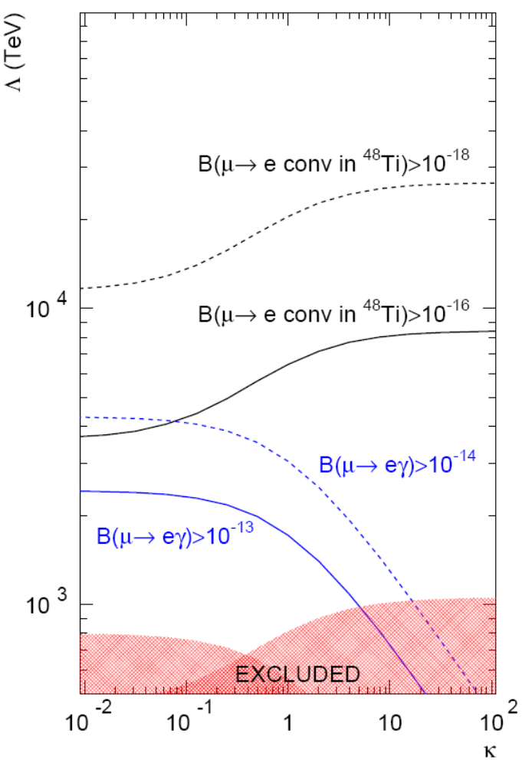
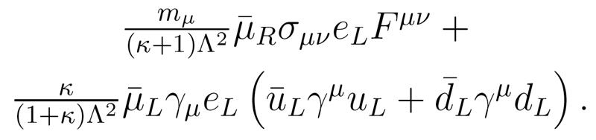
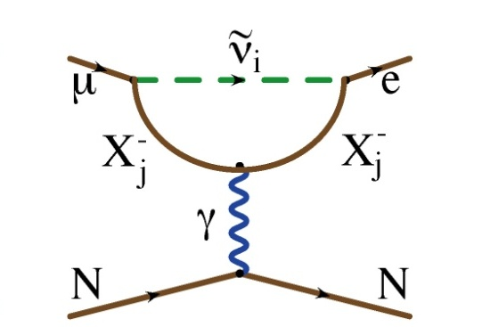
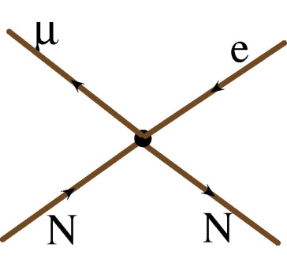
μ→e Conversion vs. μ→eγ
We can parameterize the relative strength of the dipole and four fermi interactions.
This is useful for comparing relative rates for μN→eN and μ→eγ
Courtesy: A. de Gouvea
?
?
?
MEG proposal
MEGA
Sindrum II

