Slide 1
WBS 2.08 Extinction
Independent Design Review of Mu2e
5/3/11
Eric Prebys
L3 Manager for Extinction

Slide 2
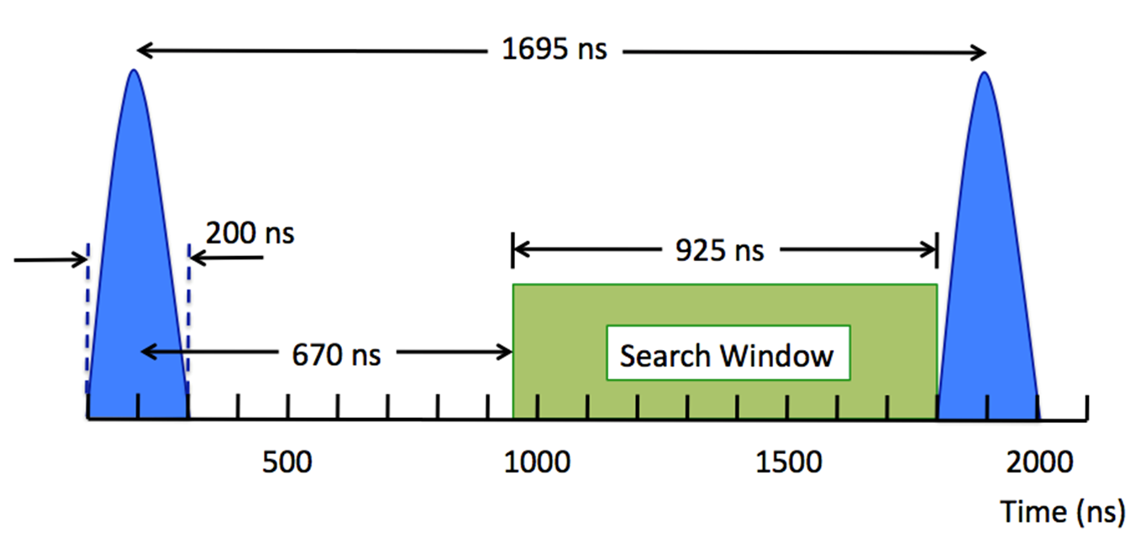
Introduction
The most important backgrounds to the Mu2e experiment are prompt with respect to the incident proton
For this reason, out of time protons must be suppressed at a level of 10⁻¹⁰ relative to in time protons.
This high level of extinction is achieved in two stages
In the Debuncher ring, prior to extraction
In the proton transport beam line
Monitoring extinction at this level will also be very challenging

Slide 3
WBS to L4
1.2.08.01 Extinction General
Overall conceptual design for extinction and extinction monitoring.
1.2.08.02 Internal Extinction System
Extinction within the Debuncher, prior to extraction
1.2.08.03 External Extinction System
Extinction in the beam line, accomplished with a system of AC dipoles and collimators
1.2.08.04 Extinction Monitoring
Monitoring of the extinction (separate talk by P. Kasper)

Slide 4
Requirements
The extinction requirements are described in Mu2e-doc-1175, posted on the review web page.
The most important background produced by out of time protons comes from radiative pion capture, in which
A pion from an out of time proton is captured on a target nucleus
The resulting decay produces a high energy photon
The photon pair converts, resulting in a electron in the signal region
For this and lesser prompt backgrounds, an extinction of 10⁻¹⁰ gives the following for 3x10²⁰ protons on target
Background Source | Events
μ⁻ decay in flight | 0.01
π⁻ decay in flight | 0.003
π⁻ radiative pion capture | 0.033
Beam electrons | 0.0006
Total | 0.047

Slide 5
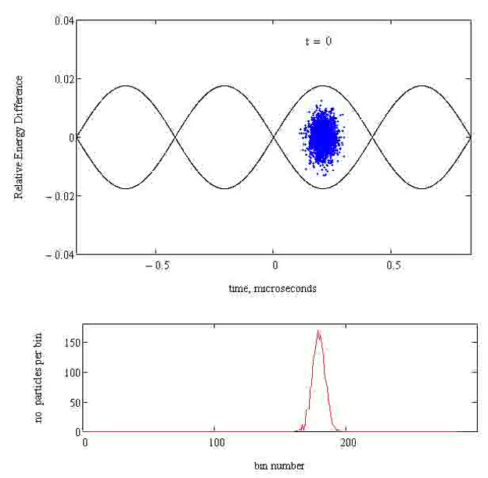
In Ring Extinction
There should be essentially no out of time beam when the single bunch is initially transferred to the Debuncher
Any out of time beam will develop during the slow extraction
Beam-gas
Space charge
RF noise
This will tend to migrate to the separatrix

Slide 6
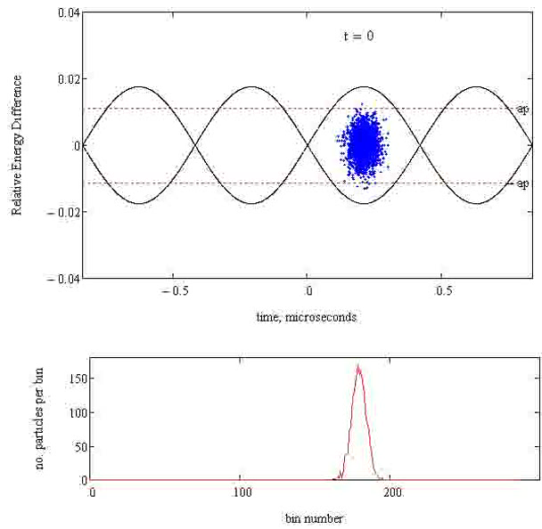
In Ring Extinction (cont’d)
The addition of momentum collimation in the Debuncher should reduce out of time beam significantly
Goal: 10⁻⁵

Slide 7
Out-of-time Beam Modeling*
The most obvious concern is DC beam, but we also have to worry about in-bucket beam
Protons near the bunch in time are more dangerous since they will be near the collimator edges during the AC Dipole sweep
A Debuncher h=4 RF system produces buckets of ~425 ns, whereas Mu2e bunch width is 200 ns
In addition to DC component diffusive tails of core bunch within the bucket may form over the ~100-150ms slow extraction
*Nick Evans

Slide 8
Sources of Tails
Several mechanisms that could lead to out-of-time beam through tail formation
Space Charge - Causes bunch growth over the course of a spill.
RF Phase Noise - Phase noise near synchrotron oscillation harmonics can lead to growth. Modeling will allow us to set limits on noise spectrum of RF system.
Intra-beam Scattering - Small energy transfer events can lead to the formation of longitudinal tails.
Beam-Gas Interactions - Energy loss through proton interactions with residual gas particles leads to longitudinal bunch growth.

Slide 9
Beam Line Extinction
General Considerations
Out of time beam may have very different transverse distribution than in time beam.
Beam line must have well defined admittance aperture which is matched to admittance of collimation channel.
Define extinction window as the time outside of which 100% of the beam will impact the extinction collimator.
Optimization Considerations
Maximize transmission efficiency of nominal bunch
Minimize cost/complexity of magnets and power supply

Slide 10
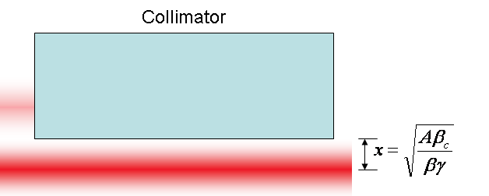
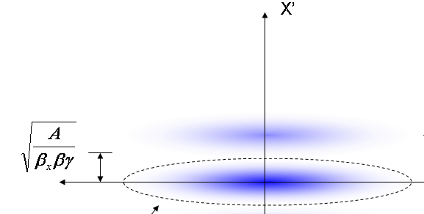
Generic Extinction Analysis*
At collimator:
Beam fully extinguished when deflection equals twice full admittance (A) amplitude
At kicker:
Angle to extinguish beam
*al la FNAL-BEAM-DOC-2925

Slide 11
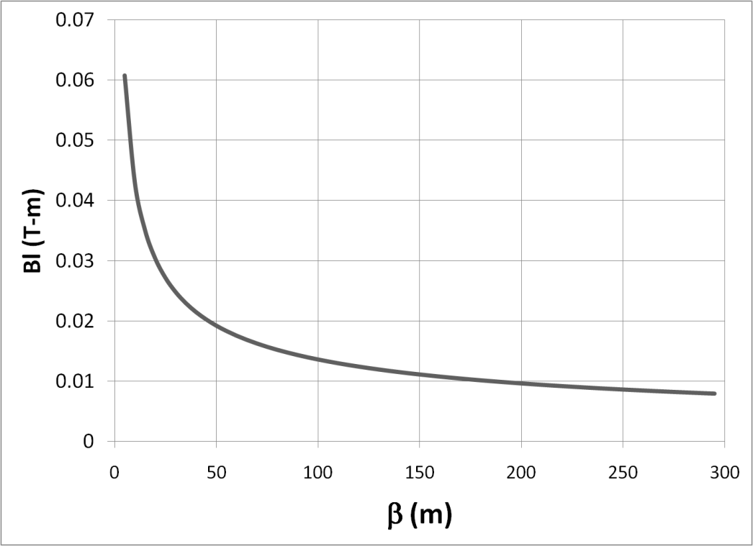
Magnet Optimization
Bend strength to extinguish:
Stored Energy:
⇒Large β_{x}, long weak magnets
- Assume β_{x}=250m, L=6m
- Factor of 4 better than β_{x}=50m, L=2m

Slide 12
Alternatives Considered
Deflection Dipole
Single frequency dipole
Nominal system in Mu2e proposal
Slewing through transmission window resulted in unacceptable transmission efficiency
Would likely require compensating dipole, which would severely impact beam line design
Broad band kicker
Beyond current state of the art
“MECO” system – three harmonic components
Lower frequency than current high frequency dipole
Additional magnet and power supply required
Inferior transmission performance

Slide 13
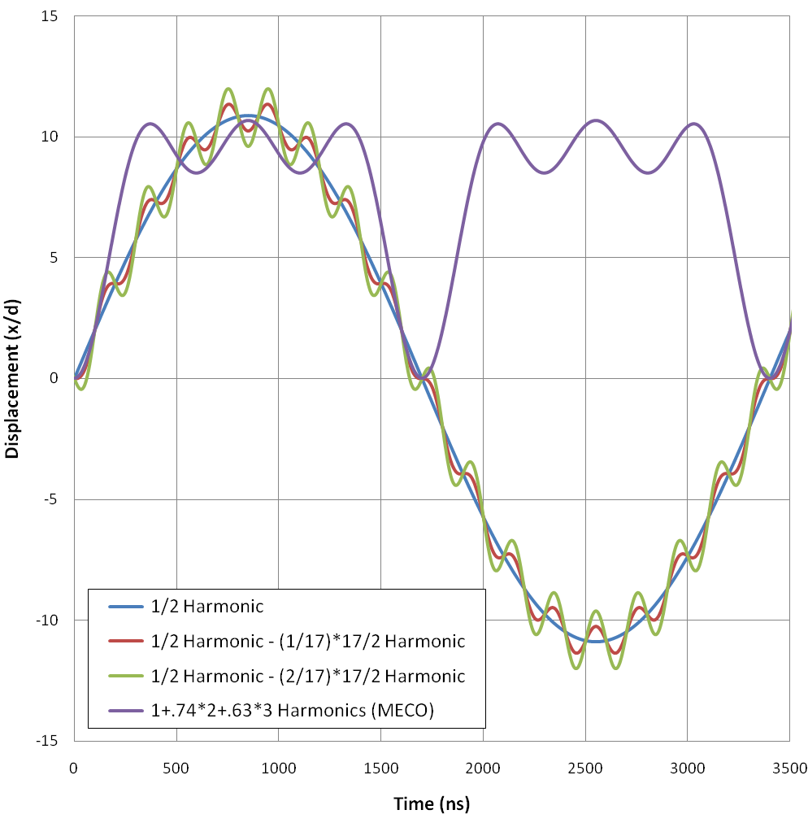
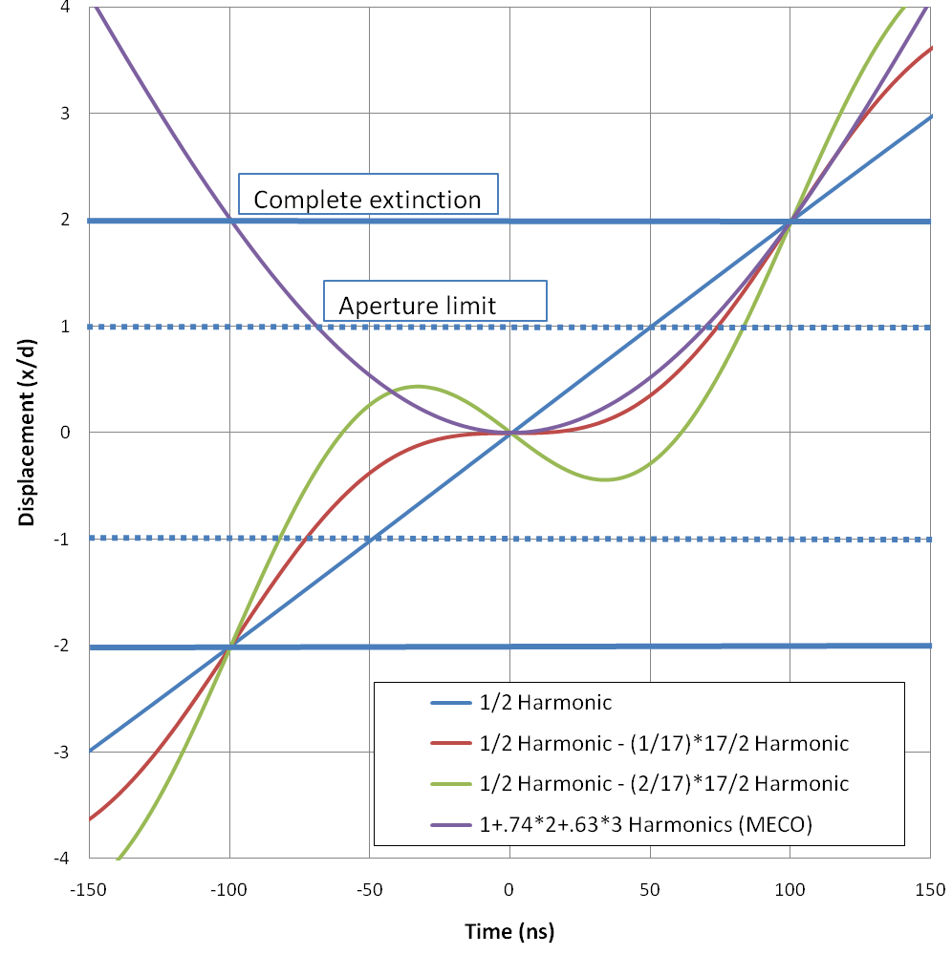
Waveform Analysis*
a)
b)
*Mu2e-DOC-552

Slide 14
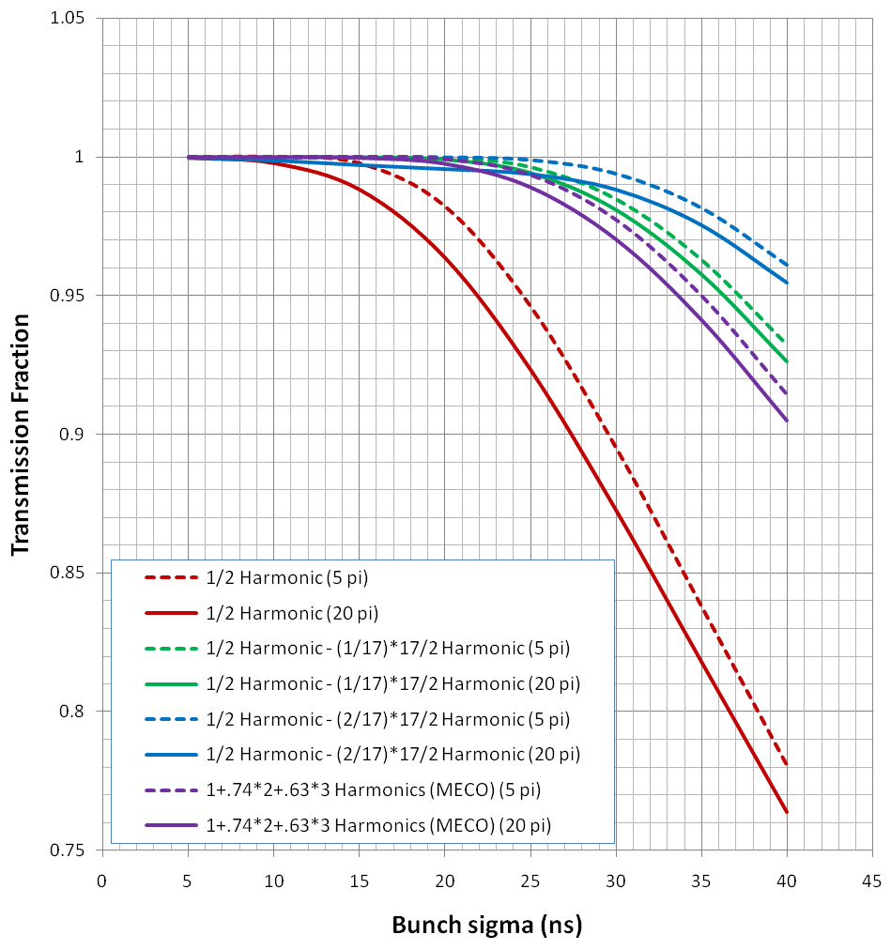
Transmission Results

Slide 15
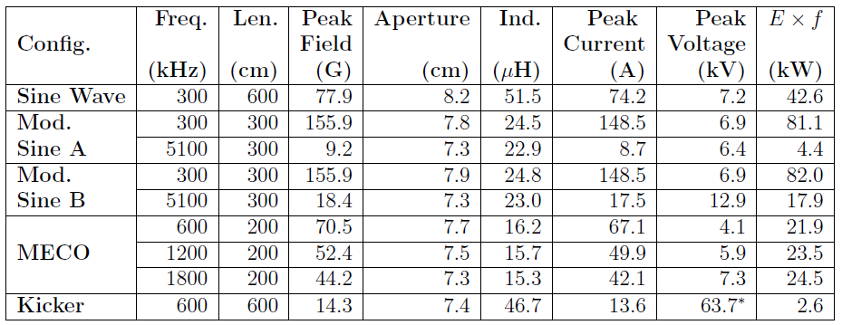
Base Line Magnet Choice
Magnet specification
Assume equal length per harmonic (6m total)
Gap in non-bend plane 1.2 cm (waist for 50π-mm-mr admittance)
Electrical parameters assume ideal magnets (μ>>μ₀)
Power = (Exf)x(2π/Q)
Pursuing Mod. Sine A as most promising, although modifying for realistic beam distribution

Slide 16
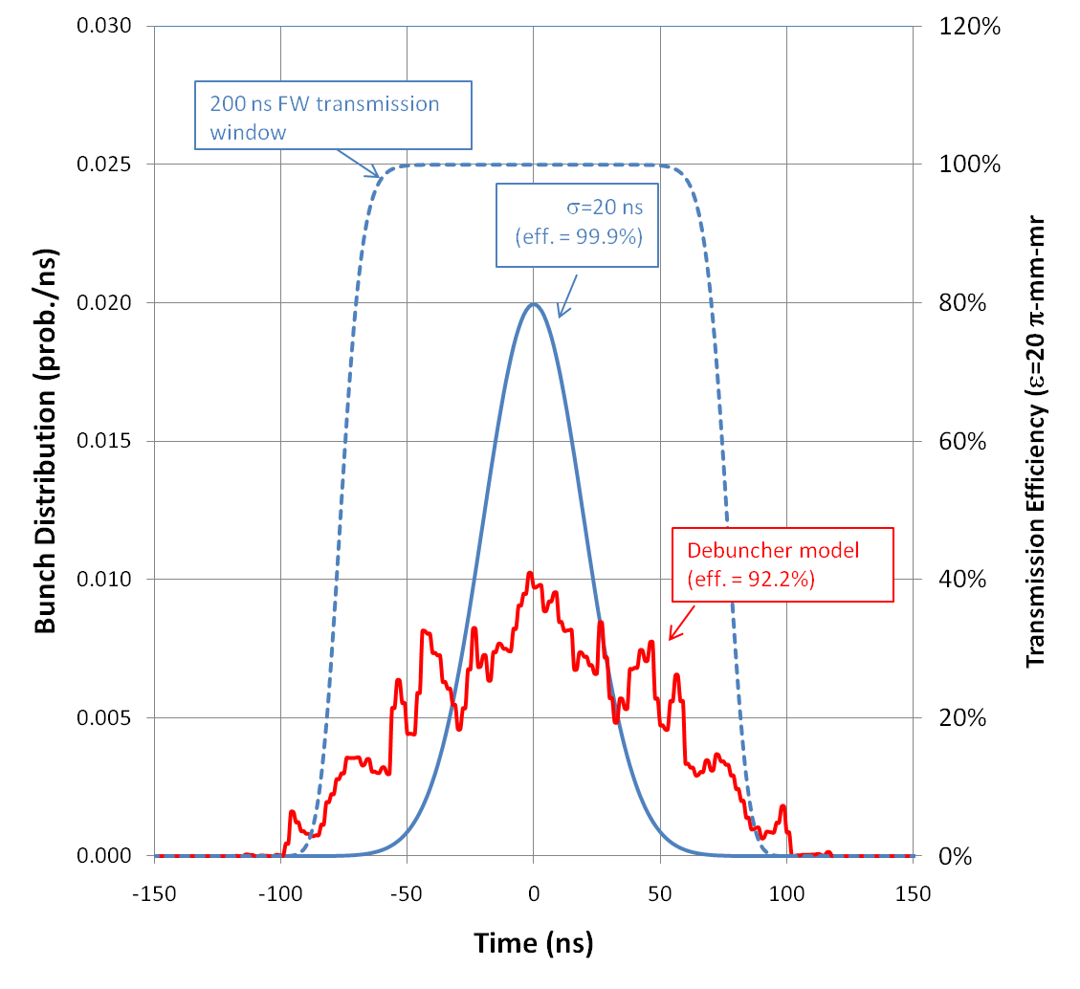
Optimization of Parameters
A more accurate model of the Debuncher produced wider distributions than were originally planned for, and the dipole parameters were subequenty reoptimized:
Solution: must go to a wider transmission window (lower harmonics)
Can also increase amplitude of high frequency component to increase efficiency

Slide 17
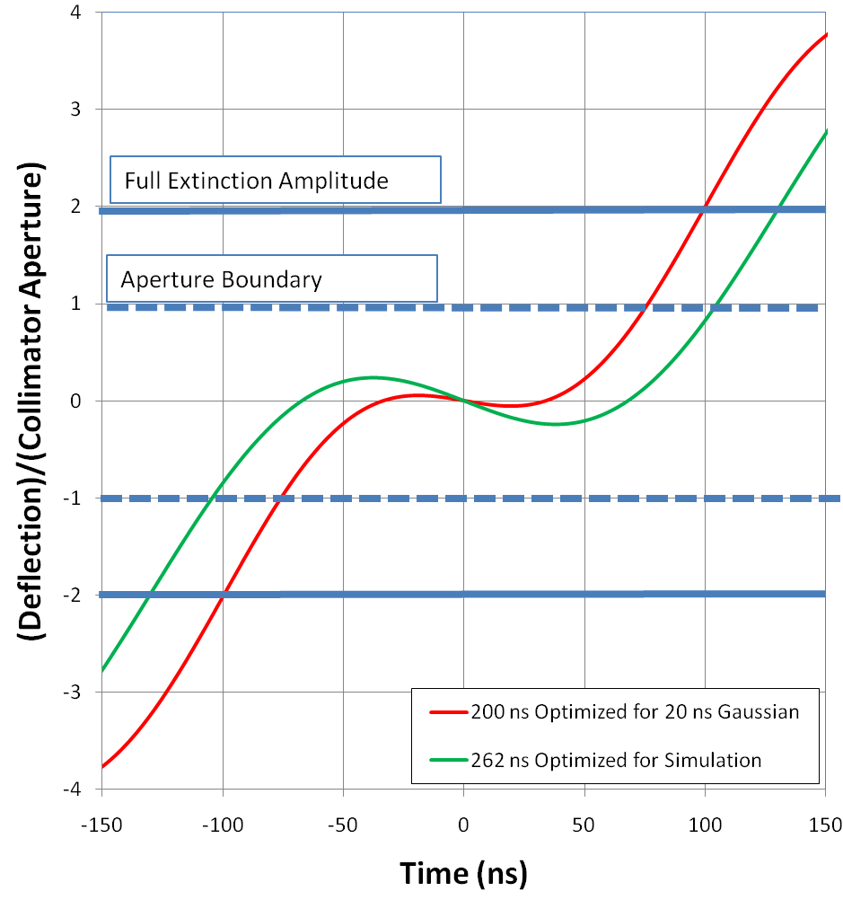
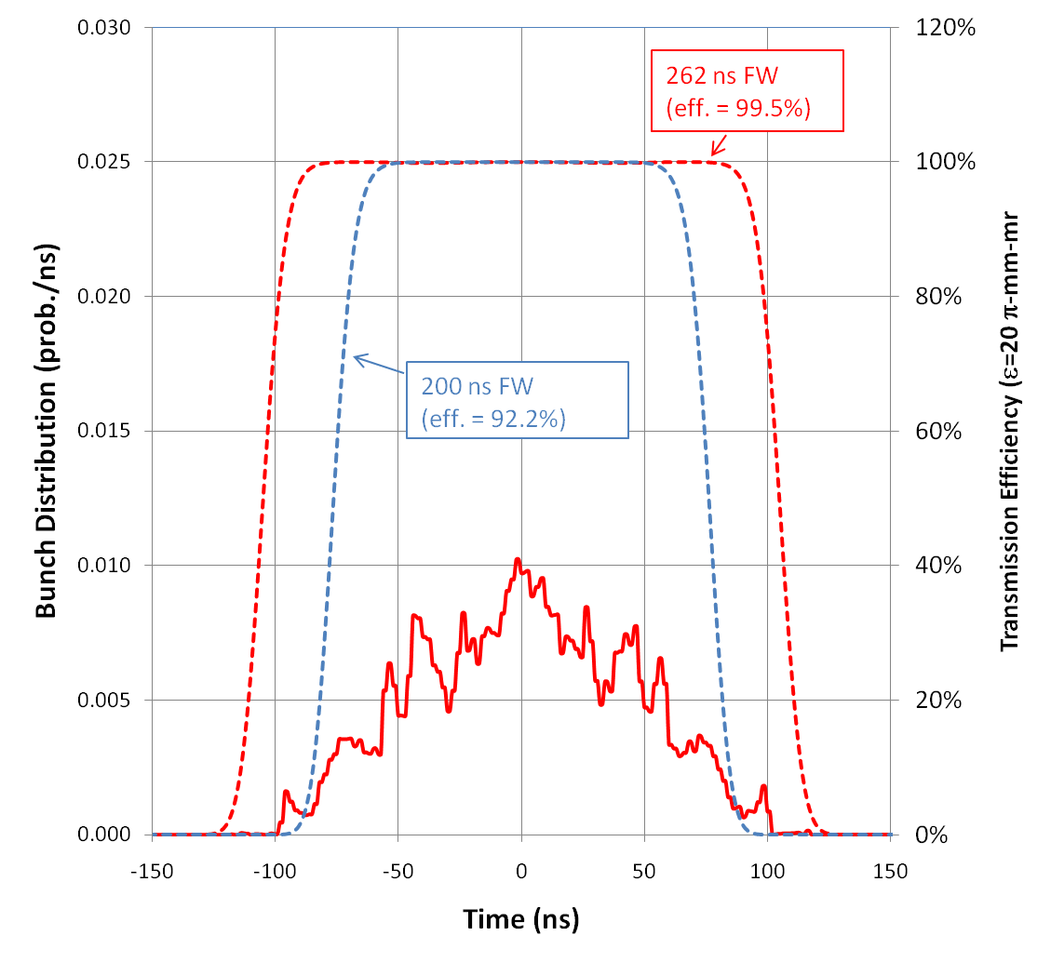
Optimized Base Line
120 G peak @ 300 kHz
15 G peak @ 3.8 MHz
Transmission efficiency: 99.5% for modeled bunch distribution

Slide 18
Ferrite Measurement
Current, A-turns | B, Gauss (start) | B, Gauss (end) | Max Temperature, C
(Need 160 G)
MnZn, 300kHz, 2 plates
0.7 | 60.81 | 54.76 | 22.34
1.4 | 164.54 | 154.65 | 31.23
2 | 256.71 | 202.13 | 36.54
2.75 | 296.17 | 231.10 | 40.87
(Need 10 G)
NiZn , 5.1 MHz, 2 plates
4.35 | 4.83 | 5.3 | 23.38
10.8 | 11.17 | 8.76 | 29.32
16.36 | 16.17 | 15.88 | 44.81
27.39 | 24.04 | 22.21 | 76.21

Slide 19
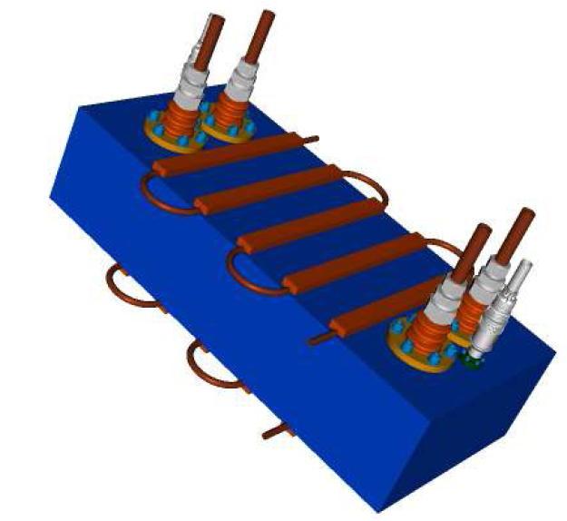
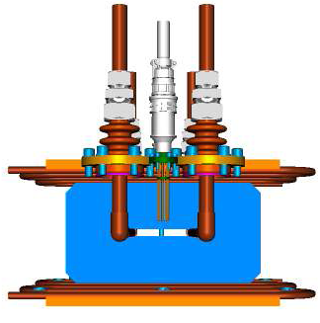
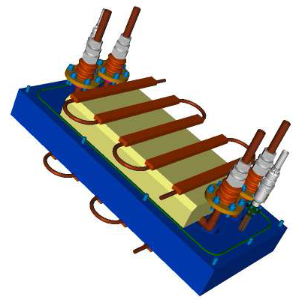
Magnet Prototype
Vacuum Box
Conductor
Cooling channel
Ferrite
Gap

Slide 20
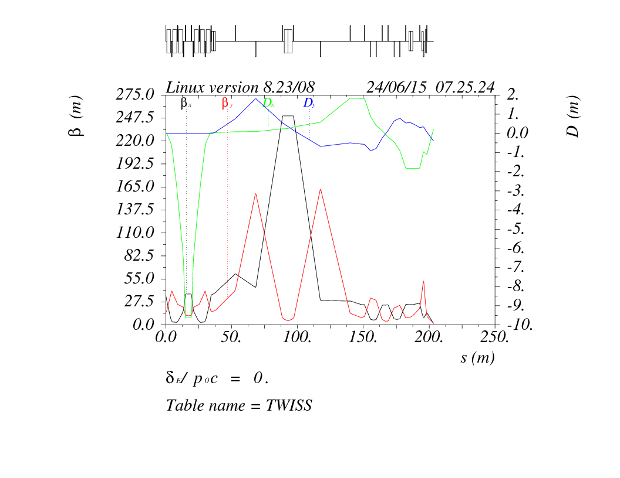
Extinction Beam Line Optics*
Optics dominated by need to accommodate AC Dipole
*Details in talk by Carol Johnstone

Slide 21
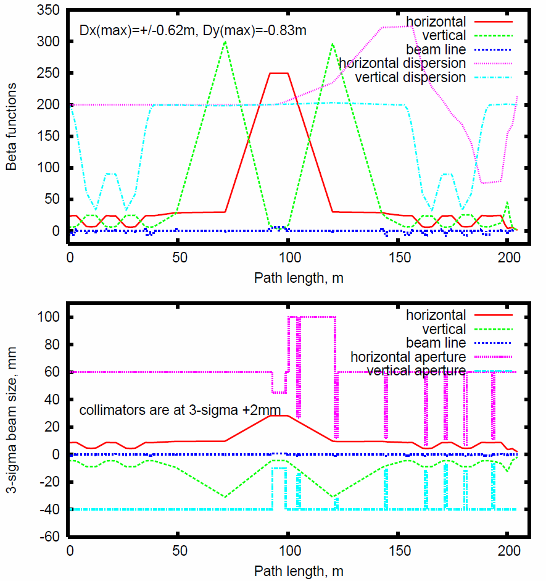
Extinction Channel Modeling*
Beta functions and dispersion (top), and 3σ of ε95%=20π mm-mrad beam size (bottom) in the Mu2e extinction section.
Dispersion Dx(max)=+/-0.62m, Dy(max)=-0.83m.
*A. Drozhdin and I. Rakhno

Slide 22
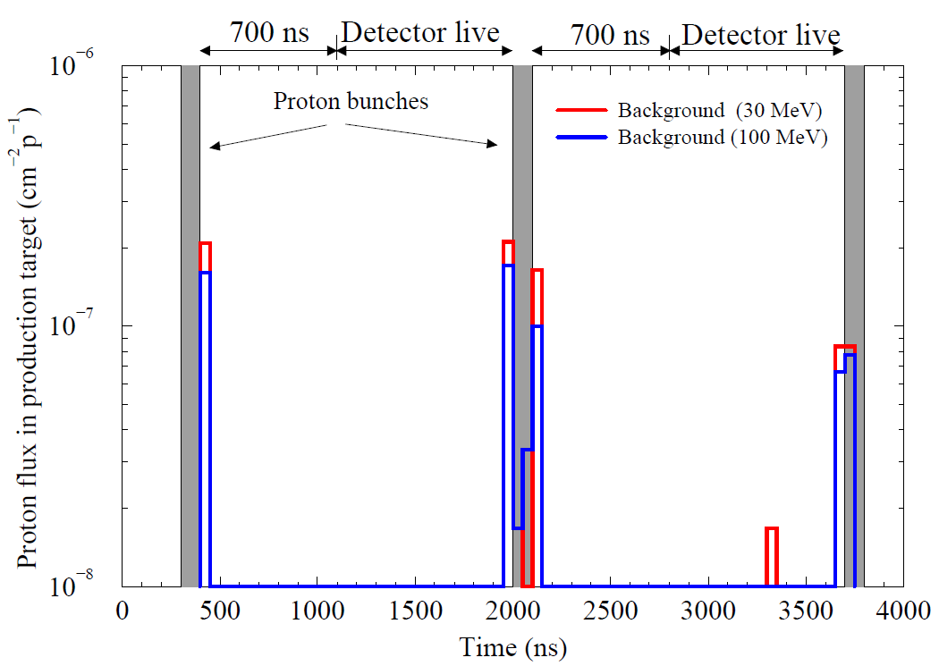
Modeling Results
Summary: out of 210M which hit the primary collimator, 27 (6.4x10⁻⁸), hit the target, but most are within 50 ns of the nominal time window

Slide 23
Technical Risks

Slide 24
ES&H
The extinction system has standard issues that are common at Fermilab
Electrical hazards from both High and Low voltage.
Mechanical hazards from calorimeter motion systems.
These hazards are all discussed in the Mu2e Preliminary Hazard Analysis document (Mu2e-doc-675) and their mitigation involves standard techniques that do not adversely affect the design in any way

Slide 25
Related Talks
J. Miller, “Experimental Technique”
Plenary overview which motives the extinction requirement
P. Kasper, “Extinction Monitoring”
Talk focusing specifically on extinction sub-task 1.2.08.04
C. Johnstone, “External Beamline”
Talk in this session covering WBS 1.x.xx

