Slide 1
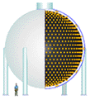



The Fermilab Neutrino Program – Status and Challenges Ahead
Eric Prebys*
Fermilab Accelerator Division/MiniBooNE
*with acknowledgements to everyone who leaves talks where I can find them

Slide 2
Preface
The turn-on of the LHC in ~2007 will mark the end of the Fermilab Tevatron’s unprecedented 20+ year reign as the world’s highest energy collider.
With the cancellation of the BTeV (B physics) project, the collider program is scheduled to be terminated in 2009, possibly sooner.
The lab has a strong commitment to the International Linear Collider, but physics results are at least 15 years away.
-> Neutrino physics will be the centerpiece of Fermilab science for at least a decade.

Slide 3
Luckily, neutrinos are very interesting
Many unanswered questions
  Type: Dirac vs. Majorana
  Generations: 3 active, but possibly sterile
  Masses and mass differences
  Mixing angles
  CP and possibly even CPT violation
Multi-disciplinary
  Study
    Solar
    Atmospheric
    Reactor
    Lab based (beta-decay)
    Accelerator Based
  Application
    Particle physics
    Astrophysics
    Cosmology
Trying to coordinate the effort and priorities
  See “APS Multidivisional Neutino Study”
    http://www.aps.org/neutino/

Slide 4
This Talk
A Brief History of Neutrinos
  Background
  Neutrino “problem”
  Neutrino oscillations
Some Key Experimental Results
  SuperKamiokande
  SNO
  Reactor Summary
  K2K
  LSND (????)
  Where do we stand?
Major Fermilab Experiments
  MiniBooNE
  NuMI/Minos
  Nova
Meeting the Needs of these Experiments
  Existing Complex
  Post-Collider
  Longer Term

Slide 5
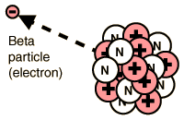

A Brief History of Neutrinos: The Beginning
In “beta decay”, one element changes to another when the nucleus emits an electron (or positron). Looked like a 2-body decay, but energy spectrum wrong.
Observed electron spectrum
Expected monoenergetic electrons
Electron Energy
In 1930, Wolfgang Pauli suggested a “desperate remedy”, in which an “invisible” particle was carrying away the missing energy. He called this particle a “neutron”.
Enrico Fermi changed the name to “neutrino” in 1933, and it became an integral part of his extremely successful weak decay theory.
In 1956, Reines and Cowen observe first direct evidence of neutrinos – 26 years after their prediction!

Slide 6
The Question of Mass, the Standard Model
All observed kinematics of neutrino interactions are consistent with zero mass to within the limits of sensitivity.
In Fermi model (and later Standard Model), neutrinos are massless by definition.
In 1956, Bruno Pontecorvo first shows that it might be possible for neutrinos to oscillate from one type to another if they have a small – but nonzero – mass.
Other important developments:
1962: Lederman, Steinberger, and Schwartz show that that there are at least two distinct “flavors” of neutrinos (ν_{μ}≠ν_{e})
1970’s: “Standard Model” completed – with massless neutrinos.
1989: LEP experiments prove there are only three flavors of active neutrino (ν_{e} ,ν_{μ}, and ν_{τ} )

Slide 7
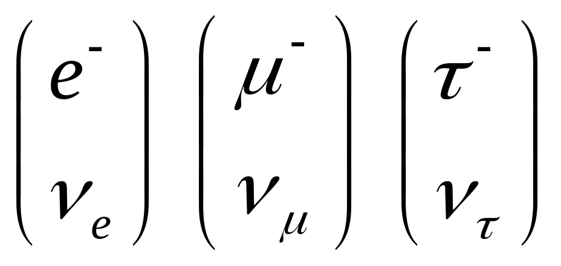
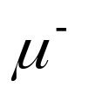
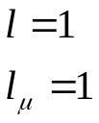

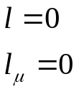

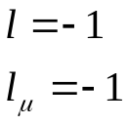
Neutrinos in the Standard Model
Each Generation lepton has an associated neutrino
The weak interaction causes a charged lepton to “flip” to a neutrino and vice versa
The weak interaction conserves “lepton number”

Slide 8
The “Neutrino Problem”
1968: Experiment in the Homestake Mine first observes neutrinos from the Sun, but there are far fewer than predicted. Possibilities:
  Experiment wrong?
  Solar Model wrong? (⇐ believed by most not involved)
  Enough created, but maybe oscillated (or decayed to something else) along the way.
~1987: Also appeared to be too few atmospheric muon neutrinos. Less uncertainty in prediction. Similar explanation.
Both results confirmed by numerous experiments over the years.
1998: SuperKamiokande observes clear oscillatory behavior in signals from atmospheric neutrinos. For most, this establishes neutrino oscillations “beyond a reasonable doubt”.

Slide 9
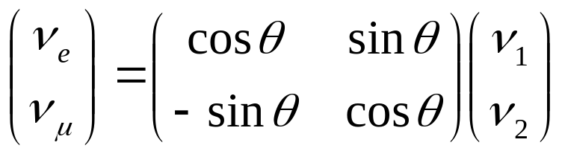
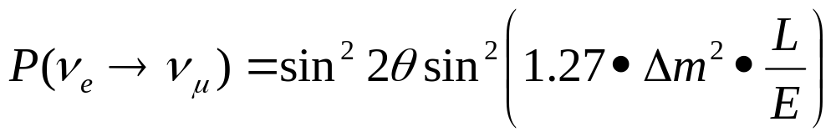

Neutrino Oscillations
Neutrinos are produced as weak eigenstates (ν_{e} ,ν_{μ}, or ν_{τ} ).
In general, these can be represented as linear combination of mass eigenstates.
If the above matrix is not diagonal and the masses are not equal, then the net weak flavor content will oscillate as the neutrinos propagate.
Example: if there is mixing between the ν_{e} and ν_{μ}:
then the probability that a ν_{e} will be detected as a ν_{μ} after a distance L is:
Flavor eigenstates
Mass eigenstates
Distance in km
Energy in GeV
Only measure magnitude of the difference of the square of the masses!
Problem: need a heck of a lot of neutrinos to study this!

Slide 10
Sources of a Heck of a Lot of Neutrinos
The sun:
  Mechanism: nuclear reactions
  Pros: free
  Cons: only electron neutrinos, low energy, exact flux hard to calculate, can’t turn it on and off.
Atmosphere:
  Mechanism: Cosmic rays make pions, which decay to muons, electrons, and neutrinos.
  Pros: free, muon and electron neutrinos, higher energy than solar neutrinos, flux easier to calculate.
  Cons: flux fairly low, can’t turn it on and off.
Nuclear Reactors:
  Mechanism: nuclear reactions.
  Pros: “free”, they do go on and off.
  Cons: only electron neutrinos, low energy, little control of on and off cycles.
Accelerators:
  Mechanism: beam dumps -> particle decays + shielding -> neutrinos
  Pros: Can get all flavors of neutrinos, higher energy, can control source.
  Cons: NOT free

Slide 11

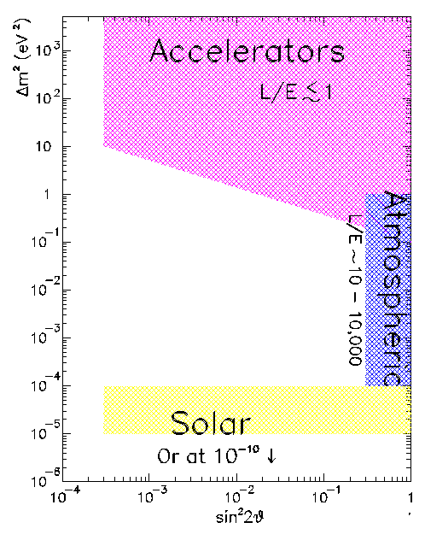
Probing Neutrino Mass Differences
Path length
Different experiments probe different ranges of
Energy
Accelerators use π decay to directly probe ν_{μ} → ν_{e}
& Reactors
Reactors use use disappearance to probe ν_{e} → ?
Cerenkov detectors directly measure ν_{μ} and ν_{e} content in atmospheric neutrinos. Fit to ν_{e}↔ν_{μ} ↔ ν_{τ} mixing hypotheses
Also probe with “long baseline” accelerator experiments
Solar neutrino experiments typically measure the disappearance of ν_{e.}

Slide 12
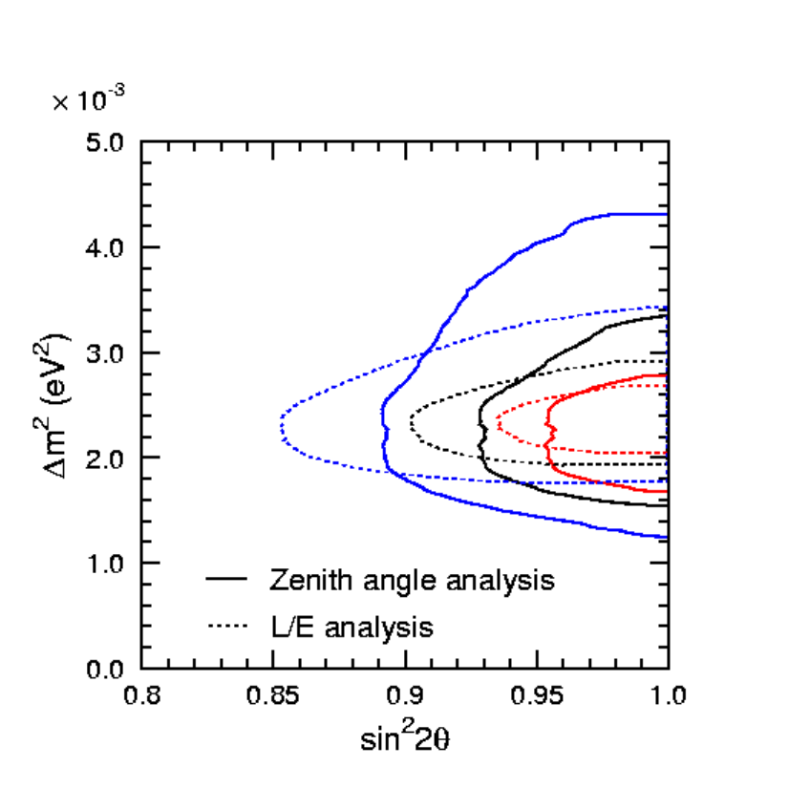
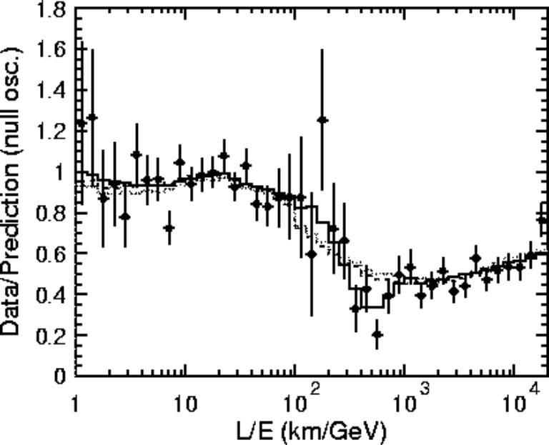
SuperKamiokande Atmospheric Result
Huge water Cerenkov detector can directly measure ν_{μ} and ν_{e} signals.
Use azimuthal dependence to measure distance traveled (through the Earth)
Positive result announced in 1998.
Consistent with ν_{μ} ↔ ν_{τ} mixing.

Slide 13
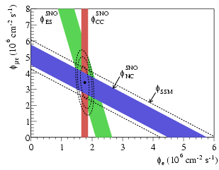
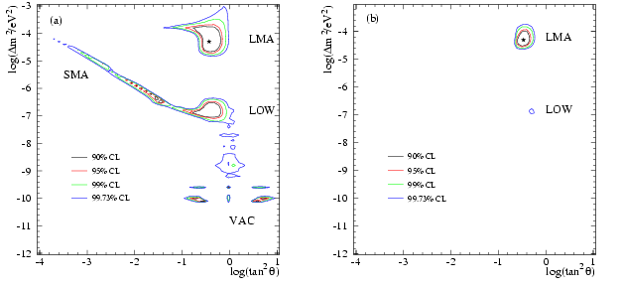
SNO Solar Neutrino Result
Looked for Cerenkov signals in a large detector filled with heavy water.
Focus on ⁸B neutrinos
Used 3 reactions:
  ν_{e}+d→p+p+e⁻: only sensitive to ν_{e}
  ν_{x}+d→p+n+ν_{x}: equally sensitive to ν_{e} ,ν_{μ} ,ν_{τ}
  ν_{x}+ e⁻→ ν_{x}+ e⁻: 6 times more sensitive to ν_{e} than ν_{μ} ,ν_{τ} d
Consistent with initial full SSM flux of ν_{e}’s mixing to ν_{μ} ,ν_{τ}
Just SNO
SNO+others

Slide 14
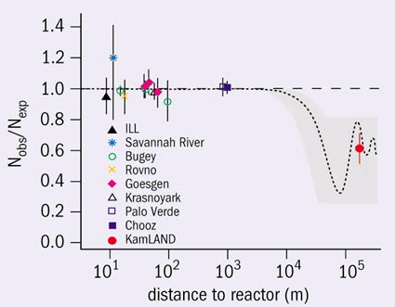
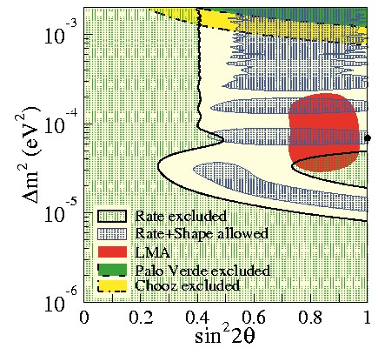
Reactor Experimental Results
Single reactor experiments (Chooz, Bugey, etc). Look for ν_{e} disappearance: all negative
KamLAND (single scintillator detector looking at ALL Japanese reactors): ν_{e} disappearance consistent with mixing.

Slide 15
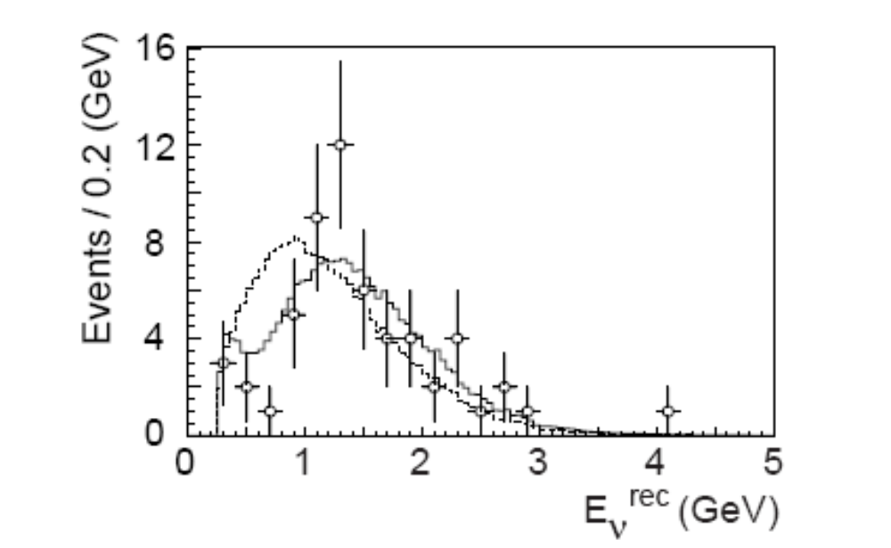
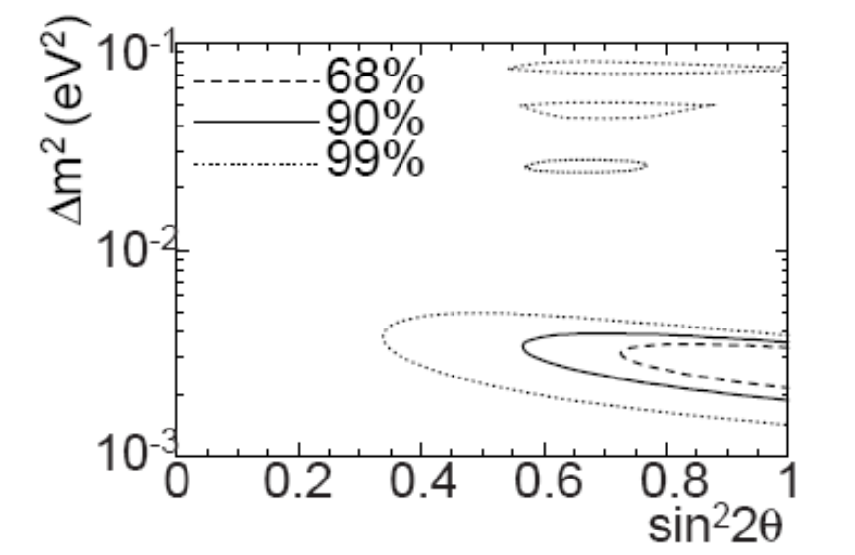
K2K
First “long baseline Experiment
  Beam from KEK PS to Kamiokande, 250 km away
  Look for nm disappearance (atmospheric “problem”)
  Results consistent with mixing
No mixing
Allowed Mixing Region
Best fit

Slide 16


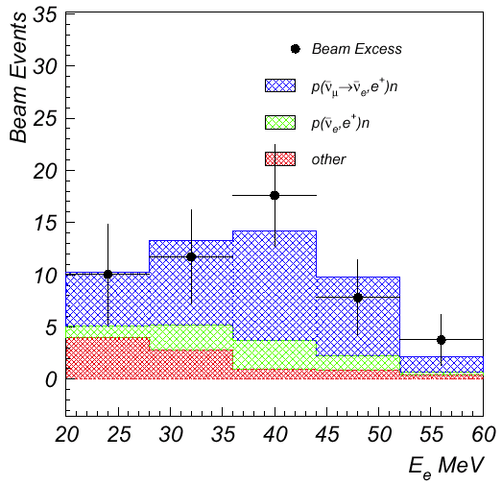
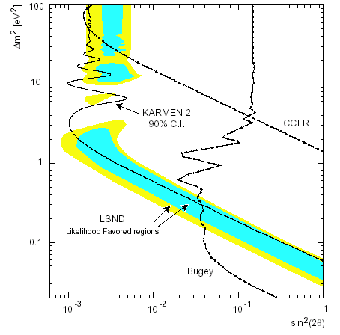

LSND Experiment (odd man out)
Looked for ν_{μ} → ν_{e} and ν_{μ} → ν_{e} in π decay from the 800 MeV LANSCE proton beam at Los Alamos
  Look for ν_{e} appearance via:
  Look for ν_{e} appearance via:
Observe excess in both channels (higher significance in ν_{e})
Only exclusive appearance result to date.
Doesn’t fit “nicely” with the other results!
LSND
positron
energy
Oscillation
signal expectation
backgrounds

Slide 17
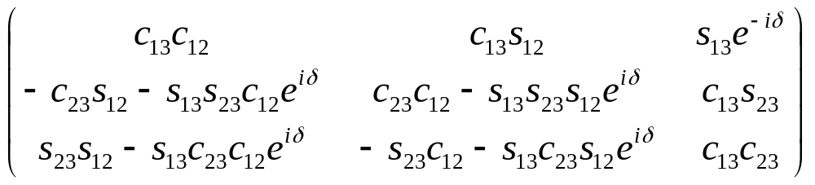
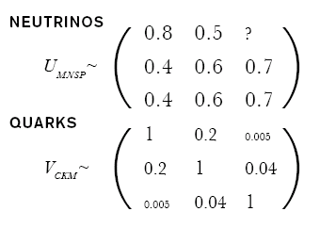
Full Mixing Picture (without LSND)
General Mixing Parameterization
CP violating phase
Almost diagonal
Third generation weakly coupled to first two
“Wolfenstein Parameterization”
Mixing large
No easy simplification
Think of mass and weak eigenstates as totally separate

Slide 18
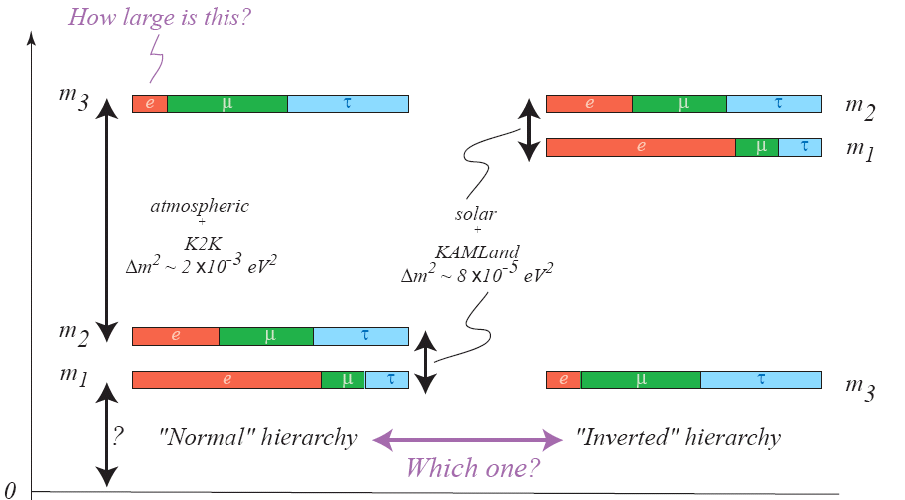
Neutrino Mixing (cont’d)

Slide 19







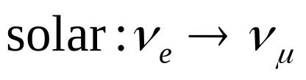
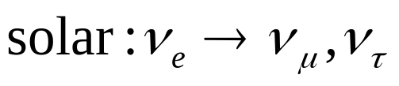
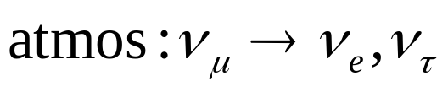
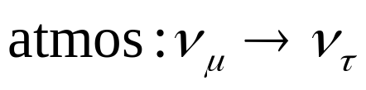



Incorporating LSND
We have 3 very different Δm²’s. Very hard to fit with only three mass states…
Only 3 active ν:
3 active+1 sterile ν:
CPT violation:
ν mass
OR...
ν mass
OR...
ν mass
OR...
- not a good fit to data
- possible(?)
- possible(?)
Can fit three mass states quite well without LSND, but no a priori reason to throw it out. Must check…

Slide 20
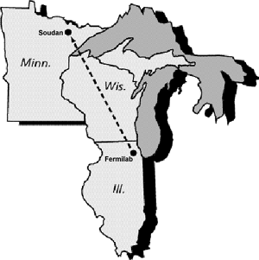
Enter the Fermilab Neutrino Program
MiniBooNE-neutrinos from 8 GeV Booster proton beam (L/E~1):
absolutely confirm or refute the
LSND result
NuMI/Minos – neutrinos from 120 GeV Main Injector proton beam (L/E~100):
precision measurement of ν_{μ} ↔ ν_{τ}
oscillations as seen in atmospheric neutrinos.

Slide 21
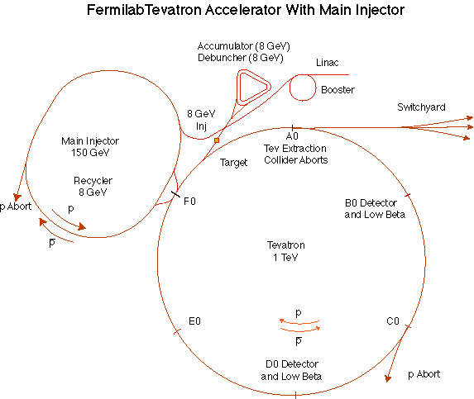
The Fermilab Accelerator Complex
MinBooNE
NUMI
= ProtonSystem
=Proton Customer

Slide 22
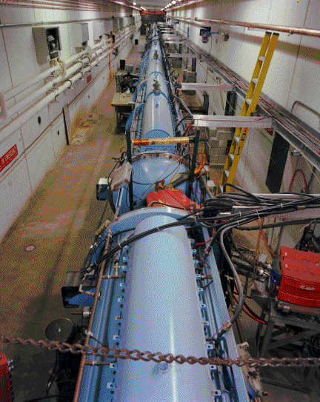
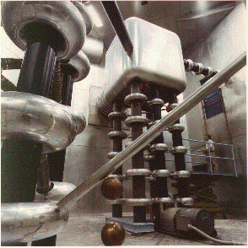
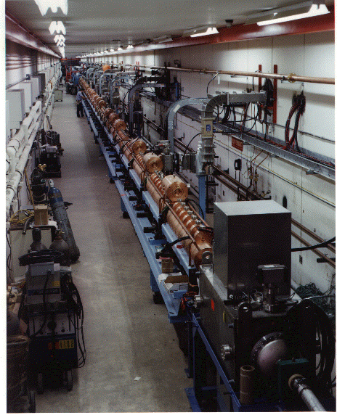
Preac(cellerator) and Linac
“New linac” (HEL)- Accelerate H- ions from 116 MeV to 400 MeV
“Preac” - Static Cockroft-Walton generator accelerates H- ions from 0 to 750 KeV.
“Old linac”(LEL)- accelerate H- ions from 750 keV to 116 MeV

Slide 23
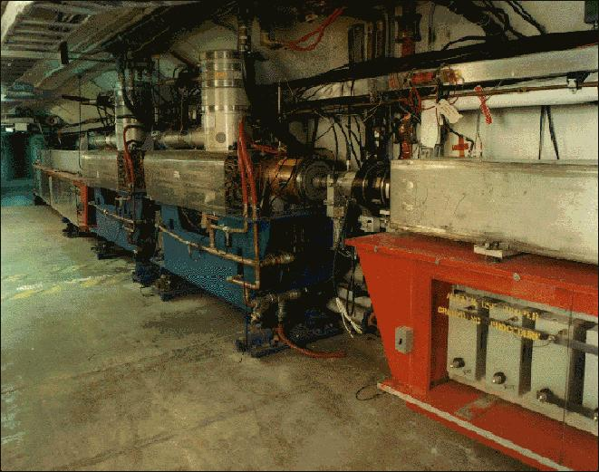
Booster
Accelerates the 400 MeV beam from the Linac to 8 GeV
From the Booster, beam can be directed to
  The Main Injector
  MiniBooNE (switch occurs in the MI-8 transfer line).
  The Radiation Damage Facility (RDF) – actually, this is the old main ring transfer line.
  A dump.
More or less original equipment

Slide 24
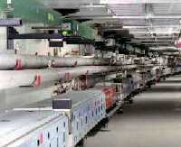
Main Injector
The Main Injector can accept 8 GeV protons OR antiprotons from
  Booster
  The anti-proton accumulator
  The Recycler (which shares the same tunnel)
It can accelerate protons to 120 GeV (in a minimum of 1.4 s) and deliver them to
  The antiproton production target.
  The fixed target area.
  The NUMI beamline.
It can accelerate protons OR antiprotons to 150 GeV and inject them into the Tevatron.

Slide 25






Producing Neutrinos At an Accelerator
8 GeV Proton beam
Target
Mostly pions
We will look for these to oscillate
Pion sign determined whether it’s a neutrino or anti-neutrino
Mostly lower energy

Slide 26






Neutrino Horn – “Focusing” Neutrinos
Can’t focus neutrinos themselves, but they will go more or less where the parent particles go.
Coaxial “horn” will focus particles of a particular sign in both planes
Target
Horn current selects π⁺ -> ν_{μ} or π⁻ -> ν_{μ}
p

Slide 27
So What’s So Hard?
Probability that a 150 GeV proton on the antiproton target will produce an accumulated pbar:
.000015 (1.5E-5)
Probability that a proton on the MiniBooNE target will result in a detected neutrino:
.000000000000004 (4E-15)
Probability that a proton on the NUMI target will result in a detected neutrino at the MINOS far detector:
.000000000000000025 (2.5E-17)
⇒ Need more protons in a year than Fermilab has produced in its lifetime!!

Slide 28
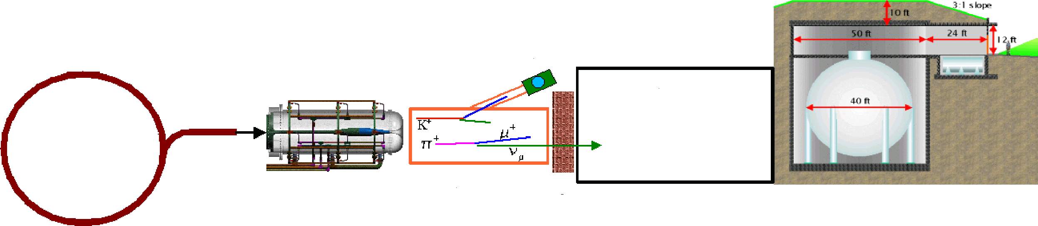
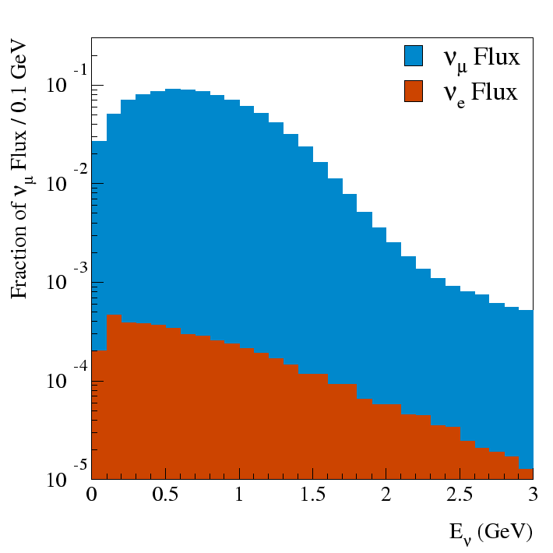
MiniBooNE Experiment
“Little Muon Counter” (LMC): to understand K flux
FNAL
Booster
500m dirt
Be Target
and Horn
50 m Decay Region
Detector
8 GeV protons
Proton flux ~ 6E16 p/hr (goal 9E16 p/hr)
  ~ 1 detected neutrino/minute
  L/E ~ 1

Slide 29
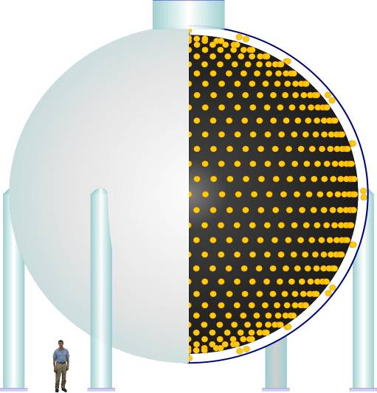
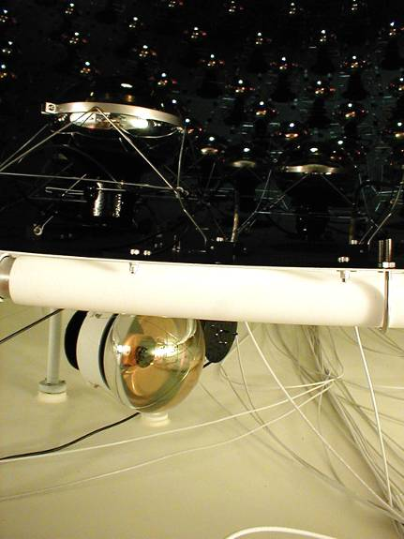
Detector
950,000 l of pure mineral oil
1280 PMT’s in inner region
240 PMT’s outer veto region
Light produced by Cerenkov radiation and scintillation
Trigger:
  All beam spills
  Cosmic ray triggers
  Laser/pulser triggers
  Supernova trigger
Light barrier

Slide 30
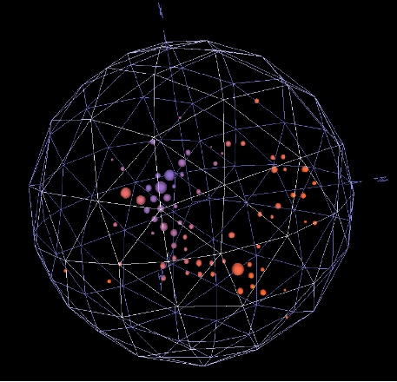
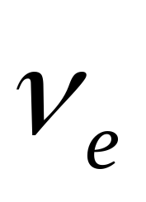
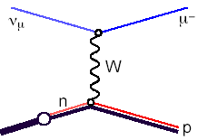
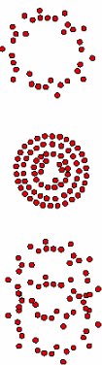

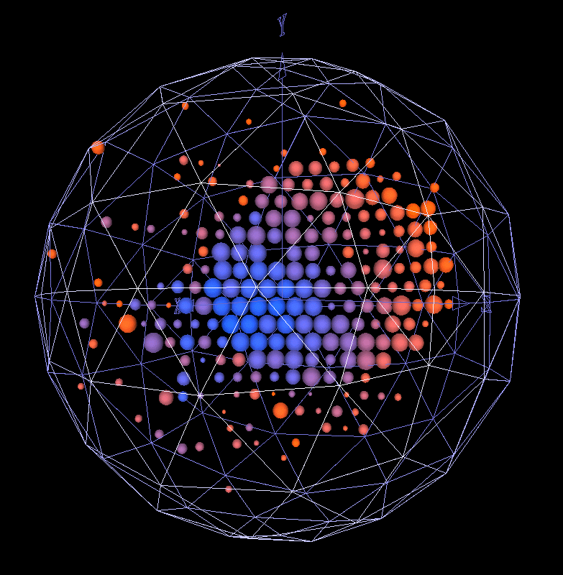
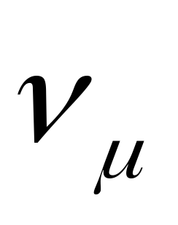
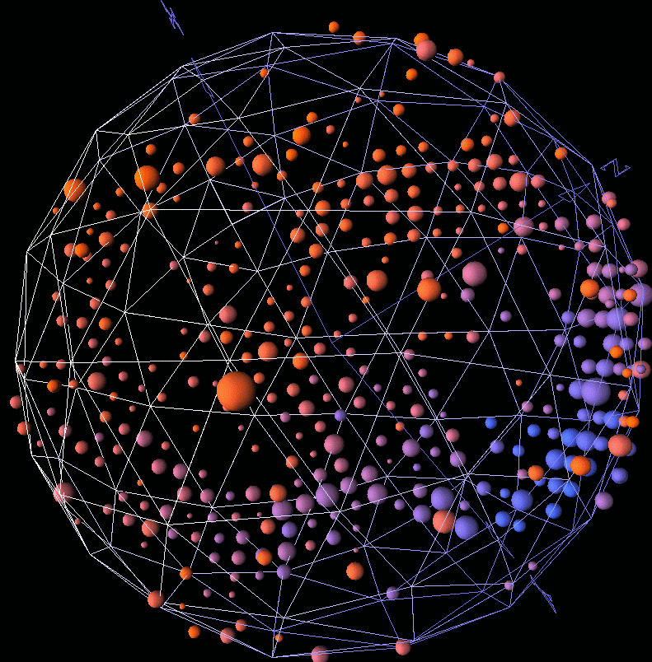
Neutrino Detection/Particle ID
ν_{e}
e⁻
W
n
p
ν_{μ}
μ⁻
W
n
p
ν_{μ}
ν_{μ}
Z
n
Δ⁰
π⁰
p
Important Background!!!

Slide 31
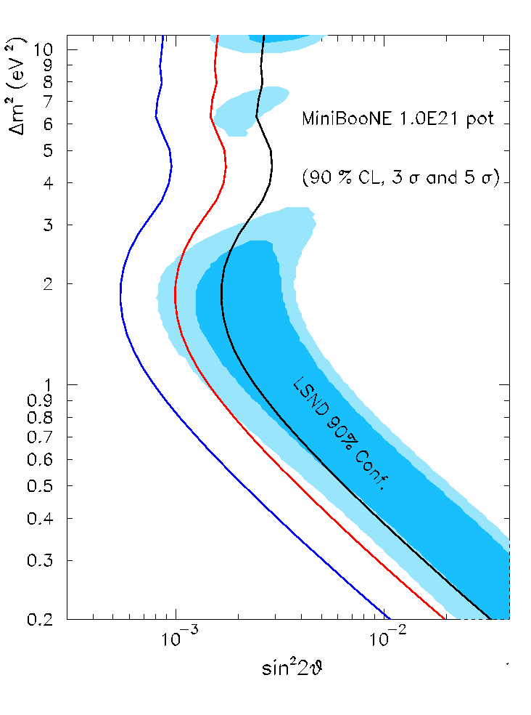
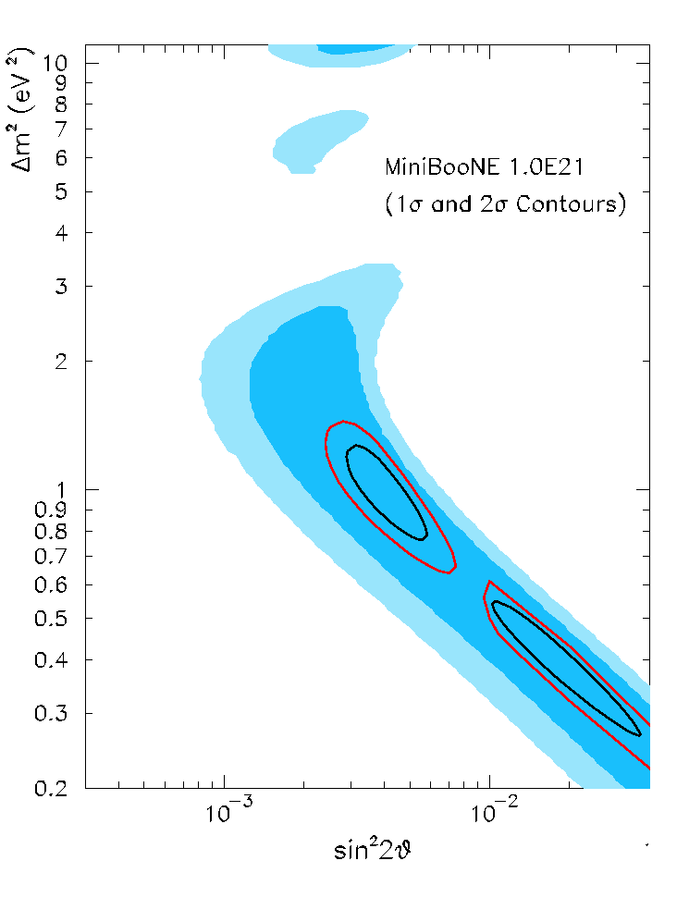
Experimental Sensitivity (1E21 POT)
Signal
  Can achieve good Δm² separation
No signal
  Can exclude most of LSND at 5σ

Slide 32
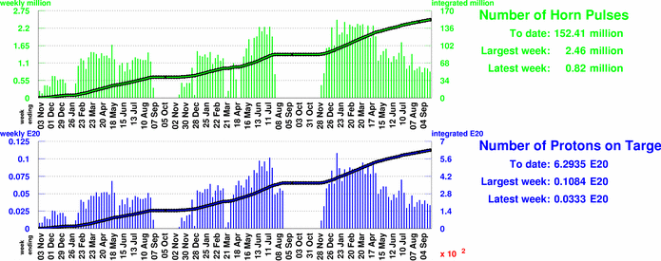
Beam to MiniBooNE
NuMI
6.3E20 to date
Plan for ~2E20/year during NuMI running
First results in early 2006

Slide 33
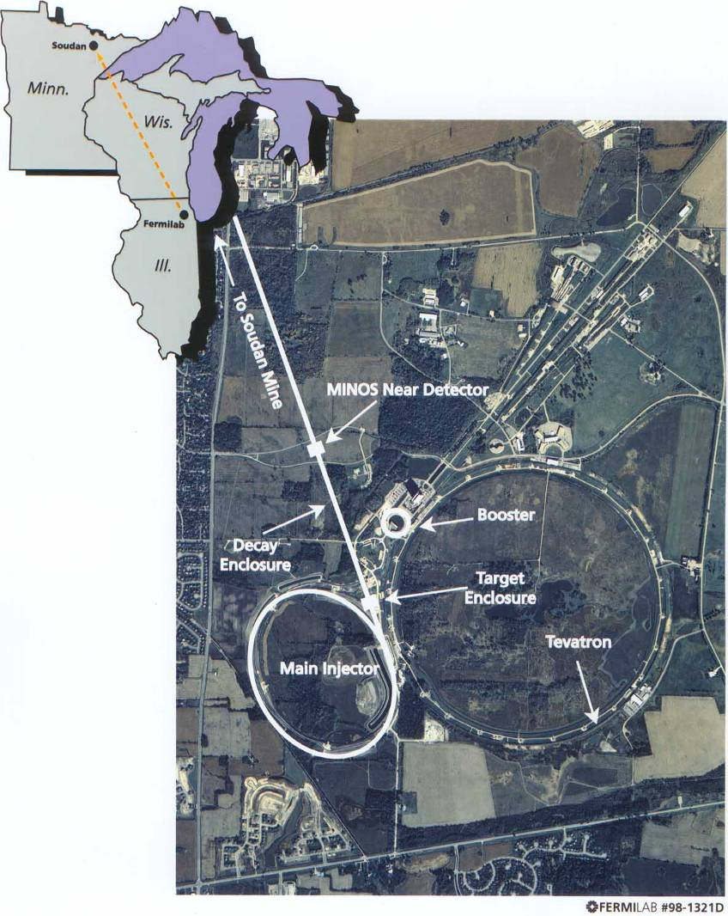
MINOS: Main Injector Neutrino Oscillation Study
8 GeV Booster beam is injected into Main Injector.
Accelerated to 120 GeV
Transported to target
Two detectors for understanding systematic
  Near detector: FNAL (L=1km)
  Far detector: Sudan Mine in Minesota (735 km away)

Slide 34
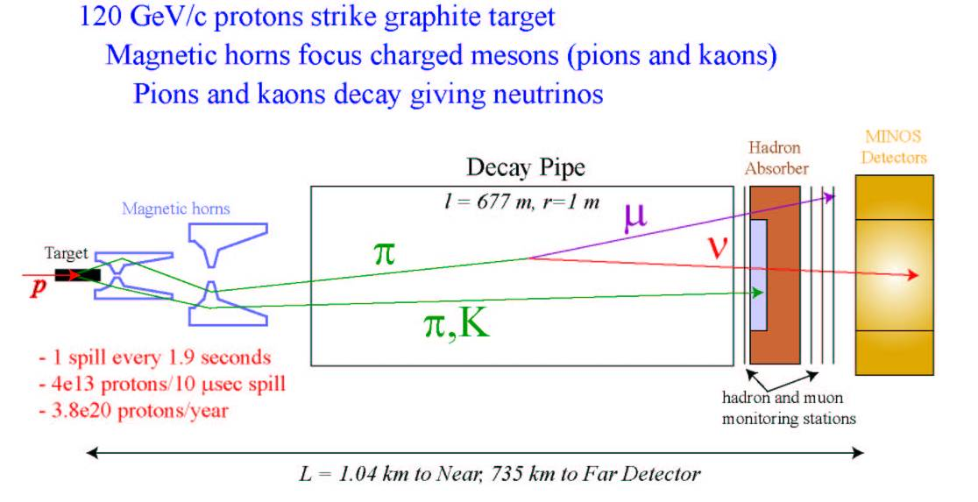


NuMI beams
Two horns (second moveable) -> adjustable beam energy
677 m decay pipe
Near
Detector
Target

Slide 35


Near – 1040 m away
veto - target - shower - μ spectrometer (detect neutrinos by μ appearance
1 kT
3.8 x 4.8 “squeezed” octagon
12,300 scint.strips
1-end readout
no-multiplexing
220 M64s
QIE-based front-end
282 steel planes
153 scintillator planes
65 km WLS fiber
51 km clear fiber
ν target region
μ spectrometer region
Near detector will provide high event
statistics for “mundane” neutrino physics

Slide 36




Far Detector – 735.3 km away
2 Supermodules
5.4 kT
484 scint. planes
92,928 strips (4.1 x 1.0 cm)
8-fold MUXed 2-ended readout
1452 M16s
722 km of WLS fiber
794 km of clear fiber
B ~ 1.5T (R=2m)
HAD ~ 55% / E ^{1/2}
EM ~ 23% / E ^{1/2}
shaft
Soudan 2/CDMS II
MINOS

Slide 37


Minos Status
Test Beam in December 2004
Startup in March, 2005
Collecting data steadily
Detectors working well
Far detector (fully contained event)
Near detector (different target positions)

Slide 38

Beam to NuMI/MINOS
Caught up!
Target water leak problems
Accumulating data at ~2-2.5E20/yr
Can do initial oscillation result at 1E20 (~end of year)

Slide 39


MINOS Ultimate Sensitivity
~3 years
~7 years

Slide 40

Beyond Minos – an Off-Axis experiment
Putting a Detector Off the NuMI Axis probes a narrower neutrino energy distribution than an on-axis experiment (albeit at a lower total intensity)
By constraining L/E, one is able to resolve different contributions to the signal by comparing neutrino and anti-neutrino events
  sin(θ₁₃)
  Sign of Δm²
  (resolve hierarchy question)
  CP violation

Slide 41


Noνa Proposal
Place a 30 kT fully active liquid scintillator detector about 14 mr off the NuMI beam axis

Slide 42



Noνa Sensitivity
Off-Axis Goal
Fraction of δ covered

Slide 43
Noνa Status and Schedule
Stage I approval: April, 2005
Project Start: October, 2006
First kton operational: October, 2009
All 30 ktons operations: July, 2011
Problems:
  Would really like a LOT of protons

Slide 44

Proton Demands (in Perspective)
Highest number I could find on a plot

Slide 45
Limits to Proton Intensity
Total proton rate from Proton Source (Linac+Booster):
  Booster batch size
    Typical ~5E12 protons/batch
  Booster repetition rate
    15 Hz instantaneous
    Currently 7.5Hz average (limited by injection bump and RF cooling)
  Beam loss
    Damage and/or activation of Booster components
    Above ground radiation
Total protons accelerated in Main Injector:
  Maximum main injector load
    Six “slots” for booster batches (3E13)
    Up to ~11 with slip stacking (5.5E13)
    RF stability limitations (under study)
  Cycle time:
    1.4s + loading time (1/15s per booster batch)
Operational Limit

Slide 46
Staged Approach to Neutrino Program
Stage 0 (now):
  Goal: deliver 2.5E13 protons per 2 second MI cycle to NuMI (~2E20 p/yr)
  Deliver 1-2E20 protons per year to Booster Neutrino Beam (currently MiniBooNE)
Stage 1 (~2007):
  A combination of Main Injector RF improvements and operational loading initiatives will increase the NuMI intensity to ~5E13 protons per 2.2 second cycle (~3.5E20 p/yr)
  It is hoped we can continue to operate BNB at the 2E20 p/yr level during this period.
Stage 2 (post-collider):
  Proton to NuMI will immediately increase by 20%
  Consider (for example) using the Recycler as a preloader to the Main Injector and reducing the Main Injector cycle time (~6.5E20 p/yr)
  The exact scope and potential of these improvements are under study
Stage 3 (proton driver)
  Main Injector must accommodate 1.5E14 protons every 1.5 seconds
  NuMI beamline and target must also be compatible with these intensities.

Slide 47

Re-tasking the Recycler
At present, the Main Injector must remain at the injection energy while Booster “batches” are loaded.
  Booster batches are loaded at 15 Hz
  When we slip stack to load more batches, this will waste > 1/3 of the Main Injector duty factor.
After the collider, we have the option of “preloading” protons into the Recycler while the Main Injector is ramping, thereby eliminating dead time.
Small invenstment
  New beamline directly from Booster to Recycler
  Some new RF
Big payoff
  At least 50% increase in protons to NuMI

Slide 48

Thinking Big: A Proton Driver
ILC/TESLA
β< 1 ILC LINAC
ILC LINAC

Slide 49

The Benefits of an 8 GeV Linac Proton Driver
Neutrino
“Super-
Beams”
SY-120
Fixed-Target
Damping Rings
for TESLA @ FNAL
With 8 GeV e+ Preacc.
NUMI
Off-
Axis
X-RAY FEL LAB
Anti-
Proton
8 GeV
neutrino
8 GeV Linac
~ 700m Active Length
1% LC Systems Test
Main
Injector
@2 MW
Bunching
Ring
Target and Muon Cooling Channel
Recirculating
Linac for Neutrino Factory
Neutrino Target
& Long-Pulse
Spallation Source
Short Baseline Detector Array
Neutrinos
to “Homestake”
VLHC at Fermilab

Slide 50
Possible “budget” Alternative to Proton Driver
Retire Booster
Build new transfer line
Replace pBar Debuncher with new Booster
Prestack in Accumulator
Transfer to recycler/Main Injector
Less Expensive than the Linear Proton Driver
Can get to 2 MW
None of the side benefits
No synergy with ILC

Slide 51

Evolution of Proton Delivery

Slide 52


Evolution of θ₁₃ discovery limit
Bands show dependence on CP violation parameter δ
(from: FNAL proton driver study, to appear)
=located at Fermilab (NUE~Noνa)

Slide 53
Other Activities at the lab (some very big)
Other Neutrino:
  FLARE: Same physics motivation as Noνa, but with a liquid Argon detector
  Cross section experiments as input to neutrino physics
    MIPP
    Minerνa
    Finese
    SciBar
Fixed Target
  Active 120 GeV program, mostly test beams
LHC
  Big player in CMS
  Level 2 Physics Center
  LARP accelerator collaboration
ILC
  Major Commitment ramping up over the next few years
  Major superconducting RF effort
Non-HEP
  Sloan Digital Sky Survey
  Auger
  Computing Grid development

Slide 54
Conclusions
It’s a little disorienting to see the end of the Fermilab collider program
We are disappointed at the cancellation of the BTeV project, nevertheless
Fermilab is poised to hold a leading position in neutrino research for the next 10-15 years.

Slide 55

MiniBooNE Beamline
8GeV Beam from Booster

Slide 56

Neutrino Horn – Cont’d
Horn will pulse with 170 kA 150 usec pulse!
Horn heating limits the average rep rate to 5 Hz.
Horn fatigue is an issue.
Under nominal MiniBooNE running conditions, it will pulse about 100 million times per year.
Highest rate neutrino horn ever built!

Slide 57
MiniBooNE Secondary “Beamline”
NOT to scale!!!!!!
Proton Beam
Counting House
removable25m Muon absorber
“Teletubby Hill”
Target vault
50m Muon absorber
25m
25m
Detector
Decay region
500 m

Slide 58

Predicted Neutrino Flux at the Detector
The L/E ~1 m/MeV is similar to that at LSND.
-8 GeV protons on Be:
p + Be → π⁺, K⁺, K⁰_{L}
-yield a high flux of ν_{μ} :
π⁺ → μ⁺ ν_{μ}
K⁺ → μ⁺ ν_{μ} , K⁰_{L} → π⁻ μ⁺ ν_{μ}
-with a low background of ν_{e} :
μ⁺ → e⁺ ν_{e} ν_{μ}
K⁺ → π⁰ e⁺ ν_{e} , K⁰_{L} → π⁻ e⁺ ν_{e}
Flux estimate is important!

Slide 59

Nova dependence on δ

