Slide 1
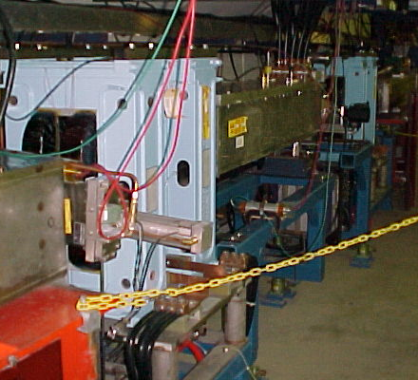
Dogleg Problem
Septum
Each of the two Booster extraction septa has a set of vertical dogleg magnets to steer the beam around it during acceleration.
More powerful doglegs were installed in 1998 to reduce losses early in the cycle.
These magnets have an edge focusing effect which distorts the horizontal injection lattice:
  50% increase in maximum β
  100% increase in maximum dispersion.
  Harmonic contributions.
Effect goes like I². Now tune to minimize.
Recently got an unusual opportunity to explore potential improvements from fixing the problem.
Working on schemes to reduce or remove problem.
Dogleg Magnets

Slide 2
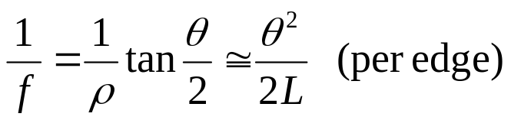
Parasitic Focusing
Rectangular (RBEND) magnet:
vertical focusing if beam has component into page
vertical focusing if
beam has component
out of page
Focusing in
non-bend plane!!
f
f
θ/2
θ/2
Side View
Top View
Always focusing!!

Slide 3
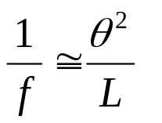




Parasitic Focusing (cont’d)
Sector (SBEND) magnet:
Focusing in
bend plane!!
Longer L
Nominal L
B ~constant
Shorter L
Trade-off:
SBEND
RBEND
Exit angle
Non-bend plane focusing
bend plane focusing

Slide 4
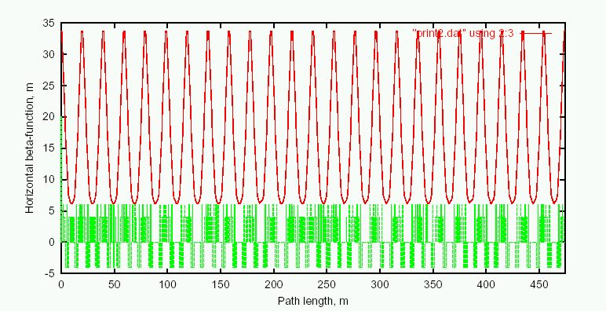
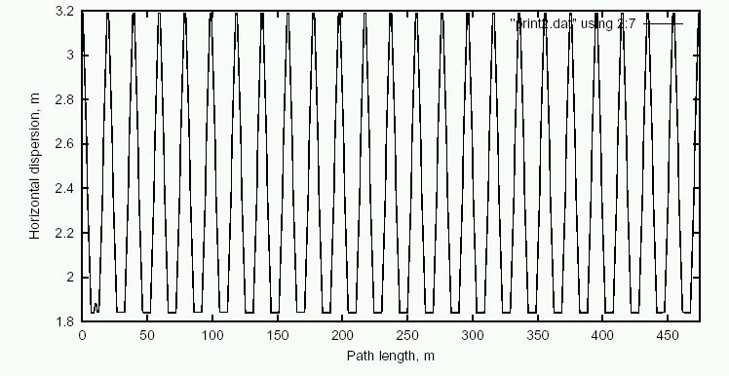
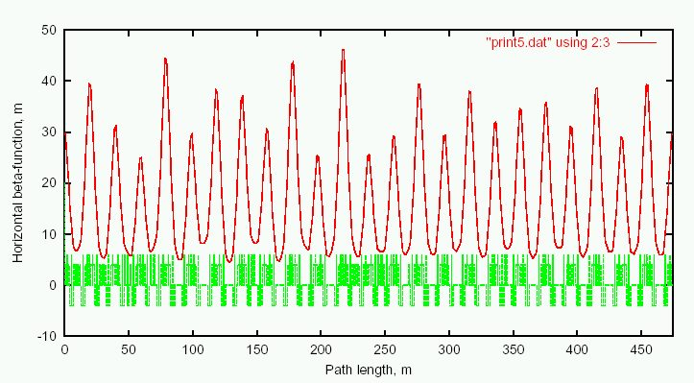
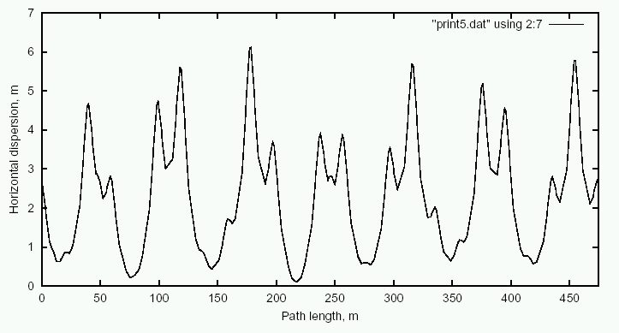
Predicted Effect of Doglegs
Ideal Lattice
β_{x}
D_{x}
Add Doglegs
β_{x}
D_{x}

Slide 5
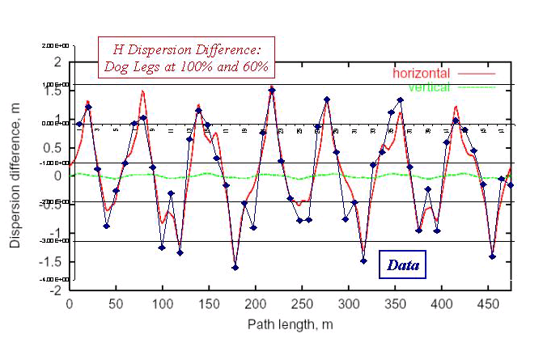
Preliminary Study: Dispersion
Measured dispersion for different dogleg currents:

Slide 6
Dead Dog Studies
Took advantage of recent TeV Magnet failure to raise the Long 13 (dump) septum and turn off the associated dogleg.
Doglegs almost exactly add, so this should reduce the effect by almost half.
The mode of operation prevents short batching, booster study cycles and RDF operation.
Had about 36 hours of study in this mode.
Bottom Line: major improvement.

Slide 7
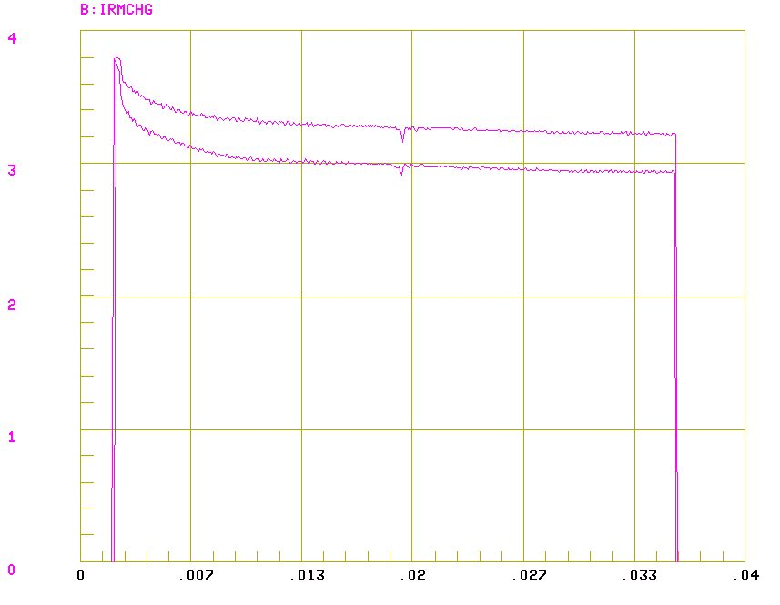
Transmission After Tuning
March 6, 7 turns, 1 dog
March 3, 7 turns, both dogs

Slide 8
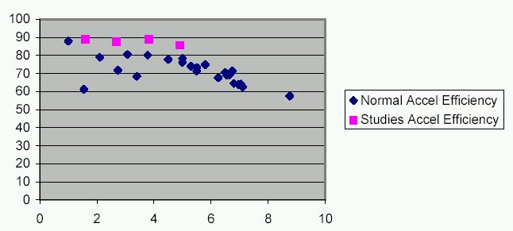
Transmission with One Dogleg
%
Injected Charge (E12)

Slide 9
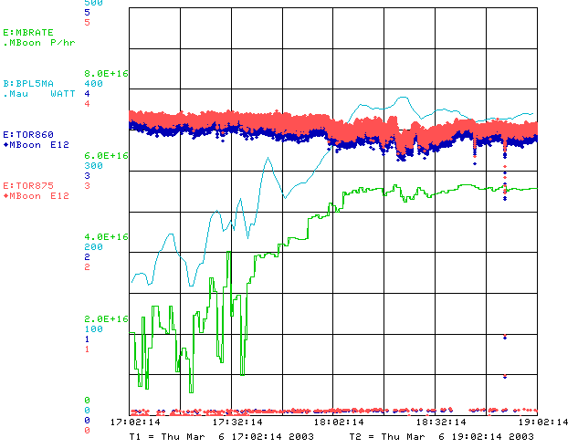
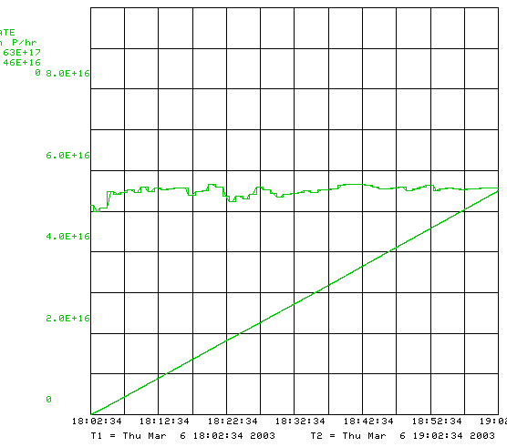
Record Running w/o Dogleg

Slide 10
Short Term Solutions
Tune to minimize current?
  helped so far, but near limit.
  Maybe raise L13 septum a bit?
Motorize L13 septum to switch modes quickly?
  Operational nightmare
Eliminate L13?
  Find another way to short-batch
  Make a dump in MI-8 for Booster study cycles?
Correctors?:
  These don’t look like quads, so can’t find a fix – yet.
Spread out doglegs (effect goes down with square of separation): YES!!
  Long 3 this summer
  Long 13 later
Possibly redesign extraction septum later: EXPENSIVE!

