Slide 1
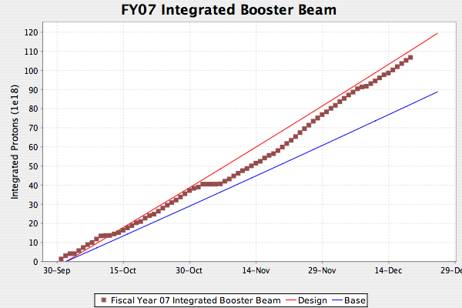
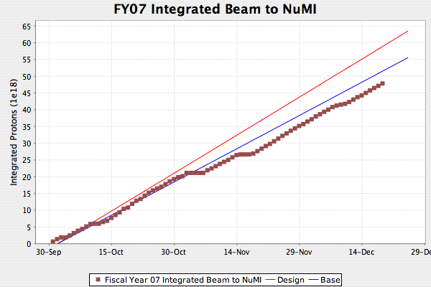
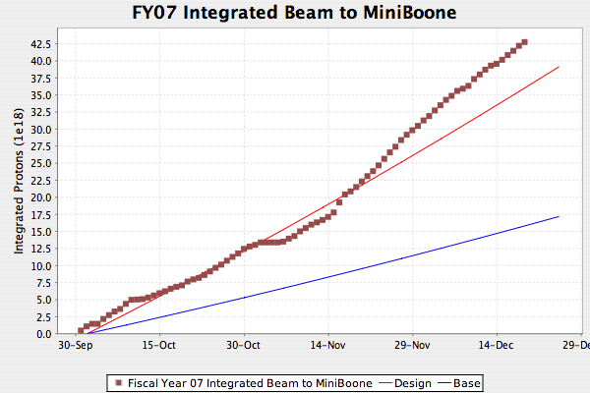
Protons in FY07 (as of today)

Slide 2
Comparison w/Projection
Last four weeks
Parameter | Projection | Actual | Factor
Avg. batch size (E12) | 4.85*.9=4.37 | 4.8*.83=4.0 | .92
Avg. Cycle time (sec)* | 2 | 2.36 | .84
Up time (%) | 80 | 94 | 1.18
Total | - | - | .90
*defined as average cycle time for 5 batches; i.e. takes into account NuMI-only cycles

Slide 3
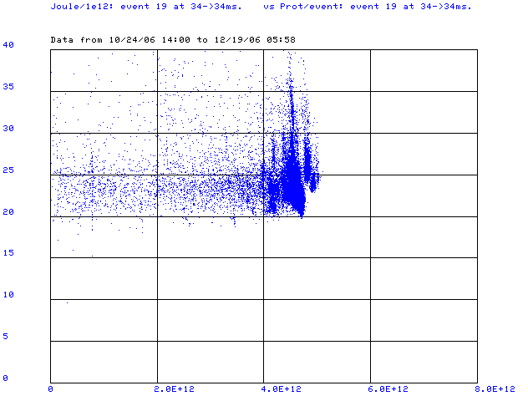
Why we reduce batch intensity
Not so good running
Normalized energy loss (J/E12) ->
Good running
Batch size ->
Losses take off very quickly once they begin!

Slide 4
NuMI vs. MiniBooNE
NuMI is loaded with the largest batches that can be loaded without dramatically increasing Booster losses
MiniBooNE gets whatever it can after that within the loss limits of the Booster
It’s possible that we might sometimes get one more turn to NuMI if we completely shut MiniBooNE off
  Not guaranteed because losses are often localized.
  Not a mode we like to run in.

Slide 5
What’s being done to increase batch size?
Lots of tuning
Keep all RF up!
Closed orbit control program
  Ready to start testing beginning of new year

