Slide 1
Diagnostics in the Fermilab Proton Source (Linac + Booster)
Eric Prebys
FNAL Beams Division

Slide 2
Outline
Description of the Fermilab Proton Source
New Challenges which we face
Current Diagnostic Tools
  *Injected Energy
  Bunch Shape
  Orbit
  Transverse Beam Profile
  *Coupled Bunch Oscillation Detector
  *Tune Measurement
  *Beam Loss
Future Tools
  Ramp Monitor
(*Made available or substantially improved in the last year)

Slide 3
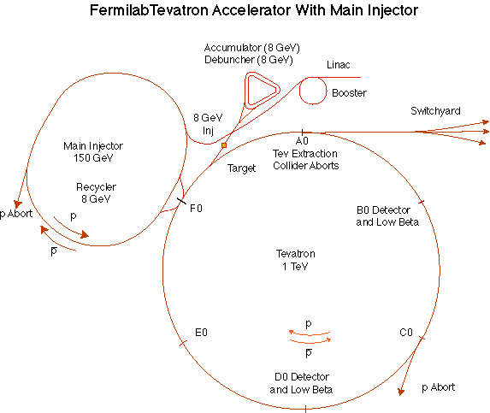
The Fermilab Accelerator Complex
Proton Source
MinBooNE
NUMI

Slide 4
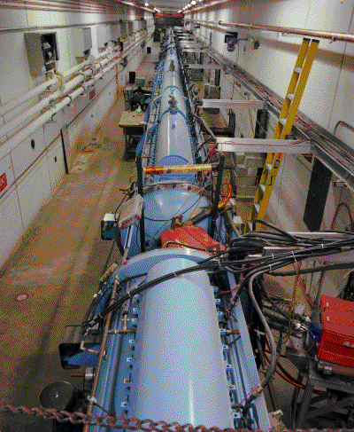
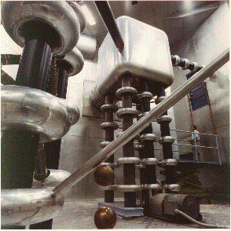
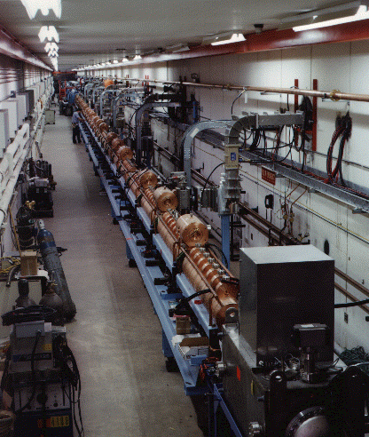
Preac(cellerator) and Linac
“New linac”- 800 MHz π cavities accelerate H- ions from 116 MeV to 400 MeV
“Preac” - Static Cockroft-Walton generator accelerates H- ions from 0 to 750 KeV. (Actually, there are two of these, H- and I-)
“Old linac”- 200 MHz Alvarez Tubes accelerate H- ions from 750 keV to 116 MeV
Preac/Linac can deliver about 45 mA of current for about 35 usec at a 15 Hz repetition rate

Slide 5
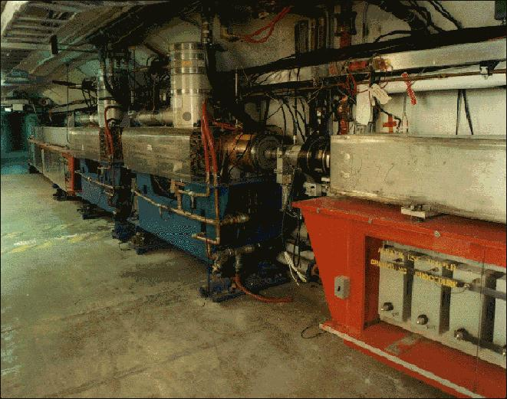
Booster
400 MeV Linac H- beam is injected into booster over several (up to 15) “turns”. The ion beam allows one to (negative) beam on top of existing (positive) beam. A set of 4 dogleg magnets steer the beam out and through a stripping foil during injection.
The main magnets of the Booster form a 15 Hz offset resonant circuit , so the Booster field is continuously “ramping”, whether there is beam in the machine or not. Ramped elements limit the average rep rate to somewhat lower.
From the Booster, beam can be directed to
  The Main Injector
  MiniBooNE (switch occurs in the MI-8 transfer line).
  The Radiation Damage Facility (RDF) – actually, this is the old main ring transfer line.
  A dump.
One full booster “batch” sets a fundamental unit of protons throughout the accelerator complex (typ. 4.5E12, max 5E12).
This is divided amongst 84 53 MHz RF buckets, which sets another fundamental sub-unit (max 6E10).

Slide 6
Primary Consumers of Protons
“stacking” (last 2 years): Proton source provides protons to Main Injector, where they are accelerated to 120 GeV for antiproton production – typically 7E15 p/hr max.
MiniBooNE (last 2 months): 8 GeV protons delivered directly to neutrino production target – typically 1.5E16 p/hr max, but baseline is 7 times that!!!
NUMI (2004?): protons delivered to Main Injector, which will accelerate them to 120 GeV for neutrino production – wants at least 5E16 p/hr while MiniBooNE and stacking are running.

Slide 7
Proton Timelines
Everything measured in 15 Hz “clicks”
Minimum Main Injector Ramp = 22 clicks = 1.4 s
MiniBoone batches “don’t count”.
Cycle times of interest
  Min. Stack cycle: 1 inj + 22 MI ramp = 23 clicks = 1.5 s
  Min. NuMI cycle: 6 inj + 22 MI ramp = 28 clicks = 1.9 s
  Full “Slipstack” cycle (total 11 batches):
    6 inject
    + 2 capture (6 -> 3)
    + 2 inject
    + 2 capture (2 -> 1)
    + 2 inject
    + 2 capture (2 -> 1)
    + 1 inject
    + 22 M.I. Ramp
    ----------------------
    39 clicks = 2.6 s

Slide 8
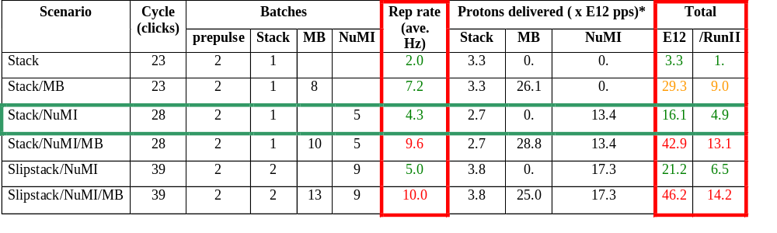
Summary of Proton Ecomomics
MiniBooNE baseline ≈ 5E20 p/year
Booster Hardware Issues
Radiation Issues
NUMI “baseline” = 13.4E12 pps x 2E7 s/year ≈ 2.7E20 p/year
*assuming 5E12 protons per batch

Slide 9
What Limits Total Proton Intensity?
Maximum number of Protons the Booster can stably accelerate: 5E12
Maximum average Booster rep. Rate: formerly 2.5Hz, currently 2 Hz, soon 7.5 Hz
(NUMI only) Maximum number of booster batches the Main Injector can hold: currently 6, possibly go to 11
(NUMI only) Minimum Main Injector ramp cycle time (NUMI only): 1.4s+loading time
Losses in the Booster:
  Above ground radiation
  Damage and/or activation of tunnel components
Our biggest worry at the moment!!!!

Slide 10
Fundamental Change in Focus
During collider operation (“stack and store”), fairly long periods of reduced proton source performance could be tolerated with no significant impact on the physics.
Proton source has not been a limiting factor in the Fermilab physics program in a very long time.
For the new generation of neutrino experiments, physics is directly related to the total number of protons delivered.

Slide 11
One Year Ago…
The only real measure of Proton Source Performance was the delivered flux. In particular,
  No measurement of energy or phase of beam going from Linac to Booster.
  No way to measure Booster tune without dedicated study time.
  No systematic way of studying losses.

Slide 12

Typical Booster Cycle
Various Injected Intensities
Transition
Intensity (E12)
Energy Lost (KJ)
Time (s)

Slide 13
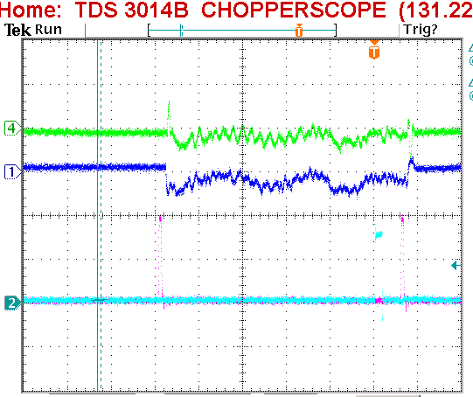
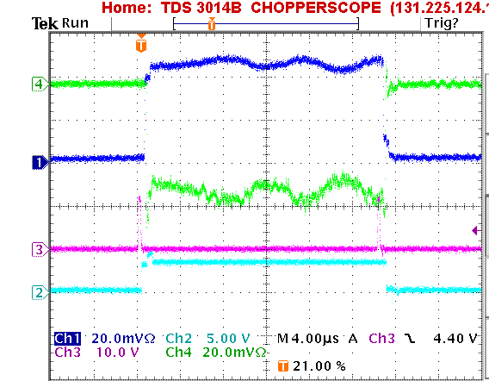
Injected Energy and Phase
Energy: Time of flight (phase difference) between end of Linac and injection debuncher cavity.
Phase: Difference between detected phase and debuncher phase at cavity
Good
Bad!!!
Injection Time
Problem: No automated alarm (yet)

Slide 14
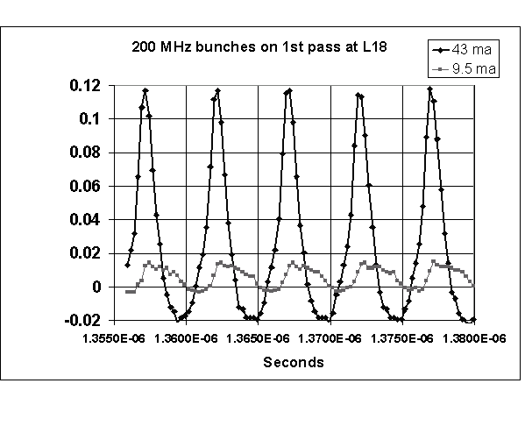
Injected Bunch Shape
Resistive Wall Monitor ¾ of the way around the ring.
Problem: not yet used in a systematic way.

Slide 15
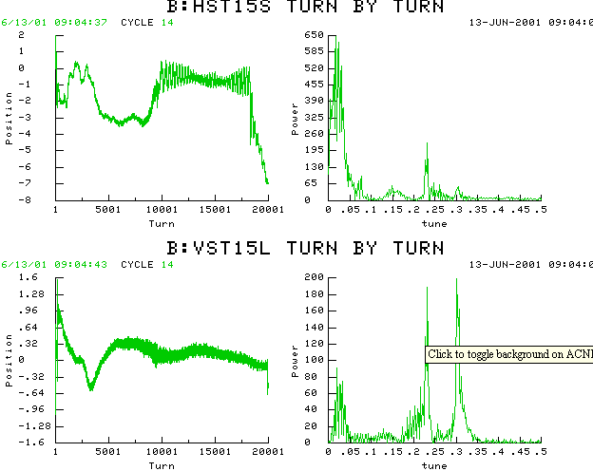
Orbit
System of 48H+48V BPM’s, which can be read out as a function of time for the whole ring each cycle.
Instability
HOR:
VERT:

Slide 16
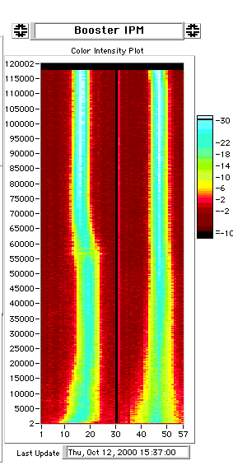
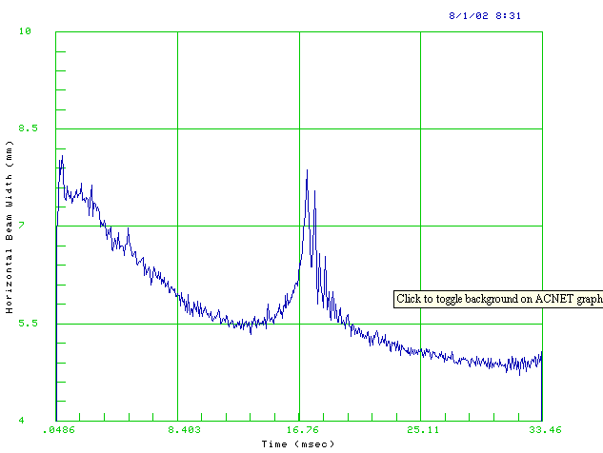
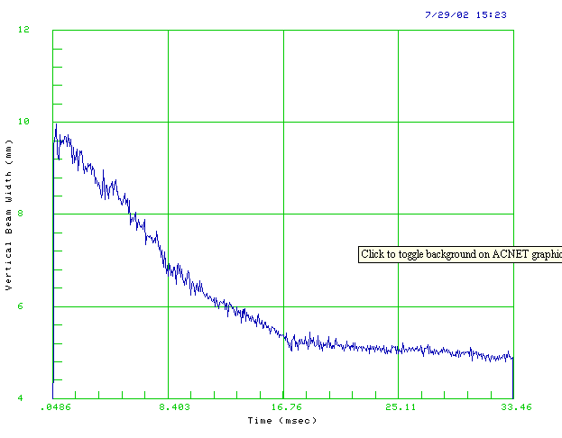
Beam Profile: Ionization Profile Monitor

Slide 17
Injected Beam Profile (“Flying Beam”)
Beam sweeps over fixed wire as it returns from injection “bump”.
Use secondary emission signal vs. time to get beam profile.
Use to calibrate IPM (in progress)

Slide 18
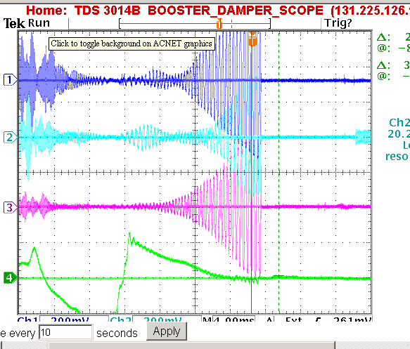
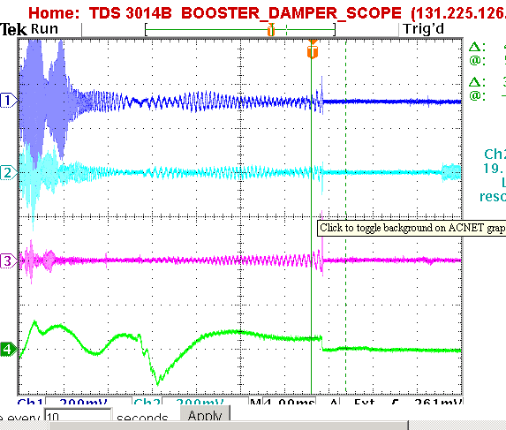
Coupled Bunch Detection
Individual Mode Lines (typically ~80 MHz) mixed down and monitored through the acceleration cycle.
Problem: No automated alarm.
System being redesigned.
Dampers Working
No Dampers

Slide 19
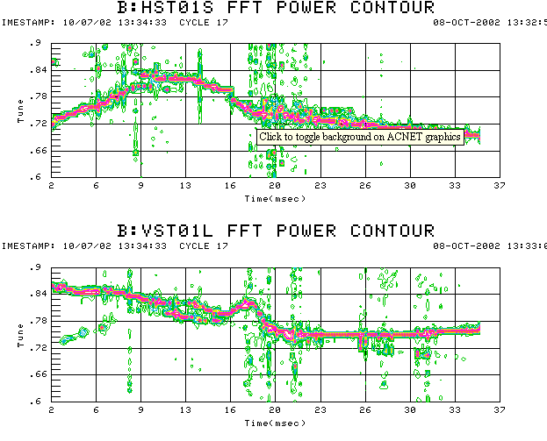
Tune Measurement (first time in many years!)
Horizontal plane pinged at 2 ms intervals.
Do FFT on one of the BPM’s
For the moment, coupling to vertical plane is sufficient to measure that too!!

Slide 20
Measured Beam Energy Loss
~ 60 “Tevatron-style” ionization monitors:
  100 second running average now our primary figure of merit for Booster performance.
  Part of Booster permit system.
Differential proton loss is measured using toroids.
  Weighted by energy to produce a “Beam Energy Lost”.
  Loss rate in Watts calculated using a 5 minute running average updated every minute. Part of Booster permit system (current limit 400 W).

Slide 21
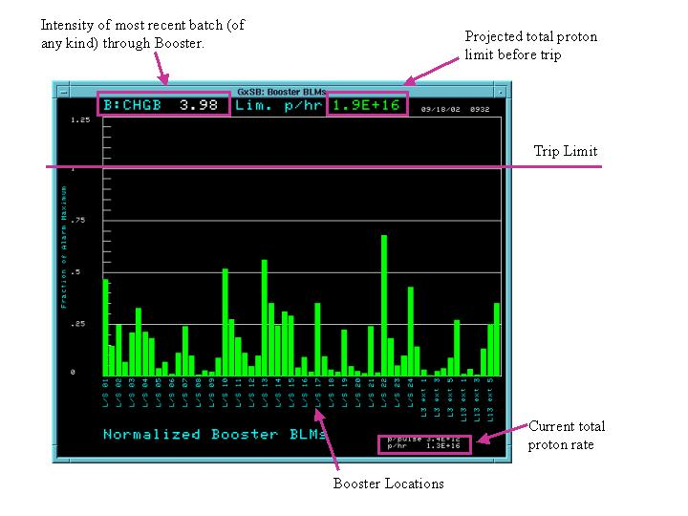
Tunnel Loss Limits

Slide 22
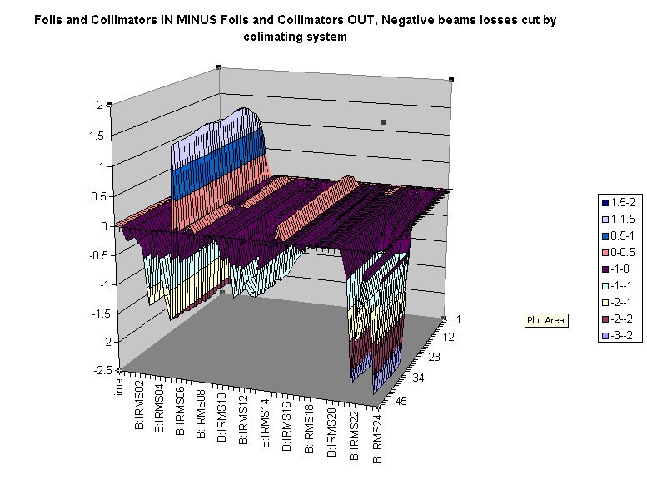
Differential Loss Monitor Example: Collimators in – Collimators Out
Collimator Position
Relative Loss
Time
Position

Slide 23
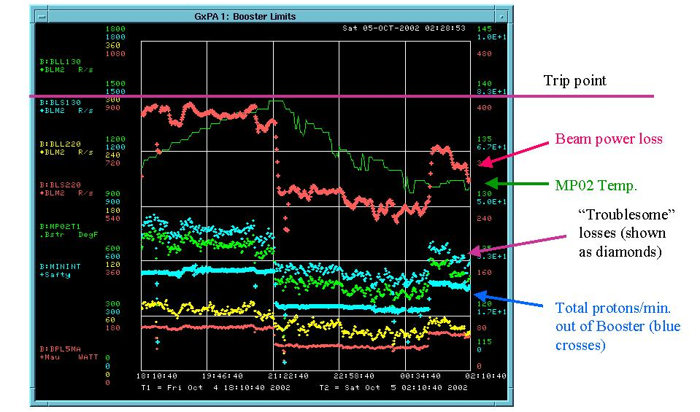
Summary of Booster Limits

Slide 24
Above Ground Radiation
Main worry are the high occupancy areas in the Booster towers.
Shielding has been added both in the tunnel and to the first floor of the Booster towers.
Offices have been moved to reclassify some worrisome areas.
Radiation is monitored by a system of “chipmunks” positioned around the Booster.
Part of the Booster permit system.

Slide 25
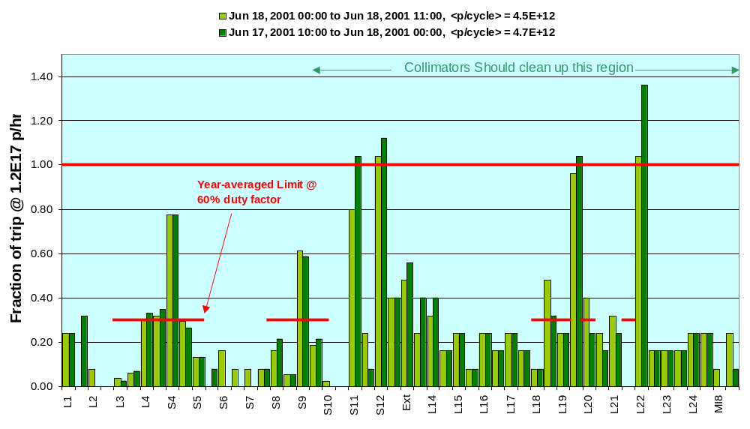
Best Performance + Shielding + BooNE Intensities
Scaled up from measurements during stacking-> looks OK

Slide 26
Problems with Fast Cycle Time
Existing Fermilab alarms and limits system works only with DC values.
There are several hundred important proton source measurements which vary over small time scales (usec to msec).
At present, the only way to monitor these is either examining them by hand or using discrete samples in the alarms and limits system.
-> Usually, problems can only be found indirectly by looking at performance. E.g. recently it took about a week to track down a low level RF problem which would have been obvious if we were looking at the right thing.
People who should be working to improve Booster performance spend all their time keeping it running.

Slide 27
Ramp Monitor Program
A dedicated task which will loop over all the ramping devices.
For each device, it will calculate a running average curve for each type of Booster cycle (pbar production, MiniBooNE, etc), and calculate an RMS.
Deviations from this curve will be logged, and possibly set alarms.
It’s envisioned that this program will greatly aid in debugging problems, and may well migrate to other parts of the accelerator.

Slide 28
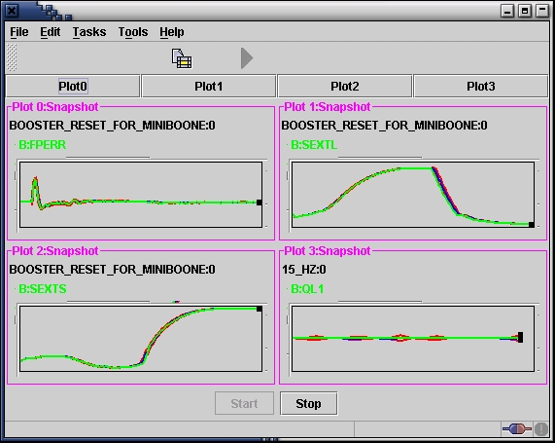
Ramp Monitor Progress
Latest Measurement
1 sigma envelope

Slide 29
Summary
Proton source performance has become important after many years of station keeping.
We have made great progress in the last year or so in improving and automating diagnostics.
Much work remains to be done!!!

