Slide 1
Fermilab Booster: Performance and Future Prospects
Eric Prebys
Off-Axis Workshop, FNAL, July 10, 2003

Slide 2
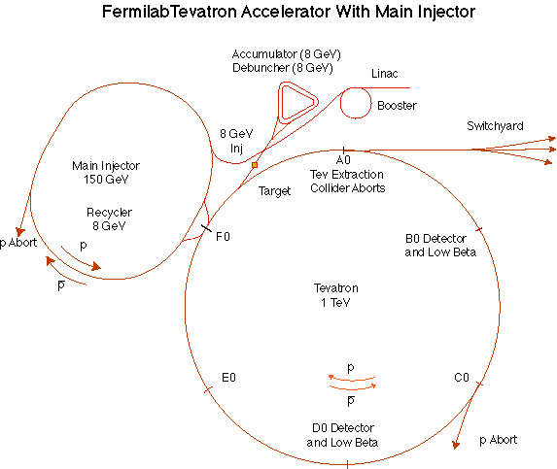
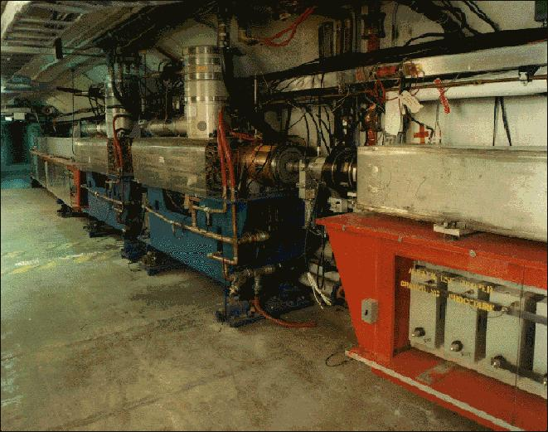
The Basics
The Booster takes the 400 MeV Linac Beam and accelerates it to 8 GeV.
From the Booster, beam can be directed to:
  The Main Injector
  MiniBooNE (switch occurs in the MI-8 transfer line).
  The Radiation Damage Facility (RDF) – actually, this is the old Main Ring transfer line.
  A dump.
The Booster is the only (almost) original accelerator in the Fermilab complex.
It maintains an average uptime of > 90%

Slide 3
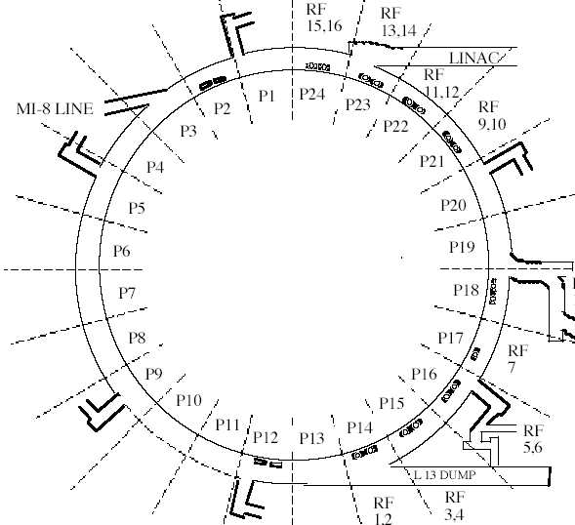
Booster layout
8GeV Beam to Main Injector and MiniBooNE
400 Mev Beam from Linac
472m in circumference
24-fold periodic lattice
Each period contains
4 combined function magnets.
Magnets cycle in a 15 Hz offset resonant circuit.
Old Main Ring Extraction Line
Used for study cycles, RDF and “short batching”

Slide 4
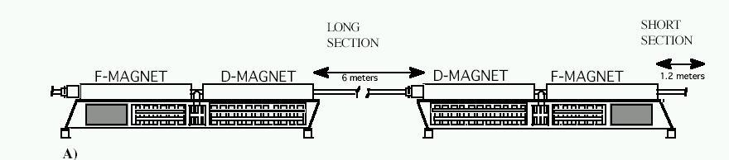
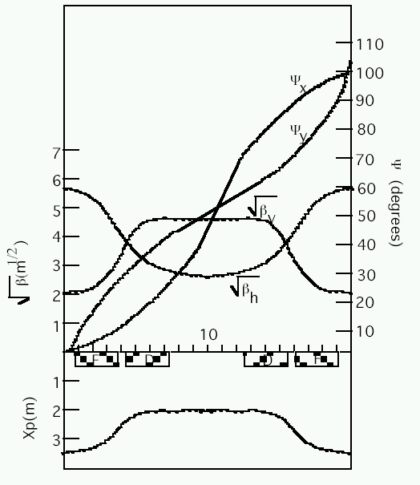
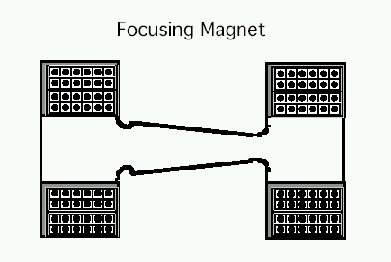
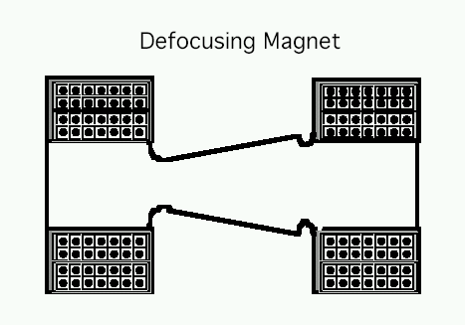
Booster Lattice Period (1 of 24)
1.64”
2.25”
Note aperture limit!!!
“Long straights” high-β in vertical plane
“Short straights” high-β in horizontal plane

Slide 5
Multi-turn Ion Injection
4 pulsed “ORBUMP” magnets
Circulating Beam
DC “Septum”
Beam at injection
400 MeV H⁻ beam from LINAC
Stripping foil
At injection, the 40 mA Linac H- beam is injected into the Booster over several “turns” (1 turn ~5E11).
The orbit is “bumped” out, so that both the injected beam and the circulating beam pass through a stripping foil, after which they circulate together.
At the moment, heating in the ORBUMP magnets limit our average rep rate (including prepulses to ~7.5 Hz).

Slide 6
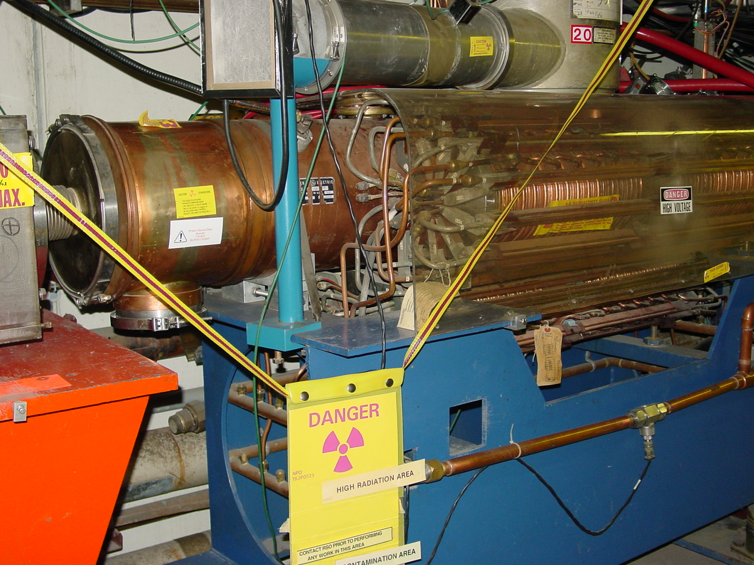
Booster RF System
18 more or less original RF cavities and power supplies.
Can run with 16 with increased losses.
biased ferrite tuners sweep frequency from 38 to 53 MHz during acceleration.
2 ¼” drift tube one of our primary aperture restrictions; new design being considered.
Pulsed when there’s beam + 2 prepulses.
Existing cavities might overheat at >7.5Hz
In-tunnel Power Amplifiers (PA’s) are by far the highest maintenance item in the Booster

Slide 7
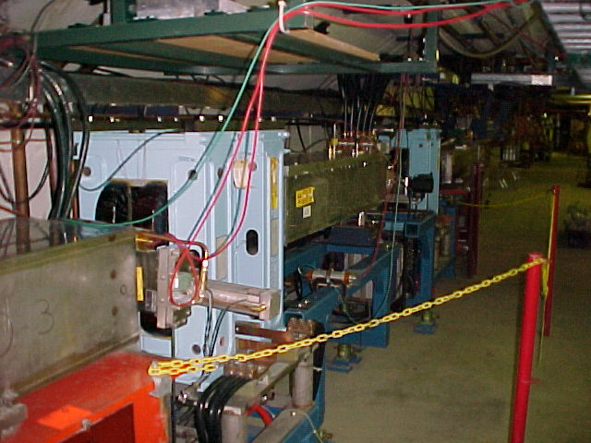
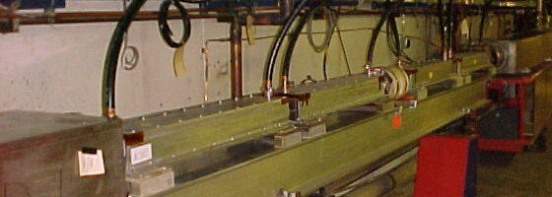
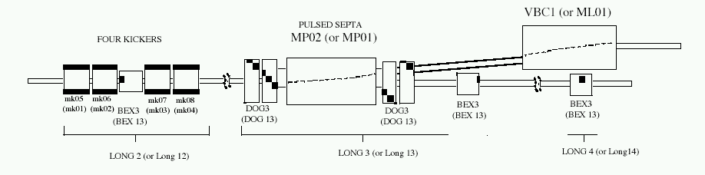
Booster Extraction (Long 3 and Long 13)
DC “doglegs” work with ramped 3-bump (BEXBUMP) to maintain 40π aperture below septum
Fast (~40 ns) kickers

Slide 8
8 GeV Proton Run II Goals and Performance
Parameter | Typical Current Performance | Run II Handbook Goal | Comments
Pbar Stacking Pulse Intensity | 4.8E12/batch* = 6.0E10/bunch | >5E12/batch | Limited by Booster efficiency and residual radiation concerns
Hourly Intensity | 0.8E16 Run II | 1.2E16 | Limited by Pbar cooling cycle time
Transverse Emittance | 15-17 π mm-mr | <15 π mm-mr
Collider filling Intensity | 7 bunches @ 5.5 – 6.0E10 / bunch | 5-7 bunches @ 6E10 / bunch
Longitudinal Emittance | 0.1 - 0.15 eV-sec / bunch | <0.1 eV-sec / bunch | Better understanding of transition crossing and improved longitudinal dampers
* One batch ~80 bunches (harmonic 84 with 3 bunch gap)

Slide 9
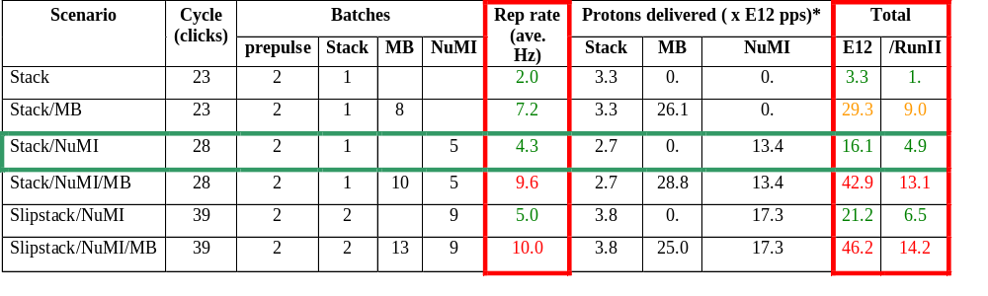
Summary of Proton Ecomomics
MiniBooNE baseline ≈ 5E20 p/year
Booster Hardware Issues
Radiation Issues
NUMI “baseline” = 13.4E12 pps x 2E7 s/year ≈ 2.7E20 p/year
Right now we’re at roughly 40% of the MiniBooNE baseline
*assuming 5E12 protons per batch

Slide 10
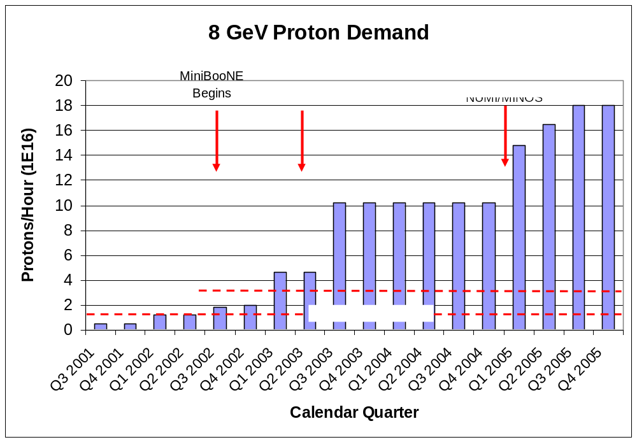
Demand for 8 GeV Protons
Fancy MI Loading schemes (or >5E12)
Shortfall
Present Operating Level

Slide 11
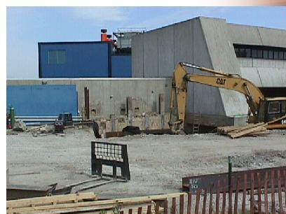
Some Things Which Have Been Done
Shielding and new radiation assessment
Vastly improved loss monitoring.
New (MP02) extraction septum and power supply (enable high rep. rate running)
New tuning strategies.

Slide 12
Limitations to Total Booster Flux
Total protons per batch: 4.2E12 with decent beam loss, 5.5E12 max.
Average rep rate of the machine:
  Injection bump magnets (7.5Hz)
  RF cavities (7.5Hz, maybe 15 w/cooling)
  Kickers (15 Hz)
  Extraction septa (was 2.5Hz, now 15Hz)
Beam loss
  Above ground:
    Shielding
    Occupancy class of Booster towers
  Tunnel losses
    Component damage
    Activation of high maintenance items (particularly RF cavities)
Of particular interest to NUMI
And stacking
Our biggest concern

Slide 13

Typical Booster Cycle
(actually much better now!)
Various Injected Intensities
Transition
Intensity (E12)
stacking
MiniBooNE
Energy Lost (KJ)
Time (s)

Slide 14
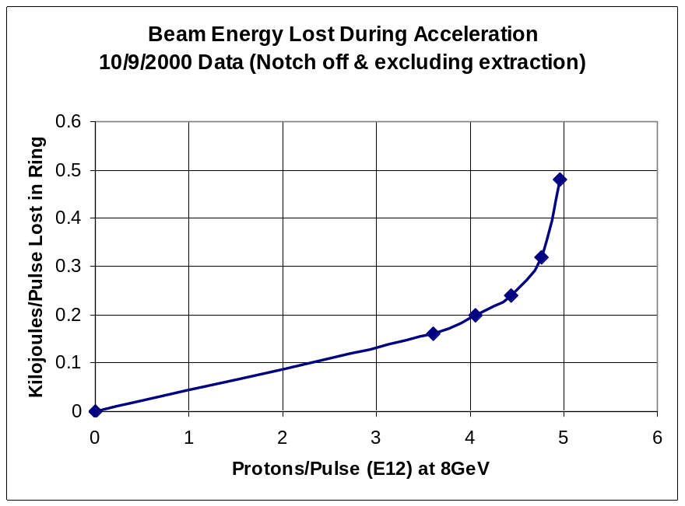
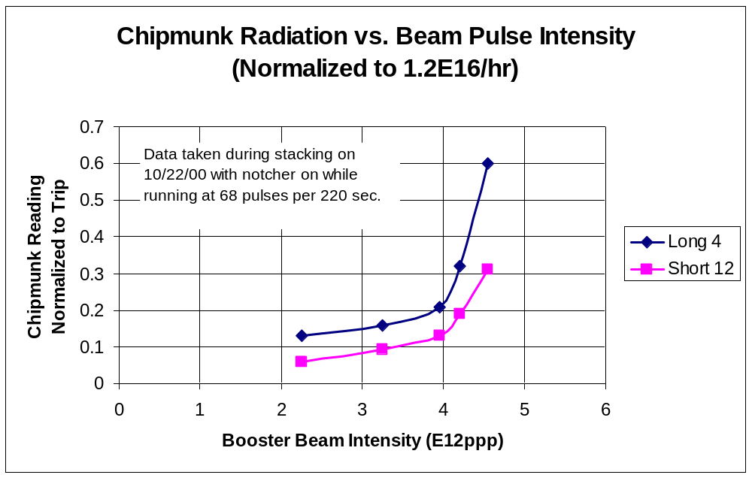
Beam Loss Intensity Sensitivity

Slide 15
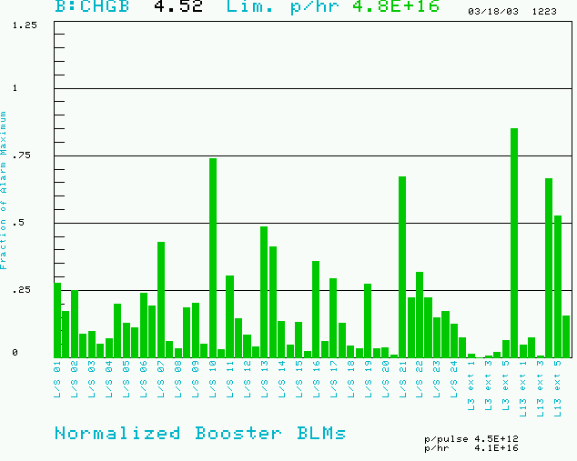
Booster Losses (Normalized to Trip Point)
Maximum based on trip point
Also limit total booster average power loss (B:BPL5MA) to 400W.
Present rate

Slide 16
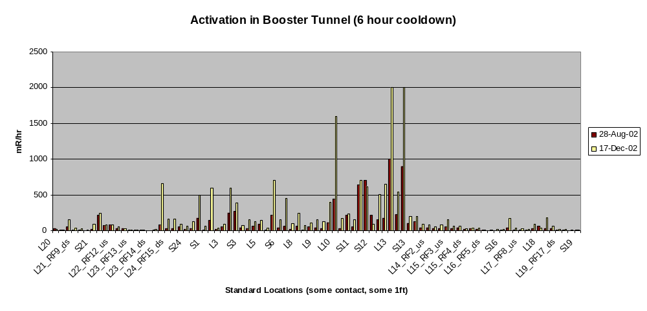
Booster Tunnel Radiation Levels
On a December access
  The people doing the radiation survey got about 20 mR.
  Two technicians received 30 mR doing a minor HV cable repair.
  We’re at (or past??) the absolute limit on our overall activation
  Some limits lowered afterwards (450W -> 400W)

Slide 17
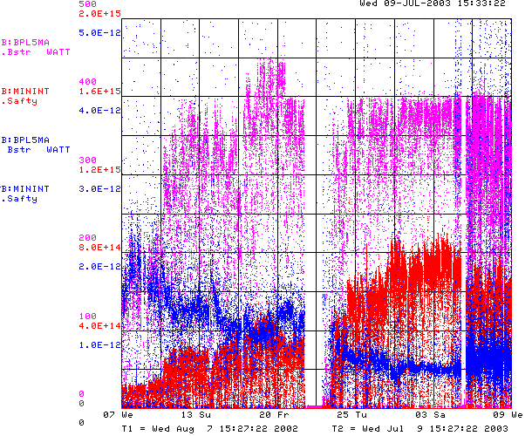
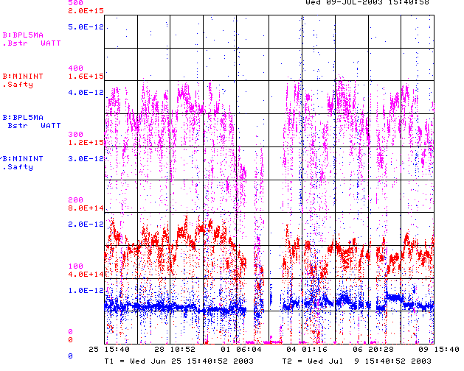
How are we doing?
Since MiniBooNE
Booster Power Loss
Last 2 weeks
Total protons/minute
Unstable Running after
power problems
Energy lost per proton
Better?

Slide 18
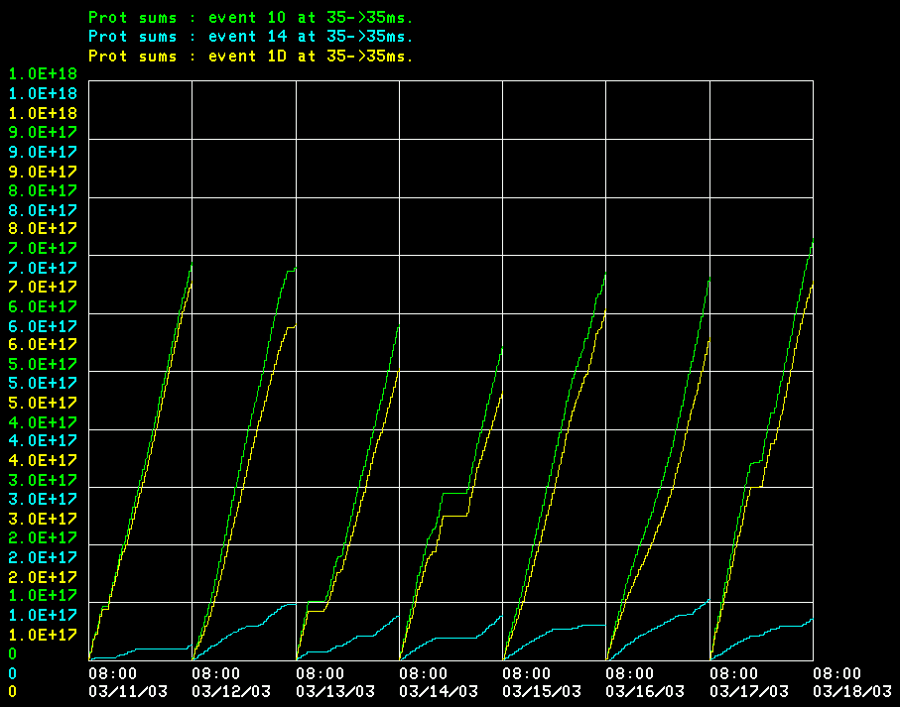
Where do Protons Go Now?
Total
MiniBooNE
Pbar production (limited by debunching and cooling)
Operationally, the collider gets whatever it wants, and MiniBooNE gets whatever is leftover within the limits

Slide 19
Bottom Line
(improvements since 11/02 indicated)
12
2E20
Running as we are now, the Booster can deliver a little over 1E20 protons per year – this is about a factor of six over typical stacking operations, and gives MiniBooNE about 20% of their baseline.
NuMI will come on line in 2005, initially wanting about half of MiniBooNE’s rate, but hoping to increase their capacity – through Main Injector Improvements – until it is equal to MiniBooNE.
Whatever the lab’s official policy, there will be great pressure (and good physics arguments) for running MiniBooNE and NuMI at the same time.
-> By 2006 or so, the Proton Source might be called upon to deliver
10 times what it is delivering now.
At the moment, there is no plan for assuring this, short of a complete replacement!
So what are we going to try?…
40%
5

Slide 20
Booster Collimator System
Basic Idea…
A scraping foil deflects the orbit of halo particles…
…and they are absorbed by thick collimators in the next periods.
Unshielded copper secondary collimators were installed in summer 2002, with a plan to shield them later.
Due the the unexpected extent of the shielding and the difficulty of working in the area, the design was ultimately abandoned as unacceptable.
Collimators were removed during the January shutdown.
A new collimator system is being designed with steel secondary jaws fixed within a movable shielding body.
Will be installed in the summer shutdown.

Slide 21
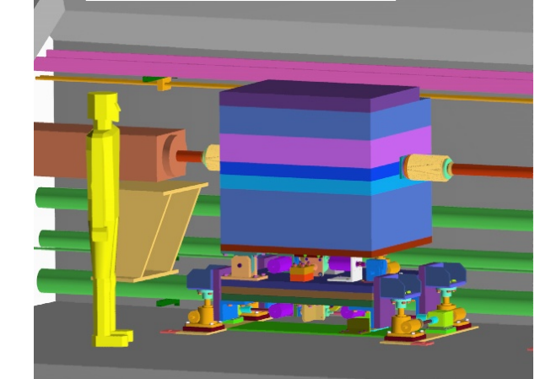
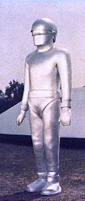
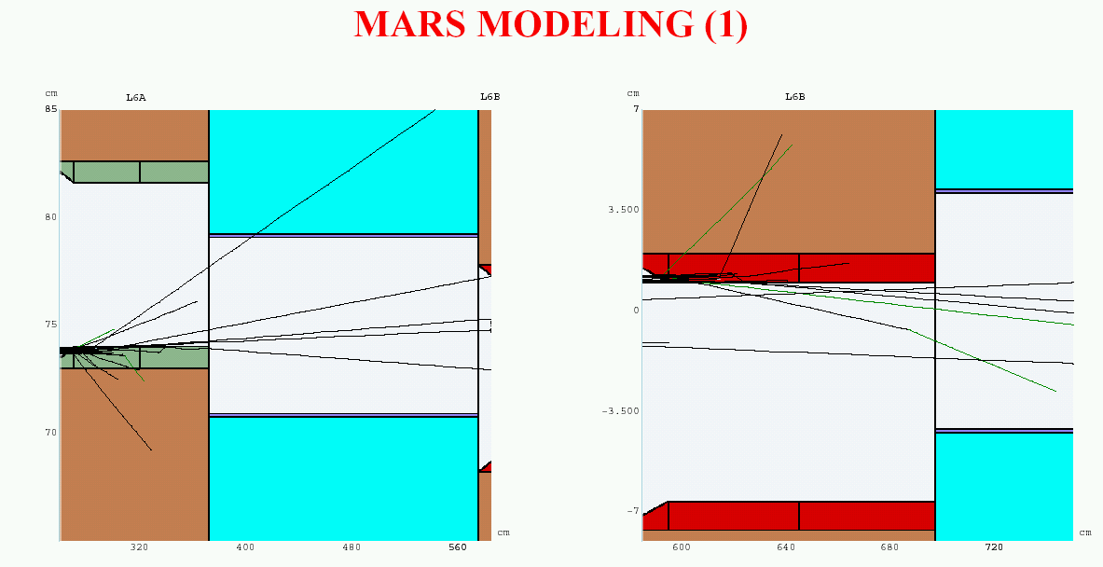
New Collimator System
System Designed to operate at full NuMI+MiniBooNE intensity and intercept:
  30% of beam at 400 MeV
  2% of beam at 8 GeV
Shielding determined by:
  Above ground radiation
  Sump water contamination
  Residual activation
No active cooling
All parts serviceable
Will be ready for summer shutdown!!
The booster technician of the future????

Slide 22
Dogleg Problem
Septum
Each of the two Booster extraction septa has a set of vertical dogleg magnets to steer the beam around it during acceleration.
More powerful doglegs were installed in 1998 to reduce losses early in the cycle.
These magnets have an edge focusing effect which distorts the horizontal injection lattice:
  50% increase in maximum β
  100% increase in maximum dispersion.
  Harmonic contributions.
Effect goes like I². Now tune to minimize.
Recently got an unusual opportunity to explore potential improvements from fixing the problem.
Working on schemes to reduce or remove problem.
Dogleg Magnets

Slide 23
Possible Solutions
Tune to minimize current?
  helped so far, but near limit.
  Maybe raise L13 septum a bit?
Motorize L13 septum to switch modes quickly?
  Operational nightmare
Eliminate L13?
  Find another way to short-batch
  Make a dump in MI-8 for Booster study cycles?
Correctors?:
  These don’t look like quads, so can’t find a fix – yet.
Spread out doglegs (effect goes down with square of separation): YES!!
  Long 3 this summer
  Long 13 later
Possibly redesign extraction septum later: EXPENSIVE!

Slide 24
Dogleg Stretch Out
Present Setup: Limited by strength of old extraction septum
Kicked beam
Circulating beam
Lattice D
septum
Lattice D
dogs
dogs
New Setup: New Long 3 septum allows it to be in middle of straight
Kicked beam
Circulating beam
septum
Lattice D
dogs
dogs
Lattice D
Increase dog pair separation from 18” -> 40”: More than a factor of four reduction in effect on beta and dispersion
Working hard to get done for L3 in summer shutdown (Argonne helping with stand fabrication)
New L13 septum built. Will modify when time allows.
When both are done, effect almost eliminated.
In the mean time, we will raise L13 (dump) septum slightly -> Overall factor of two reduction.
Expect dramatic improvements!!!!

Slide 25
New RF System?
The existing RF cavities form the primary aperture restriction (2 ¼” vs. 3 ¼”).
They are high maintenance, so their activation is a worry.
They might have heat load problems beyond 7.5Hz
There is a plan for a new RF system with 5” cavities:
  Powered prototype built
  Building two vacuum prototypes for the summer shutdown with substantial machining done at universities.
  Evaluate these and proceed (hopefully?) with full system

Slide 26
Summary of Major Projects for the Summer Shutdown
Stretch out Long 3 extraction region (ameliorates dogleg problem).
Install collimator system.
Replace 2 (of 18) RF cavities with wide aperture prototypes.
New dedicated damping cavity for additional longitudinal modes.
Do complete vertical alignments !! (as-founds are ongoing)
Install new Linac Lamberston (will improve 400 MeV optics and reduce losses)
Install four new wide aperture magnets in 8 GeV line.
Cautiously optimistic we can reach the MiniBooNE baseline goal after this shutdown!!

Slide 27
Multibatch Timing
In order to Reduce radiation, a “notch” is made in the beam early in the booster cycle.
Currently, the extraction time is based on the counted number of revolutions (RF buckets) of the Booster. This ensures that the notch is in the right place.
The actual time can vary by > 5 usec!
This is not a problem if booster sets the timing, but it’s incompatible with multi-batch running (e.g. Slipstacking or NuMI)
We must be able to fix this total time so we can synchronize to the M.I. orbit.
This is called “beam cogging”.

Slide 28
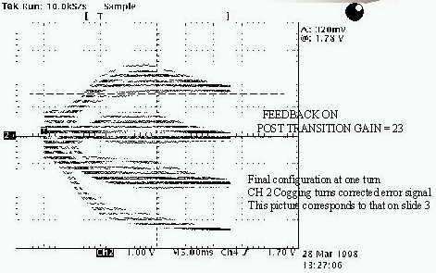
Active cogging
Detect slippage of notch relative to nominal and adjust radius of beam to compensate.
Allow to slip by integer turns, maintaining the same total time.
Does not currently work at high intensities.
Still do not really understand the problem.
Problem delayed by RF personnel problems -> easing up somewhat.
Significantly ramping up activity on this problem (and other LLRF)

Slide 29
Rate Issues running MiniBooNE+NUMI+Stacking
In order to meet all future demands of the Booster, it will have to either produce markedly larger batches (>8E12), or go to higher rep. Rate (10-12 Hz). This is limited by:
  ORBUMP magnets and PS
    Adiabatic PS upgrade in progress
    Have a plan to stretch out injection dogleg to allow it to run at lower current. All we need is the money.
  RF system
    Present system is limited to ~7.5 Hz by worries about heating of the drift tube and blocking capacitor.
    Can either implement cooling on existing system (some worries about its state) OR
    Go to new RF system which has cooling built in.

Slide 30
Simulation/Studies
Historically, the booster has lacked a fundamental understanding of beam loss mechanisms.
If (!!!) it is possible at all to go the the required beam flux, it will require some mitigation of beam loss.
Recently, there has been an great increase in the involvement of the Beam Physics department in the Booster:
  Space charge group (W. Chou, et al) has begun to focus on the Booster again. Immediate focus: improving model.
  Starting to make quantitative comparisons between predictions and measurement.
An almost immediate result of this increased effort was the discovery of the “dogleg problem”….

Slide 31
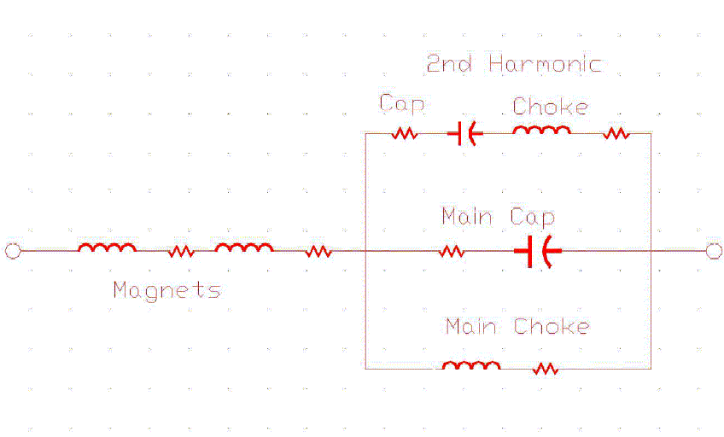
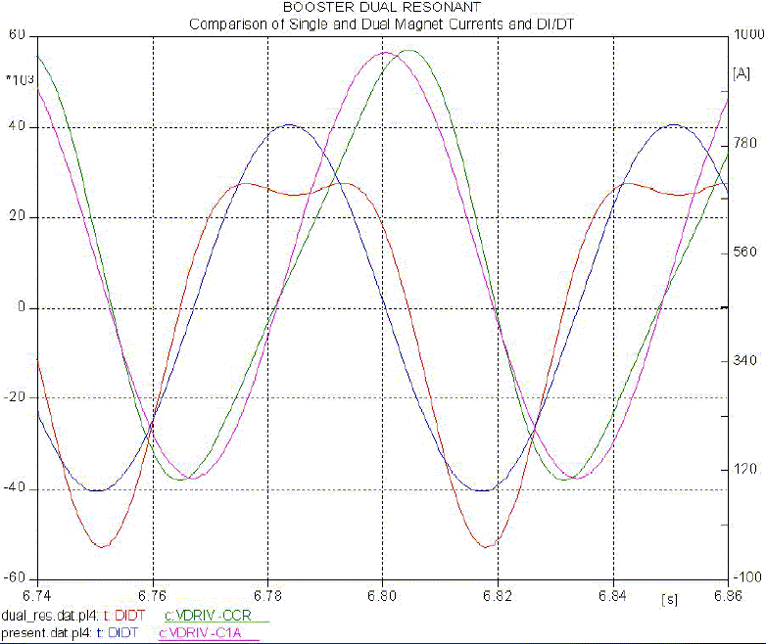
Idea: 2nd Harmonic Operation
We’re investigating the possibility of adding some 30 Hz harmonic to our magnet cycles
~ 1/3 reduction in peak dB/dt
~ 1/3 more RF power!!!
Would probably get more beam through transition.
Looking into it. Cost is probably around $1M

Slide 32
Summary and Outlook
On a good day, the Booster can deliver about 5E16 protons per hour – about half of what is needed now.
There is a reasonable chance that the collimators+dogleg fixes will get us to 1E17 pph – enough for stacking and MiniBooNE.
Adding initial NuMI+slipstacked pbar stacking will raise the demand to ~1.5E17 pph, and require the Booster to go to ~9Hz
  ORBUMP improvements
  RF cooling improvements (or new RF)
If fancy MI loading schemes work, the demand – limited by MI cycle time, will be about 2E17 pph, about four times our best performance now.
This is not out of the realm of possibility, but certainly not guaranteed.
It would not be responsible to make plans which involve the existing Booster delivering more than this.

Slide 33
(additional slides)

Slide 34
Proton Timelines
Everything measured in 15 Hz “clicks”
Minimum Main Injector Ramp = 22 clicks = 1.4 s
MiniBoone batches “sneak in” while the MI is ramping.
Cycle times of interest
  Min. Stack cycle: 1 inj + 22 MI ramp = 23 clicks = 1.5 s
  Min. NuMI cycle: 6 inj + 22 MI ramp = 28 clicks = 1.9 s
  Full “Slipstack” cycle (total 11 batches):
    6 inject
    + 2 capture (6 -> 3)
    + 2 inject
    + 2 capture (2 -> 1)
    + 2 inject
    + 2 capture (2 -> 1)
    + 1 inject
    + 22 M.I. Ramp
    ----------------------
    39 clicks = 2.6 s

Slide 35
New RF System?
The existing RF cavities form the primary aperture restriction (2 ¼” vs. 3 ¼”).
They are high maintenance, so their activation is a worry.
There is a plan for a new RF system with 5” cavities:
  Powered prototype built
  Building two vacuum prototypes for the summer shutdown with substantial machining done at universities.
  Evaluate these and procede (hopefully?) with full system

Slide 36
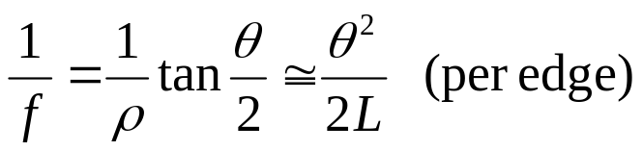
Parasitic Focusing
Rectangular (RBEND) magnet:
vertical focusing if beam has component into page
vertical focusing if
beam has component
out of page
Focusing in
non-bend plane!!
f
f
θ/2
θ/2
Side View
Top View
Always focusing!!

Slide 37
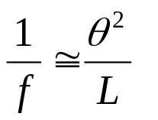




Parasitic Focusing (cont’d)
Sector (SBEND) magnet:
Focusing in
bend plane!!
Longer L
Nominal L
B ~constant
Shorter L
Trade-off:
SBEND
RBEND
Exit angle
Non-bend plane focusing
bend plane focusing

Slide 38
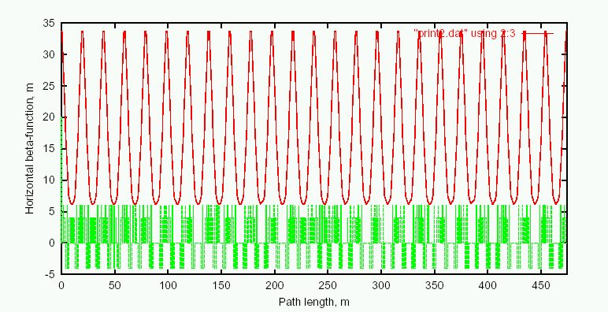
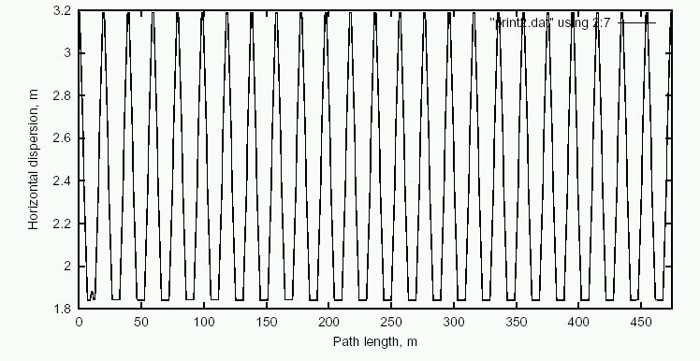
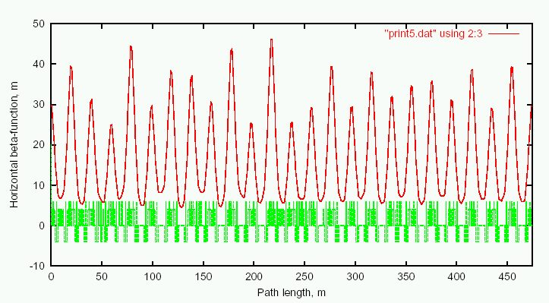
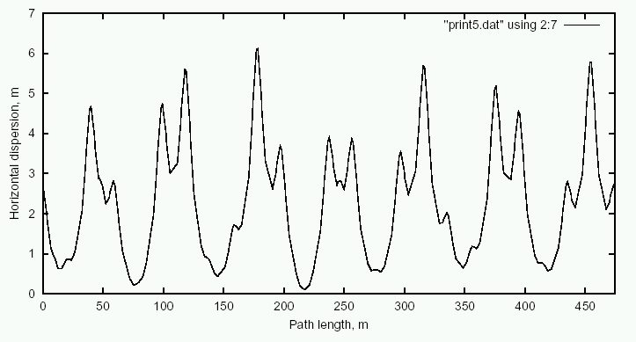
Predicted Effect of Doglegs
Ideal Lattice
β_{x}
D_{x}
Add Doglegs
β_{x}
D_{x}

Slide 39
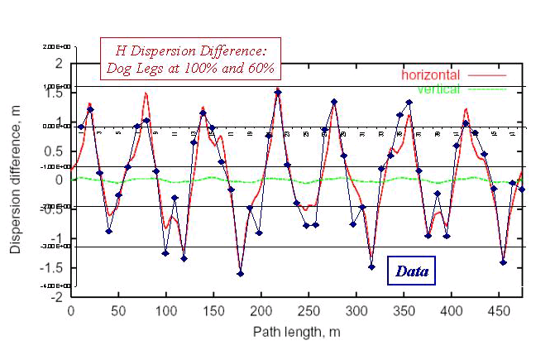
Preliminary Study: Dispersion
Measured dispersion for different dogleg currents:

Slide 40
Dead Dog Studies
Took advantage of recent TeV Magnet failure to raise the Long 13 (dump) septum and turn off the associated dogleg.
Doglegs almost exactly add, so this should reduce the effect by almost half.
The mode of operation prevents short batching, booster study cycles and RDF operation.
Had about 36 hours of study in this mode.
Bottom Line: major improvement.

Slide 41
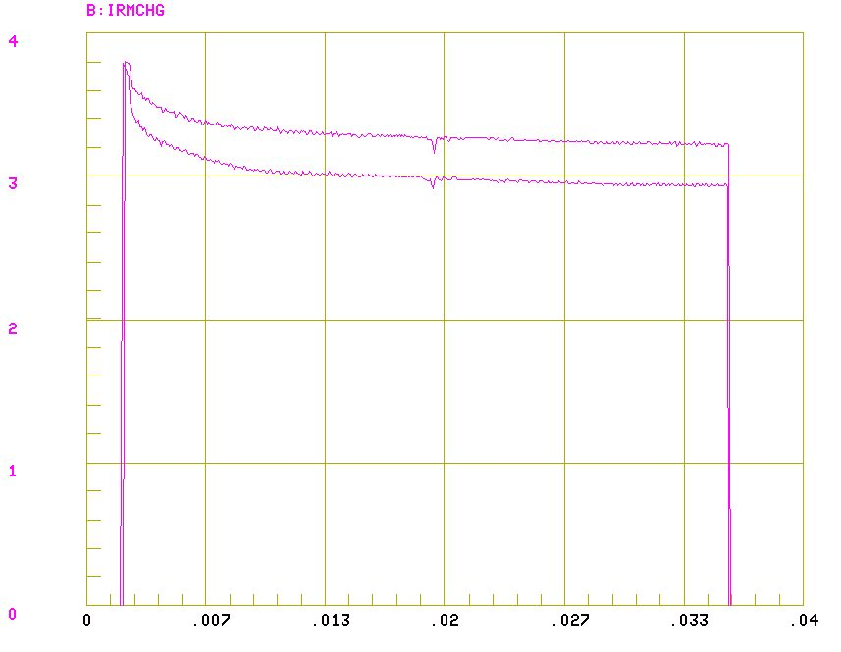
Transmission After Tuning
March 6, 7 turns, 1 dog
March 3, 7 turns, both dogs

Slide 42
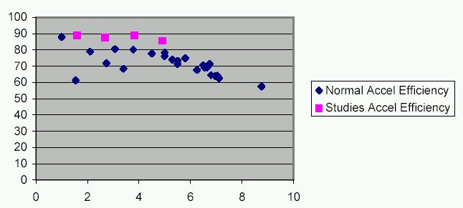
Transmission with One Dogleg
%
Injected Charge (E12)

Slide 43
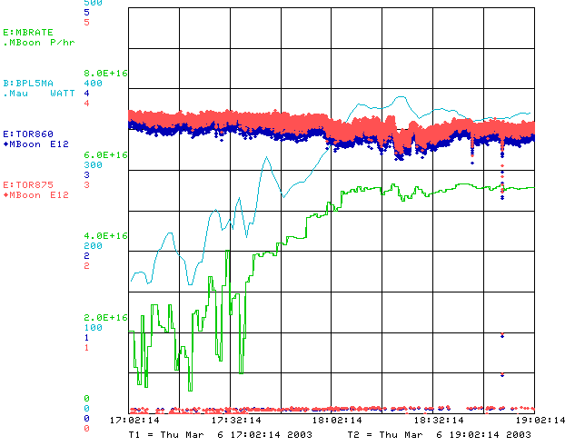
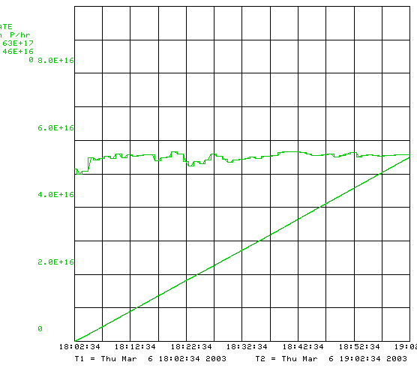
Record Running w/o Dogleg

Slide 44
Increasing Reliability and Repeatability
Until shutdown, primary goal is to improve repeatability of demonstrated performance.
Fully characterize machine during periods of good running:
  Beam positions in 400 MeV line
  Beam energy and phase
  Longitudinal parameters
  Record loss patterns
  Upgrade BPM system to give turn-by-turns for full cycle
  New tuning tools will allow us to display losses relative to a reference, rather than just a limit.
  Whatever else we can think of
Booster monitoring program
  Basically an alarms and limits system that works with ramping devices or measurements.
  Collaboration with CD
  Uses JAVA controls system to monitor a list of Booster devices, separated by event type
  Logs deviations from nominal.
  Being commissioned now.

Slide 45
Injection Dogleg (ORBUMP)
The current injection bump dogleg (ORBUMP) magnets can ramp at 7.5 Hz, with a substantial temperature rise.
Need to go to 10 to support MiniBooNE and NuMI.
2 spares for the 4 (identical) magnets. Most likely failure mode probably repairable.
Considering new design which will stretch existing magnets further apart, which will lower their current, but will require a pulsed injection septum between the first two.
Can new design incorporate injection improvements??
Some power supply issues as well:
  One full set of replacement SCR’s for the switch network.
  New switchbox being designed, but needs attention (or order more spare SCR’s).
  No spare for charge recovery choke.

Slide 46
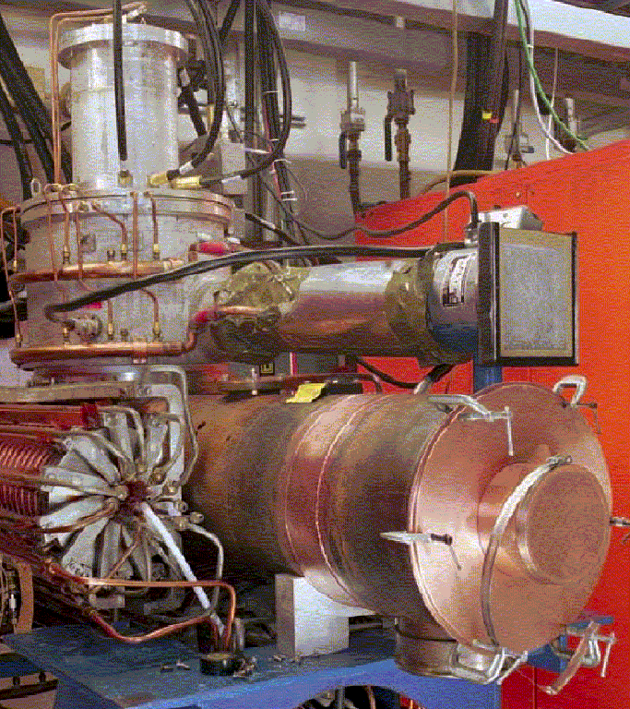
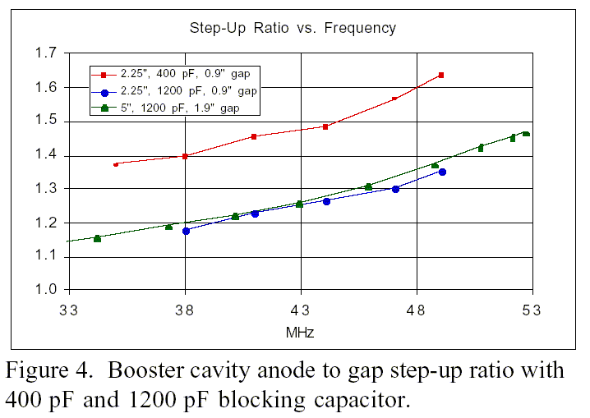
Large Aperture RF Prototype (2001)
Non-vacuum large aperture cavity built as proton driver R&D project.
Straightfowarward modification of existing design.
Results:
  Will work for Booster
  Higher gap voltage

Slide 47
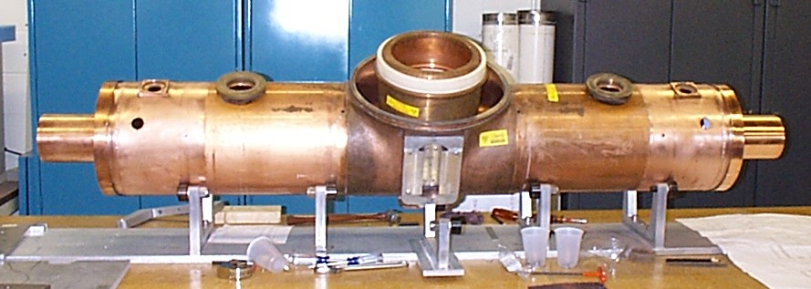
Status of Vacuum RF Prototype Project
Substantial Machining done at 6 NUMI+MiniBooNE universities
  All parts completed and up to spec!!!
  Total cost to lab $10K
All assembly fixtures complete. Fabrication at MI-60
Cavity fabrication proceding in parallel.
Use slightly modified existing tuners.
Still on track for installation in summer shutdown.

