Slide 1
The Proton Source
Booster
Linac
400 MeV “DMZ”
Activities:
  Deliver reliable beam to the entire complex
  Work to reduce beam losses, which currently limit the total flux to the neutrino experiments.
  Address reliability concerns, under the assumption that the existing source will have to operate for ~10 more years.

Slide 2
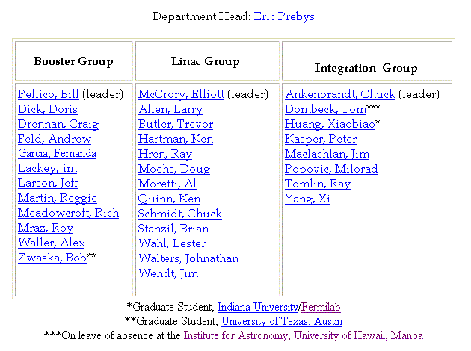
Jumping on the Restructuring Bandwagon…
Proton Source Department
New
New group. Responsibilies:
Coordinate modeling and studies
Address global issues

Slide 3
Some Specific Issues
Near Term
  Linac/400 Mev Line Instrumentation and Characterization
  Booster Lattice Optimization
  Collimator Commissioning
  Beam Cogging for pbar production
  Alignment!!!!!
This year:
  Complete lattice work (Long 13 dogleg)
  Upgrade ORBUMP and power supply
  Install prototype RF cavities as 19th and 20th (???)
Longer term (proton plan):
  Upgrade RF system (cavities and/or distributed amps)
  New corrector system (trims+multipoles):
  30 Hz Harmonic to Booster ramp ???
  Lots of maintenance projects

Slide 4
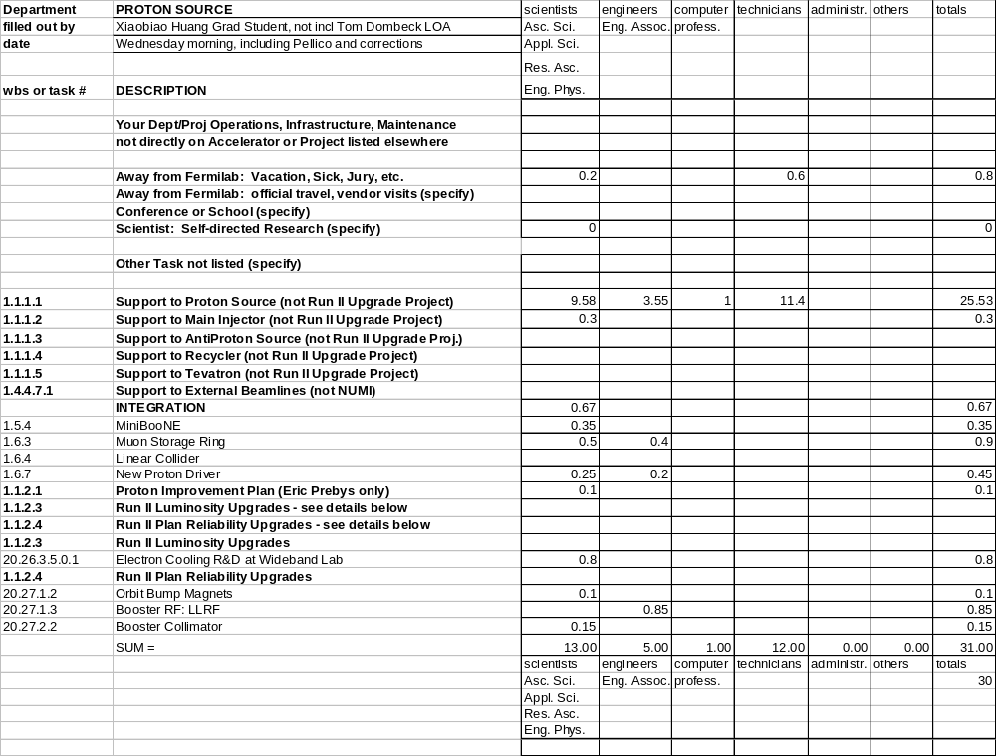
Effort Snapshot

