Slide 1
Delivering 9E16 to MiniBooNE
5E12 protons per pulse
  10 MiniBooNE + 1 pBar + 2 prepulse @ 2 sec.
    5Hz to MiniBooNE
    6.5Hz Booster total
  Slightly increased radiation to Booster
4E12 protons per pulse
  12 MiniBooNE + 1 pBar + 2 prepulse @ 2 sec.
    6 Hz to MiniBooNE
    7.5Hz Booster total
  Increased risk to:
    MiniBooNE horn
    ORBUMP magnets

Slide 2
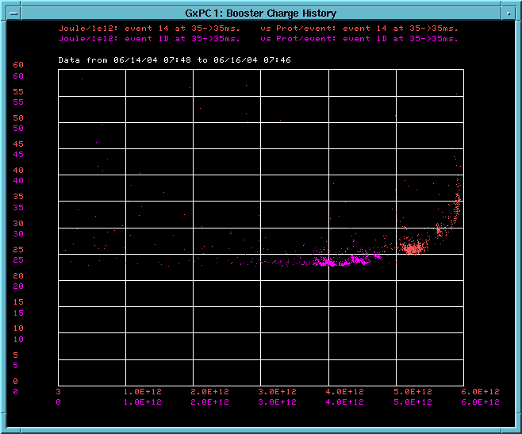
Effect of increased intensity (recent running)
4E12
5E12
Energy Lost per proton
~5% more losses (activation) at 5E12
Protons per pulse

Slide 3
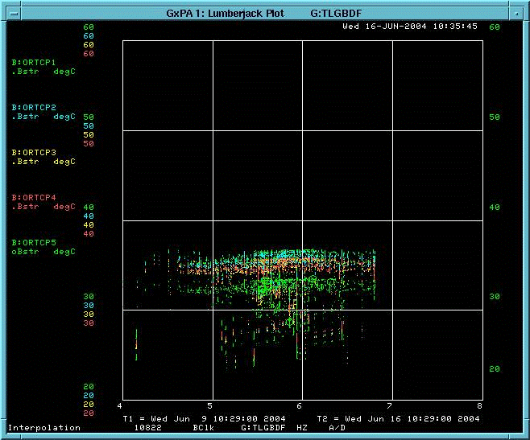
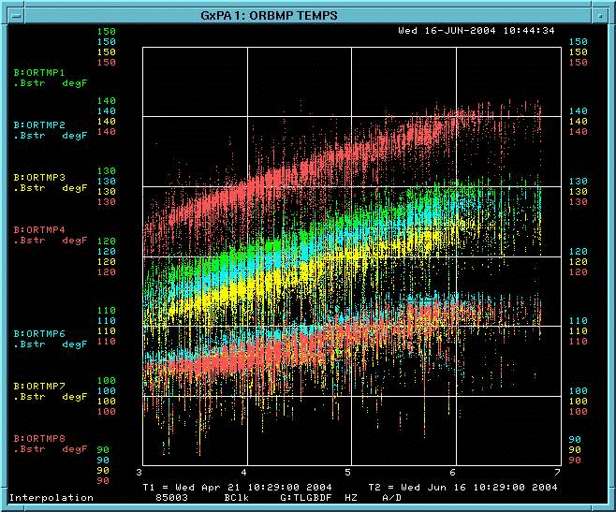
Effect of Increased rep. rate
ORBUMP Cap. Temp
ORBUMP Mag. And stripline temp
6.5
7.5
6.5
7.5
Probably OK
A bit worrisome

Slide 4
Comments and Conclusion
All projection assume 5E12, NOT 4E12 from MiniBooNE
The results in slightly more radiation (of order ~5%)
Increased rep. rate is a worry:
  Regularly run at 6.5Hz
  7.5Hz demonstrated for one 24 hour period
Most likely high rep. Rate failure: vacuum leak in ORBUMP magnets
  Would pick up a LOT of radiation fixing it.

