Slide 1
Impact of MiniBooNE on Collider
No direct impact by definition
  Pbar and collider get whatever protons they want.
  MiniBooNE gets whatever it can after that.
Indirect impacts
  Negative
    Increased Booster loss trips
    Increased failure rate of pulsed components (not seen yet)
    Increased cooldown time due to activation.
  Positive
    More consistent Booster performance because of closer attention.
    Better understanding of Booster will lead to superior performance for the collider.
Bottom Line:
  Typical collider luminosities (peak and integrated) have gone up almost 50% since MiniBooNE started running.
  It is unlikely that MiniBooNE will ever have a significant effect on collider operation.

Slide 2
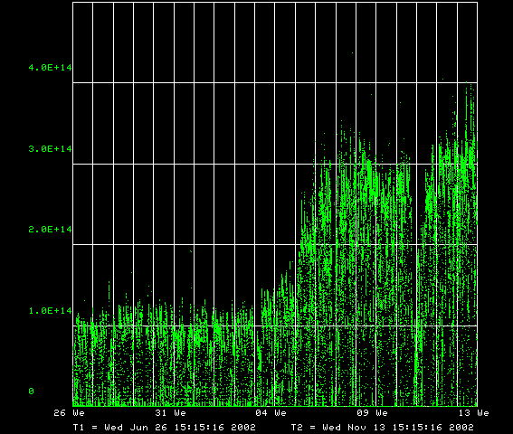
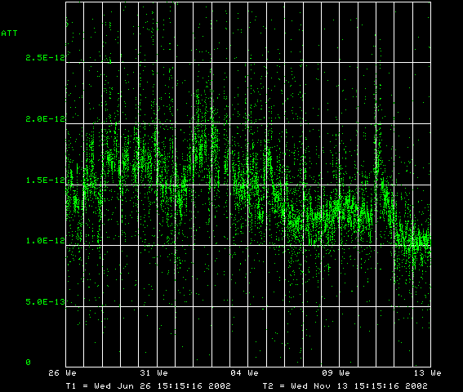
Performance of Booster (Last 20 Weeks)
Total Proton Output (p/min.)
Tunnel Loss per proton (W-min/p)
MiniBooNE Running
MiniBooNE Running

