Slide 1
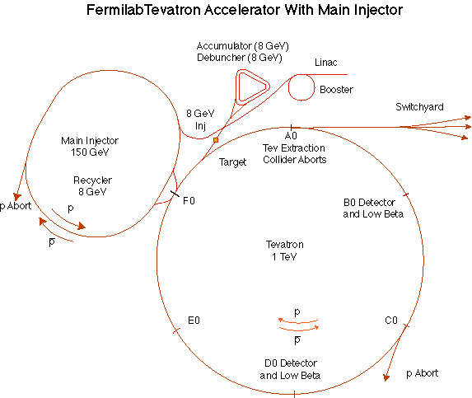
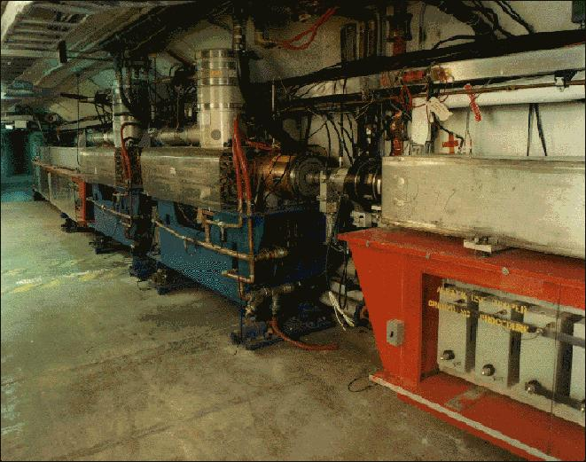
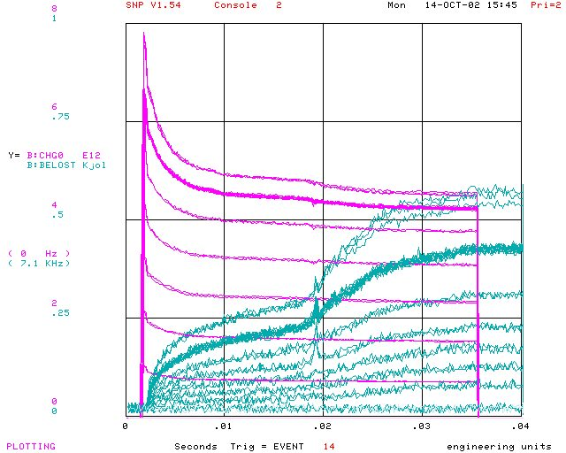
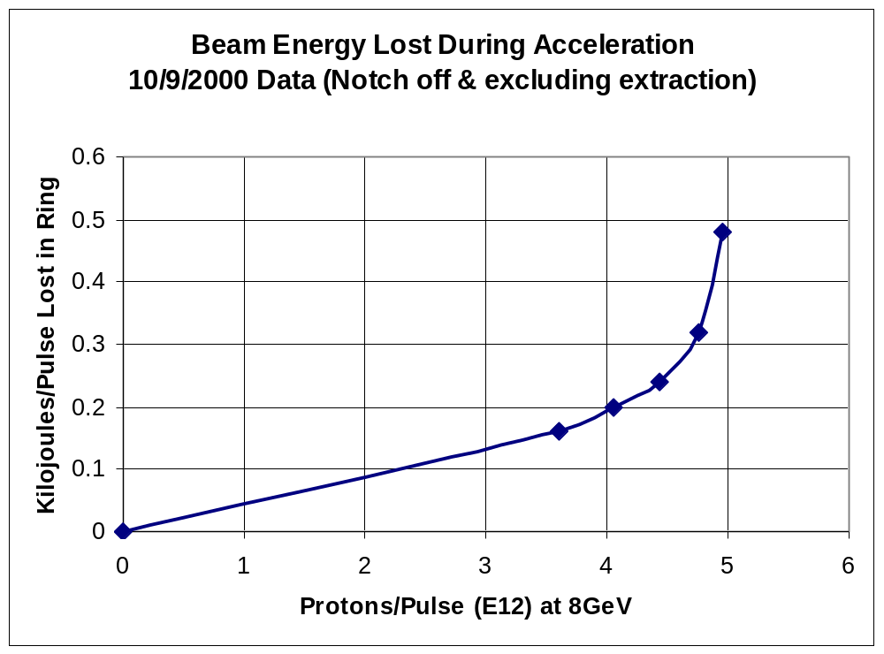
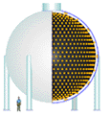
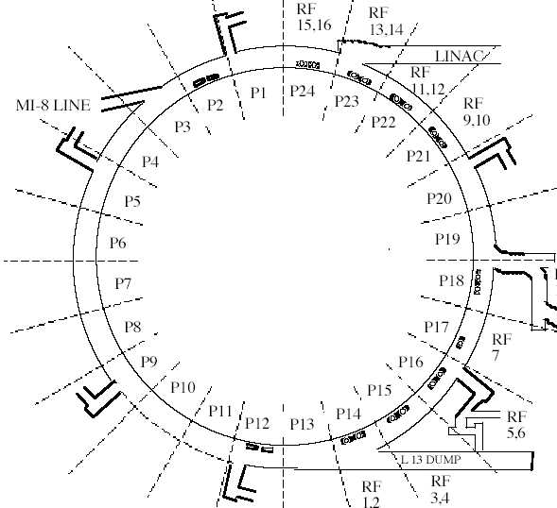
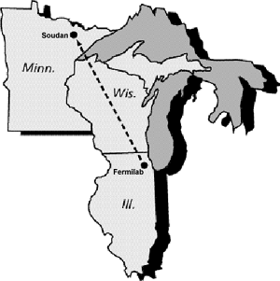
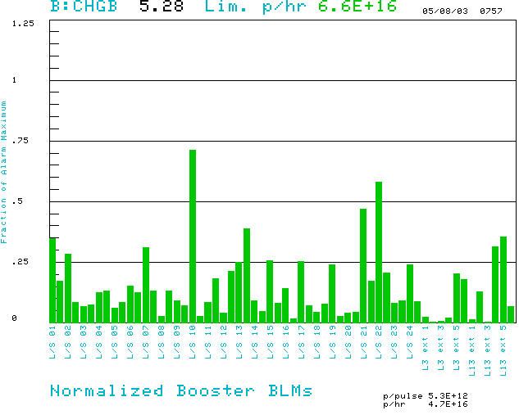
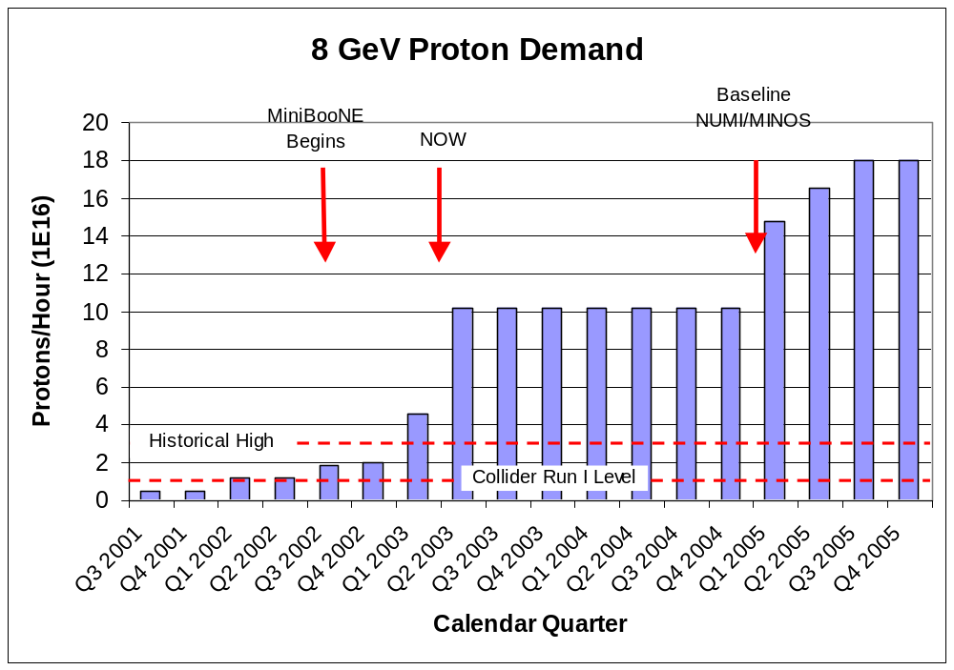
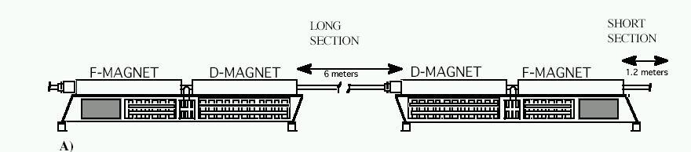
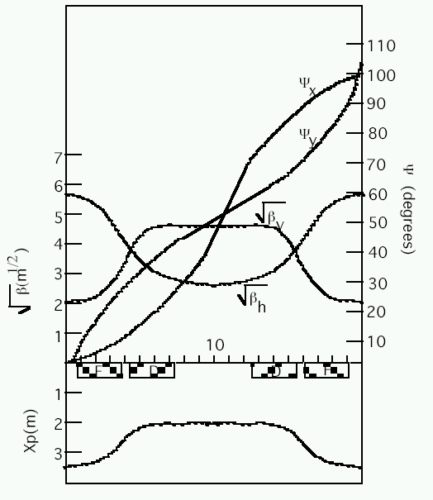
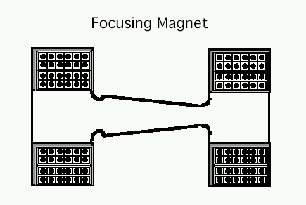
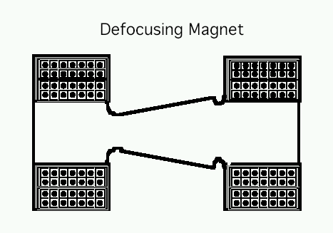
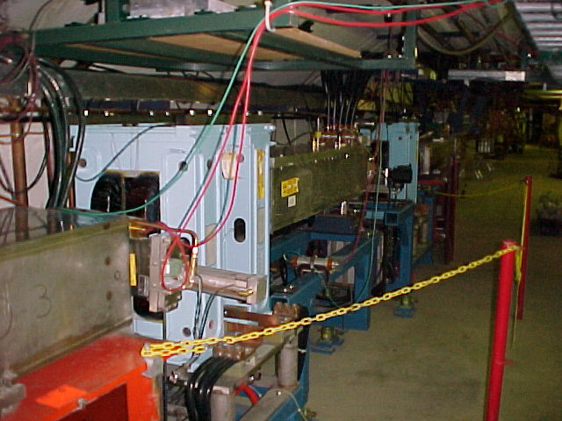
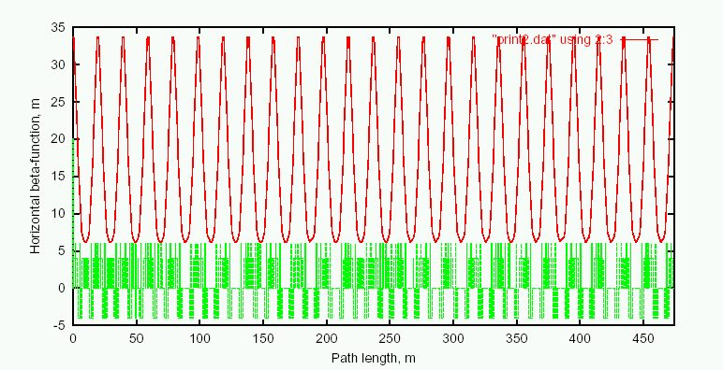
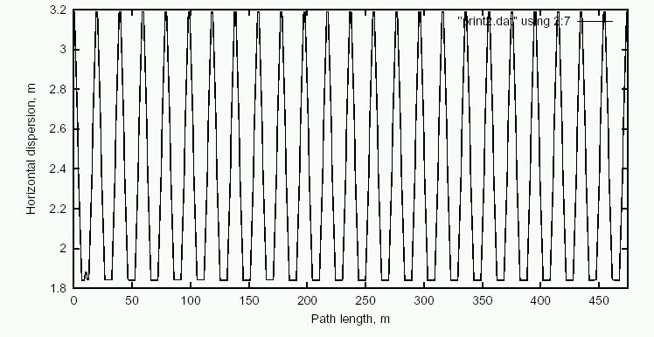
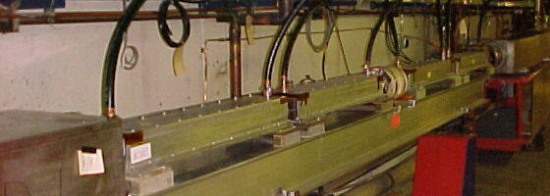
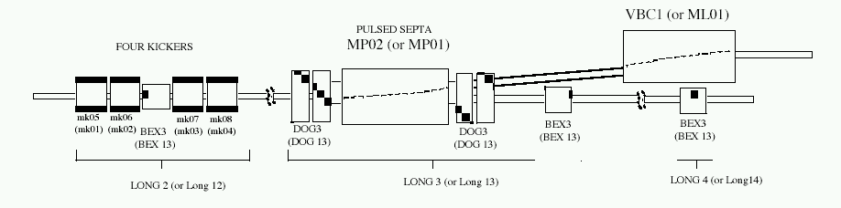
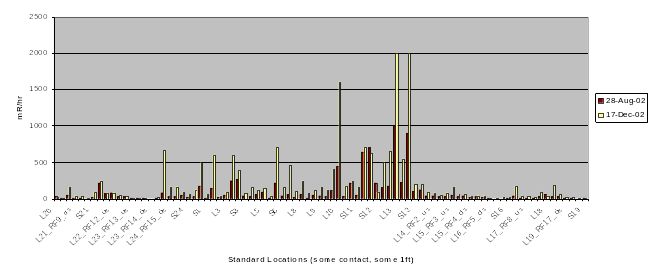
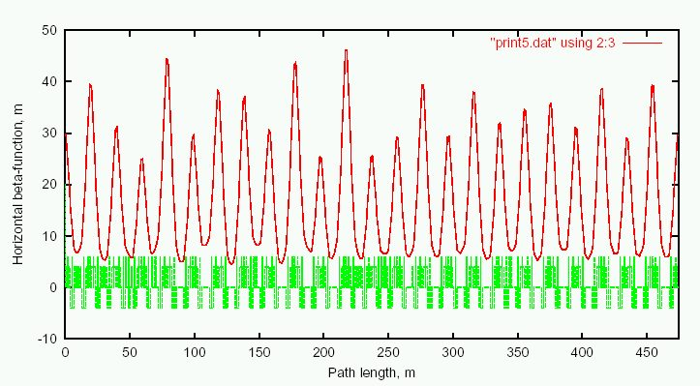
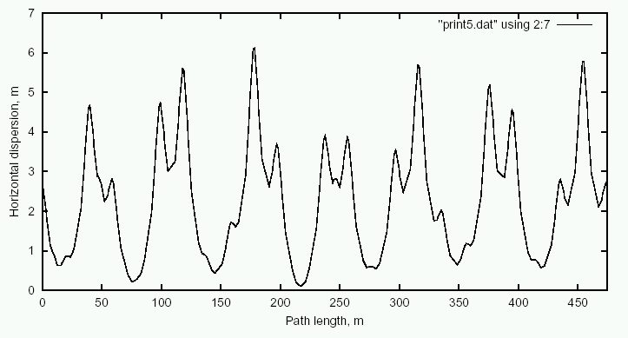
Increasing the Intensity of the Fermilab Booster
E. Prebys, C. Ankenbrandt, W. Chou, A. Drozhdin, P. Kasper, J. Lackey, N. Mokhov, W. Pellico, T. Sullivan, R. Tomlin, R. Webber
FNAL, Batavia, IL 60510
ABSTRACT
The Fermilab Booster is a fast-cycling synchrotron which accelerates protons from 400 MeV to 8 GeV of kinetic energy. Until recently, the primary demand for protons was for antiproton production, which typically uses about 7E15 protons per hour. Over the next few years, the Fermilab neutrino program will increase that demand dramatically, possibly beyond 1.8E17 protons per hour. This paper discusses the issues involved in reaching these intensities, and the plan for achieving them.
The Fermilab Booster
Increasing Proton Demand
Beam Loss and Monitoring
The Booster takes the 400 MeV Linac beam and accelerates it to 8 GeV.
From the Booster, beam can be directed to:
  The Main Injector
  MiniBooNE (switch occurs in the MI-8 transfer line).
  The Radiation Damage Facility (RDF)
  A dump.
The Booster is the only (almost) original accelerator in the Fermilab complex.
It maintains an average uptime of > 90%
ANTIPROTON PRODUCTION
Various Injected Intensities
Intensity (E12)
5E12 protons sent to the Main Injector every 2 seconds, to be accelerated to 120 GeV and delivered to the antiproton production trarget
~.7E16 protons per hour
Small compared to…
Transition
Energy Lost (KJ)
NEUTRINO PROGRAM
MiniBooNE-neutrinos from 8 GeV Booster proton beam (L/E~1):
absolutely confirm or refute the LSND result
8GeV Beam to Main Injector and MiniBooNE
400 Mev Beam from Linac
Time (s)
Maximum based on trip point
NuMI/Minos – neutrinos from 120 GeV Main Injector proton beam (L/E~100):
precision measurement of ν_{μ} ↔ ν_{τ} oscillations as seen in
atmospheric neutrinos.
100 second average beam loss at 60 locations, normalized to trip point (will inhibit beam if >1).
472m in circumference
24-fold periodic lattice
Each period contains
4 combined function magnets.
Magnets cycle in a 15 Hz offset resonant circuit.
Old Main Ring Extraction Line
DEMAND
Also limit total booster average power loss to 400W.
Used for study cycles, RDF and “short batching”
Fancy MI Loading schemes (or >5E12)
LATTICE
Present rate
Shortfall
Present Operating Level
Known Lattice Problems
“Long straights” high-β in vertical plane
“Short straights” high-β in horizontal plane
Septum
Each of the two Booster extraction septa has a set of vertical dogleg magnets to steer the beam around it during acceleration.
More powerful doglegs were installed in 1998 to reduce losses early in the cycle.
These magnets have an edge focusing effect which distorts the horizontal injection lattice:
  50% increase in maximum β
  100% increase in maximum dispersion.
  Harmonic contributions.
Effect goes like I². Now tune to minimize.
Recently got an unusual opportunity to explore potential improvements from fixing the problem.
Working on schemes to reduce or remove problem.
INJECTION
Limitations to Total Booster Flux
Circulating Beam
Total protons per batch: 4E12 with decent beam loss, 5E12 max.
Average rep rate of the machine:
  Injection bump magnets (7.5Hz)
  RF cavities (7.5Hz, maybe 15 w/cooling)
  Kickers (15 Hz)
  Extraction septa (was 2.5Hz, now 15Hz)
Beam loss
  Above ground:
    Shielding
    Occupancy class of Booster towers
  Tunnel losses
    Component damage
    Activation of high maintenance items (particularly RF cavities)
DC “Septum”
Of particular interest to NUMI
And stacking
400 MeV H⁻ beam from LINAC
Beam at injection
4 pulsed
“ORBUMP” magnets
Dogleg Magnets
Stripping foil
At injection, the 40 mA Linac H- beam is injected into the Booster over several “turns” (1 turn ~5E11).
The orbit is “bumped” out, so that both the injected beam and the circulating beam pass through a stripping foil.
Ideal Lattice
EXTRACTION
Our biggest concern
β_{x}
D_{x}
TUNNEL ACTIVATION
Add Doglegs
Before MiniBooNE
D_{x}
Hottest Period (lowered loss limits afterward)
Fast (~40 ns) kickers
DC “doglegs” work with ramped 3-bump (BEXBUMP) to maintain 40π aperture below septum

Slide 2
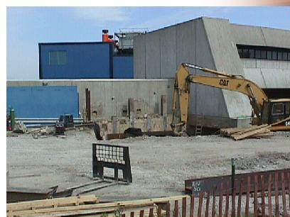
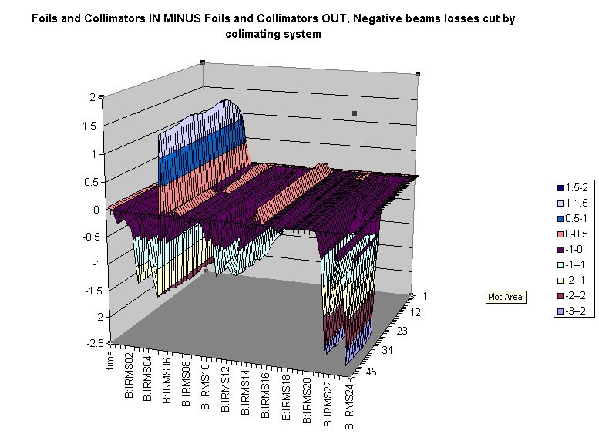
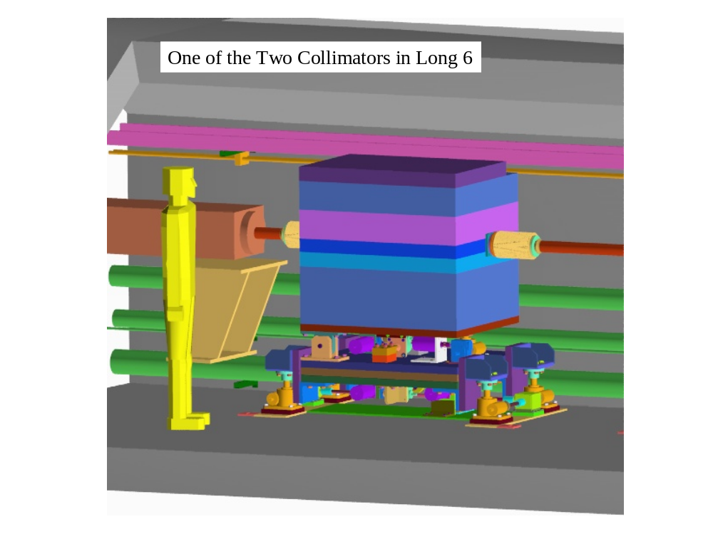
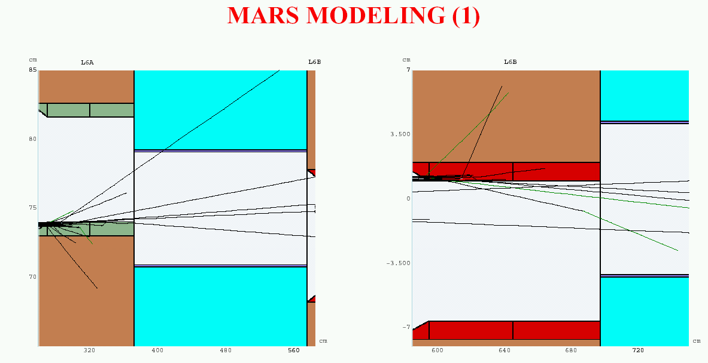
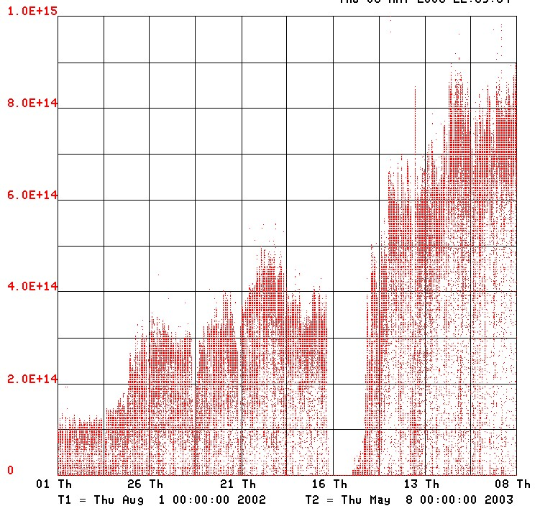
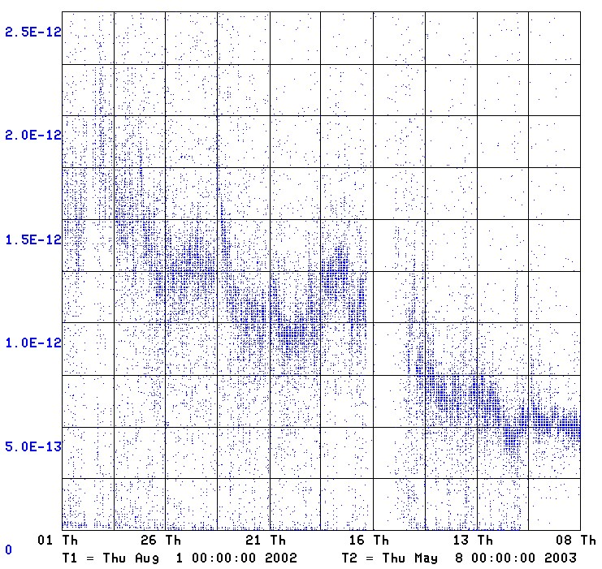
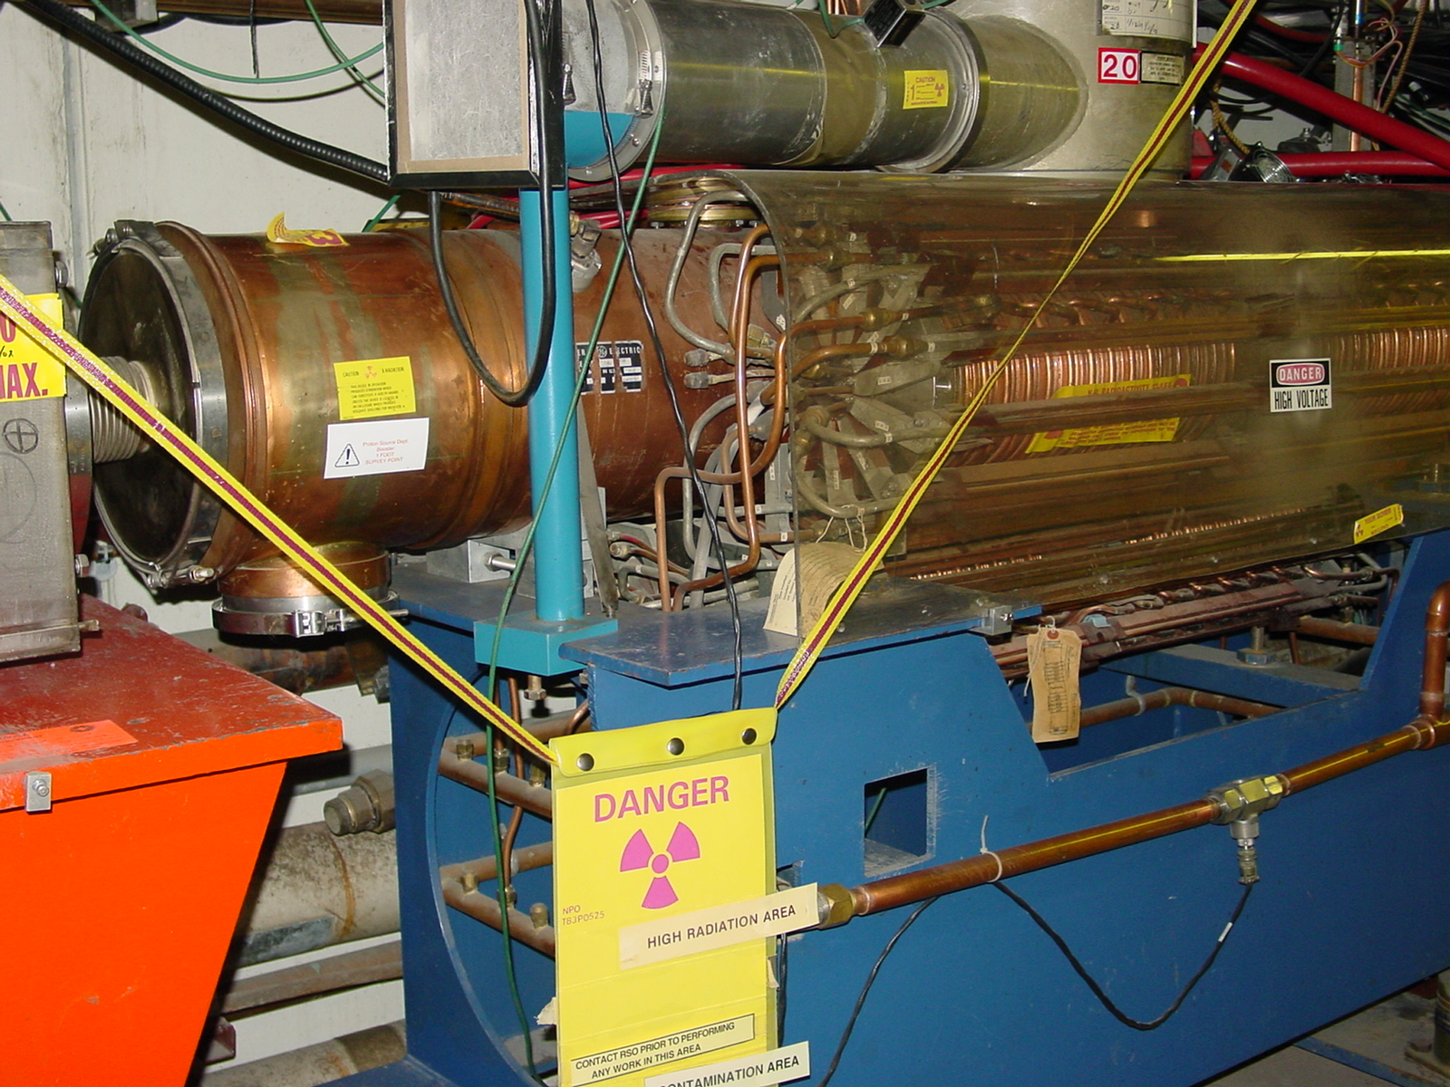
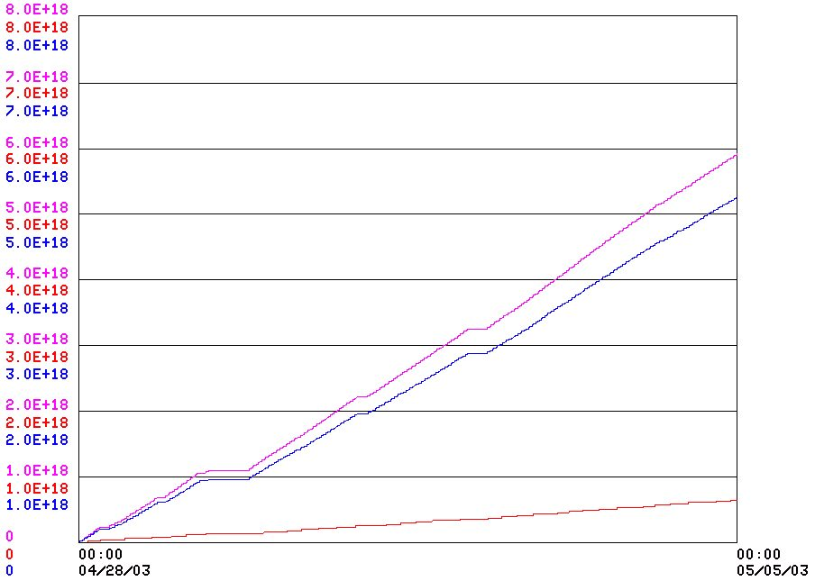
Preparation for High Intensity
Collimator Project
Possible Fixes for Dogleg Problems
Substantial increase in Booster shielding
Rearrangement and reclassification of work areas
CONCEPT
Rearrange extraction region to increase distance between dogleg magnets from 18” to 41” -> factor of five reduction in parasitic focusing.
  Simple
  Does not entirely eliminate problem
Replace DC dogleg, with a pulsed system which is only active at the end of the ramp
  will totally eliminate problem.
  straightforward.
  expensive!!
Replace lattice magnets upstream of extraction septa with wide aperture ones, eliminating the need for a dogleg.
  cleanest solution.
  magnet field quality critical.
  expensive.
  Difficult to make it work electrically with existing magnets.
Move septum up and down at 15 Hz!
  eliminates problem.
  cheaper than new magnets.
  risky.
⇒ Still investigating best solution
A scraping foil deflects the orbit of halo particles…
…and they are absorbed by thick collimators in the next periods.
PRELIMINARY RESULTS WITH PROTOTYPES
Kicked Beam
Just before Extraction
Collimator Position
Pulsed Magnet
Pulsed “anti-septum”
Pulsed Magnet
Circulating Beam
Vastly improved loss monitoring.
New extraction septum and power supply to enable high average repetition rate running.
Improvements to time time line generator to optimize high rate running.
Relative Loss
Time
FINAL DESIGN
System Designed to operate at full NuMI+MiniBooNE intensity and intercept:
  30% of beam at 400 MeV
  2% of beam at 8 GeV
Shielding determined by:
  Above ground radiation
  Sump water contamination
  Residual activation
No active cooling
All parts serviceable
Currently in review
Current Performance
Plans for Summer 2003 Shutdown
BOOSTER OUTPUT IN THE NEUTRINO ERA (SINCE AUGUST 1, 2002)
MiniBooNE
Discovered dogleg problem: tune to reduce dogleg currents
Install collimation system.
Install large aperture magnets in extraction line to reduce losses and above ground radiation.
Replace 2 out of 18 RF cavities with new large aperture magnets to evaluate their effectiveness in reducing critical losses.
Increase the separation of the dogleg magnets in one of the two extraction regions.
Booster Output (protons/minute)
Before MiniBooNE began running, the Booster typically averaged .5E16 protons per hour.
Between MiniBooNE and increased antiproton production, that number has grown by a factor of 10.
During that time, the average energy lost per proton in the Booster tunnel has fallen by more than a factor of three.
The typical Booster activation has only increase by slightly more than a factor of two.
Energy Lost per Proton
(W-min/proton)
RF Upgrade Project
⇒ Hope to be able to supply antiproton production and full MiniBooNE baseline intensity after shutdown.
The existing RF cavities form the primary aperture restriction (2 ¼” vs. 3 ¼”).
They are high maintenance, so their activation is a worry.
There is a plan for a new RF system with 5” cavities:
  Powered prototype built
  Building two vacuum prototypes for the summer shutdown with substantial machining done at universities (part fabrication completed).
  Evaluate these and procede (hopefully?) with full system.
Total cost: $5.5M cavities + $5.5M power supplies (power supplies would pay for themselves in a few years)
A TYPICAL WEEK
Summary
(improvements since 11/02 indicated)
Total Protons Delivered
12
2E20
MiniBooNE (about 45% of the baseline request, limited by losses in the Booster tunnel)
Running as we are now, the Booster can deliver a little over 1E20 protons per year – this is about a factor of six over typical stacking operations, and gives MiniBooNE about 20% of their baseline.
NuMI will come on line in 2005, initially wanting about half of MiniBooNE’s rate, but hoping to increase their capacity – through Main Injector Improvements – until it is equal to MiniBooNE.
Whatever the lab’s official policy, there will be great pressure (and good physics arguments) for running MiniBooNE and NuMI at the same time.
-> By 2006 or so, the Proton Source might be called upon to deliver
10 times what it is delivering now.
We’ve made great progress, but there’s still a long way to go.
40%
Antiproton production, limited by accumulator cooling.
5

