Slide 1
Proton Planning
Eric Prebys
FNAL Accelerator Division

Slide 2
Promises for this Talk
At least 10% original content since the last four times I’ve given it.
I won’t refer to the Proton Team Report as the “Finley Report”.

Slide 3
Proton Team Report
Group formed in early 2003 to study proton demands and needs for the “near” future (through ~2012 or so), in the absence of a proton driver.
Work culminated in a report to the director, available at www.fnal.gov/directorate/program_planning/studies/ProtonReport.pdf
No big surprises [see P. Kasper “Getting Protons to NuMI (It’s a worry)”, FNAL Beams-doc-1036, 2001].
This work will form the basis of “The Proton Plan”.

Slide 4
What Limits Total Proton Intensity?
Maximum number of Protons the Booster can stably accelerate: 5E12
Maximum average Booster rep. Rate: currently 7.5 Hz, may have to go to 10 Hz for NuMI+ (full) MiniBooNE
(NUMI only) Maximum number of booster batches the Main Injector can hold: currently 6 in principle, possibly go to 11 with fancy loading schemes in the future
(NUMI only) Minimum Main Injector ramp cycle time (NUMI only): 1.4s+loading time (at least 1/15s*nbatches)
Losses in the Booster:
  Above ground radiation
  Damage and/or activation of tunnel components
Our biggest worry at the moment!!!!

Slide 5
What about the Linac?
The linac is not currently a performance bottleneck for the complex when it is running stably.
There are ongoing longevity and reliability concerns in the linac
  General state of instrumentation is inadequate to characterize linac behavior
  The 7835 tubes from Burle continue to be a major concern, although the situation is better than it was a year ago.
  There are new worries about the klystrons, which we formerly believed were not an issue.
  There are some other longevity issues, if we expect the linac to last another ~10 years.

Slide 6
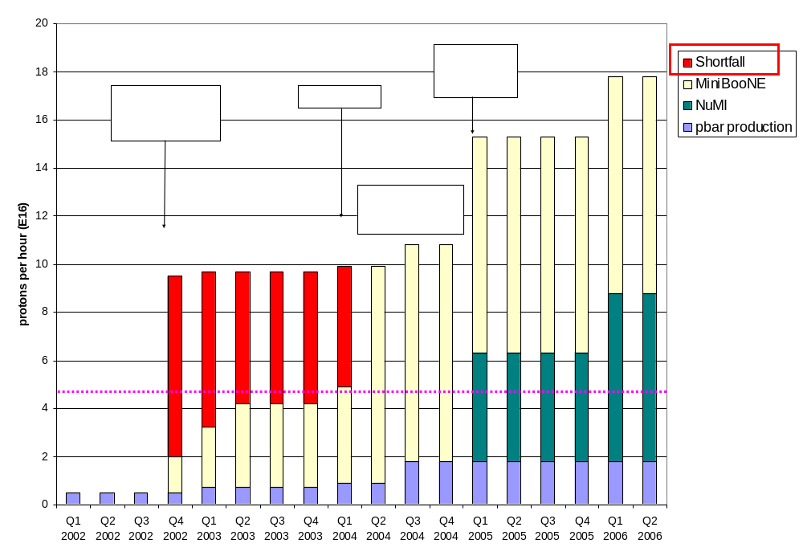
Proton Demand
Can we do this???

Slide 7
Projects in 2003 (a short list)
2003 Activities centered around preparation for the September shutdown:
  Linac water system upgrade
  New Linac Lambertson
    Better optics in 400 MeV line
  Booster two-stage collimation system
    In the works a long time
    Now in place.
  Major modifications at main extraction region
    Address “dogleg problem” caused by extraction chicane system.
  New, large aperture magnets in extraction line:
    Should reduce above-ground losses
  Major vacuum system upgrade.
  Lots of smaller jobs.

Slide 8
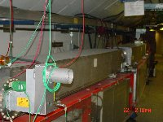
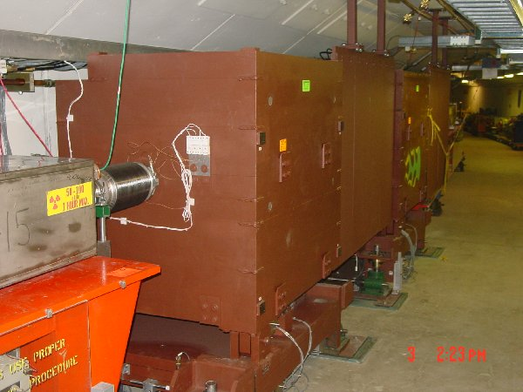
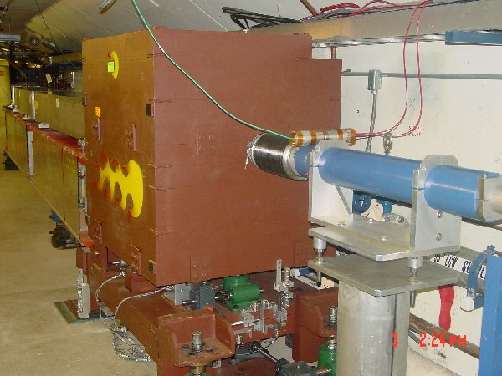
New Collimator System
Basic Idea…
A scraping foil deflects the orbit of halo particles…
…and they are absorbed by thick collimators in the next periods.
Should dramatically reduce uncontrolled losses

Slide 9
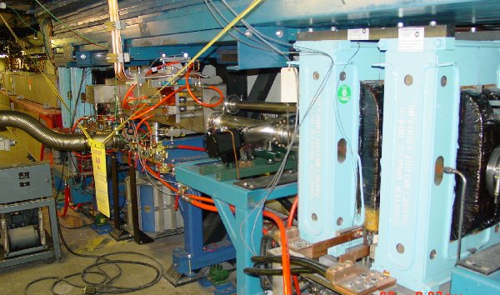
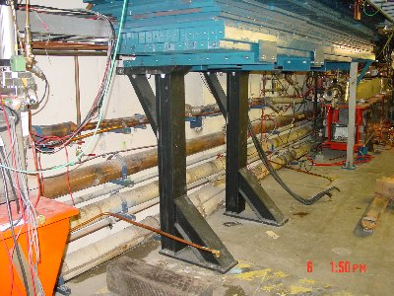
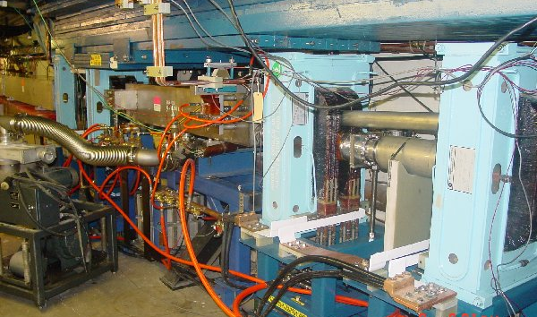
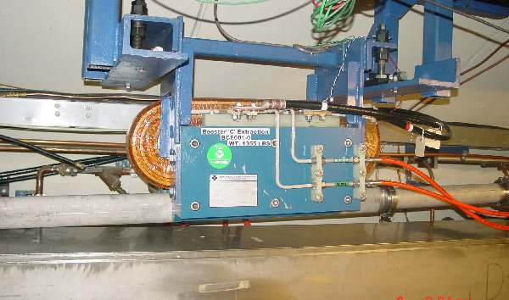
Long 3 Dogleg Work
New magnet to match extraction line
Increase spacing between dogleg pairs from 18” to 40” to reduce lattice distortions at injection.

Slide 10
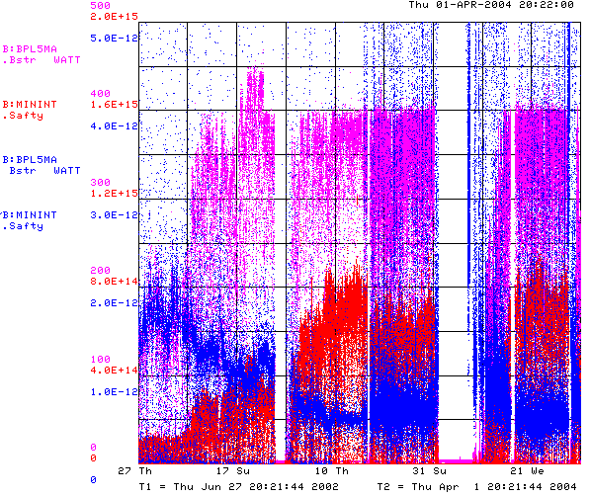
How are We Doing?
Power loss (W)
Protons (p/min)
Energy Lost (W-min/p)
Record Performance
BooNE turn-on (Sept. 2002)
“Mysterious”
Performance Problems
Big Shutdown

Slide 11

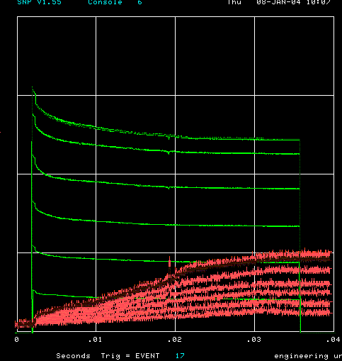
How far have we come?
Before MiniBooNE
Now (same scale!!)
Charge through Booster cycle
Time (s)
Energy Lost
Note less pronounced injection and transition losses

Slide 12
Near Term Priorities (Booster)
Optimizing Booster for improved lattice:
  Tuning and characterizing 400 MeV line (Linac to Booster).
  Tuning Booster orbit to minimize losses.
Commission Collimators:
  Estimate another month or so to bring into standard operation. (discussed shortly)
Aperture Improvments:
  Alignment (discussed shortly)
  Orbit control
    Abandoning our original global plan in favor of local control at problem spots for the time being.
  Prototype RF Cavities
    Two large aperture prototype cavities have been built, thanks to the help of MiniBooNE and NuMI universities.
    We will install these as soon as they are ready to replace existing cavities which are highly activated.
Multibatch timing: Beam cogging (discussed shortly)

Slide 13
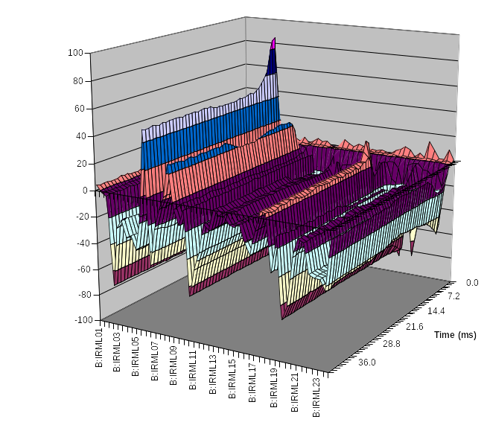
Collimator Studies
Collimator location
Shown is the effect of putting in one of the secondary collimators as a percentage change in losses as a function of time around the ring.
Studies are continuing.
  “Rapid response team” will be put on problem.
At present, primary collimators are not optimized to energy loss profile
  Will replace in upcoming shutdown.
location

Slide 14
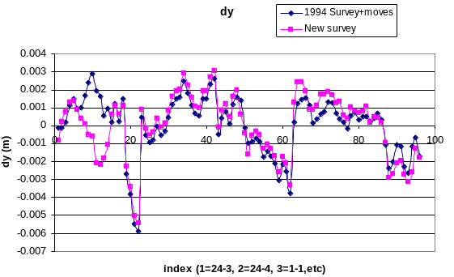
Alignment Problems
Effect of Booster tower shielding
¼” Misalignment at Collimators!
Working closely with AMG
As opportunity allows
  Fix vertical orbit
  Align RF cavities
Over the next year
  Complete network
  Integrate with MAD
  Make a horizontal plan.

Slide 15
Multibatch Timing
In order to Reduce radiation, a “notch” is made in the beam early in the booster cycle.
Currently, the extraction time is based on the counted number of revolutions (RF buckets) of the Booster. This ensures that the notch is in the right place.
The actual time can vary by > 5 usec!
This is not a problem if booster sets the timing, but it’s incompatible with multi-batch running (e.g. Slipstacking or NuMI)
We must be able to fix this total time so we can synchronize to the M.I. orbit.
This is called “beam cogging”.

Slide 16
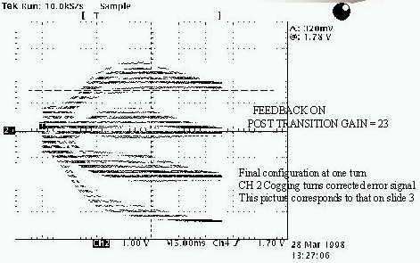
Active cogging
Detect slippage of notch relative to nominal and adjust radius of beam to compensate.
Allow to slip by integer turns, maintaining the same total time.
Efforts in this area have been recently increased, with the help of a Minos graduate student (R. Zwaska).
Aim to get working in the next month or so.

Slide 17
Planning for the future
In response to the “Proton Team Report”, the lab management has asked for a “Proton Plan” for the proton source over the next few years, analogous to the Run II plan, but much lower in scope.
The plan is to do what we can reasonably do to maximize the throughput and reliability of the existing proton source (incl. MI), assuming:
  a Proton Driver will eventually be built.
  There will be no shutdowns longer than 2 months or so.
Beyond the things I have already mentions, the scope is largely determined by the budgetary guidance:
  FY04: $0-2M
  FY05: $6M
  FY06: $5M
  FY07: $5M
  FY08: $2.5M

Slide 18
Comment on the Budget
This budget is more than enough to do the basic things that we must do to keep the proton source going, provided some of it appears this year!
It precludes certain ideas that have been suggested:
  New Linac front end, or any significant 200 MHz upgrade.
  Decreasing the Main Injector ramp time
There are some “big” (>$1M) projects that must be discussed.

Slide 19
Projects over the Next Year
Linac Characterization and Reliability
  Increase instrumentation of old linac to study instabilities.
  Develop set of performance parameters.
Booster improvements.
  Prepare for modification of second extraction region
    New septum
    Modified dogleg magnets
    On track for next year’s shutdown.
  Injection bump (ORBUMP) improvements:
    Injection Bump (ORBUMP) Power Supply
      Existing supply a reliability worry.
      Limited to 7.5 Hz
      Building new supply, capable of 15 Hz.
    New ORBUMP Magnets
      Existing magnets limited by heating to 7.5 Hz
      Working on a design for cooled versions.
      These, with a new power supply, will make the Booster capable of sustained 15 Hz operation.

Slide 20
Projects over the next year (cont’d)
  Prototype RF cavities
    Add the two university-build RF cavities as 19th and 20th Booster cavities.
  Transition crossing
    Now that injection efficiency is up, we seem to be limited by transition issues
    Working closely with Fermilab Beam Physics, as well as people from Argonne to understand the issues.
    Resurrecting the transition crossing (gamma-t) system.

Slide 21
Longer Term Projects
Booster RF System
  New solid state PA’s
    Increase reliability.
    Decrease time in hot areas
    Cost ~$7M
    Will almost certainly recommend
    Could build by end of 2005.
  New RF system
    Larger aperture
    Higher gap envelope
    Reduced HOM
    Cost ~$7M
    Work out a design by end of 2004
    Possibly recommend
    Aggressive schedule would be by end of 2006.

Slide 22
Long Term Projects (cont’d)
Booster Corrector System
  Each of the 48 subperiods has a corrector package, consisting of
    Horizontal dipole
    Vertical dipole
    Quad
    Skew quad
  These are not powerful enough to control the orbit or the tune through the acceleration cycle
  Working with the TD to design a new corrector system approx. 3 times as powerful.
  Will have a design by end of 2004
  Will almost certainly recommend
  Cost ~$3M
  Could have by end of 2006.

Slide 23
Longer Term Projects (cont’d)
Booster Harmonic
  Adding a 30 Hz harmonic to the Booster ramp could reduce the maximum dE/dt and therefore effectively increase the RF power.
  Working on a prototype choke this year.
  Will make a decision by the end of the year.
  Could be done by end of 2005.
  Cost ~$1-2M
New quad supplies for the Low Energy Linac (LEL)
  Reliability worry
  Will certainly recommend
  Cost ~$1M

Slide 24
Closing Comments: Expectation Management
What we really think we can achieve:
  Slipstacking to provide 1E13 protons per pulse for pbar production.
  5E20 protons to MiniBooNE by the time NuMI fully comes on in early 2005
  2-2.5E20 p/yr to NuMI in the first year of operation.
  Increasing that over the next few years, to something over 3E20 p/yr.
What we might achieve:
  Continuing to operate the 8 GeV line at some significant level after NuMI comes on, ultimately delivering 1E21 protons to MiniBooNE and possibly supporting other experiments (e.g. FINESSE).
  Delivering as many as 4E20 p/yr to NuMI, at which point things will be limited by Main Injector aperture and cycle time (with the present source, anyway).
It would be unrealistic to believe:
  We will ever send more than 4E20 p/yr to NuMI without significant (~$100M) investment in the existing complex.
  That would be direct competition for resources with the current Proton Driver proposal.

