Slide 1
Proton Economics and Proton Plan - Update
Eric Prebys
FNAL Accelerator Division

Slide 2
Outline
General Issues
  Limitations
  Demands
Recent Successes
  The past year
  Proton intensity
  Exposure to workers
  Other topics
The “Proton Plan”
  Near future
  Long term
Projections

Slide 3
What Limits Total Proton Intensity?
Maximum number of Protons the Booster can stably accelerate: 5E12
Maximum average Booster rep. Rate: currently 7.5 Hz, may have to go to 10 Hz for NuMI+ (full) MiniBooNE
(NUMI only) Maximum number of booster batches the Main Injector can hold: currently 6 in principle, possibly go to 11 with fancy loading schemes in the future
(NUMI only) Minimum Main Injector ramp cycle time (NUMI only): 1.4s+loading time (at least 1/15s*nbatches)
Losses in the Booster:
  Above ground radiation
  Damage and/or activation of tunnel components
Our biggest worry at the moment!!!!

Slide 4
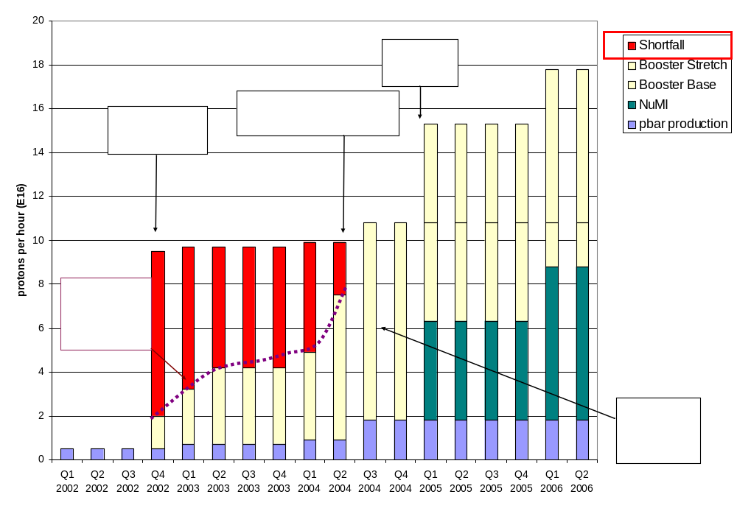
Proton Demand
7.5 Hz
Have now exceeded initial NuMI needs!!!!

Slide 5
Big Improvements in the Last Year
Primary extraction “dogleg fix”
  Increase spacing between magnets in chicane system
  Reduces distortion to injection lattice by ~40%
Vertical alignment
  Eliminate ¼” misalignment at collimator region
  Improve high field orbit
400 MeV line work
  Better understanding
  Improved stability and repeatability
Injection bump (ORBUMP) improvements
  Improved water flow
  New, lower resistance capacitors
  Much more reliable
Collimator installation and commissioning

Slide 6
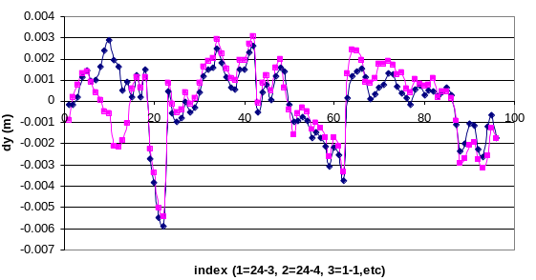
Vertical Alignment
Magnet moves
  Moved 9 (out of 48) girders and one magnet on a girder
Fix high field orbit
Fix L3 misalignment

Slide 7
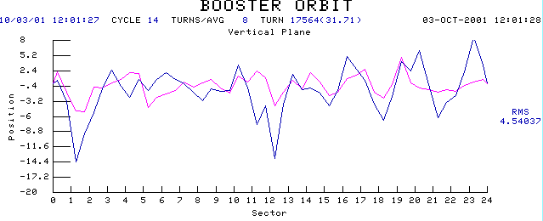
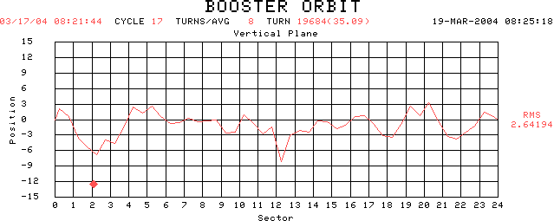
Effects of Moves on High Field Orbit
Before (blue curve)
RF Cavities
After (matches prediction)
Extraction

Slide 8
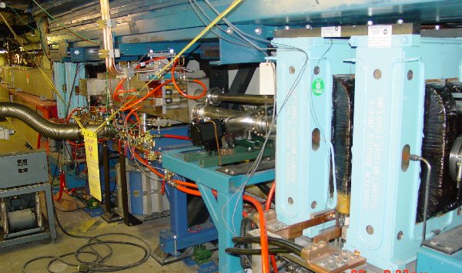
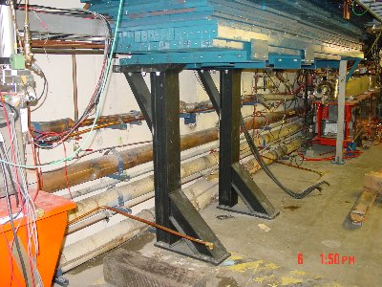
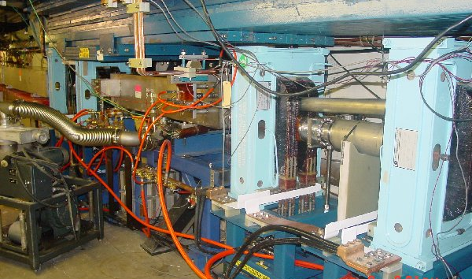
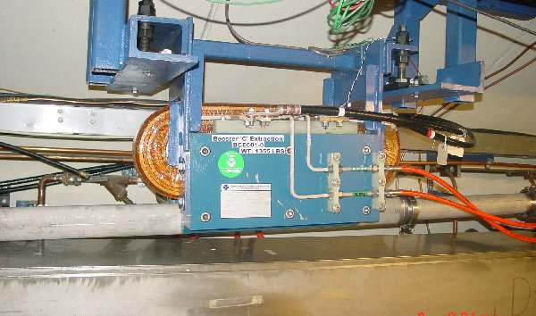
Long 3 Dogleg Work
New magnet to match extraction line
Increase spacing between dogleg pairs from 18” to 40” to reduce lattice distortions at injection.

Slide 9
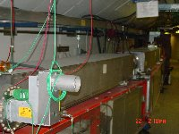
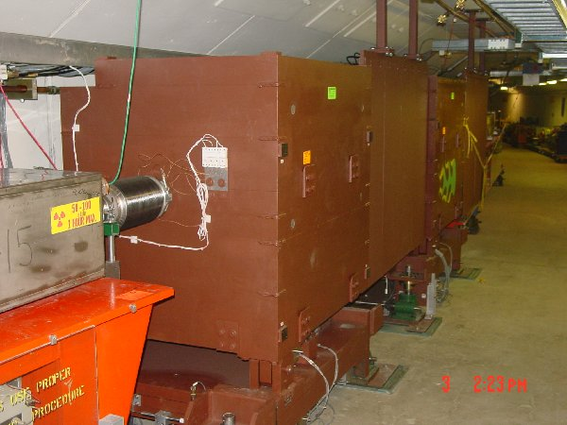
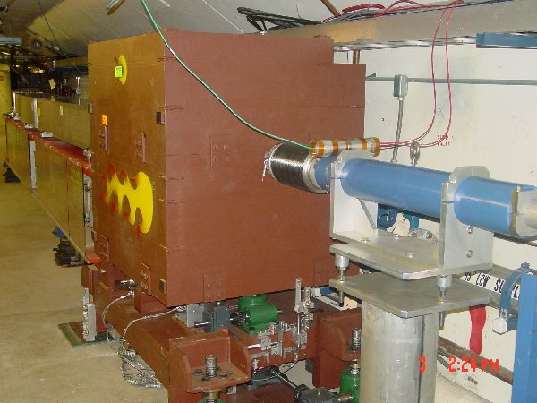
Collimator System
Basic Idea…
A scraping foil deflects the orbit of halo particles…
…and they are absorbed by thick collimators in the next periods.
Should dramatically reduce uncontrolled losses

Slide 10
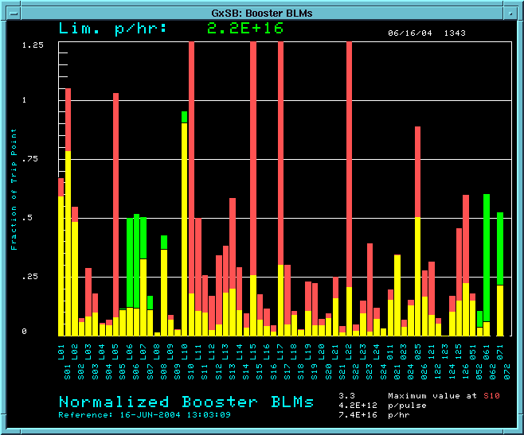
Collimator Commissioning
We have begun to use the collimators in normal operation:
Losses w/o collimators
Losses with collimators
RF Region

Slide 11
Taking advantage of Collimators
General principles
  Activiation was “OK” before collimator implementation.
  Want to use collimators to increase rate while keeping activation “about the same”.
Historically, the “watt meter” has been our most reliable indicator of activation, but
  It works by counting lost protons
  Can’t distinguish protons absorbed on the collimator
Now must rely on individual loss monitors
Tighten up limits based on detailed study of activation versus measured loss
Do weekly radiation surveys
Increase rate (watt limit) to keep activation at roughly the level it was before the collimators were implemented.

Slide 12
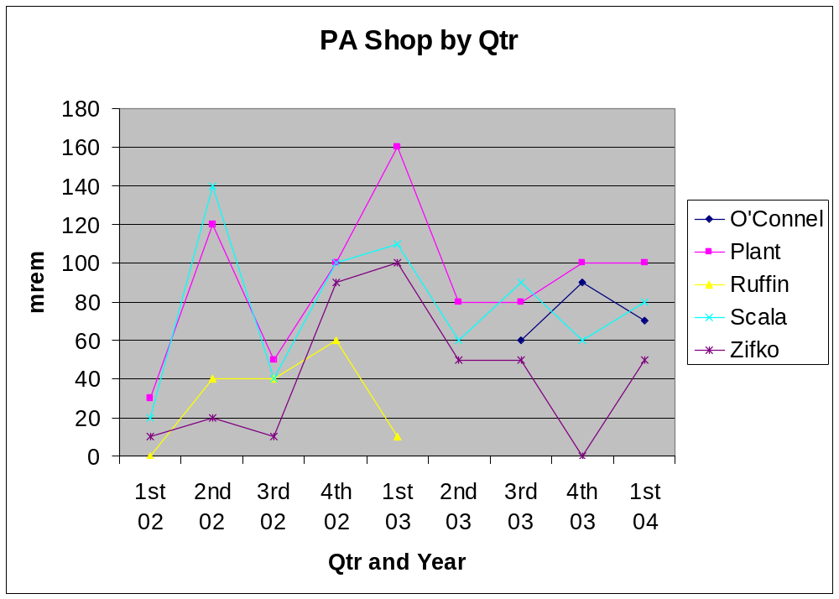
Basis of activation assessment - Dose to Workers
Administrative limit at 300 mRem/qtr
This is “ok”, but we don’t want to get any worse
MiniBooNE

Slide 13
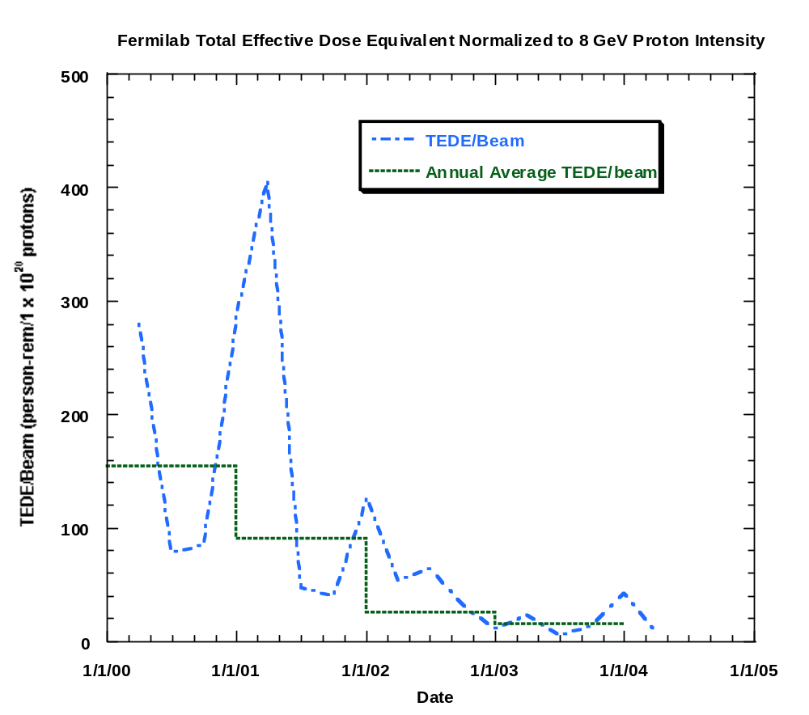
Normalized Dose to Workers (as reported to DOE)

Slide 14
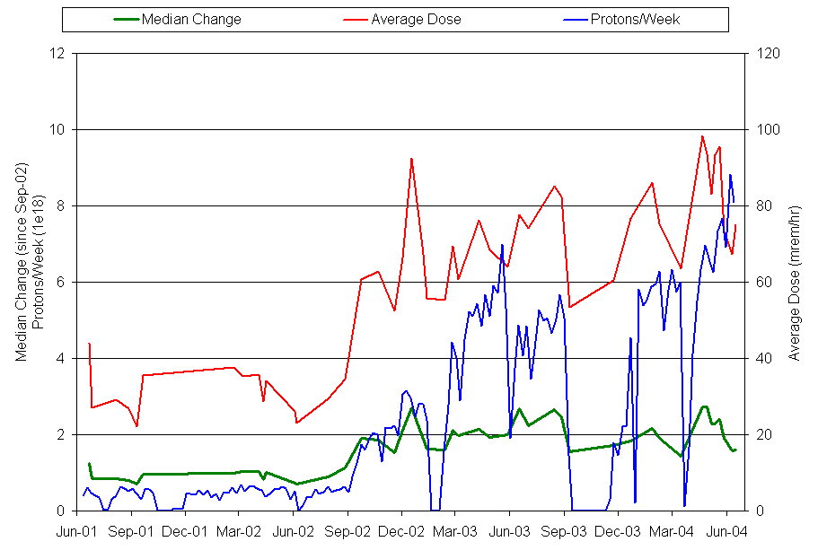
Activation History In Booster
MiniBooNE
x2~3 activation
16x proton increase
Collimators

Slide 15
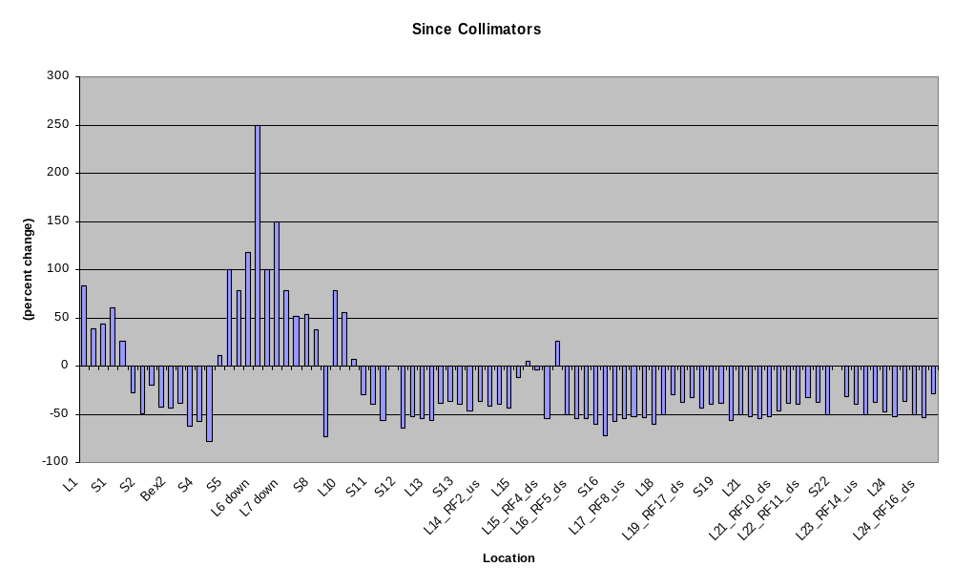
Change In Activation Since Collimators
Collimator
region
L3
Extraction
L13
Extraction
RF Region

Slide 16
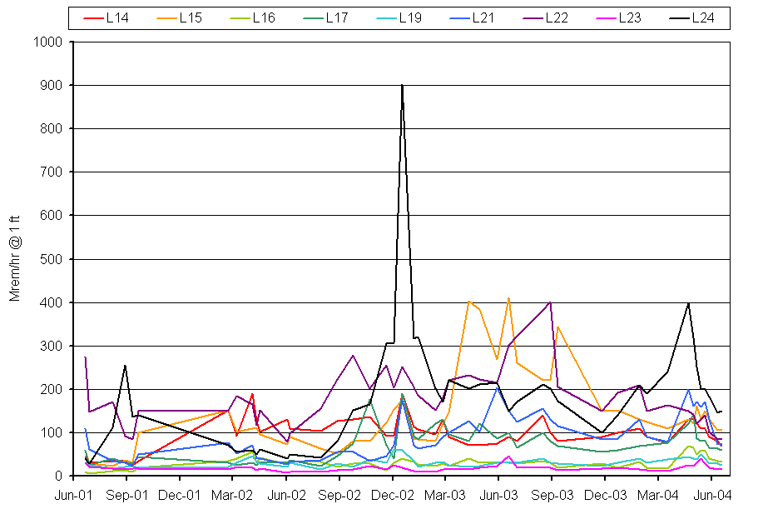
Activation in RF Cavities
MiniBooNE
Collimators
Pre-MiniBooNE levels!!

Slide 17
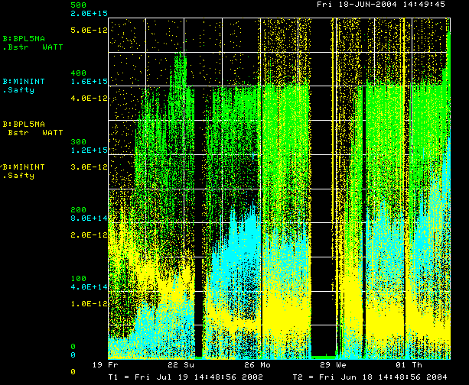
Booster History
MiniBooNE
Power Loss
Total proton rate
Energy loss/proton

Slide 18

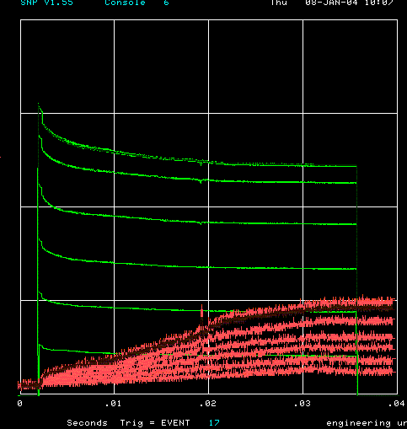
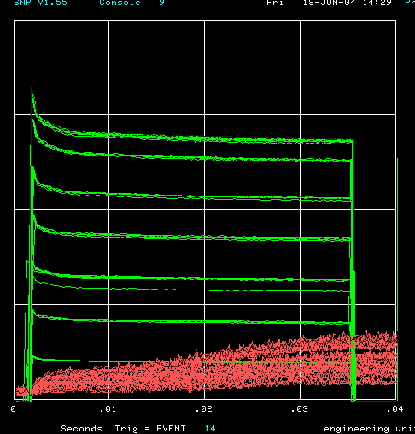
How far have we come?
Oct. 2002 (MB turn-on)
Jan. 2004
Now
Charge through Booster cycle
Energy Lost
Time (s)
Typical:
  5.5E12 protons/batch to stacking (Run II handbook = 5E12)
  >7E16 pph to MiniBooNE (MiniBooNE goal 9E16)
Records:
  6E12 protons/batch to stacking
  8E16 pph to MiniBooNE (current administrative limit)

Slide 19
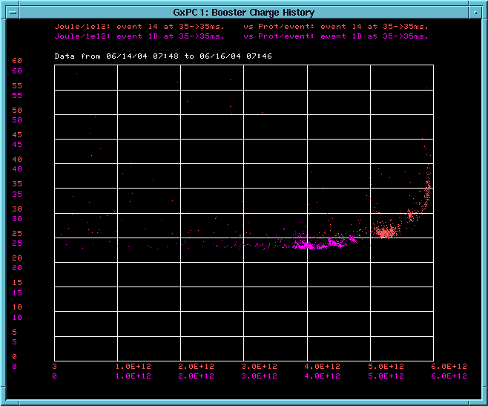
Effect of increased intensity (recent running)
4E12
5E12
~5% more losses (activation) at 5E12
Energy Lost per proton
Protons per pulse
Can really deliver 5E12 efficiently for the first time!!!!!

Slide 20
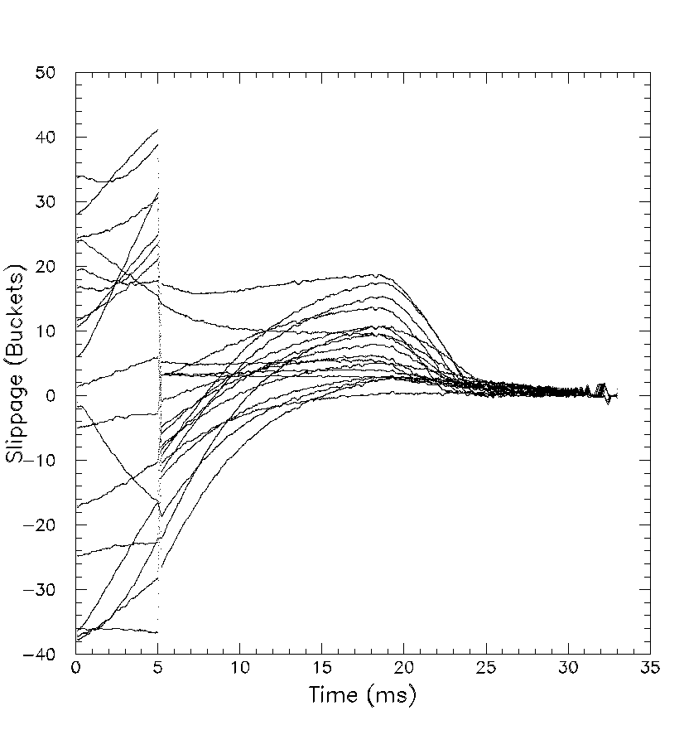
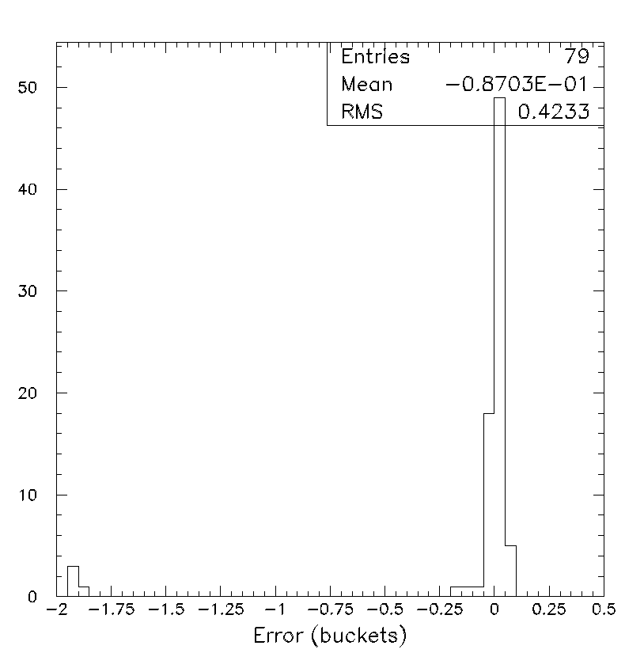
Progress in Beam Cogging
Vital to multibatch operation
  Slipstacked pBar production – after Main Injector beam loading compensation in shutdown
  Multibatch to NuMI – assume 1/05
Cogging principle demonstrated
  Have cogged multi-batch transfers up to 4E12 protons/batch
  Expect to be fully operational soon

Slide 21
Current Status - Summary
Exceeding Run II intensity goals
Can deliver 5E12 protons per batch with good efficiency
Regularly delivering ~80% of MiniBooNE goal
Demonstrated NuMI intensities
Expect increased intensity in the near future, quite possibly to 9E16 pph MiniBooNE goal.
Cogged multibatch operation demonstrated at 80% of nominal intensity.
  Expect full intensity test soon.
  Last Run II milestone for the proton source.

Slide 22
“Proton Plan”
The details of proton demand and issues can be found in an official report to the director at:
www.fnal.gov/directorate/program_planning/studies/ProtonReport.pdf
Working assumptions:
  Existing proton source must last at least another 10 years or so in more or less it’s current configuration.
  During that time, a new “proton driver” will be built, which will ultimately replace the existing proton source.
  Proton source improvements should require no significant downtimes beyond those needed for other reasons.
  The maximum total funding for proton source improvements will be of the order of $18M over the next few years.
  Near term projects most important to performance

Slide 23
Scope of Improvements
The level of funding precludes some things which have been discussed:
  Replacement or major upgrade of 200 MHz linac
    Official policy on 7835 PA’s: keep fingers crossed.
  Decrease of Main Injector ramp time
    Unless it is done as part of Proton Driver
For this reason, the proton plan focuses primarily on the Booster
  Decreasing uncontrolled losses.
  Increasing reliable average repetition rate.
  Biggest decisions involve plan for RF system.

Slide 24
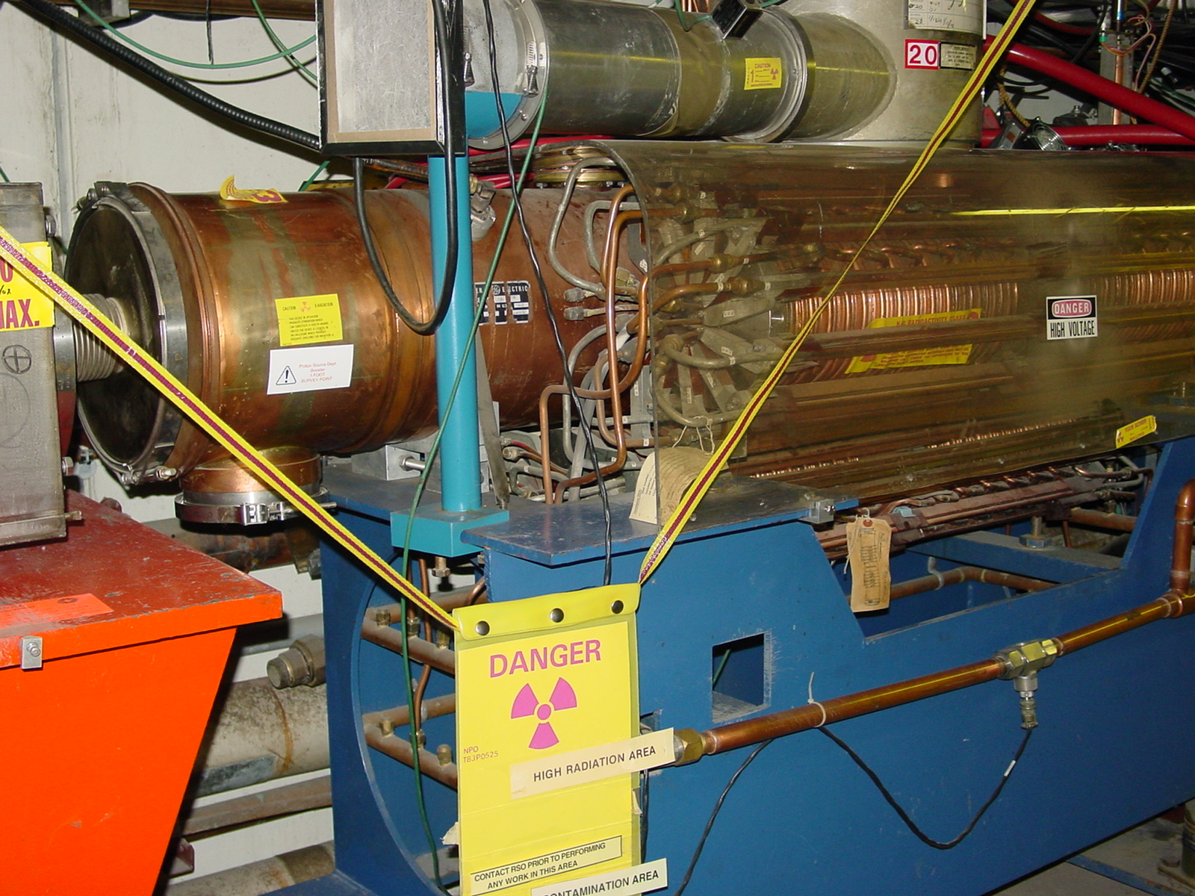
Booster RF Issues
The existing RF cavities are an aperture restriction
They are a high maintenance item (primarily the PA), so their activation is a worry.
There is a possibility that heating could be a worry beyond 7.5 Hz.
The RFSUM of the existing 18-cavity system is a limitation to the maximum proton batch size.
Decisions about the RF system are the most significant part of the plan, at least from the finance/resource point of view.

Slide 25
Booster RF Options
New, solid state PA’s
  Dramatically reduce maintenance
  Similar to Main Injector design
  One being used already.
  Total cost: ~$7M
  Definitely part of the plan
Increase number of RF cavities:
  Can use the two large aperture prototypes built with help from MiniBooNE and NuMI/Minos universities
  Hope to have at least one in by end of Summer shutdown.
  Second in during 2005.
  Could potentially increase Booster batch size to 6.5E12 or higher.

Slide 26
RF Cavity Replacement Options
Control losses with alignment and collimators?
  Don’t replace
  Should know by ~8/04
Move forward with 5” prototype design?
  Design complete and tested
  Could begin procurement and construction immediately in FY05.
  Aggressive schedule could have cavities in place by 2007
  Cost: ~6M
Completely new design?
  Could be designed with higher GE voltage and reduced HOM.
  Frequency range a challenge
  Could have design by end of 2005, cavities in place by 2008
Plan to decide on preliminary recommendation by 8/04

Slide 27
Corrector Packages
The Booster contains corrector packages at each of the 48 sub-periods.
  Horizontal trim
  Vertical trim
  Quad
  Skew quad
The trims are not powerful enough to control the orbit throughout the cycle
The quads are not powerful enough to fully control the tune/coupling throughout the cycle
We would like to replace the corrector system with one with roughly 3-4 times the strenght.
Working with TD on the specifications.
Could have in place in ~2 years
Cost ~3M.

Slide 28
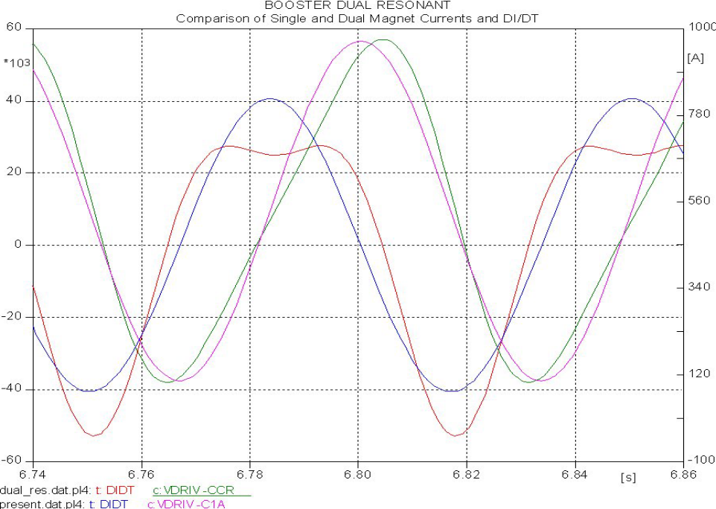
Higher Harmonic Operation
By adding a 30 Hz compononent to the Booster magnetic lattice, we could reduce the maximum dp/dt by ~35%, effectively increasing the RF power.
Pursue prototype in 2005
If successful, implement in 2006
Cost ~$1M

Slide 29
Major Linac Projects
Quad power supplies
  Very old technology, reliability concern
  Major source of PCB’s
  About $1M to replace
7835 filament current stability
  Believed to be a source of linac instability
  Investigating 480 isolation
  Plan to implement on all stations ASAP
  Cost ~100K

Slide 30
Projects – Near term
Fall Shutdown
  Modify L13 extraction region
    Increased aperture
    A factor of 3 reduction in injection lattice distortion
  Use prototype RF cavity at 19th cavity and prep for 20th
    Increase reliability
    Increase efficiency
    Allow batch intensities of 6.5E12 or higher
  Add extra extraction kicker
    Increase beam aperture near extraction
    Reduce extraction losses
    Increase reliability (can run without one kicker)
  Alignment projects
    Complete RF cavity and vertical alignment
    Complete 3D network and as-found
  (possibly) Add two quads to 400 MeV line
    Decrease tuning sensitivity of line

Slide 31
Projects – near term (cont’d)
ORBUMP
  New magnets, based on ferrites
  New power supply, based on existing new SCR switch
  Both ready early to mid-2005
  -> Full 15 Hz operation

Slide 32
Approximate Timeline
2004
  Collimators commissioned and fully operational
  L13 Modification
  Vertical and RF cavity alignment
  Complete alignment network and as-found
  19th RF cavity added to Booster
2005
  New ORBUMP magnets and Power supplies.
  Horizontal alignment proceeds
  Procurement for solid state PA’s
  Either design or procurement of new RF cavities, if recommended
  Design and procurement for new corrector system
  New quad supplies in Linac
2006
  Complete installation of solid state PA’s
  Install new corrector system
  Continue with RF cavity design/procurement.
  Install 30 Hz harmonic, if recommended
2007
  Complete installation of 5” RF cavities, if recommended.
2008
  Complete installation of new RF system, if recommended.

Slide 33
Proton Projections – Basic Assumptions
Based on stated policies of Directorate…
  Run II (pBar production) will continue to have priority.
  One NuMI comes on line, it will be given protons up to the lower of:
    The Main Injector loading/ramp time limit
    The Booster loss limit
  IF the Main Injector loading limit is reached with significant Booster loss headroom, we will continue to run the 8 GeV line (MiniBooNE, FiNESSE, etc) up to the Booster loss limit.
We have demonstrated the ability to deliver the intensities needed by NuMI, with at least some headroom left over for 8 GeV line operation*
Unfortunately, under this scenario, it is still very difficult to make accurate projections wrt MiniBooNE’s future.
*I could not have made this statement a month ago!!!

Slide 34
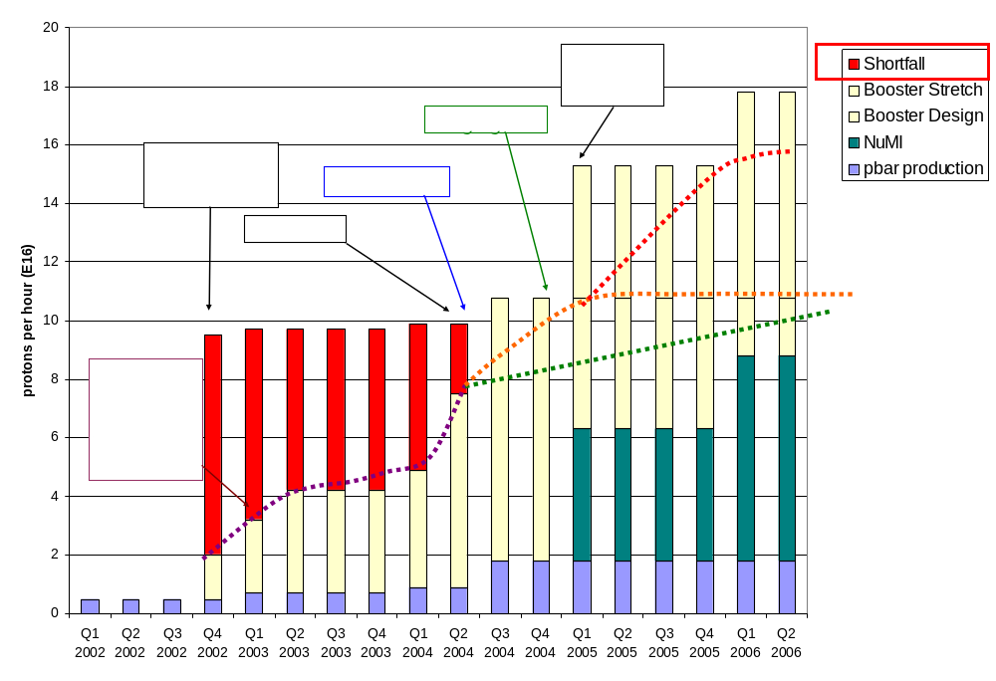
Making Projections
Stretch
7.5 Hz
“design”
Conservative

Slide 35
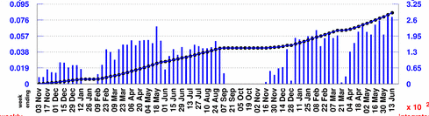
Projecting to MiniBooNE
Rather than use the instantaneous rate, will scale from typical weekly MiniBooNE totals:
Baseline Scenario:
  Improvements compensate for increased protons to pBar -> Continue to average 7.5E18/wk (have gotten 1E19 in last 7 days!)
  Get About 1.5E18 after 1/05
Design Scenario:
  MBooNE rate increases more or less linearly to 10E18/wk at 1/05
  5.5E18/wk after NuMI turns on.
Stretch Scenario:
  MBooNE rate increases to 10E18 at 1/05
  5.5E18 when NuMI turns on
  Increases to 10E18 over 2005
Typically 7.5E18/wk

Slide 36
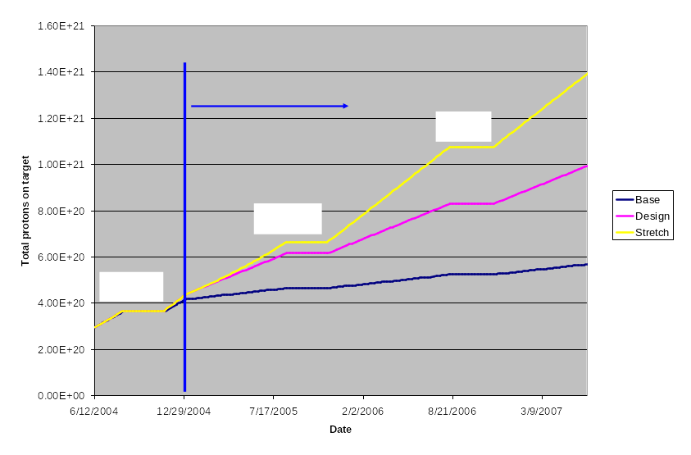
Protons to MiniBooNE

Slide 37
Summary
The proton source has made remarkable progress in the two years, and recently in particular
We have exceeded our Run II intensity commitments, and when beam cogging is fully operational, we will have met all of our run II specifications.
We have demonstrated 89% of the MiniBooNE and hope to meet the goal in the near future.
We have demonstrated NuMI intensity goals.
We still expect significant improvement in the future.
  By mid-2005, the Booster should be a full 15Hz machine
  The improvements in this year’s shutdown should allow us to reach significantly higher proton throughput
We are working toward a plan which will maximize reliable proton source output over the next 10-15 years

Slide 38
Acknowledgements (it takes a village)
I won’t name names, because I’d leave someone out, but realize that these achievements reflect enormous efforts:
  Within the proton source department
  Operations!!!
  All parts of the lab
  The MiniBooNE and NuMI collaborations
  Other national labs

Slide 39
Closing Comments: Expectation Management
What we really think we can achieve:
  Slipstacking to provide 1E13 protons per pulse for pbar production.
  5E20 protons to MiniBooNE by the time NuMI fully comes on in early 2005
  2-2.5E20 p/yr to NuMI in the first year of operation.
  Increasing that over the next few years, to something over 3E20 p/yr.
  The ability to run the 8 GeV line at some level at least during early NuMI operation
What we might achieve:
  Continuing to operate the 8 GeV line at some significant level after NuMI comes on, ultimately delivering 1E21 protons to MiniBooNE and possibly supporting other experiments (e.g. FINESSE).
  Delivering as many as 4E20 p/yr to NuMI, at which point things will be limited by Main Injector aperture and cycle time (with the present source, anyway).
  Maintining a total Booster output of as high as 1E21 protons/year
It would be unrealistic to believe:
  We will ever send more than 4E20 p/yr to NuMI without significant (~$100M) investment in the existing complex.
  That would be direct competition for resources with the current Proton Driver proposal.

