Slide 1
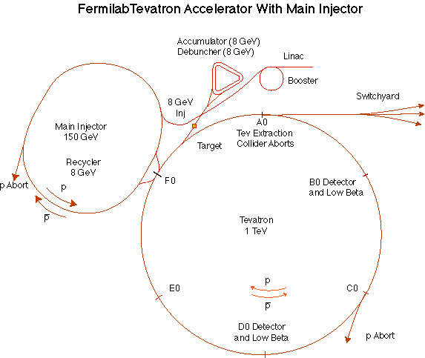
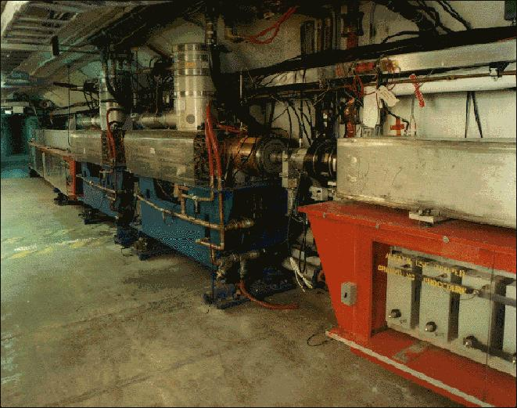
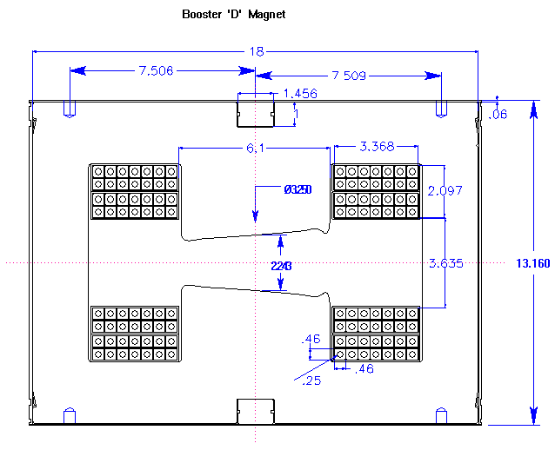
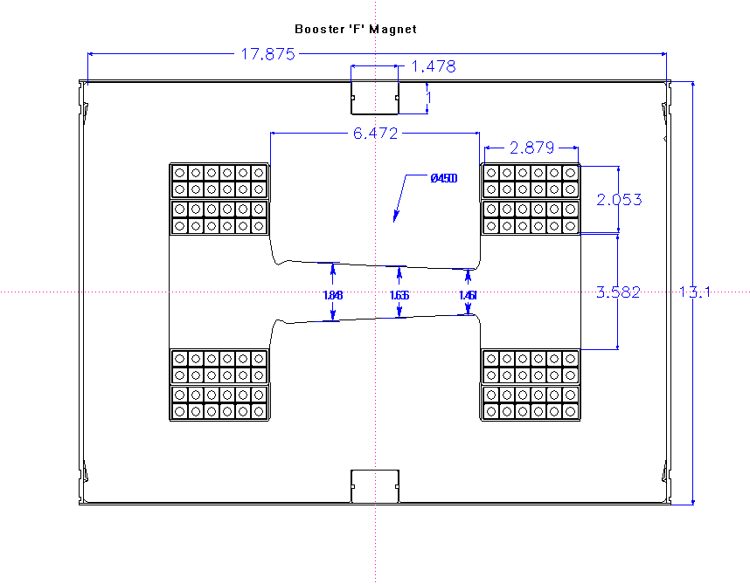
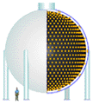
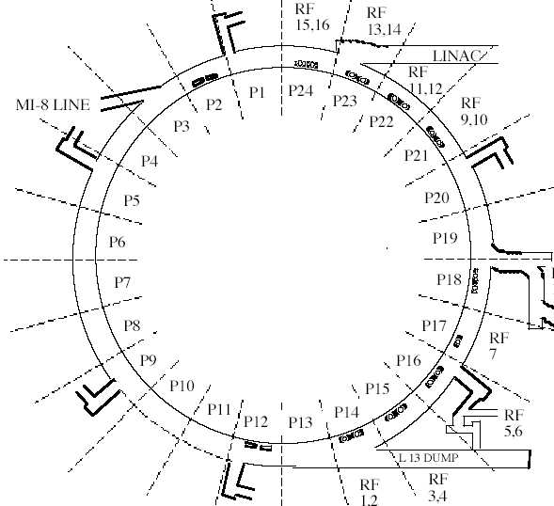

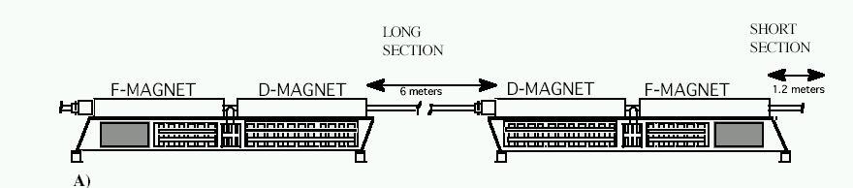
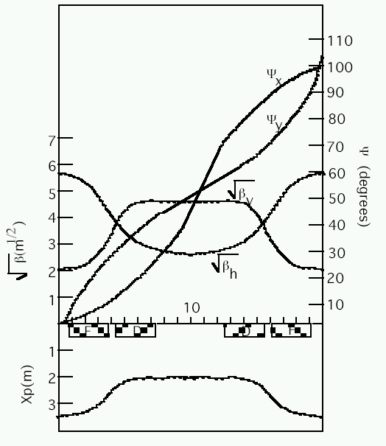
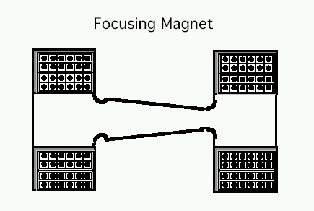
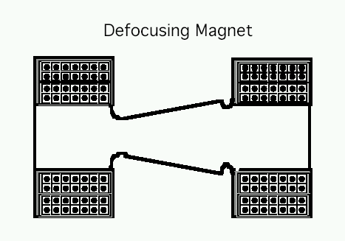
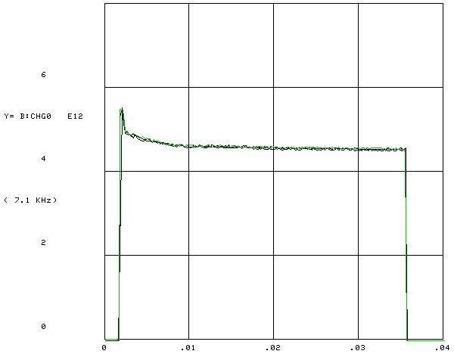
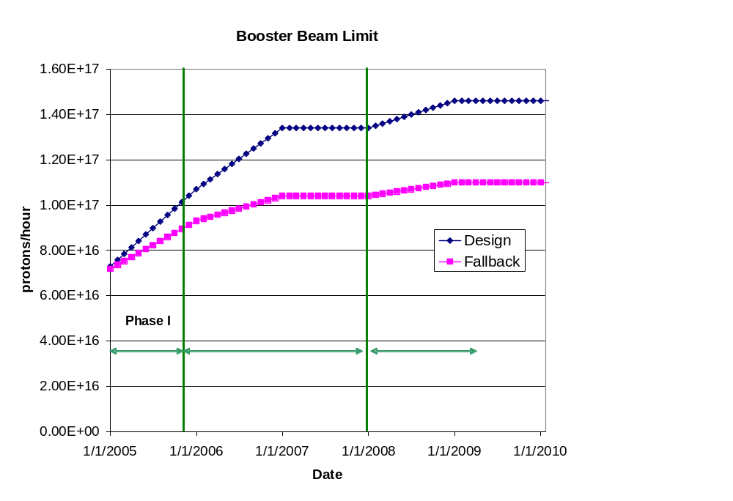
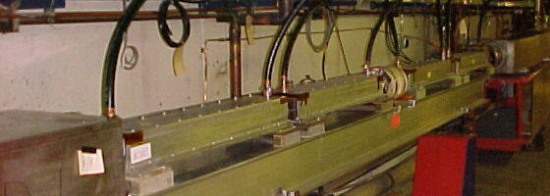
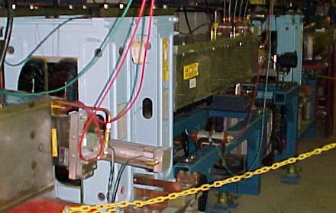
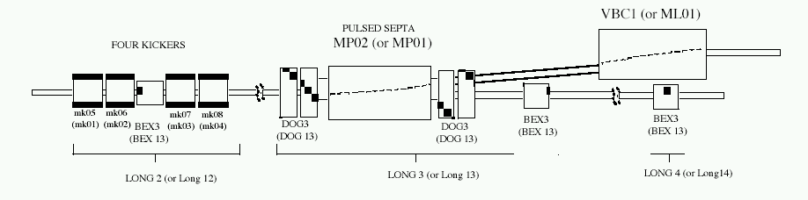
Radiation Damage Issues in the Fermilab Booster Magnets
Eric Prebys, FNAL, Batavia, IL 60510
ABSTRACT
The demands of the Fermilab neutrino program will require the lab’s 30+ year old 8 GeV Booster to deliver higher intensities than it ever has. Total proton throughput is limited by radiation damage and activation due to beam loss in the Booster tunnel. Of particular concern is the epoxy resin that acts as the insulation in the 96 combined function lattice magnets. This paper describes a simulation study to determine the integrated radiation dose to this epoxy and a discussion of the potential effects.
The Fermilab Booster
Increasing Proton Demand
The Booster takes the 400 MeV Linac beam and accelerates it to 8 GeV.
From the Booster, beam can be directed to:
  The Main Injector
  MiniBooNE (switch occurs in the MI-8 transfer line).
  The Radiation Damage Facility (RDF)
  A dump.
The Booster is the only (almost) original accelerator in the Fermilab complex.
It maintains an average uptime of > 90%
ANTIPROTON PRODUCTION
Magnet Design
8E12 protons sent to the Main Injector every 2 seconds, to be accelerated to 120 GeV and delivered to the antiproton production trarget
~1E16 protons per hour
Small compared to…
NEUTRINO PROGRAM
MiniBooNE-neutrinos from 8 GeV Booster proton beam (L/E~1):
absolutely confirm or refute the LSND result: Running since fall 2002. To date has taken >5E20 protons: more protons than all other experiments in the 30 year history of the lab combined!
8GeV Beam to Main Injector and MiniBooNE
400 Mev Beam from Linac
NuMI/Minos – neutrinos from 120 GeV Main Injector proton beam (L/E~100):
precision measurement of ν_{μ} ↔ ν_{τ} oscillations as seen in atmospheric neutrinos. Began running in March, 2005. Will ultimately use numbers of protons similar to MiniBooNE
Water cooled coils
Yoke
Insulating epoxy resin. This is the major concern for radiation damage
472m in circumference
24-fold periodic lattice
Each period contains
4 combined function magnets.
Magnets cycle in a 15 Hz offset resonant circuit.
Nova – Same beam line as Minos, but detector built off axis. Would like 2-4 times the protons of Minos.
Old Main Ring Extraction Line
Used for study cycles, RDF and “short batching”
Limitations to Total Booster Flux
Beam Loss Modeling
LATTICE
Total proton rate from Proton Source (Linac+Booster):
  Booster batch size
    Typical ~5E12 protons/batch
  Booster repetition rate
    15 Hz instantaneous
    Currently 7.5Hz average (limited by injection bump and RF cooling)
  Beam loss
    Damage and/or activation of Booster components
    Above ground radiation
Total protons accelerated in Main Injector:
  Maximum main injector load
    Six “slots” for booster batches (3E13)
    Up to ~11 with slip stacking (5.5E13)
    RF stability limitations (currently ~4E13)
  Cycle time:
    1.4s + loading time (1/15s per booster batch)
Beam interaction:
  Used MARS Monte Carlo
  Simplified magnet model
    Magnetic yoke
    Coils
    Insulating epoxy resin
    Included magnetic field
Incident beam rate:
  Based on observed beam loss
  Some loss absorbed by collimation system, so used
    10% at 500 MeV
    1% at 5 GeV (~transition energy)
  Convert this to incident beam rate
    Recently average 5x10¹⁶ p/hr (1.4x10¹⁴) p/sec
    Assume evenly divided over 96 magnets
      1.4x10¹⁰ p/sec @ 500 MeV
      1.4x10⁹ p/sec @ 5 GeV
“Long straights” high-β in vertical plane
“Short straights” high-β in horizontal plane
Operational limit
INJECTION
Circulating Beam
DC “Septum”
400 MeV H⁻ beam from LINAC
Beam at injection
4 pulsed
“ORBUMP” magnets
Stripping foil
Upcoming Improvements and Projections
At injection, the 40 mA Linac H- beam is injected into the Booster over several “turns” (1 turn ~5E11).
The orbit is “bumped” out, so that both the injected beam and the circulating beam pass through a stripping foil.
Major Improvements:
  New ORBUMP system (2005 shutdown)
  Relocate L13 dump to MI-8 line (2005 shutdown)
  New corrector system (2007)
  19th and 20th cavities added
Performance
  Rep rate (after 2005)
    7.5 Hz -> 8-9 Hz
  Total protons (by end 2008)
    8E16 pph -> 1.45E17 pph
  Batch size (by end 2008):
    5E12 -> 5.5E12
EXTRACTION
sec
Typical acceleration cycle
Fast (~40 ns) kickers
DC “doglegs” work with ramped 3-bump (BEXBUMP) to maintain 40π aperture below septum

Slide 2
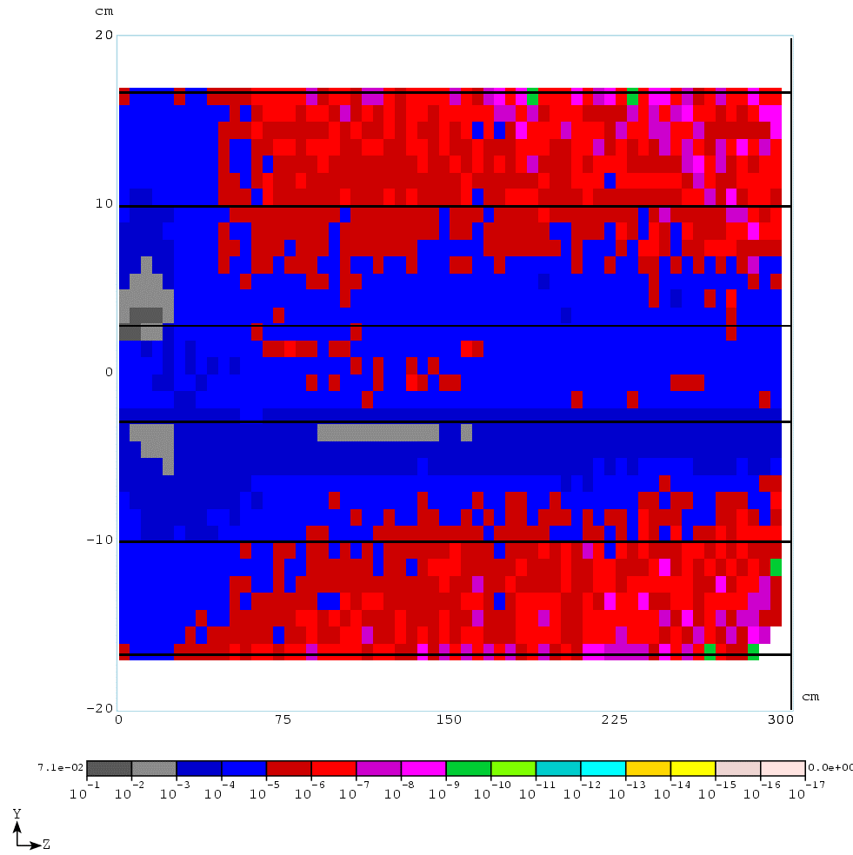
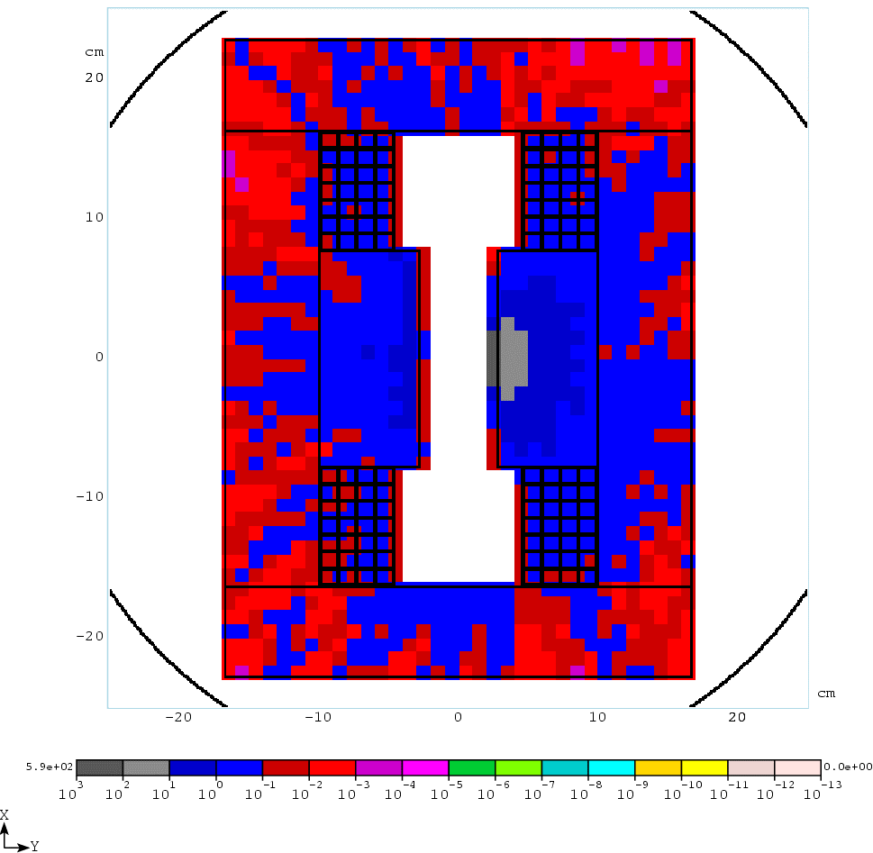
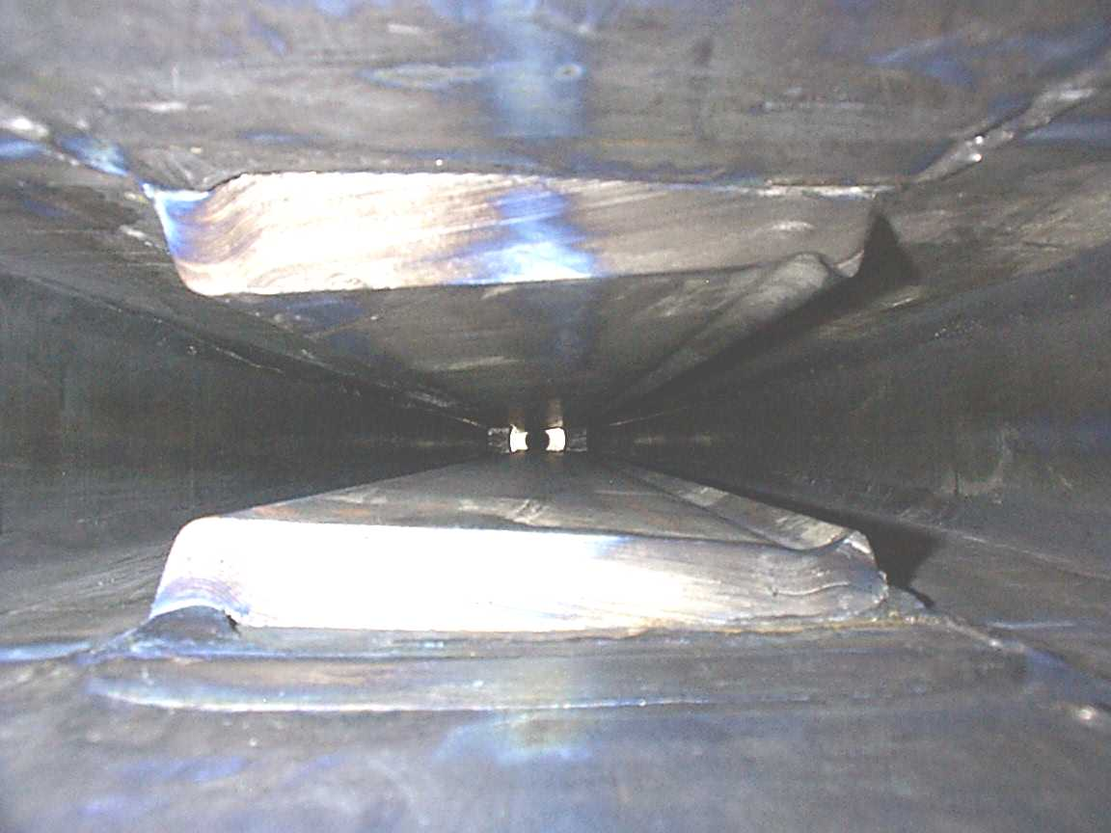
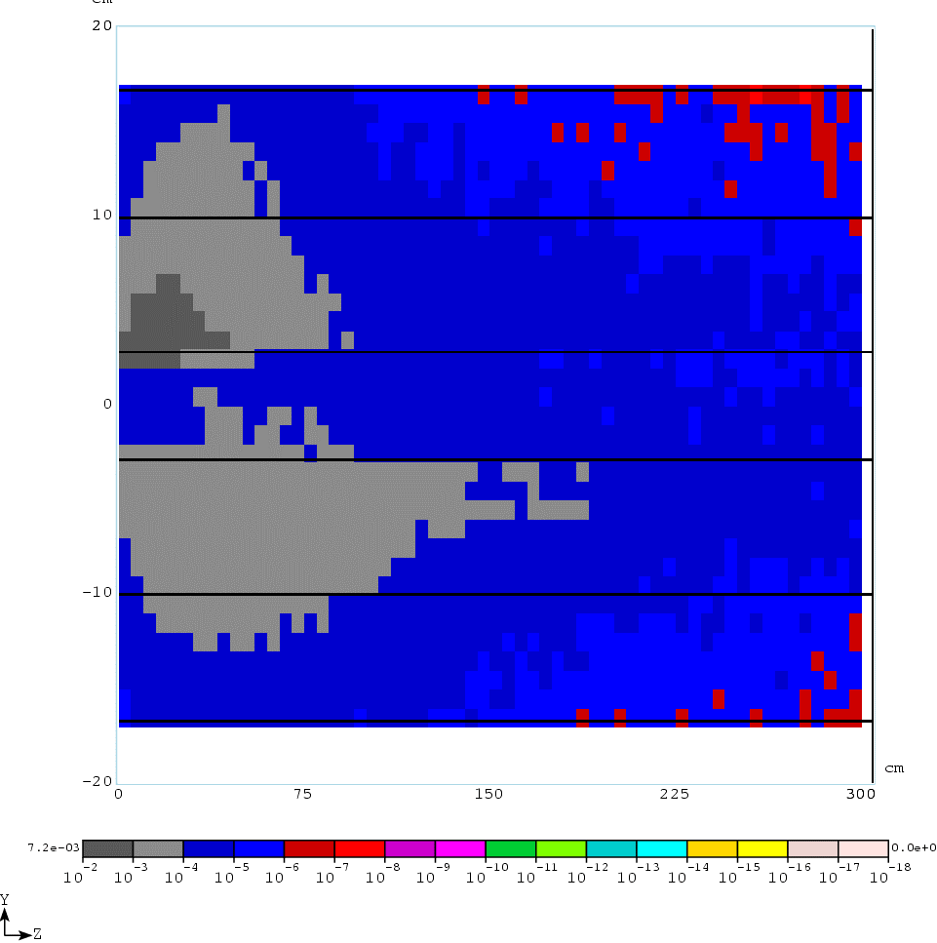
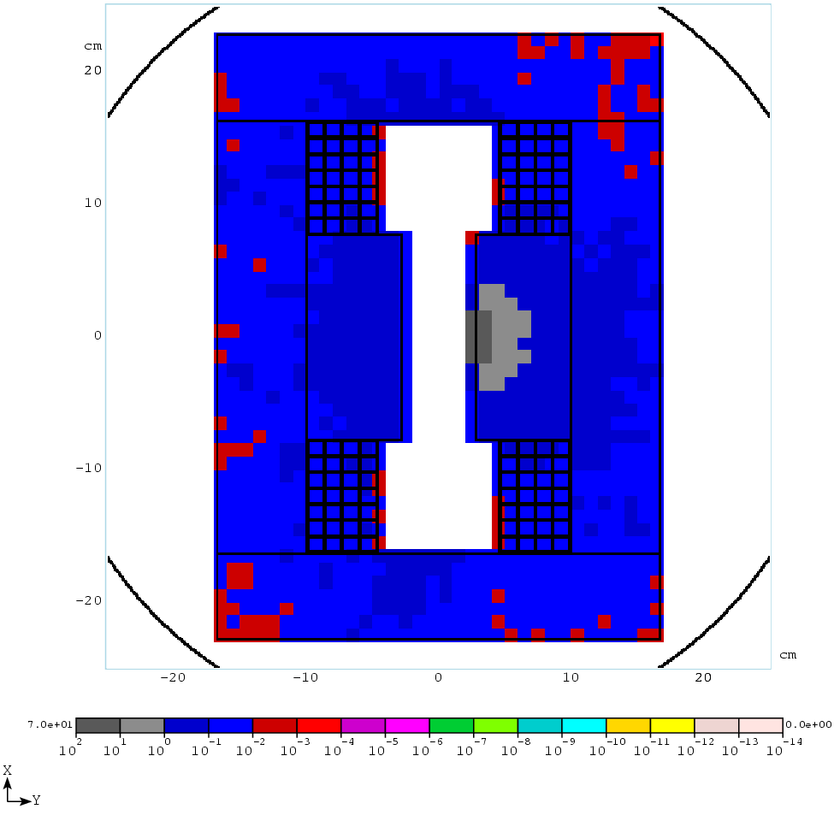
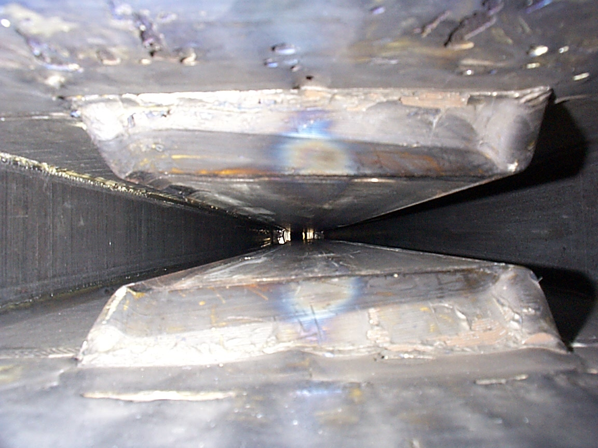
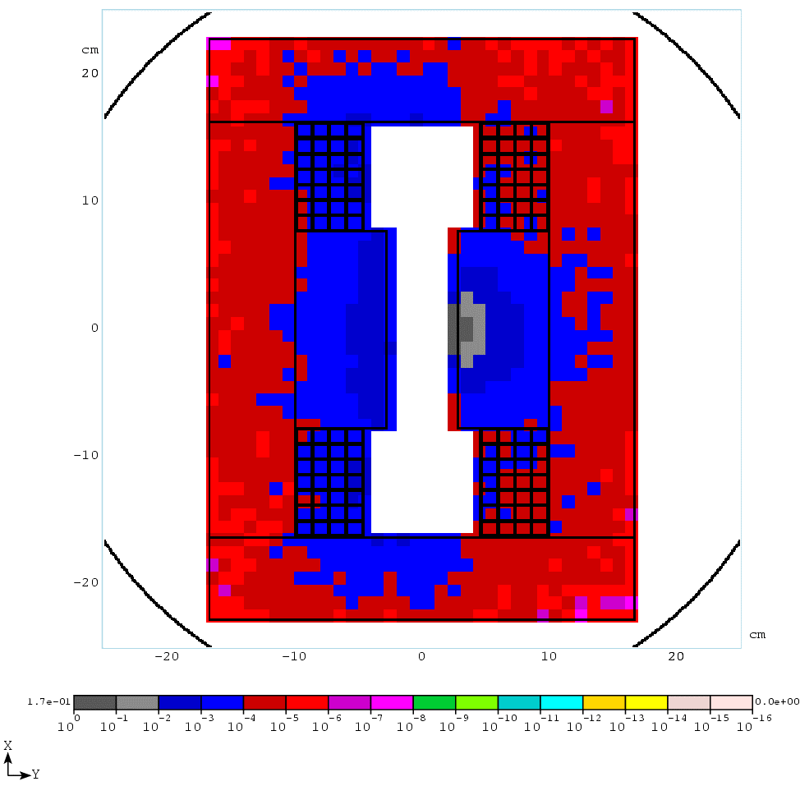
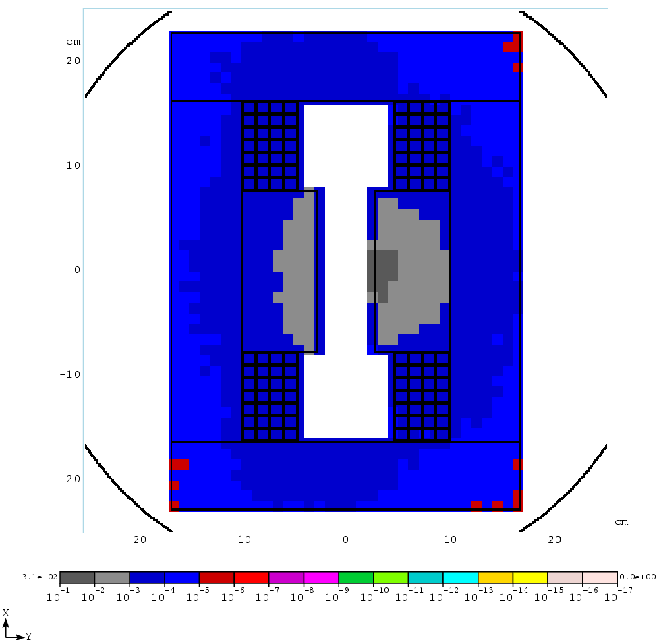
Longitudinal Profiles
Residual Radiation
Inspection of Magnets
Radiation Damage
These figures show the longitudinal energy deposition (Gy/sec) at 500 MeV (top) and 5 GeV (bottom)
Based on this distribution, we choose the first 50 cm as the shower max, which is used to find the maximum energy deposition in the lateral cross sectional profile
This shows the residual activation (mSv/hr) after 30 days of running and 1 day cool down due to 500 MeV (top) and 5 GeV (bottom) incident beam.
It is consistent with surveyed activation in the Booster, which gives us confidence in the model.
Discussion
Peak Energy Deposition
Unfortunately, there is little information on the details of the epoxy used in the Booster magnets.
In typical epoxy resins of this type, detectable radiation damage begins to occur with exposure at the few hundred kGy level, but the first symptoms are embrittlement and an increase in moisture absorption.
The former should not be a worry unless it becomes extreme.
The latter might be a concern in that moisture could affect the conductivity of the resin; however, as the coils are in vacuum, this is not an issue.
Epoxy resins in the magnets at the Tristan ring at KEK had exposure as high as 10 MGy and while they were visibly darkened they continued to function properly.
Integrated Dose
The simulated energy deposition results in roughly 1-2x10⁻¹⁷ Gy per accelerated proton.
The Booster has delivered roughly 1.10²¹ protons over its 30+ year life
This corresponds to 10-20 kGy.
However, keeping in mind that the Booster was much less efficient in the past and the nonuniformity of beam loss, its reasonable to assume that some areas of the Booster have gotten as much as 100-200 kGy.
The Booster is projected to deliver 5-10x10²¹
This will necessarily involved reducing losses, but it still reasonable to assume that some areas of the epoxy will receive as much as 1 MGy or so.
Conclusions
Our studies indicate that the epoxy resin used as an insulator in the magnets of the Fermilab Booster may have received integrated radiation doses as high as 100 kGy over the life of the machine.
The increased proton flux needed by the neutrino program could mean that some areas will receive as much as 1 MGy over the next ten years.
While these numbers are within the range where epoxy resins have been shown to work in the past, they are definitely at a level which causes some concern, particularly given our lack of details about the exact epoxy used.
It is therefore extremely important to keep beam loss at a minimum in the coming years and to try to keep it as uniform as possible to avoid excessive localized dosage.
Further study is warranted, and should a magnet fail for other reasons, it will be important to inspect the condition of the epoxy.
These figures show the transverse energy deposition (Gy/sec) in the first 50 cm at 500 MeV (top) and 5 GeV (bottom)
This shows that the epoxy sees as much as 10⁻³ Gy/sec at each energy

