Slide 1

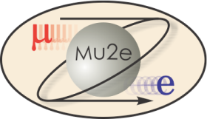

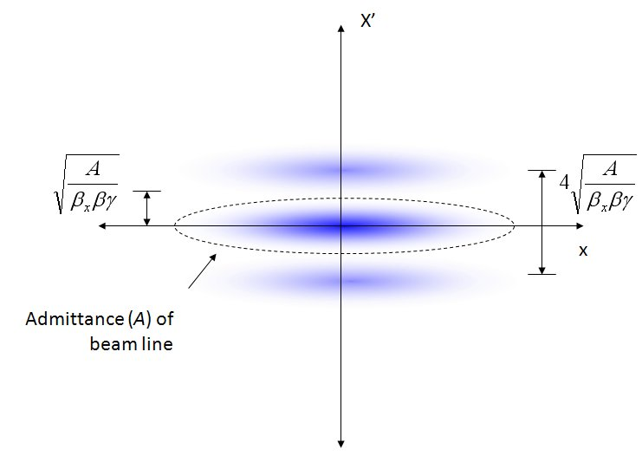
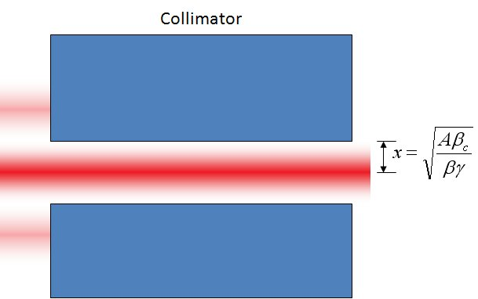
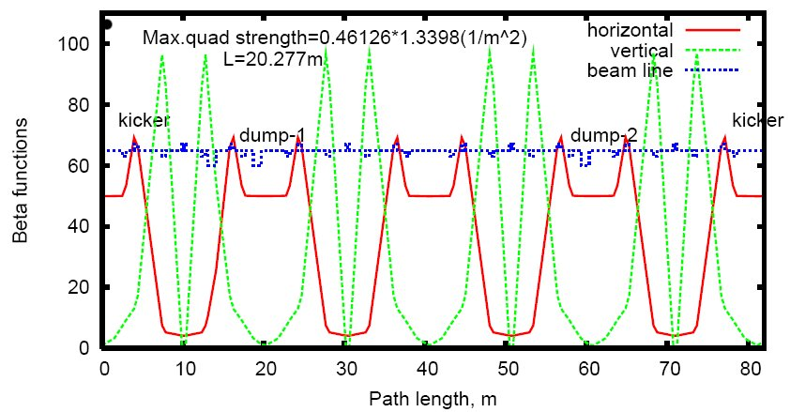
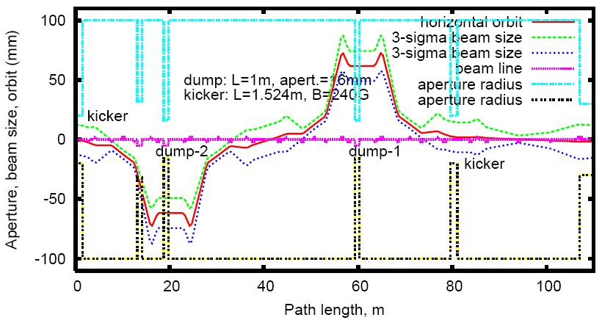
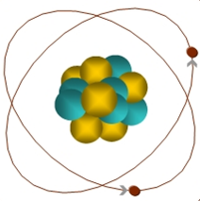
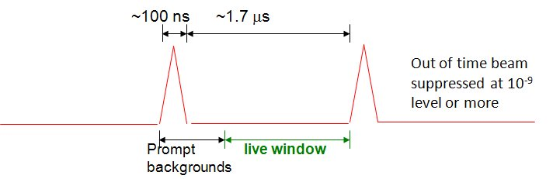
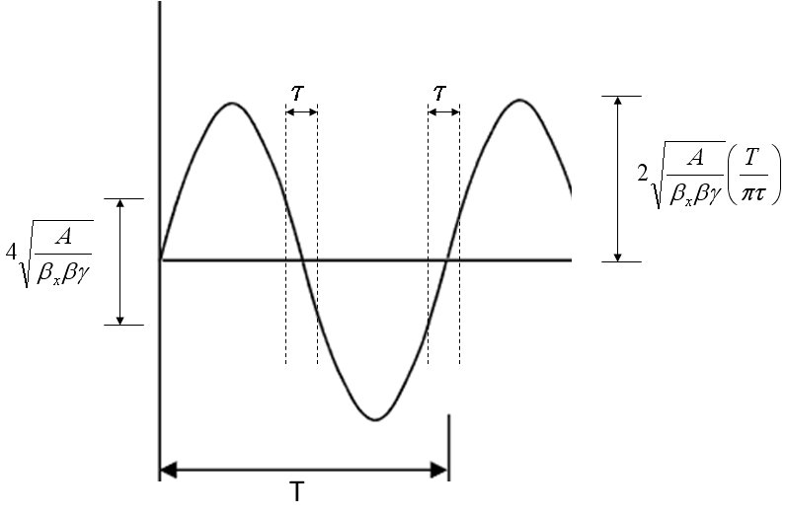
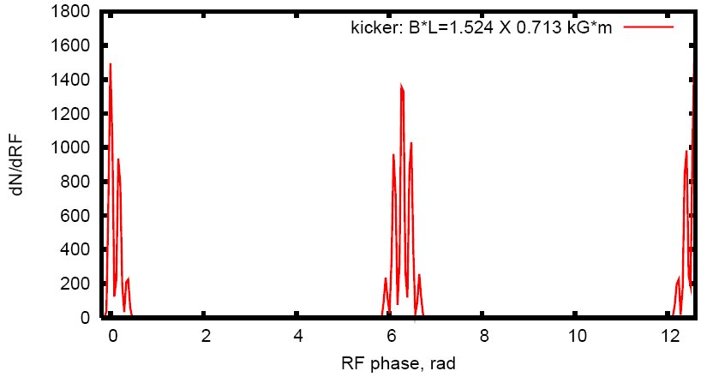
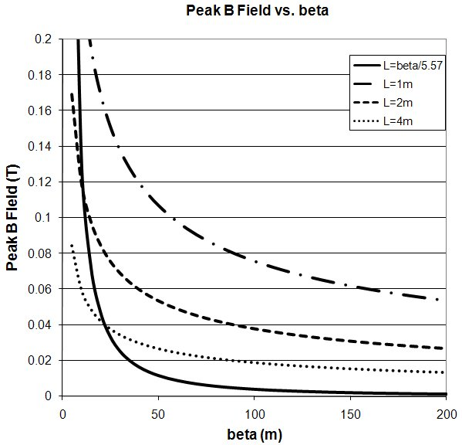
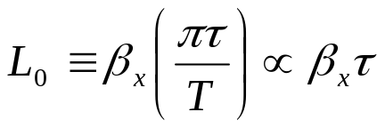
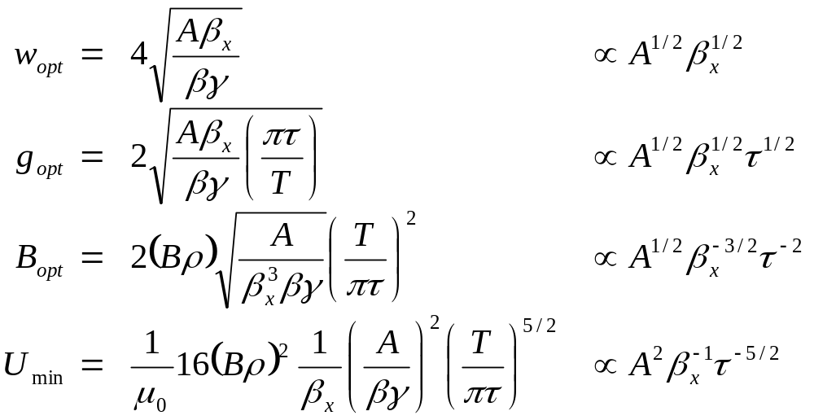
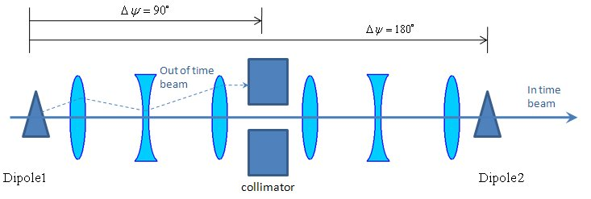
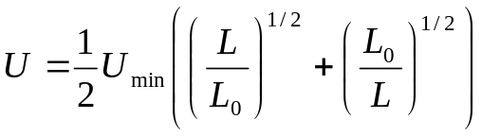
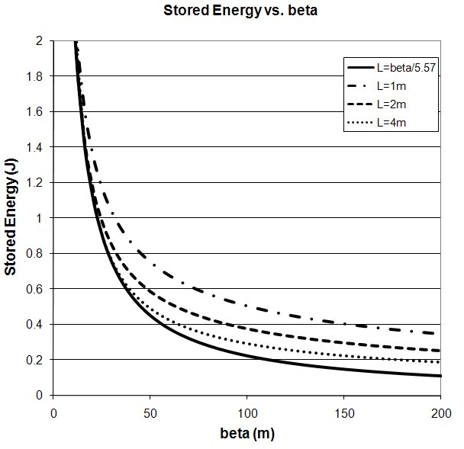
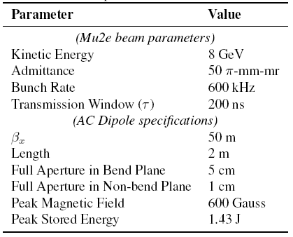
AC Dipole System for Inter-Bunch Beam Extinction in the Mu2e Beam Line
E.J. Prebys, A.I. Drozhdin, C.J. Johnston, N.V. Mokhov, Fermilab, Batavia, IL 60510
C.M. Ankenbrandt, Muons, Inc, Batavia, IL 60510
ABSTRACT
The Mu2e experiment has been proposed at Fermilab to measure with unprecedented precision the rate for muons to convert to electrons in the field of an atomic nucleus. This experiment uses an 8 GeV primary proton beam consisting of short (~100 nsec) bunches, separated by 1.7 μsec. It is vital that out-of-bunch beam be suppressed to the level of 10⁻⁹ or less. Part of the solution to this problem involves a pair of matched dipoles operating resonantly at half the bunch rate. There will be a collimation channel between them such that beam will only be transmitted when the fields are null. The magnets will be separated by an integer multiple of 180° in phase advance, such that their effects cancel for all transmitted beam. Magnet optimization considerations will be discussed, as will optical design of the beam line. Preliminary simulations of the cleaning efficiency will also be presented.
Motivation
Magnet Optimization
Preliminary Simulations
  The study of rare decays are a powerful tool to probe mass scales that are beyond the reach of conventional searches.
    Those that involve charged lepton flavor violation (CLFV) are particularly interesting.
    Such decays are a virtually universal features of proposed models beyond the Standard Model.
  The effect of the AC dipole can be treated generically
    If the admittance of the beam line A is well defined and matched to the admittance of the collimator, then an angular kick corresponding to twice the angular amplitude associated with that admittance will completely extinguish the beam.
  This extinction channel has been incorporated into a preliminary beam line design
    The second AC dipole has been placed at 360° to allow for a second collimator at 180°.
  A STRUCT simulation has been performed to estimate the cleaning efficiency.
  The Mu2e experiment has been proposed at Fermilab to search for the conversion into an electron of a muon which has been captured by a nucleus.
    The muon can decay via the exchange of a virtual particle with the
    nucleus, resulting in a two body decay.
    This produces the striking experimental signature of a
    mono-energetic electron, carrying most of energy associated with
    the muon's rest mass.
    Occurs in the standard model via virtual neutrino mixing at a rate of
    10⁻⁵⁴ (out reach of any presently conceivable experiment)
    Experiment aims to measure with a sensitivity of 10⁻¹⁶
      An improvement of four orders of magnitude over previous experiments.
      Sensitive to a broad range of new physics.
μ
105 MeV e⁻
In time beam
Extinction channel optics
Beam optics for 20 π-mm-mr beam at point of full extinction
Out of time beam
  A beam distribution is generated which is initially flat in time.
    For the purposes of calculation, it is divided into 70 “pseudo-bunches” of approximately 50 ns each.
  The surviving beam is shown below as a function of phase of the bunch frequency (twice the phase of the AC dipole).
  The width of the transmission window τ also drives the peak magnetic field requirement.
  In general, we want a low peak magnetic field and low total stored energy. These can be expressed as a function of:
    β_{x} – betatron function at bend point.
    A – admittance of the beam line
    τ – full width of the transmission window (200 ns for our purposes)
  We find that this drives us toward very large, low field magnets and large β_{x}
    Eventually practical considerations of magnet and beam line design must be considered.
  A key component of the experimental technique is the proton beam structure.
    The beam consists of short (~100 ns FW) proton bunches with 8 GeV kinetic energy.
    These produce muons, which are in turn transported and captured on a nuclear target.
    The proton bunches are separated by approximately 1.7 μsec.
    During this time, the captured muons either decay normally or potentially convert into electrons.
    The experimental search takes place in this time between the bunches.
  Most of the experimental backgrounds are prompt with respect to the muon production, transport and capture.
    Very important that beam between the bunches is suppressed to the 10⁻⁹ level or less.
    Some of the suppression will come from bunch production technique.
    Active suppression in the beam line should produce an additional 10⁻⁶ suppression.
Optimum length
  Note that as expected, beam more than 100 ns from the AC dipole node is full extinguished.
  Unfortunately, significant beam is also lost 50 ns from the peak.
Technique
Bend plane aperture
Non-bend plane aperture
Status and Plans
Peak field
  Mu2e has been granted Stage 1 approval by Fermilab
    Working to refine and optimize design, including extinction channel.
  It's become clear that the preliminary magnet specifications present challenges in terms of the peak field required.
    Investigating larger, lower field options
  The loss of beam within the longitudinal bunch envelope is undesirable
    We are investigating the addition of higher harmonics in order to reduce the beam slewing within the transmission window.
  Preliminary investigations show that the efficiency can be increased dramatically by introducing a secondary collimator at 90°of phase advance past the first one.
    Preparing full MARS simulation.
Stored energy
Length dependence
  Two AC dipoles are separated by an integer multiple of 180° in phase advance.
    Driven by a common sine wave, such that the second cancels the deflection of the first.
  A collimator, or collimation system, is placed between them such that beam is only transmitted at times close to the nodes of the sine wave.
Preliminary beam line and magnet specifications.
  The system need only run at half the bunch frequency
    300 kHz
  The system is operated as a resonant circuit
    Assuming a reasonably high Q (~100-1000), this will greatly reduce the requirement for the power supply.
Related Posters
  J. F. Amundsen, et al, “Space Charge Simulations for the Mu2e Experiment at Fermilab” (TH5PFP017)
  K. Y. Ng, “Stability Issues for the Mu2e Proton Beam” (FR5RFP060)
  M. J. Syphers, et al, “Preparations for Muon Experiments at Fermilab” (TU6PFP062 )
  C. Y. Yoshikawa, et al , "Intense Stopping Muon Beams" (MO6RFP080)
Work supported under DOE contract DE-AC02-07CH11359

