Slide 1
Fermilab Accelerator Complex in the Near Term: Muon Physics Program Eric Prebys Accelerator Physics Center FNAL

Slide 2
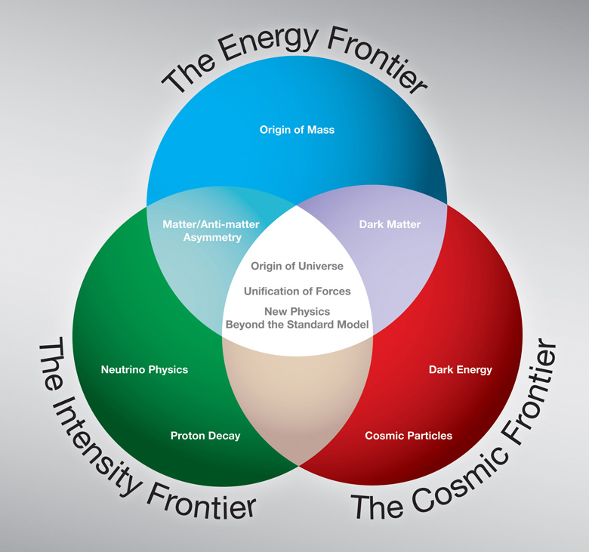

Outline
Background
Mu2e and g-2 experimental goals
Beam delivery schemes
Common elements
Mu2e only
Status and plans

Slide 3
Background
It’s important for Fermilab to have as large a scientific program as possible between now and the turn on of Project X
Now that the pBar complex is no longer being used, there is an opportunity to re-task part of it for other experiments; in particular
The Recycler can be used to store and bunch protons
G-2:
The pBar target area can be used for muon production and the Debuncher ring can be used to serve as a decay path and to direct them to the storage ring.
Mu2e:
The Debuncher ring can be used to generate the 8 GeV beam structure needed by the Mu2e experiment.

Slide 4
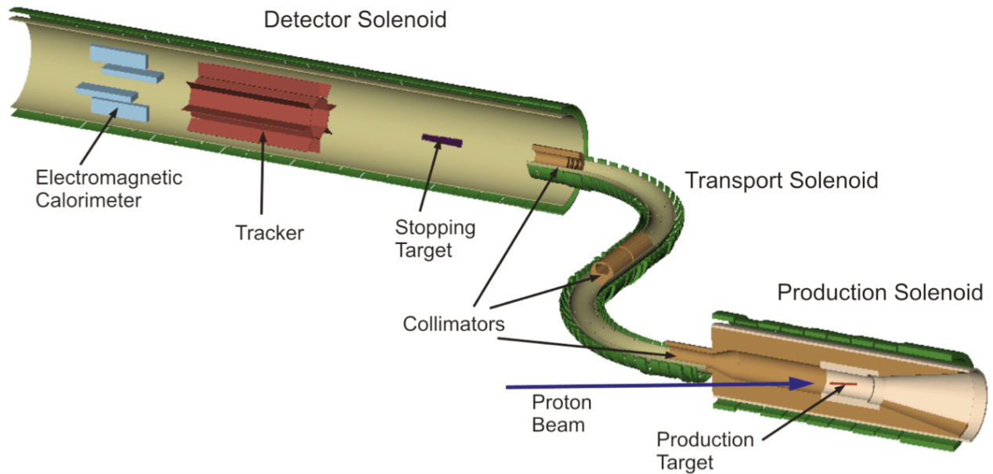
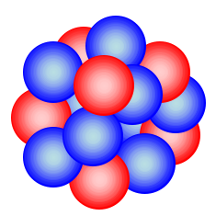


Mu2e Experimental Goal
μ ⁻ N → e⁻ N
Stop muons in an aluminum target
Aluminum
Nucleus
Goal: measure
μ ⁻
e⁻
Monoenergetic electron
Captured μ ⁻
E_{e} ≈ 105 MeV
with a 90% CL of <10⁻¹⁶

Slide 5
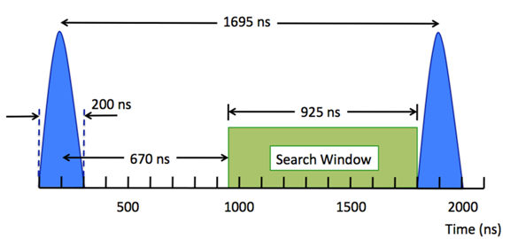
Mu2e Beam Requirements
Total protons on target ~4×10²⁰
Mu2e requires a train of beam pulses that are separated in time by an interval that is larger than the μ⁻ lifetime in Aluminum (864 nsec).
The protons for each pulse must be contained within an interval of ±100 nsec of the pulse center.
Out of time beam must be extinguished by a factor of 10⁻¹⁰.
Bunch intensity variation < 50%
Bunch intensity < 50×10⁶

Slide 6
Mu2e Time Line
1992 | MELC proposed at Moscow Meson Factory
1997 | MECO proposed for the AGS at Brookhaven as part of RSVP (at this time, experiment incompatible with Fermilab)
July 2005 | RSVP cancelled for financial reasons
Fall 2008 | mu2e submits proposal to Fermilab
November 2008 | Stage 1 approval. Formal Project Planning begins
November 2009 | DOE Grants CD-0
Summer 2011 | Estimated cost grows dramatically, prompting call from director to lower it
 | Task force formed to investigate ways to lower cost - focus on eliminating Accumulator from beam delivery scheme - factor of 3 to 6 reduction in beam
 | This talk will consider that as the new baseline

Slide 7
Muon g-2 Experiment Goal
Measurement of the value of muon anomalous magnetic moment, a_{μ}, where to an uncertainty of 16×10⁻¹¹ (0.14 ppm)
Present Situation:
Physics beyond the standard model?

Slide 8
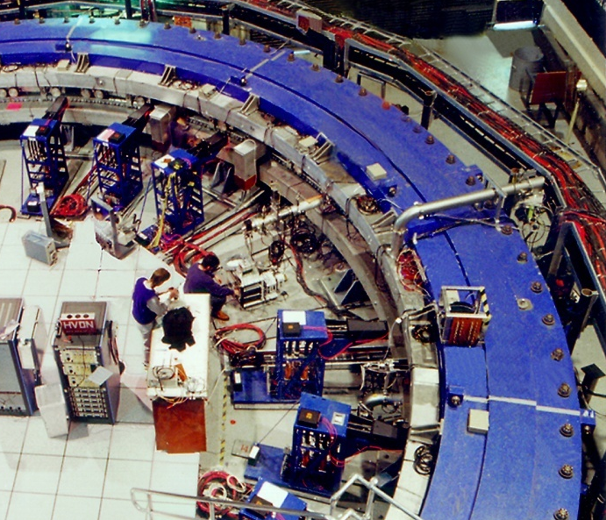
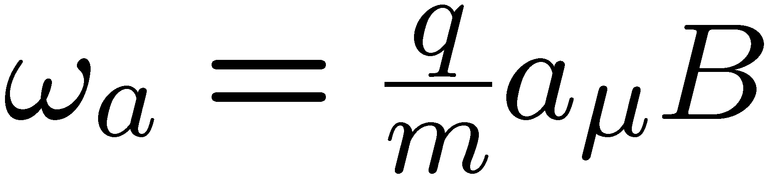
g-2 Experimental Technique
Capture polarized 3.094 GeV/c muons in a uniform magnetic field
Use electric quadrupoles to focus. “Magic” momentum cancels component of precession caused by E field
Remaining precession directly proportional to a_{μ}
Experimental apparatus will be moved from Brookhaven
e
Momentum
Spin

Slide 9
Muon g-2 Beam Requirements
Total of 4×10²⁰ protons on the pion production target
Transport of 3.094 GeV/c secondaries from pion production target
Large aperture (330 π mm-mrad) long (900 m) decay path to allow pions to decay to muons
Very narrow pulse width rms < 50 nsec
Pulse-to-pulse separation time ~10 msec

Slide 10
Muon g-2 Project Timeline*
Past
1997 – 2001 Brookhaven runs
May 2008 New g-2 included in P5 strategic plan
March 2009 New g-2 proposal presented to PAC
November 2009 PAC recommends stage-1 approval
April 2010 Proposal submitted to DOE
Now CD-0 paperwork at the DOE
*C. Polly 10/20/11

Slide 11
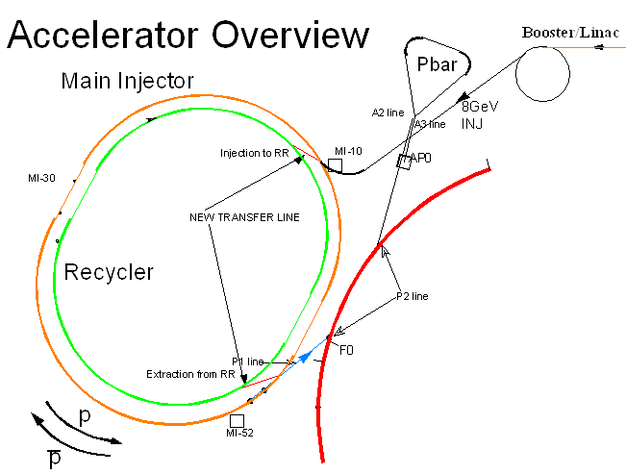
Use of the Accelerator Complex for Mu2e and g-2
Common:
Beam is transferred from Booster to Recycler
It is bunched into 4 2.5 MHz Bunches
g-2:
Bunches are extracted one at a time to muon production target
Muons are steered through Debuncher toward storage ring
Mu2e:
Bunches are transferred to and stored in Debuncher Ring
Mu2e and g-2 do NOT run concurrently. Accelerator operation is switched between Mu2e mode and g-2 mode.

Slide 12
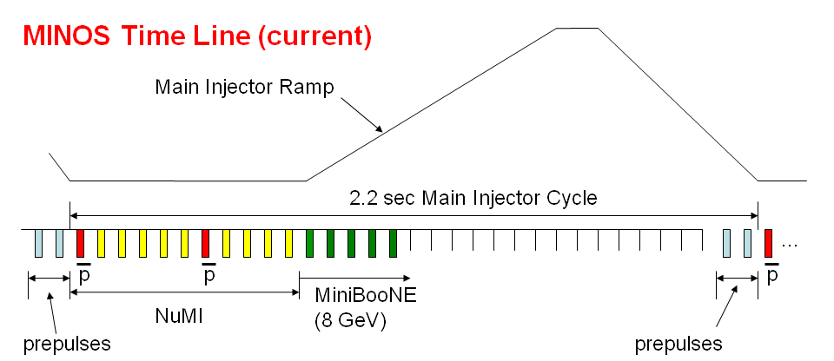
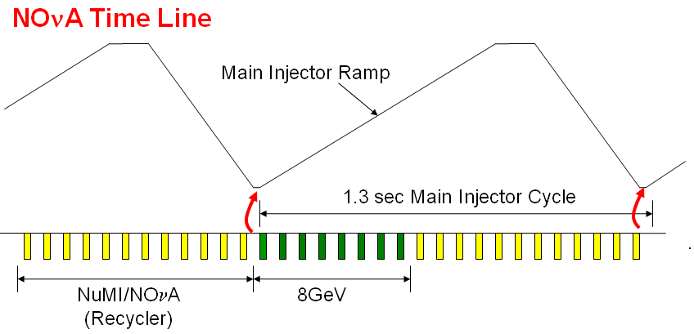
Reminder: NOνA time line improvements
300 kW
Present: must allow time at injection energy to load protons into Main Injector
700 kW
Upgrade: a new transfer line will allow us to “prestack” in the Recycler
Up to ~5x10²⁰ protons/year that cannot be used by NOνA

Slide 13
Mu2e and g-2 Common Ground: Bunch Formation in the Recycler
Booster batch Injected
Split into 4 bunches with 2.5 MHz RF
During the 8 Booster ticks which are not used by NOvA, Booster batches are injected into Recycler
2.5 MHz RF is used to divide these into 4 bunches of ~1x10¹² each
Subsequent handling
g-2
Bunches are extracted individually to the muon production target
Mu2e
Individual bunches are extracted to the pBar Debuncher ring
Each is resonantly extracted to produce the required Mu2e time structure.

Slide 14
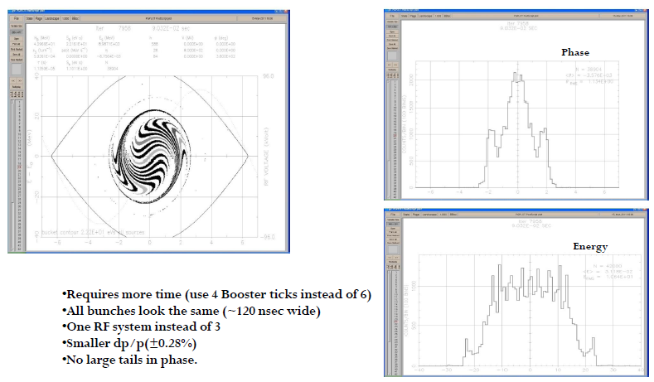
Common: Bunch Formation in Recycler*
Single 2.5 MHz RF system
Requires ~90 ms
Δp/p ≈ .28%
No large tails
*I. Kourbanis

Slide 15
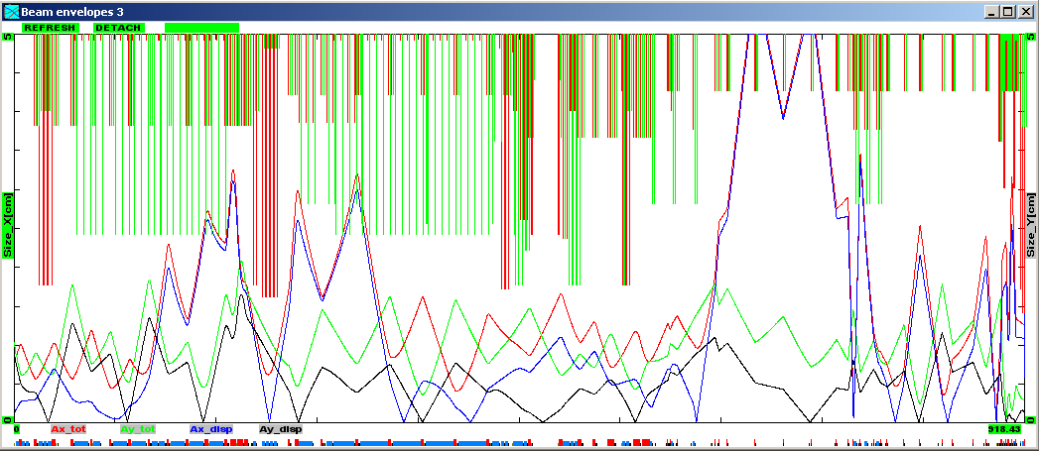
Common: Aperture Issues in AP2 Line*
ε=15 π-mm-mr, Δp/p=.25%
Red = Δx total, Blue = Δx from Δp
Green = Δy total, Black = Δy from Δp
⇒ looks doable
Can be fixed by tuning
V714 C-magnets
Accumulator Lambertson
and C-Magnet
MI-52 Lam. / V701 C-magnets (?)
Tev. F0 Lambertsons
HV100 dipoles
HT105 trim
F-17 C-Magnets
HV102 dipoles
Improvements already planned
*J. Morgan

Slide 16
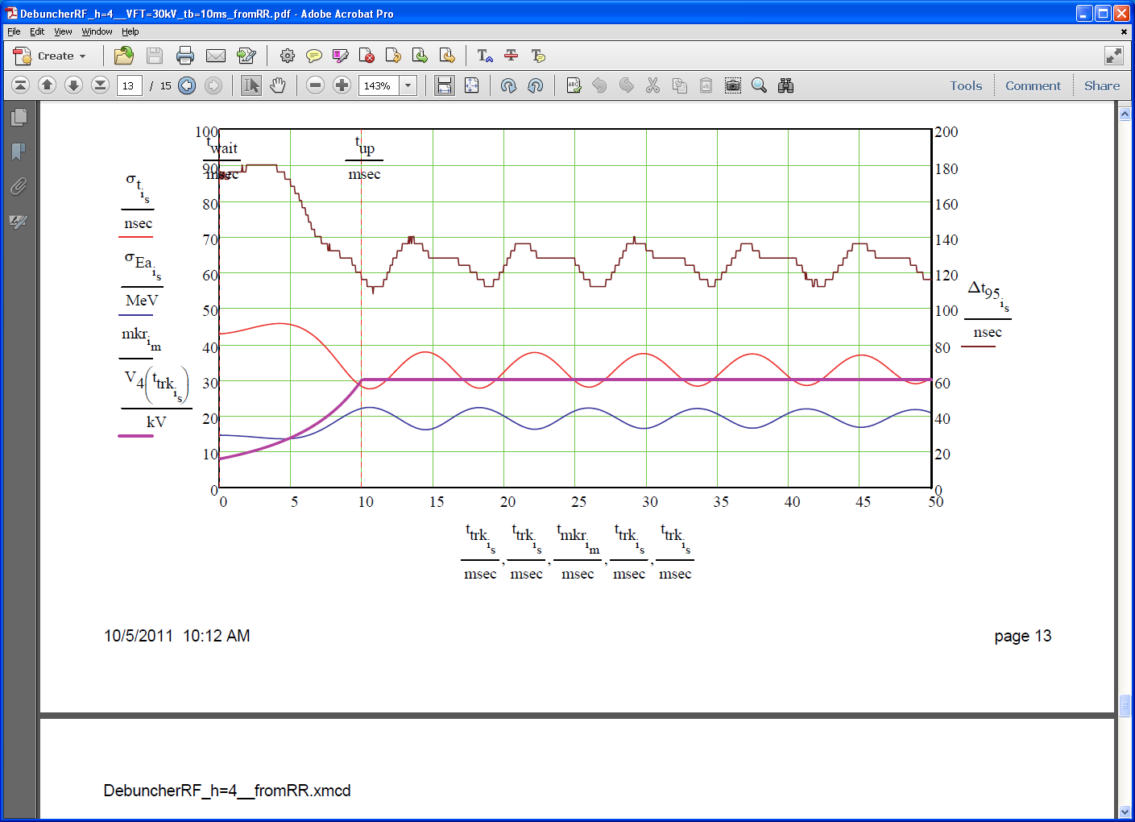
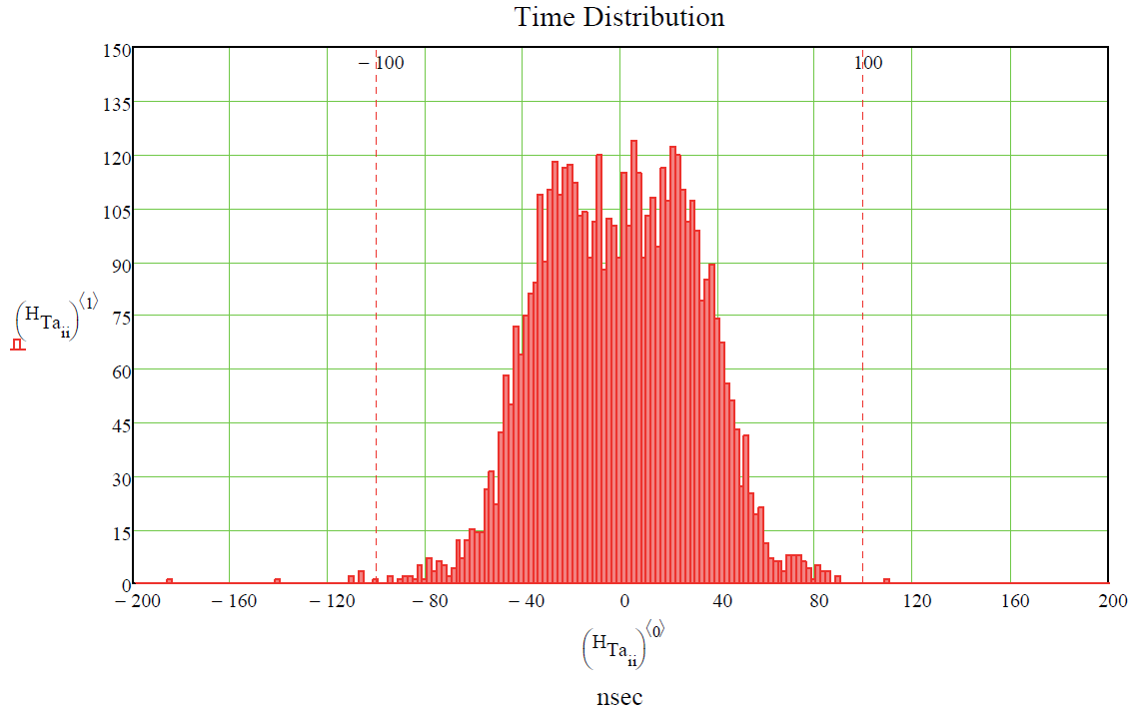
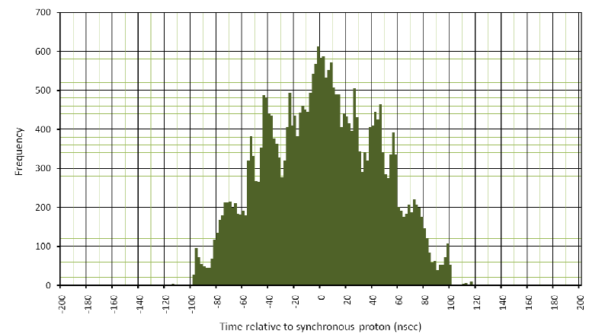
Mu2e: Bunch Formation in Debuncher*
Bunch formation by 3 2.4 Mhz cavities (30 kV)
For comparison: previous baseline distribution
*S. Werkema

Slide 17
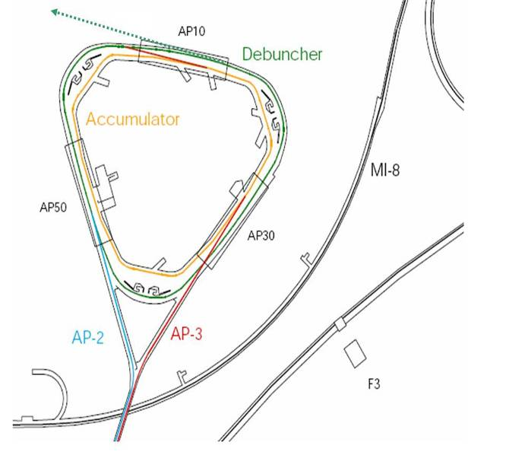
Mu2e: Resonant Extraction
A resonance is driven to slowly extract the single bunch which is circulating around the Debuncher.
The result is a train of bunches separated by the period of the Debuncher (~1.7 μs)
~100 ns
~1.6 μs

Slide 18
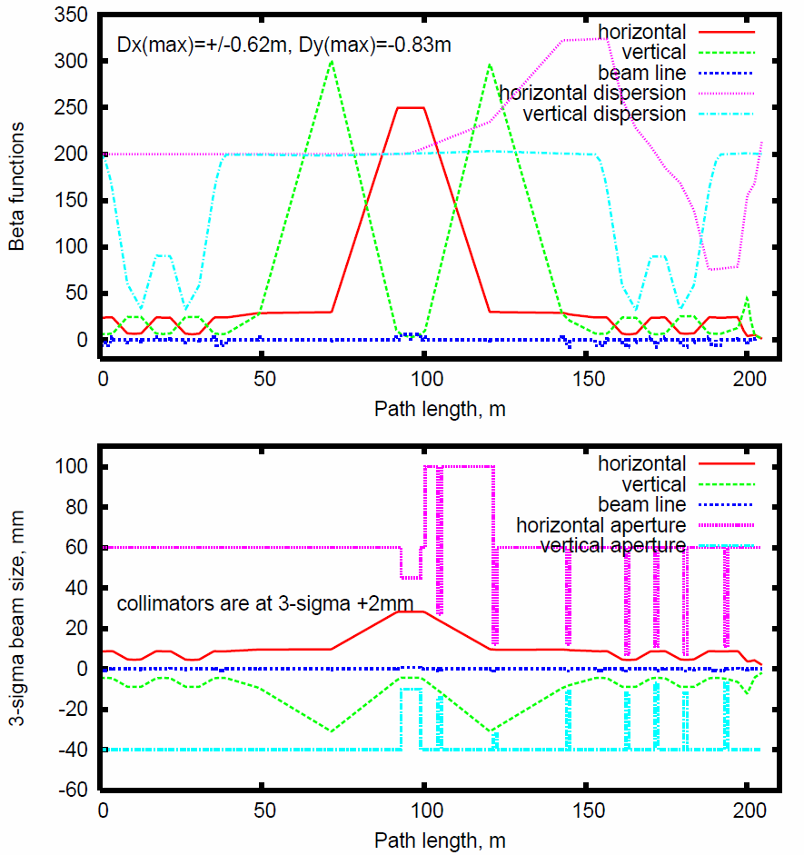
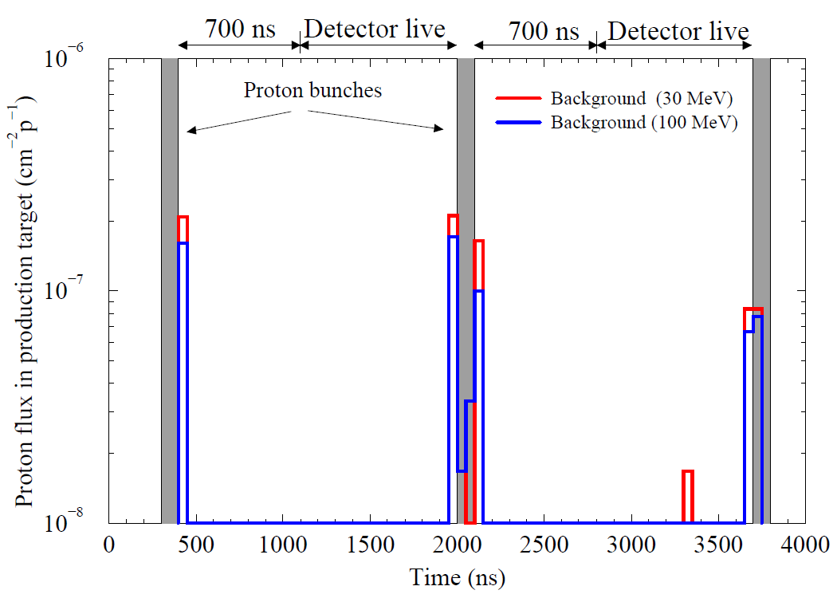
Mu2e: Beam Line and Extinction
Optics dominated by need to accommodate AC Dipole
Requirement
10⁻¹⁰
Modeling (beam line alone)
Generated 210M
Hit target: 27
⇒ 1.2 10⁻⁷
⇒ Need extinction out of ring to be < 10⁻³

Slide 19
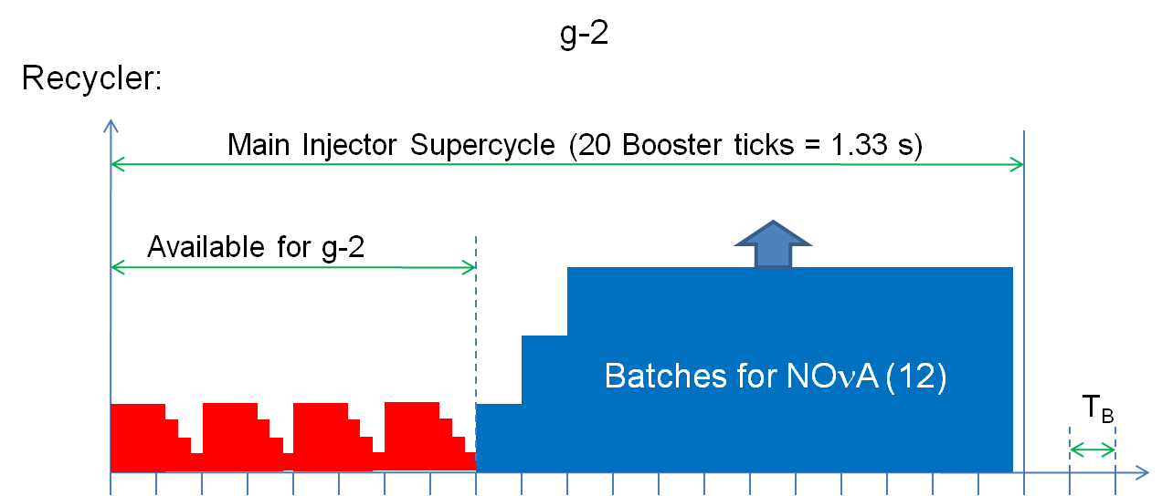
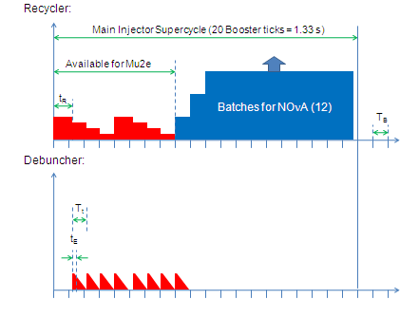
Beam Delivery Time Lines
g-2:
Individual bunches are extracted to muon production target
Bunches are extracted to present pBar debuncher
Captured by 2.4 MHz RF
Resonantly extracted to experiment
“g-2” Scheme for Mu2e:

Slide 20
Summary of Beam Needs and Issues
 | Mu2e | Muon g-2
Proton Source | 2 batches/super-cycle | 4 batches/super-cycle
Recycler Injection | Use NOνA kicker & beamline
Recycler Ring | Bunch Formation with 2.5 MHz RF
Recycler Extraction | One bunch extracted every ~40 msec Extraction kicker rate: Average = 3 -- 6 Hz Peak = 25 Hz | One bunch extracted every ~10 msec Extraction kicker rate: Average = 12 Hz Peak = 83 Hz
Average Beam Power | ~4-8 kW | ~15 kW
Accelerator Physics | 2.5 MHz Bunch Formation in Recycler
 | Resonant Extraction from Debuncher
 | Extinction

Slide 21
Approximate Project Time Lines
Mu2e |  | Muon g-2
Oct. – Nov. 2011 | Re-baseline Conceptual Design | Jan. 2012 | CD-0 granted
Dec. 2011 – Apr. 2012 | Re-write CDR, Revise cost & schedule | Jul. 2012 | Conceptual Design complete
Jun. 2012 | CD-1 Review | Jul. – Aug. 20012 | CD-1 Review
Sep. 2013 | CD-2/CD-3a | Jun. 2013 | CD-2/CD-3a
Sep. 2014 | CD-3 | Dec. 2014 | CD-3
2019 | Project Complete | 2016 | Project Complete
Previous plans delayed by ~1 yr

