Slide 1
The Fermilab Accelerator Complex: Status and Challenges
Eric Prebys
FNAL Beams Division

Slide 2
Outline
Basic Accelerator Physics Concepts
  Horizontal motion (lattice functions, emittance)
  Tune plane
  Longitudinal motion (phase stability, longitudinal emittance)
The Accelerator Complex
  Proton Source (Preac, Linac, Booster)
  Main Injector
  Pbar source (target, debuncher, accumulator)
  Tevatron
  Recycler
  Operational modes
The Challenges
  Run II
  MiniBooNE
  NUMI

Slide 3

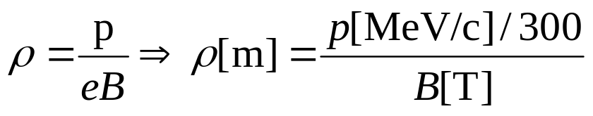

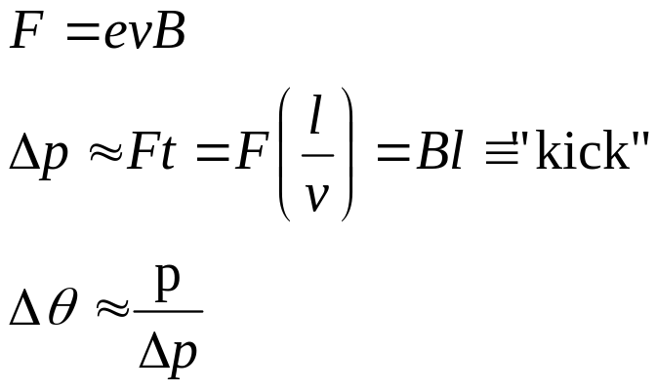



Dipole Field, Thin Lens Approximation.
side view
A uniform magnetic field will bend particles in path of constant curvature:
top view
For small deflections:
1 T-m = 300 MeV/c
“kink” at ≈ center of magnet

Slide 4

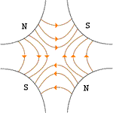



Quadrupole Fields (focusing elements)
Vertical Plane:
Horizontal Plane:
Luckily…
…pairs give net focusing in both planes!
“FODO cell”

Slide 5

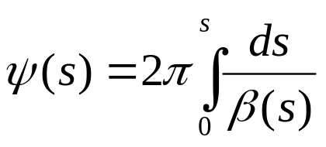

Betatron Motion
For a particular particle, the deviation from an idea orbit will undergo “pseudo-harmonic” oscillation as a function of the path along the orbit:
x
Lateral deviation in one plane
s
The “betatron function” β(s) is effectively the local wavelength and also defines the beam envelope.
Phase advance
Closely spaced strong quads -> small β -> small aperture
Sparsely spaced weak quads -> large β -> large aperture
β(s) is has the fundamental cell periodicity of the lattice
length of one, e.g., FODO cell
However, in general the phase (and therefore particle motion) does not, and indeed must not, follow the periodicity of the ring…

Slide 6
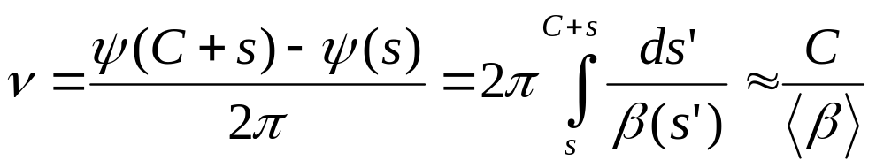
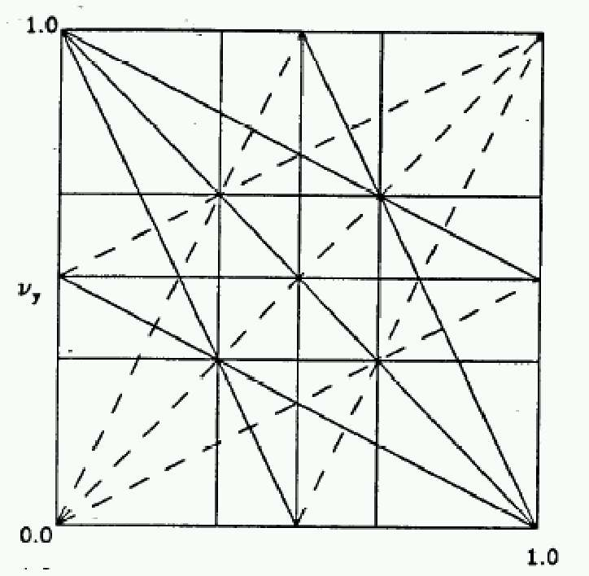
Tune and Tune Plane
We define the “tune” Q (or ν) as the number of complete betatron oscillations around the ring.
For example, the horizontal tune of the Booster is about:
6.7
Magnet Count/Aperture optimization
Beam Stability
In general…
“small” integers
Many deviations from the ideal lattice are characterized in terms of their resulting “tune-shift”. In general, the beam will become unstable if it shifts onto a resonance.
fract. part of Y tune
fract. part of X tune

Slide 7
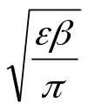

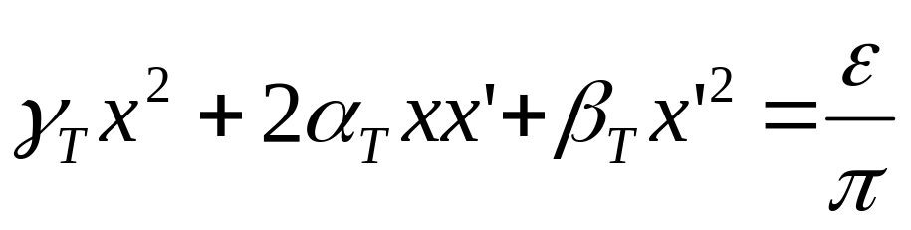


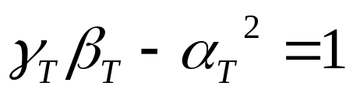
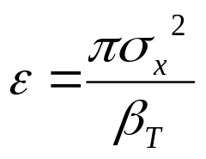
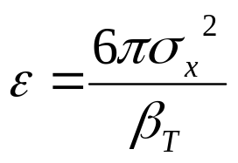
Emittance
As a particle returns to the same point on subsequent revolutions, it will map out an ellipse in phase space, defined by
Area = ε
Twiss Parameters
An ensemble of particles will have a “bounding” ε. This is referred to as the “emmitance” of the ensemble. Various definitions:
Electron machines:
Contains 39% of Gaussian particles
Usually leave π as a unit, e.g. E=12 π-mm-mrad
Proton machines:
(FNAL)
Contains 95% of Gaussian particles

Slide 8
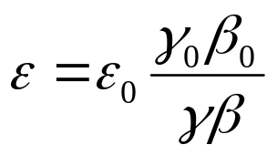

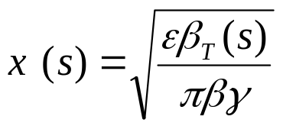
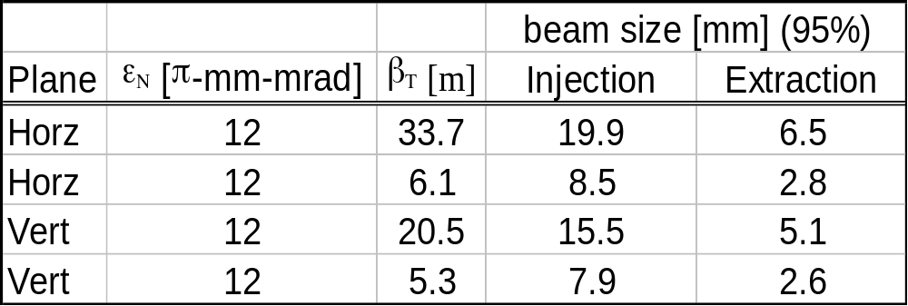
Normalized Emittance
As the beam accelerates “adiabatic damping” will reduce the emittance as:
The usual relativistic γ and β !!!!
so we define the “normalized emittance” as:
We can calculate the size of the beam at any time and position as:
Example: Booster

Slide 9
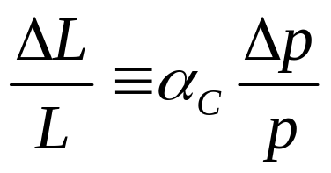
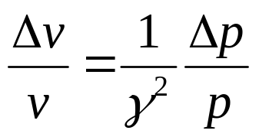
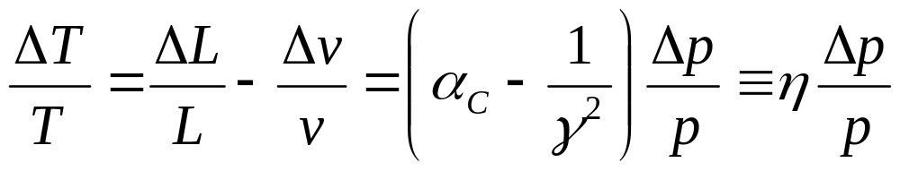
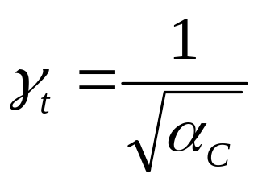
Slip Factor/Transition
A particle which deviates from the nominal momentum will travel a different path length given by….
“Momentum compaction factor”
It will also travel at a slightly different velocity, given by
… so the time it takes to make one revolution will change by an amount
“slip factor”
This changes sign at “transition”, defined by
Usually γ_{T} ≈ ν. In booster γ_{T} = 5.45

Slide 10


Phase Stability
As particles circulate around a ring, they pass through standing RF waves in accelerating cavities. The stability depends on the relative energy received by off-energy particles
Particles with lower E arrive earlier and see greater V.
Particles with lower E arrive later and see greater V.
Nominal Energy
Nominal Energy
Below Transition
Above Transition

Slide 11

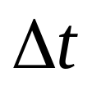
Longitudinal Phase Space
Stable particle motion (“bunch”)
Stable particle motion
Stable “bucket” (shrinks at high phase)
Stable “bucket”
φ=0 (no acceleration):
φ=60° (acceleration):
Generally, hold RF amplitude constant, and adjust phase to control acceleration.
If amplitude control is needed, it is accomplished by adjusting the relative phase of two sets of RF cavities.

Slide 12



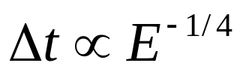
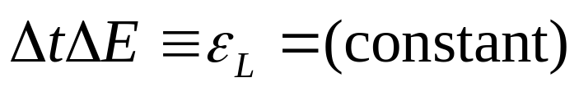
Longitudinal Emittance
As the particles accelerate
Typical values out of the booster are about .15 eV-s
Longitudinal Emittance. Usually expressed in eV-s

Slide 13
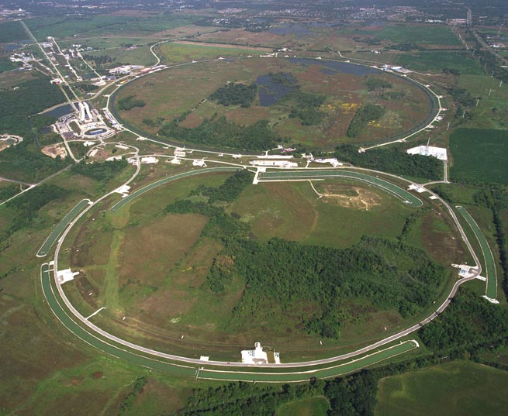
Fermilab Accelerators
History
Early 1960’s – plans solidify for a high energy national accelerator laboratory.
1966 – The AEC chooses the Weston, IL site from amongst hundreds proposed.
1968 – Construction begins.
1972 – First 200 GeV beam in the Main Ring.
1983 – First (512 GeV) beam in the Tevatron (“Energy Doubler”). Old Main Ring serves as “injector”.
1985 – First proton-antiproton collisions observed at CDF (1.6 TeV CoM).
1995 – Top quark discovery. End of Run I.
1999 – Main Injector complete.
2001 – Run II begins.

Slide 14
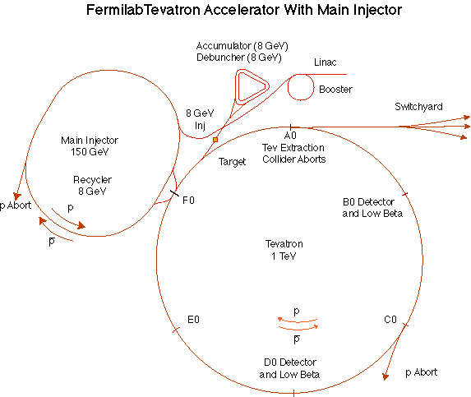
The Fermilab Accelerator Complex
MinBooNE
NUMI

Slide 15
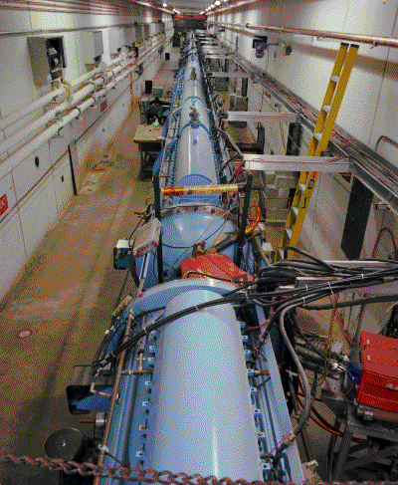
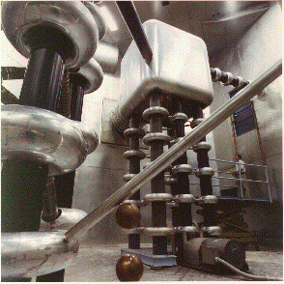
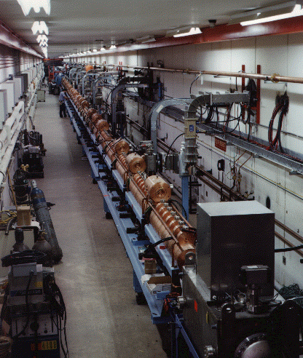
Preac(cellerator) and Linac
“New linac”- 800 MHz “π cavities” accelerate H- ions from 116 MeV to 400 MeV
“Preac” - Coolest looking thing at Fermilab. Static Cockroft-Walton generator accelerates H- ions from 0 to 750 KeV. (Actually, there are two of these, H- and I-)
“Old linac”- 200 MHz “Alvarez tubes” accelerate H- ions from 750 keV to 116 MeV
Preac/Linac can deliver about 45 mA of current for about 35 usec at a 15 Hz repetition rate

Slide 16
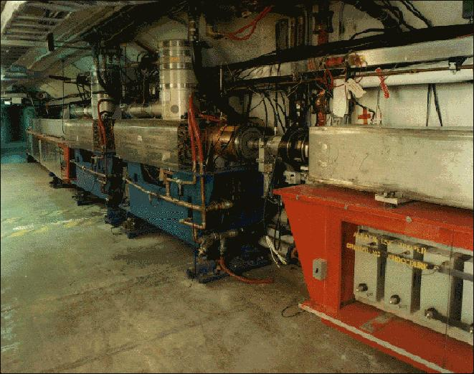
Booster
400 MeV Linac H- beam is injected into booster over several (up to 15) “turns”. The ion beam allows one to “cheat” Liouville’s theorem and inject (negative) beam on top of existing (positive) beam.
The main magnets of the Booster form a 15 Hz offset resonant circuit , so the Booster field is continuously “ramping”, whether there is beam in the machine or not. Ramped elements limit the average rep rate to somewhat lower.
From the Booster, beam can be directed to
  The Main Injector
  MiniBooNE (switch occurs in the MI-8 transfer line).
  The Radiation Damage Facility (RDF) – actually, this is the old main ring transfer line.
  A dump.
One full booster “batch” sets a fundamental unit of protons throughout the accelerator complex (max 5E12).
This is divided amongst 84 53 MHz RF buckets, which sets another fundamental sub-unit (max 6E10).

Slide 17
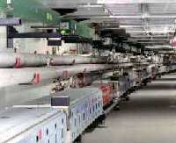
Main Injector
The Main Injector can accept 8 GeV protons OR antiprotons from
  Booster
  The anti-proton accumulator
  The Recycler (which shares the same tunnel)
It can accelerate protons to 120 GeV (in a minimum of 1.4 s) and deliver them to
  The antiproton production target.
  (soon) The fixed target area.
  (soon) The NUMI beamline.
It can accelerate protons OR antiprotons to 150 GeV and inject them into the Tevatron.
The Main Injector can also accept 150 GeV antiprotons from the Tevatron and decelerate them to 8 GeV for transfer to the Recycler.
The Main Injector is exactly 7 times the circumference of the Booster. Allowing one empty “slot” for switching, it can hold six booster batches, in the absence of exotic stacking schemes (slip stacking, RF barrier).
It’s envisioned that one batch will be used for stacking and the rest for NUMI and/or switchyard 120.

Slide 18
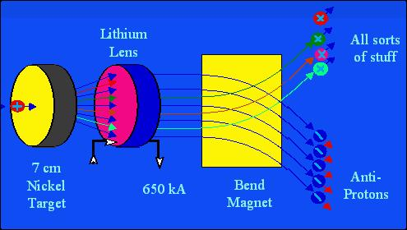
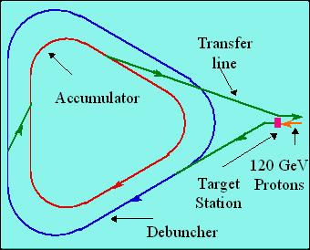
Antiproton Source
120 GeV protons strike a target, producing many things, including antiprotons.
a Lithium lens focuses these particles.
a bend magnet selects the negative particles around 8 GeV. Everything but antiprotons decays away.
The antiproton ring consists of 2 parts – the debuncher and the accumulator.

Slide 19
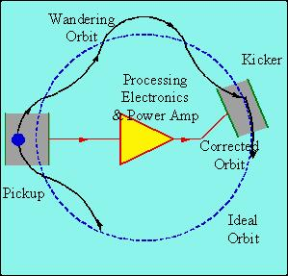




Antiproton Source – Debunching and Cooling
Debunching
Cooling
Particles enter with a narrow time spread and broad energy spread.
High (low) energy pbars take more (less) to go around…
…and the RF is phased so they are decelerated (accelerated),
resulting in a narrow energy spread and broad time spread.
Pickups detect deviations from an ideal orbit, which are used to “kick” the orbit back to the nominal. This reduces the transverse emittance in a statistical way.
The anti-proton source can typically “stack” at about 7E10 pbars/h, up to a maximum of about 120E10, at which point anti-protons are transferred to the Tevatron (via the M.I.).

Slide 20
Tevatron
The Tevatron was the world’s first superconducting accelerator.
It accepts protons AND pbars at 150 GeV from the Main Injector. Typically:
  36 proton bunches with 180E9 protons in each. (Run IIa goal: 270E9)
  36 pbar bunches with 12E9 pbars in each. (Run IIa goal: 33E9)
These are accelerated to 980 GeV.
Collisions (“low beta”) are initiated at the B0 (CDF) and D0 detector regions.
These “stores” are kept for typically 16 hours, while more antiprotons are made for the next “shot”.

Slide 21
Recycler
The Recycler is an 8 GeV storage ring in the same tunnel as the Main Injector.
The main lattice elements (dipoles and quadrupoles) are made out of permanent magnets).
The Recycler can accept 8 GeV antiprotons from
  The antiproton accumulator.
  The Main Injector (after deceleration).
The Recycler can deliver these antiprotons to the Main Injector for acceleration.
The goal of the recycler is
  To store antiprotons from the accumulator, thereby increasing the total antiproton production capacity.
  To recover antiprotons from a Tevatron store for use in subsequent stores.
At the moment, the recycler is not being used in standard operation.

Slide 22
Primary Modes of Operation
Stacking: full booster batches (~5E12 p) are accelerated to 120 GeV by the Main Injector, and delivered to the pbar target about once every 3 seconds (limited by the rate at which they can be debunched and cooled. It takes 10-16 hours to get enough pbars for a “shot”.
Shot setup: various beamline tuning takes place. Most importantly, pbar transfer lines are tuned with reverse protons.
Proton Injection: about 7 53 MHz booster bunches are injected into the M.I., accelerated to 150 GeV and “coalesced” into a single bunch, which is injected into the Tevatron (x 36).
Antiproton Injection: part of the “core” of the accumulator is manipulated to a separate extraction orbit and about 11 53 MHz bunches are extracted to the M.I., where they are accelerated to 150 GeV, coalesced and injected into the tevatron at 150 GeV.
Acceleration/collision: The protons and pbars are accelerated together to 980 GeV over a few minutes. The beam is scraped, and the beta is reduced (“squeezed”) at the collision regions. Physics begins. During this time, the rest of the accelerator complex is totally free to do other things (primarily stacking).
MiniBooNE Operation: While the M.I. Is ramping, a chain of 8 GeV Booster batches is switched to the MiniBooNE beamline.
NUMI Operation: along with the stacking batch, 5 additional batches are loaded into the Main injector. These are accelerated along with the stacking batch and extracted to the NUMI line after it has been extracted.

Slide 23
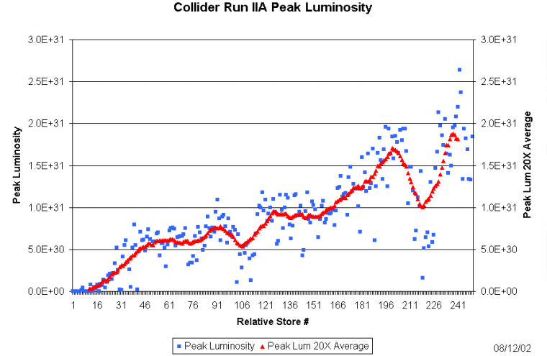
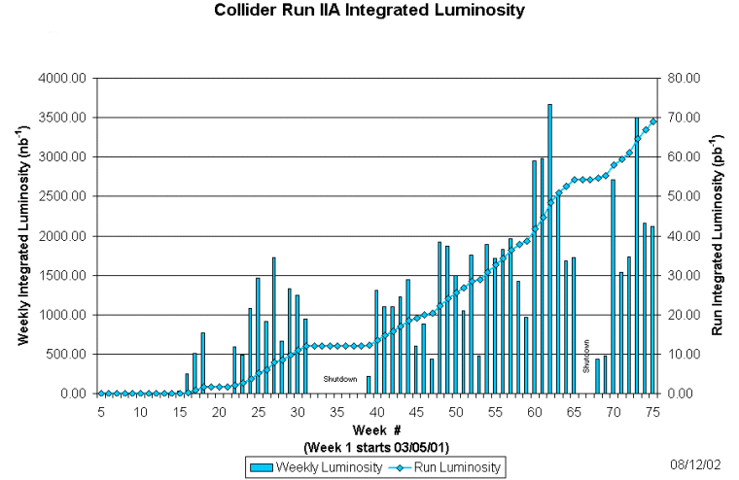
How is Run II Going?
Record: 2.7E31
Run IIa Goal: 8.3E31
Original Run IIa Goals:
  2E32 Peak Luminisity
  2 fb⁻¹ in two years

Slide 24
Why Haven’t Run IIa Goals been Met?
Number of pbars!!!
  NOT (primarily) due to protons on target or pbar production rate.
  Typically only around 50% of pbars from the accumulator make it to collisions.
  Some of this is due to large emittances out of the accumulator. This gets worse with larger stacks.
  Some is due to aperture and matching problems throughout the system.
Long range beam interactions in the Tevatron:
  Limit total number of protons.
  Due to aperture and helix problems.
General reliability problems:
  It’s a very complicated system
  If we lose the antiprotons, it takes at least 12 hours to recover.

Slide 25
The Plan
New cooling has been installed in the accumulator and is being tested. Initial results look good.
Studies continue to understand all the transfer efficiencies of the machines.
Continue to improve helix and aperture in Tevatron to reduce long range beam interaction.
Integrate recycler into accelerator operation some time in 2003.

Slide 26
(Near) Future Challenges
Two important neutrino experiments are coming on line soon:
  MiniBooNE will use the 8GeV Booster beam and a detector 500 m away to look for neutrino oscillations in the range Δm²~1 eV² – the range indicated by the LSND experiment.
  NUMI will use the 120 GeV Main Injector beam and a detector 750 km away to look for neutrino oscillations in the range of Δm²~10⁻⁵ eV² – the range indicated by atmospheric and solar neutrino data.
Both of these experiments place a major challenge on the Booster – arguably the only more or less original part of the Fermilab accelerator complex.

Slide 27
What’s so Hard About Neutrino Physics (from the Accelerator Standpoint)?
Probability that a proton on the AP target will produce an accumulated pbar:
.000015 (1.5E-5)
Probability that a proton on the MiniBooNE target will result in a detected neutrino:
.000000000000004 (4E-15)
Probability that a proton on the NUMI target will result in a detected neutrino at the MINOS far detector:
.000000000000000025 (2.5E-17)
⇒ Need more protons in a year than Fermilab has produced in its lifetime!!

Slide 28
What Limits Total Proton Intensity?
Maximum number of Protons the Booster can stably accelerate: 5E12
Maximum average Booster rep. Rate: currently 2.5 Hz, soon 7.5 Hz
(NUMI only) Maximum number of booster batches the Main Injector can hold: currently 6, possibly go to 11
(NUMI only) Minimum Main Injector ramp cycle time (NUMI only): 1.4s+loading time
Losses in the Booster:
  Above ground radiation
  Damage and/or activation of tunnel components
Our biggest worry at the moment!!!!

Slide 29
Proton Timelines
Everything measured in 15 Hz “clicks”
Minimum M.I. Ramp = 22 clicks = 1.4 s
MiniBoone batches “don’t count”.
Cycle times of interest
  Stack cycle: 1 inj + 22 MI ramp = 23 clicks = 1.5 s
  NuMI cycle: 6 inj + 22 MI ramp = 28 clicks = 1.9 s
  Full Slipstack cycle (total 11 batches):
    6 inject
    + 2 capture (6 -> 3)
    + 2 inject
    + 2 capture (2 -> 1)
    + 2 inject
    + 2 capture (2 -> 1)
    + 1 inject
    + 22 M.I. Ramp
    ----------------------
    39 clicks = 2.6 s

Slide 30
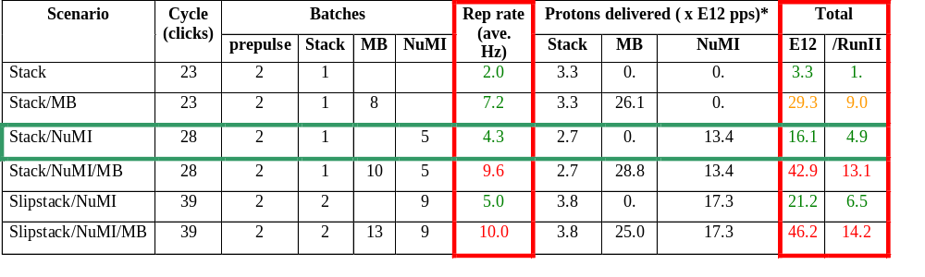
Summary of Proton Ecomomics
MiniBooNE baseline ≈ 5E20 p/year
Booster Hardware Issues
Radiation Issues
NUMI “baseline” = 13.4E12 pps x 2E7 s/year ≈ 2.7E20 p/year
*assuming 5E12 protons per batch

Slide 31
Booster Repetition Rate Limits
Presently, the Booster is limited to an average rep. Rate of 2.5 Hz, which would only yield a small fraction of the desired MiniBooNE intensity. The primary limitation is the pulsed extraction septum magnet (MP02).
A new power supply will go in in the next few weeks, which will raise this rate to 4.5 Hz, which would give about half the nominal MiniBooNE rate.
A new magnet will go in during the January shutdown which will allow the Booster to go to 7.5 Hz – enough for MiniBooNE or NUMI.
In order to run both MiniBooNE and NUMI, we need
  More cables for the extraction septum.
  Cooling for the RF cavities (or new RF cavities)
  A new “bump” magnet, which steers beam out during injection.

Slide 32
Above Ground Radiation
Main worry are the high occupancy areas in the Booster towers.
Shielding has been added both in the tunnel and to the first floor of the Booster towers.
Offices have been moved to reclassify some worrisome areas.

Slide 33
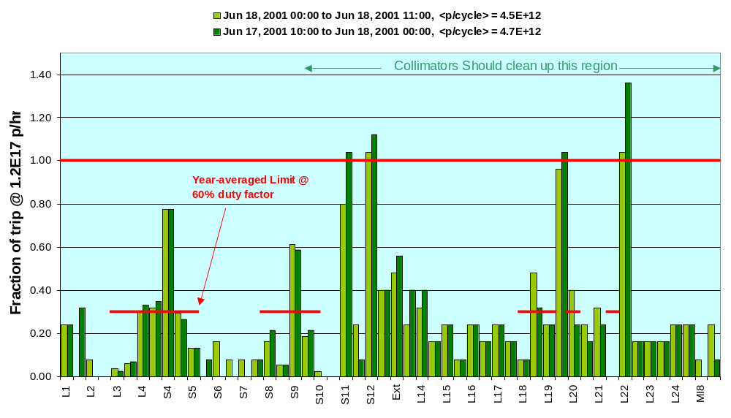
Best Performance + Shielding + BooNE Intensities
Scaled up from measurements during stacking-> looks OK

Slide 34
Booster Tunnel Losses
Harder to quantify – no hard limits
Major worry is activation of high maintenance components (e.g. RF cavities).
Administrative limit set at twice the total power loss during “messy” stacking (for 9 times the beam!!!).
If we had to run tomorrow, we could deliver roughly 20% of the nominal MiniBooNE intensity under this scenario.
Steps are being taken to reduce beam losses and proton source consistency.

Slide 35
Collimators
Basic Idea…
A scraping foil deflects the orbit of halo particles…
…and they are absorbed by thick copper collimators.
All are moveable, and the Copper collimators are located in areas (period 6&7) where radiation is less of an issue. Once their operation has been established, these areas will be heavily shielded.
It is hoped that this collimation could reduce important losses by up to a factor of two – possibly more in critical areas.
Status: All collimators are in and have been exercised. Initial results look encouraging. A preliminary shielding design is complete and shielding should be installed over the next few months.

Slide 36
Other Improvements
Beam control: programmable trim magnet control cards now allow control of the orbit throughout the cycle.
Improved beam monitoring: a number of new beam diagnostics, including a real time tune measurement, had been or are being commissioned.
New monitoring and analysis tools: we have been pledged support from computing division, which we plan to use to develop improved tools for monitoring and analyzing the performance of the proton source.

Slide 37
Summary
The Fermilab accelerator complex is very complex and versatile.
It presents many challenges which keep us busy now and in the foreseeable future.
We’re always looking for people to help out.

