Slide 1
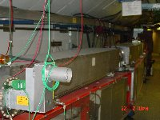
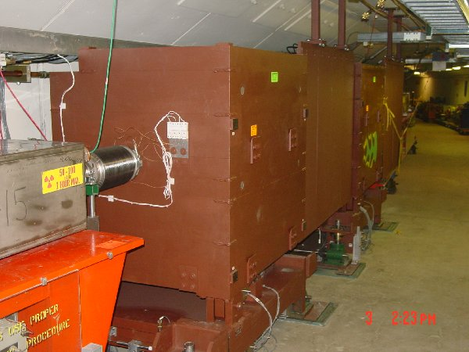
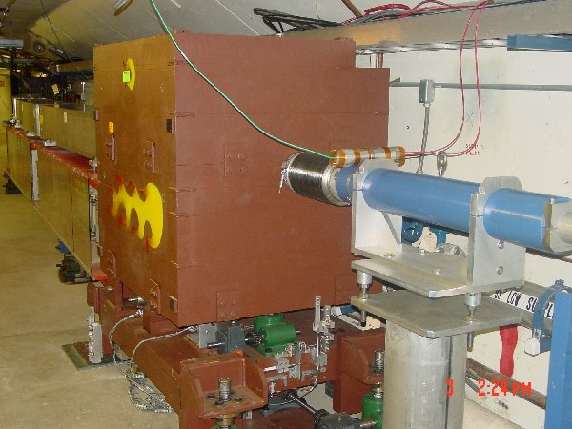
Solving Problems: New Collimator System
Basic Idea…
A scraping foil deflects the orbit of halo particles…
…and they are absorbed by thick collimators in the next periods.
Should dramatically reduce uncontrolled losses

Slide 2
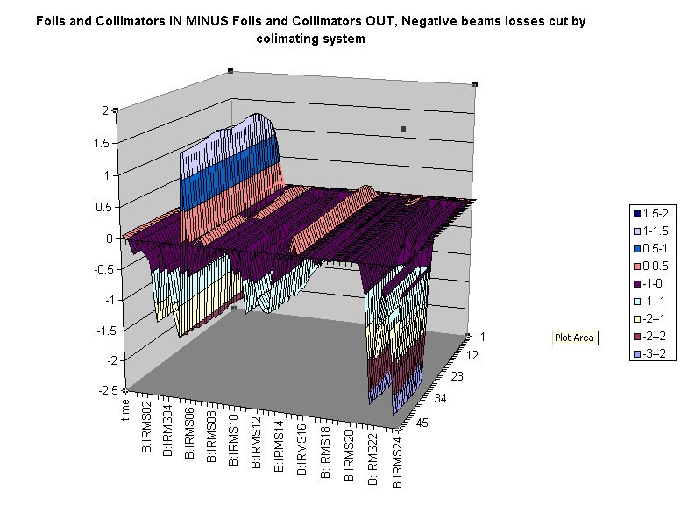
Differential Loss Monitor Example: Collimators in – Collimators Out
Collimator Position
Relative Loss
Time
Position

Slide 3
Initial Commissioning Plan
Collimator Position and Angle Registration: (.5-1 shifts)
  Conditions: Turn MiniBooNE off; moderate impact on stacking.
  With pitch and yaw set to zero, move each of the secondary collimators in all directions until beam transmission is reduced by 10-20%. Record transmission vs. location.
  Repeat Horizontal measurements with yaw angle at each extreme.
  Repeat Vertical measurements with pitch angle at each extreme.
  Use information to calculate beam angle at collimators and set pitch and yaw accordingly.
  Move both vertical and horizontal primary collimators in until transmission is reduced by 5-10%. Record transmission vs. location to determine the position of the beam relative to these.

Slide 4
Plan (cont’d)
Performance Studies (1-2 shifts)
  Conditions: Minor impact on stacking. Reduce MiniBooNE as needed to prevent tripping
  With the angles established, move each of the secondary collimators individually in the design vertical direction (1 and 2 up, 3 down) until an effect is seen on transmission. Back out until the observed effect disappears. Stapshot beam losses (B136) in each case.
  Begin to run the primary vertical collimator into the beam. As soon as there is any measurable effect on losses or transmission, move the primary collimator into the beam in roughly 1mm increments, snapshotting losses at each point, until transmission is reduced by 5%.
  Retract and repeat individual collimator studies in the horizontal plane (1 and 2 move out, 3 moves in).
  Repeat measurements in each plane with all three secondary collimators in their operational configuration.

