Slide 1
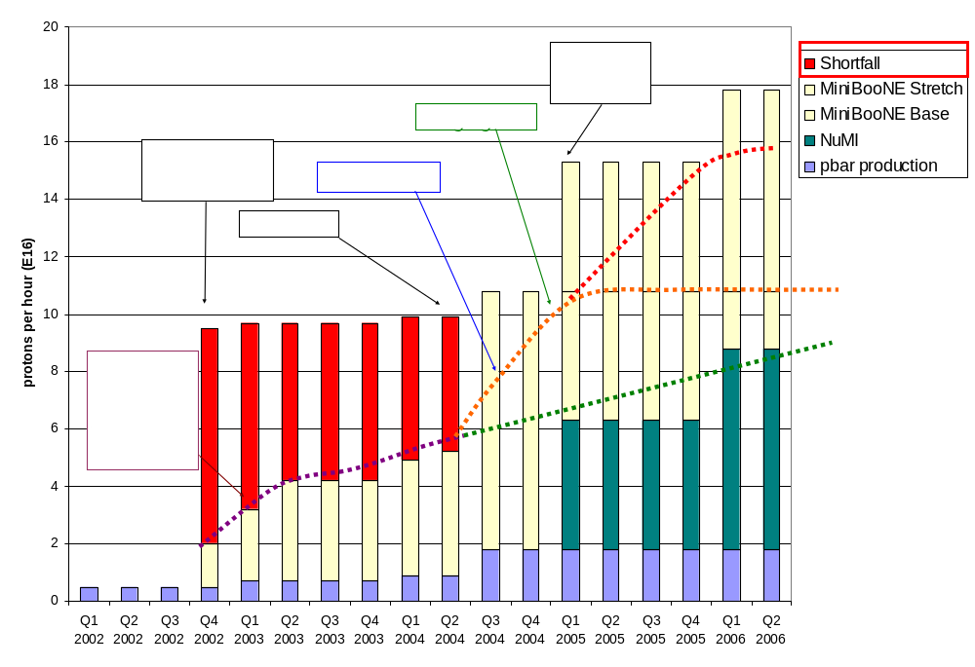
Making Projections
Stretch
Optimistic
Conservative

Slide 2
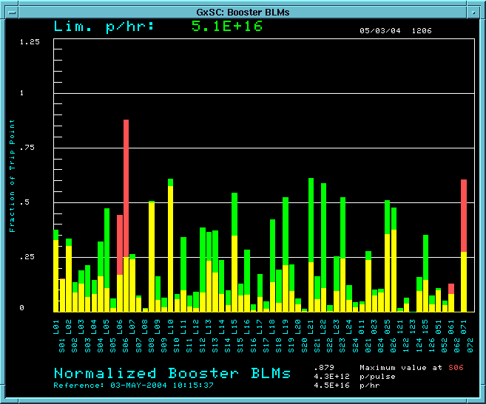
Reasons for Optimism
We have begun to use the collimators in normal operation:
Losses w/o collimators
RF Region
Losses with collimators

Slide 3
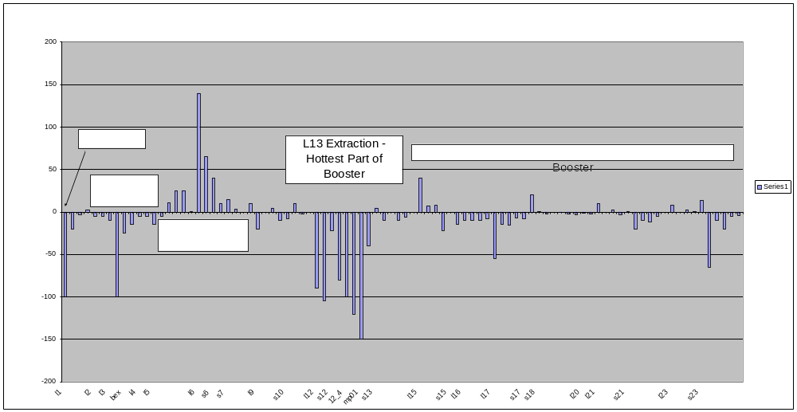
Effect of Collimators on Activation
One week of collimator operation….
  Difference from previous week measurement (mr/hr @ 1ft)

Slide 4
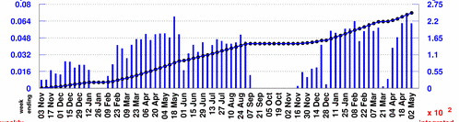
Protons to MiniBooNE
Rather than use the instantaneous rate, will scale from typical weekly MiniBooNE totals:
Baseline Scenario:
  Improvements compensate for increased protons to pBar -> Continue to average 5.5E18/wk
  MBooNE shuts OFF 1/05
Optimistic Scenario:
  MBooNE rate increases more or less linearly to 10E18/wk at 1/05
  5.5E18/wk after NuMI turns on.
Stretch Scenario:
  MBooNE rate increases linearly to 10E18/wk at 1/05
  5.5E18/wk after NuMI turns on.
  Linearly to 10E18/wk on 1/06
Typically 5.5E18/wk

Slide 5
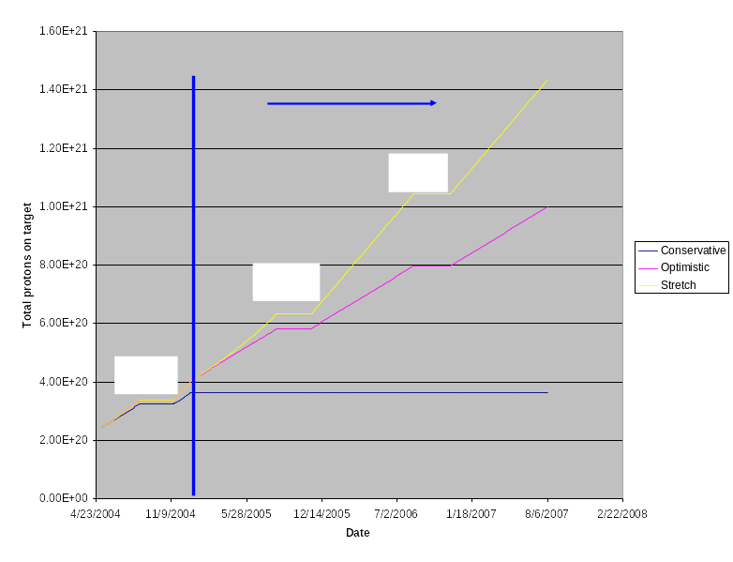
Protons to MiniBooNE

