Slide 1
Muon Needs of Project X
Eric Prebys/Keith Gollwitzer

Slide 2
Muon Task Force
Experiments:
Yoshitaka Kuno, Osaka University, Japan
Jim Miller, Boston University
Accelerator:
Eric Prebys, FNAL
Keith Gollwitzer, FNAL

Slide 3
Potential Muon Experiments* at Project X
Muon Charged Lepton Flavor Violation
μ→eγ
μ→eee
μ+N→e+N (muon to electron conversion)
Muon electric dipole moment (EDM)
Muon lifetime
Muonium (μ⁺e⁻) → anti-muonium (μ⁻e⁺)
chosen as “flagship” experiment
*neutrino factory and muon collider are explicitly excluded from this list.

Slide 4
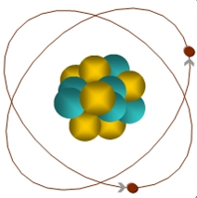
Muon-to-Electron Conversion: μ+N → e+N
When captured by a nucleus, a muon will have an enhanced probability of exchanging a virtual particle with the nucleus.
This reaction recoils against the entire nucleus, producing the striking signature of a mono-energetic electron carrying most of the muon rest energy
μ
105 MeV e⁻
Similar to μ→eγ, with important advantages:
No combinatorial background
Because the virtual particle can be a photon or heavy neutral boson, this reaction is sensitive to a broader range of BSM physics
Relative rate of μ→eγ and μN→eN is the most important clue regarding the details of the physics

Slide 5
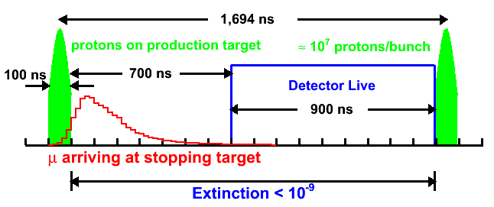
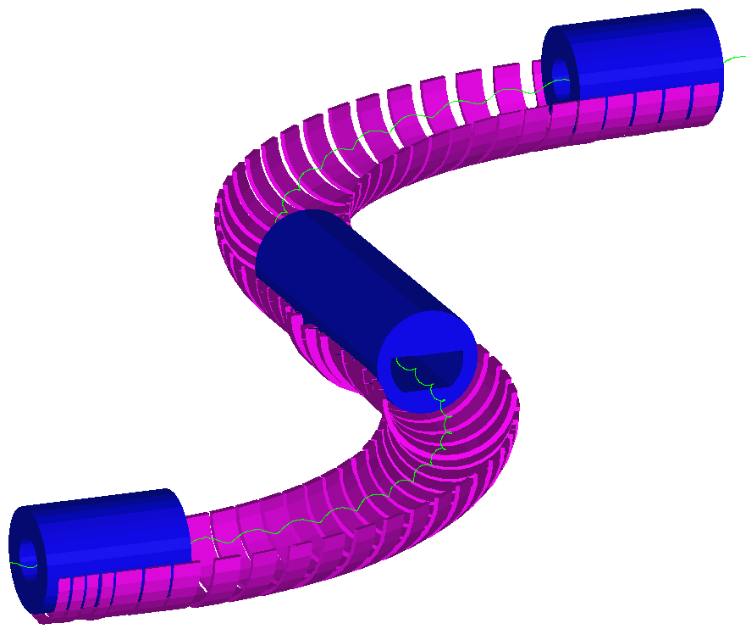
Pre-Project X Mu2e Experiment and Limitation
Will use existing accelerator complex.
μ⁻ are accompanied by e⁻, π⁻, …
Extinction required to make prompt background ~equal to all other backgrounds
1 out of time proton per 10⁹ in time protons.
Expect a single event sensitivity of 2x10⁻¹⁷ (4 order of magnitude improvement)
Limited by
π- content in beam
Time distribution of muons “straggling” down the transport line
Energy smearing due to required thick target.

Slide 6
Caveat
Mu2e is proposed to run using modifications to the existing Fermilab complex
Sensitivity goal: < 1x10⁻¹⁶ (a four order of magnitude improvement over existing limits)
This is a challenging goal, and achieving it is by no means assured.
The beam available at Project X could potentially extend this significantly
We assume a working goal of <1x10⁻¹⁸
There are big challenges to doing this that have not been addressed at any credible level.
Proposals have not advanced beyond the cartoon stage at this point.
Side note: you might build a very different experiment if Mu2e sees something!

Slide 7
Next to Next Generation Experiment
To hope to go beyond the limit of Mu2e, one needs the following:
Improved pion suppression
Longer time/beam line for pions to decay away.
Narrower momentum spread
Muons can be stopped in a narrower target, so there is less problem with multiple scattering before the detector
Narrower time distribution for arriving muons
Allows one to set the live window closer to the proton arrival
Particularly important for different target nuclei
If a signal is see, exploring different nuclear key to understanding fundamental nature
Heavier nuclei have shorter lifetimes, eg τ(μ+Au) = 72 ns
Better suppression between pulses
10⁻¹⁰→10⁻¹²
Two very different proposals have been put forth to achieve these goals.

Slide 8
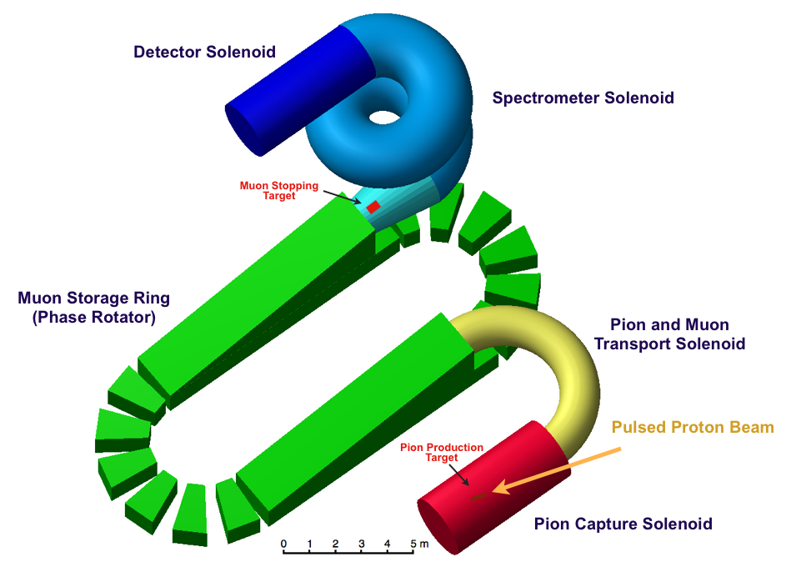
FFAG-based Proposal
Similar to PRISM/PRIME, proposed at J-Parc
Produced muons are captured in an FFAG storage ring and phase rotated, while remaining pions decays away

Slide 9
Ionization Cooling Channel Propoposal
Based on R&D for muons collider/neutrino factories
By cooling and decelerating, we can take advantage of higher momentum pions, for which the yield is much higher.
target
325 MHz* capture/π decay
162.5 MHz bunch rotation
Transverse cooling
6D cooling
deceleration
*optimum frequencies for capture and phase rotation still under study

Slide 10
Primary Beam Requirements
Unfortunately, the primary beam requirements are very different in the two cases
FFAG case
Limited by the maximum injection/extraction kicker in the FFAG
Assume 1 kHz
1MW @ 1kHz = 2x10¹² protons/pulse
10 ns pulse length
CANNOT come directly from linac
Need:
333 μs@ 1 mA
Phase Rotator
100 ns gap for extraction kicker
to production
target
Stripper/Accumulator

Slide 11
Beam Requirements (cont’d)
Ionization Channel Cooling Case
In this case, beam could come directly from Project X linac
No need for bunching or stripping
Directly produce beam structure needed by experiment
E.g.
1 MW @ 500 kHz
10 mA (2x10⁸ protons/325 MHz bunch)
22 bunches=68 ns
Every 2 μsec

Slide 12
Comparing the Two Techniques
Both proposals have significant synergy with muon collider/neutrino factories
FFAG proton accumulator/buncher similar to the NF&MC proton driver
Ionization cooling is obvious
Clearly the ioniziation cooling channel is much simpler from the standpoint of primary protons
Both techniques for muon transport are very complicated and beyond state of the art:
Need to study in detail to do a proper comparison.

