Slide 1
Booster/Beam Status
Eric Prebys
FNAL Beams Division

Slide 2
Basic Facts
Proton Source will not be a limiting factor in Run II for the foreseeable future.
Maximum Run II stacking protons ~1.2E16 p/hr (5E12 ea. 1.5s).
MiniBooNE wants ~1E17 p/hr (5E12@5Hz).
NUMI wants ~5E16 p/hr or more.

Slide 3
Proton Timelines
Everything measured in 15 Hz “clicks”
Minimum M.I. Ramp = 22 clicks = 1.4 s
MiniBoone batches “don’t count”.
Cycle times of interest
  Stack cycle: 1 inj + 22 MI ramp = 23 clicks = 1.5 s
  NuMI cycle: 6 inj + 22 MI ramp = 28 clicks = 1.9 s
  Full Slipstack cycle (total 11 batches):
    6 inject
    + 2 capture (6 -> 3)
    + 2 inject
    + 2 capture (2 -> 1)
    + 2 inject
    + 2 capture (2 -> 1)
    + 1 inject
    + 22 M.I. Ramp
    ----------------------
    39 clicks = 2.6 s

Slide 4
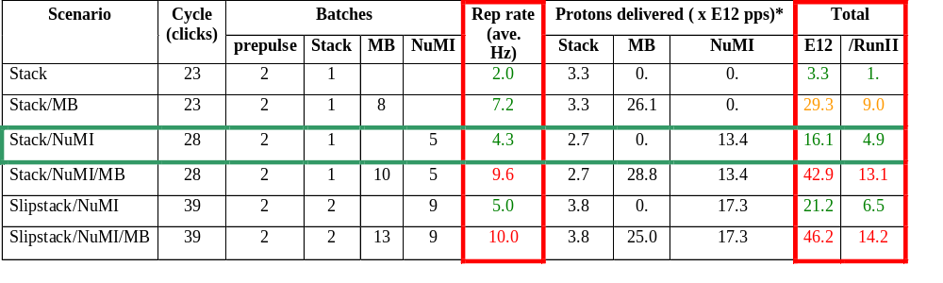
Summary of Proton Ecomomics (MiniBooNE and Beyond)
Booster Hardware Issues
Radiation Issues
*assuming 5E12 protons per batch

Slide 5
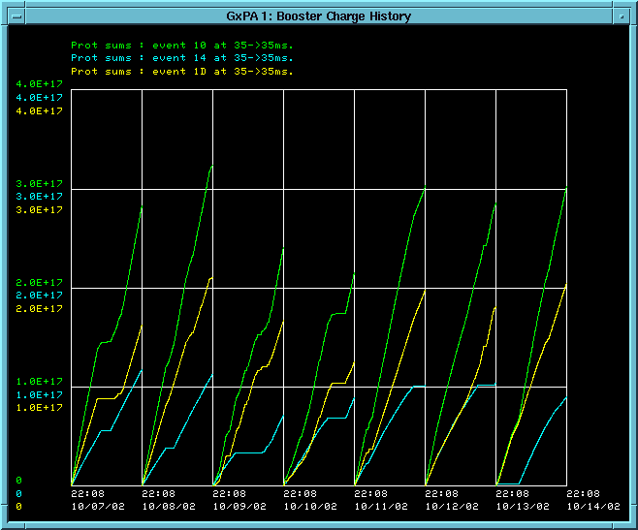
Protons to MiniBooNE this Week
Total
MiniBooNE
Stacking

Slide 6
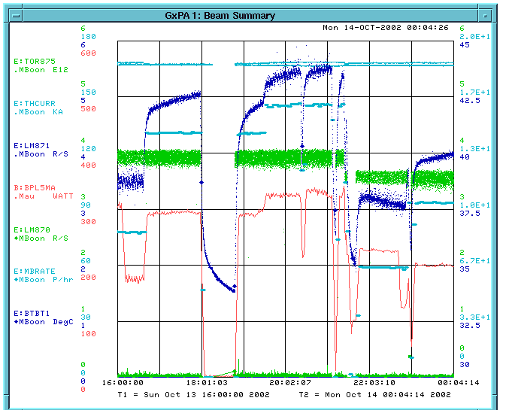
Typical Performance
Per pulse intensity (E12)
MiniBooNE rate (p/hr)
Booster Power Loss

Slide 7
In Short…
MiniBooNE is running.
We typically take 1.5-2.0 times as many protons as stacking.
This number needs to go up by about a factor of 8.

Slide 8
What it Limiting MiniBooNE
(Longitudinal?) instabilities in the Booster are limiting the per pulse intensity to ~3.7E12 ppp.
Normalized tunnel losses limit the total protons to about 2E16 pph when the Booster is running well.
Beam power loss limit (currently 400 W) is similar.
Heating in the extraction septum (MP02) currently limits MiniBooNE rate to ~.9 Hz during stacking.

Slide 9
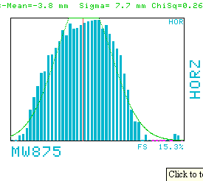
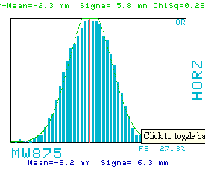
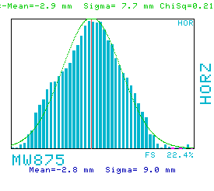
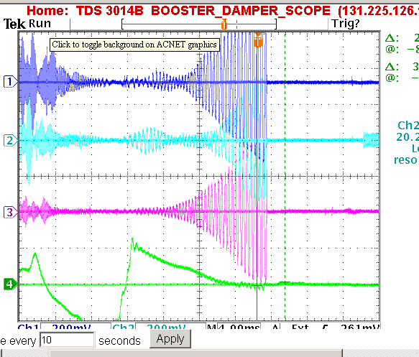
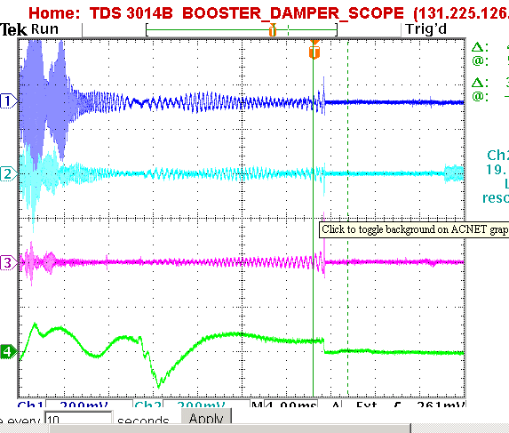
Effect of Longitudinal Damping
High Dispersion Region
Dampers Working
Occasional Bad Pulse at High Intensity (trips loss monitors)
No Dampers

Slide 10
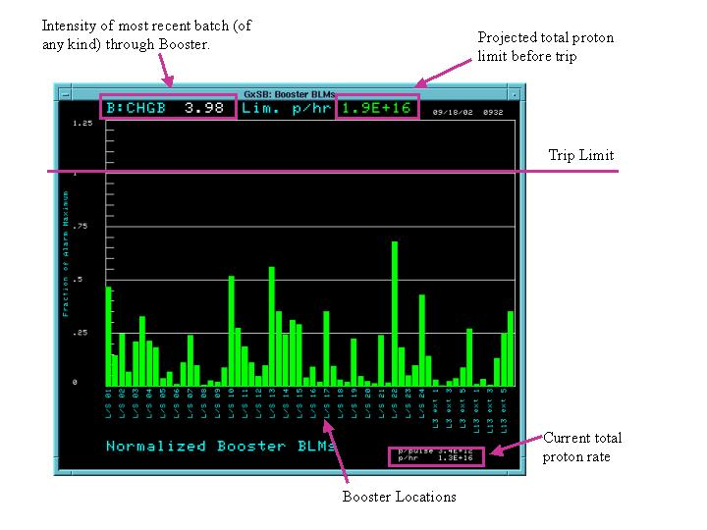
Tunnel Losses

Slide 11
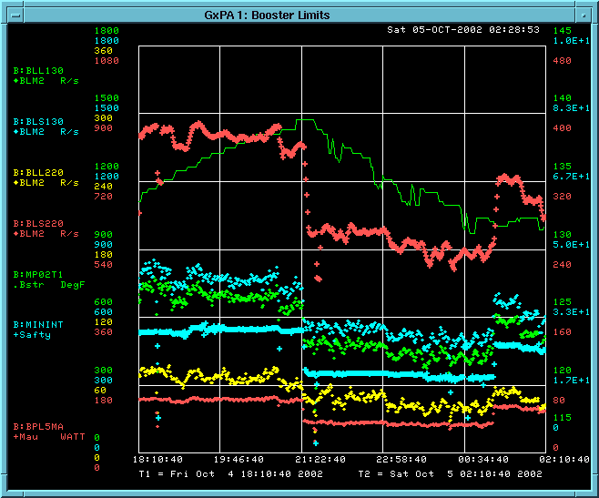
Booster Limitations
Trip point
Beam power loss
MP02 Temp.
“Troublesome” losses (shown as diamonds)
Total protons/min. out of Booster (blue crosses)

Slide 12
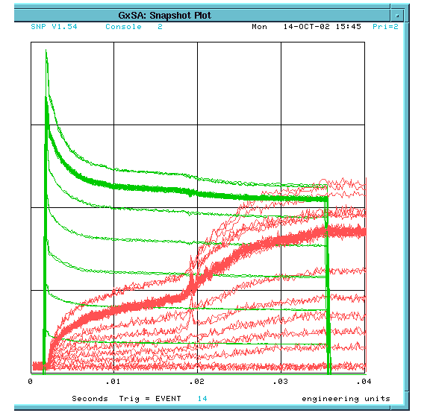
Transition Problem
Booster Charge
Beam Energy Lost (B:BELOST)
Half our Problem is Transition!!!

Slide 13
Plan
New Power Supply is Ready for MP02. Negotiating time to connect, but probably won’t happen until early November, because of the impact on Run II.
At the same time, we will do a magnet move which should improve some of the worst losses (L13, L22, L24).
It is unlikely that collimator shielding will be installed until the January shutdown.
Finally making progress in beam orbit correction. Tuning to reduce loss at high intensity.
New extraction septum nearly ready to be pumped down and tested. Will be installed during January shutdown.

Slide 14
Questions
How can we improve longitudinal damping stability at >4E12 ?
Will transverse dampers improve things at high intensity?
Why do we lose >30% of the beam early in the cycle?
How can we reduce transition losses?

