Slide 1
Shutdown Schedule
Sun | Mon | Tue | Wed | Thu | Fri | Sat
Sept. 7 | 8 | 9 | 10 | 11 | 12 | 13
14 | 15 | 16 | 17 | 18 | 19 | 20
21 | 22 | 23 | 24 | 25 | 26 | 27
28 | 29 | 30 | Oct. 1 | 2 | 3 | 4
5 | 6 | 7 | 8 | 9 | 10 | 11
12 | 13 | 14 | 15 | 16 | 17 | 18
BOOSTER OFF- Cool down and miscellaneous prep work
Collimators (with ironworkers) – Assumes collimators have been assembled in access bay!
Lambertson (LInac Tunnel)
EDWA Installation
Collimators (ironworkers move to EDWA installation)
Lambertson (LInac Tunnel)
EDWA Installation
Lambertson (LInac Tunnel)
Dogleg Modification at Long 3
EDWA Installation
Install Damper Cavity
EDWA Installation

Slide 2
Shutdown Schedule (cont’d)
Sun | Mon | Tue | Wed | Thu | Fri | Sat
Oct. 19 | 20 | 21 | 22 | 23 | 24 | 25
26 | 27 | 28 | 29 | 30 | 31 | Nov 1
2 | 3 | 4 | 5 | 6 | 7 | 8
9 | 10 | 11 | 12 | 13 | 14 | 15
16 | 17 | 18 | 19 | 20 | 21 | 22
Commissioning and Studies. Test MI-8 extraction.
Shutdown to Install Prototype RF Cavities
Commissioning and Studies. Possible off-hours beam to MiniBooNE
Return to normal operation

Slide 3
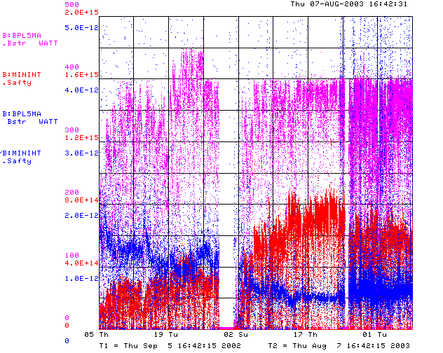
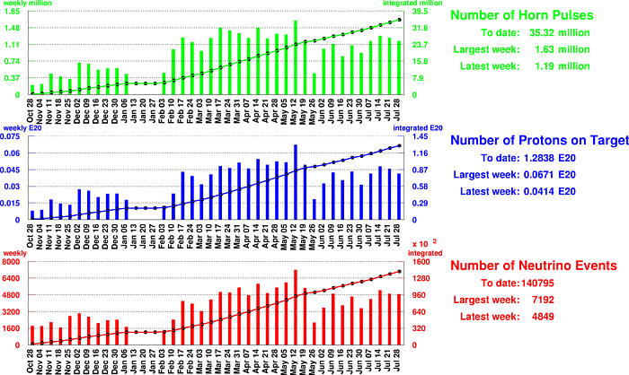
How are we doing?
Total Output
Beam to MiniBooNE
MH2 and Q10 supplies replaced
Mid-March to Mid May: great running!!!
What the hell has happened

Slide 4
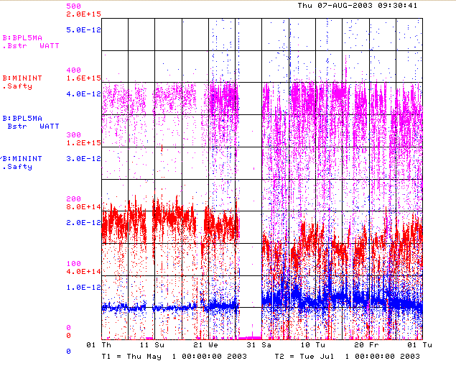
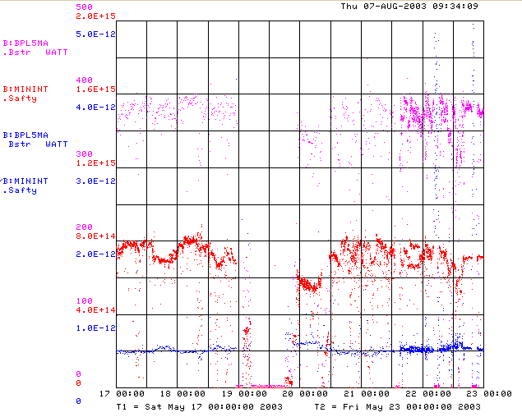
When did we start having problems?

Slide 5
What Happened?
May 19th owl:
  LRF3 Changed
  “Studied the effect of various parameters on 4VELO” –LJA
May 21st afternoon:
  Rested LRF5
  Changed module on debuncher water skid. Some problems bringing back up.
May 22nd owl:
  KRF1 trip on CS fault
  Tied of BRF4 to replace modulator
Problem was definitely there after the May 22nd owl shift

Slide 6
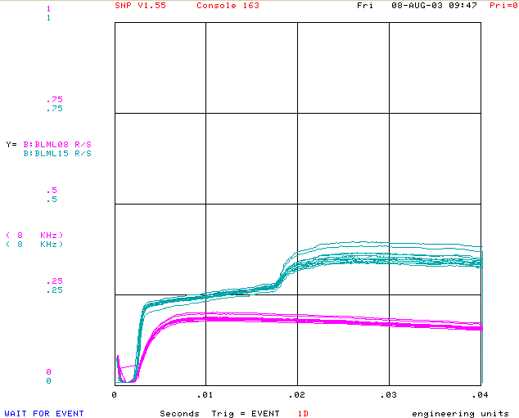
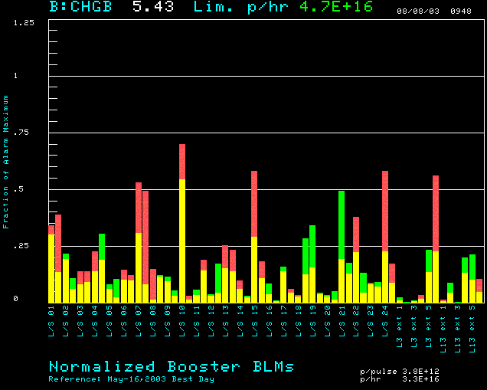
What’s Different
Losses Compared to May 13
L3 and L15
L8
Sometimes these are
much more unstable
L15

Slide 7
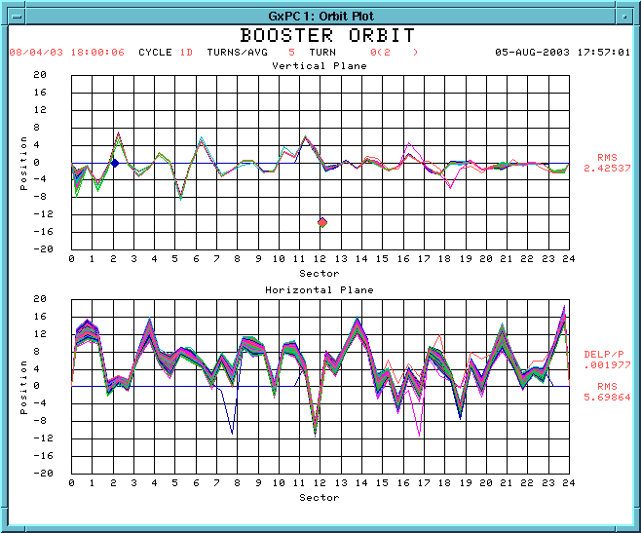
Injection Orbit Jitter?
Consistent with
Dp/p ~ .1%

