Slide 1
Proton Source Meeting – August 22, 2003
Linac pre-chopping at the ion source – D. Moehs
Shutdown status (discussion)
Pre-shutdown studies (open)

Slide 2
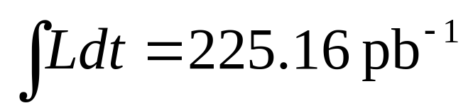
The Good News
As of 7:58 this morning,

Slide 3
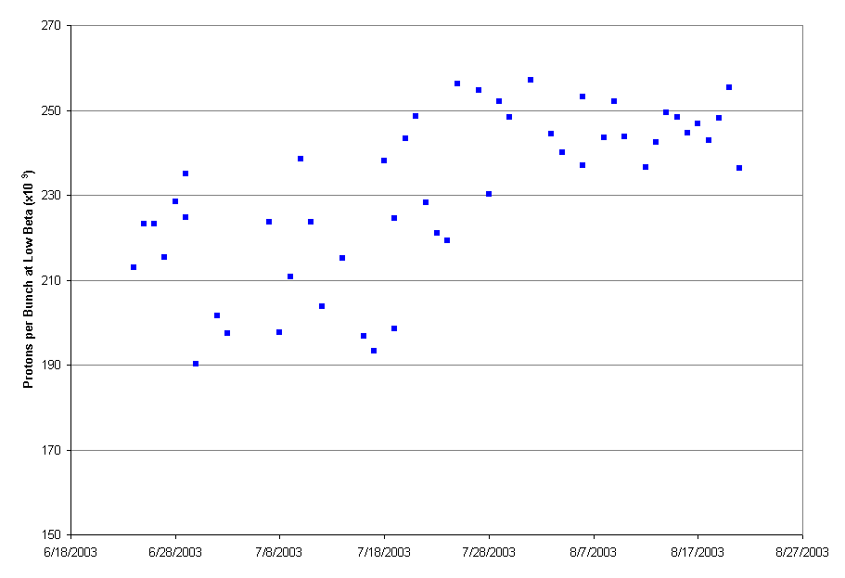
It Takes a Village

Slide 4
Shutdown Schedule
Sun | Mon | Tue | Wed | Thu | Fri | Sat
Sept. 7 | 8 | 9 | 10 | 11 | 12 | 13
14 | 15 | 16 | 17 | 18 | 19 | 20
21 | 22 | 23 | 24 | 25 | 26 | 27
28 | 29 | 30 | Oct. 1 | 2 | 3 | 4
5 | 6 | 7 | 8 | 9 | 10 | 11
12 | 13 | 14 | 15 | 16 | 17 | 18
BOOSTER OFF- Cool down and miscellaneous prep work
Collimators (with ironworkers) – Assumes collimators have been assembled in access bay!
Lambertson (LInac Tunnel)
EDWA Installation
Collimators (ironworkers move to EDWA installation)
Lambertson (LInac Tunnel)
EDWA Installation
Lambertson (LInac Tunnel)
Dogleg Modification at Long 3
EDWA Installation
Install Damper Cavity
EDWA Installation

Slide 5
Shutdown Schedule (cont’d)
Sun | Mon | Tue | Wed | Thu | Fri | Sat
Oct. 19 | 20 | 21 | 22 | 23 | 24 | 25
26 | 27 | 28 | 29 | 30 | 31 | Nov 1
2 | 3 | 4 | 5 | 6 | 7 | 8
9 | 10 | 11 | 12 | 13 | 14 | 15
16 | 17 | 18 | 19 | 20 | 21 | 22
Commissioning and Studies. Test MI-8 extraction.
Shutdown to Install Prototype RF Cavities
Commissioning and Studies. Possible off-hours beam to MiniBooNE
Return to normal operation

Slide 6
Study Priorities
Machine Characterizations (what do we need?):
  Tunes
  Orbits
  Losses
  Chromaticities
  Dispersion
  Injection longitudinal profiles
  ???
Things we’ve been wanting to do:
  Debuncher studies
  Cogging studies
  Xiaobiao’s harmonic dogleg corrections
  Beta bump studies
  ???

