Slide 1
Summary of Shutdown Studies
Eric Prebys
February 20, 2003

Slide 2
Booster Studies During Shutdown
Studies Completed See this page for writeups on the results of these studies.
  Monday, 1/27
    day: Establish beam in Booster. Do MP02 aperture scan. Return beam to pre-shutdown quality. Pulse MP02 power supply. (Tomlin, Lackey) Done.
    Fire up gamma-t in parallel (Pellico) Done
    AC Chromiticity measurements Done.
    20-24: Aperture scans (Coney, Prebys) Running into RMS limits from trims--tough to proceed
  Tuesday, 1/28
    0-8: Aperture scans continue (Coney, Prebys)
    day: continue MP02 pulsing, beam optimization, and parasitic gamma-t work. Done.
    18-??: Secure M.I. and extract beam (Lackey). Done, but one of the extraction kicker magnets failed
  Wednesday, 1/29
    0-7: Test Shekhar Shukla's old lattice measurement program (Prebys) Done.
    7-8: RDF running. Done.
    8-16: Fire up Gamma-t. system. Look at beam steering and attempt to center beam in quads. Look at stability of beam for high intensity with the long. damping system. Perhaps try to spoil the beam with the "fuzzer" (Tomlin, Lackey, Prebys, Pellico). Gamma-t system verified but much of this can be done later, parisitically, when MI is running.
    8-16: IPM Shakedown Done OrBump vertical beta effect measurement Done
    16-24: Lattice measurement (Coney, Prebys).
  Thursday, 1/30
    0-12: Go to DC. Shake down McGinnis' program and do resonance scans (Spentz, Pellico, McGinnis, Sullivan). Done.
    12-16: DC Acceptance measurement (Ankenbrandt, Chou, Tomlin, McCrory) Done
    16-20: Emmittance Measurement + ORBUMP painting; DC chromaticity measurements (Tomlin, Chou)Done
    20-24: Cleaning crews will be cleaning half of the carpet in the MCR; may be too noisy or stinky to work there.This only took a fraction of an hour!
    20-24:Beam extinction studies (Prebys) Done.
  Friday, 1/31
    0-4: Longitundal filling studies (Prebys+??) Done.
    4-8: TDB
    8-9: NTF irradiation customerDone.
    8-12: RF Sweep studies + dogleg dispersion measurements (numerous) Done
    12-16: IPM aborted beam studies, DC short batch studies (Pellico+??).
    Evening: contingency
  Saturday, 2/1: more DC dogleg studies.
  Sunday: return to AC operation.
  Monday (if startup is delayed): Do vertical surveying run of all of Booster, as time and availability of workers permits.

Slide 3
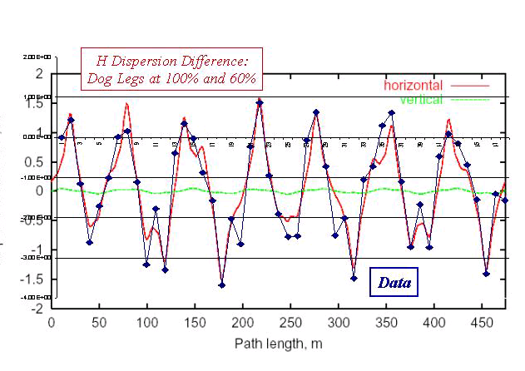
Effect of Vertical Doglegs

Slide 4
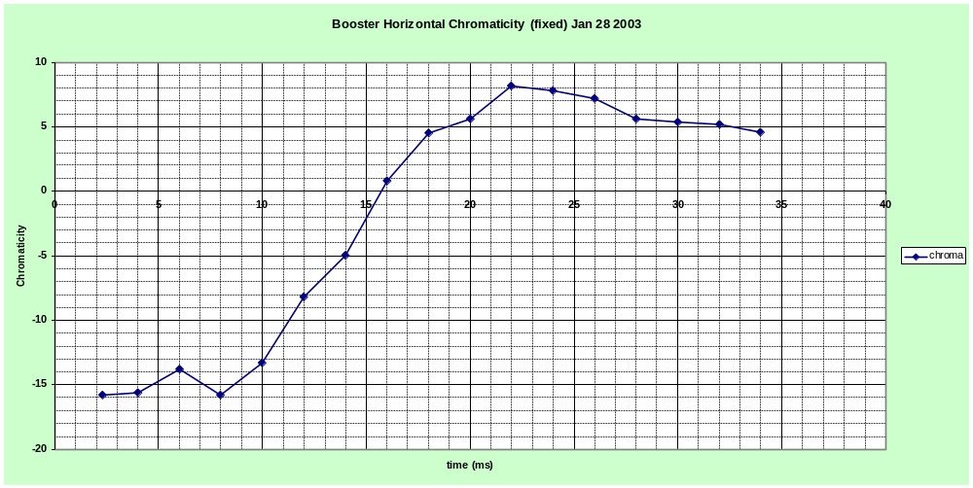
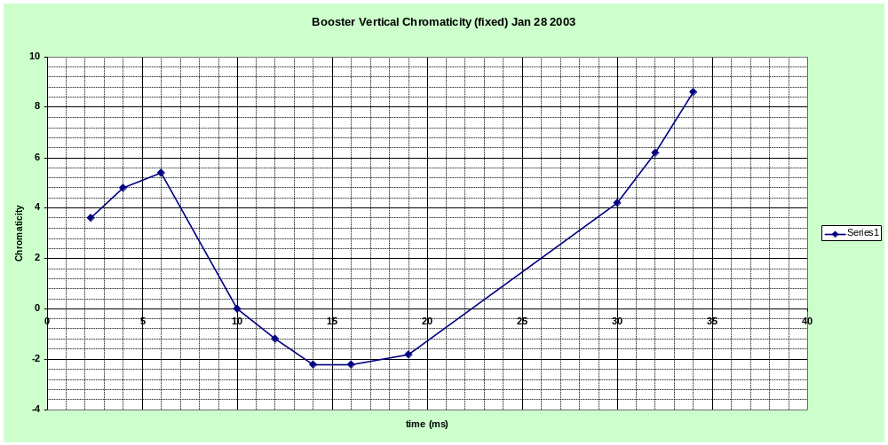
A/C Chromaticity Measurements

Slide 5
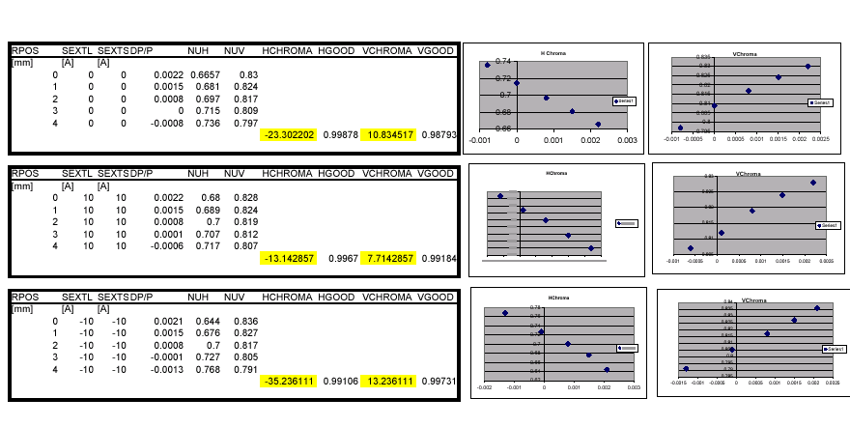
D/C Chromaticity Measurements

Slide 6
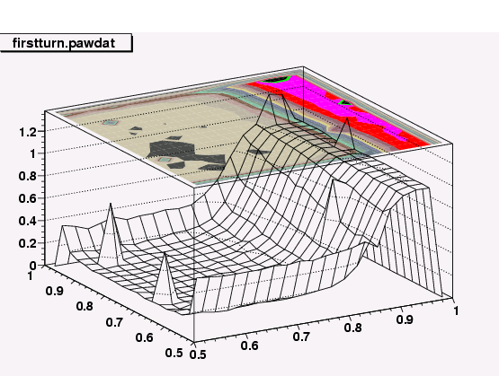
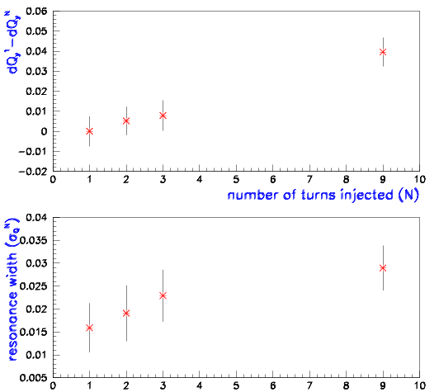
Tune Scan Measurements

Slide 7
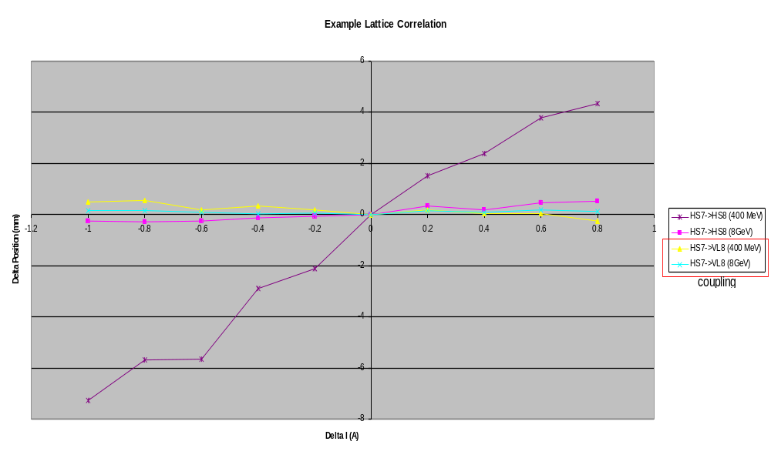
Lattice Measurement

Slide 8
Write-ups
Results of all studies being documented at:
  http://www-bd.fnal.gov/proton/booster/results_1_2003.html
Generally, experimental measurements can be found at
  http://www-bd.fnal.gov/pdriver/booster/

