Slide 1
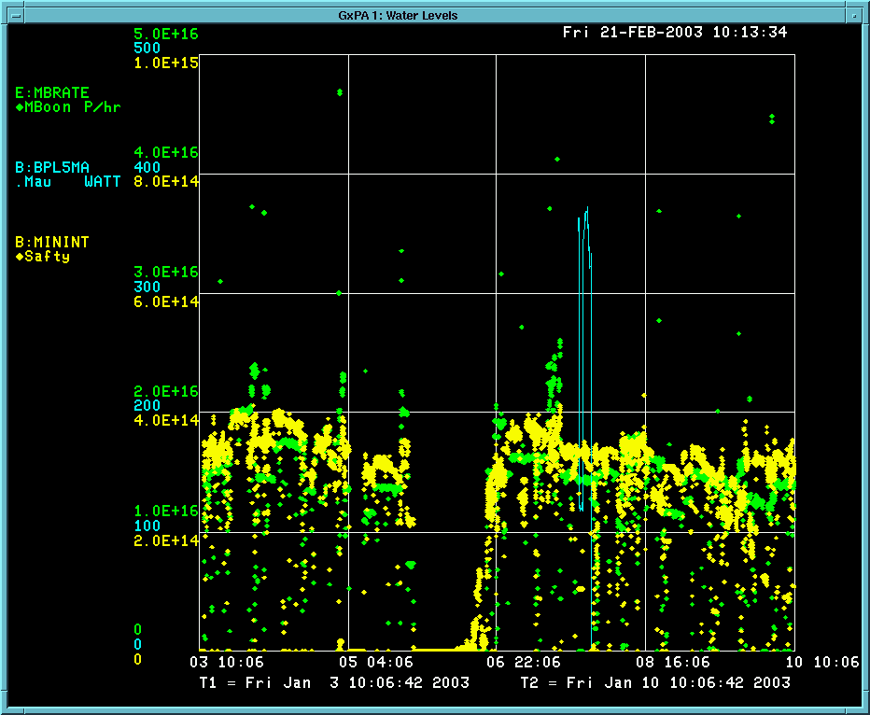
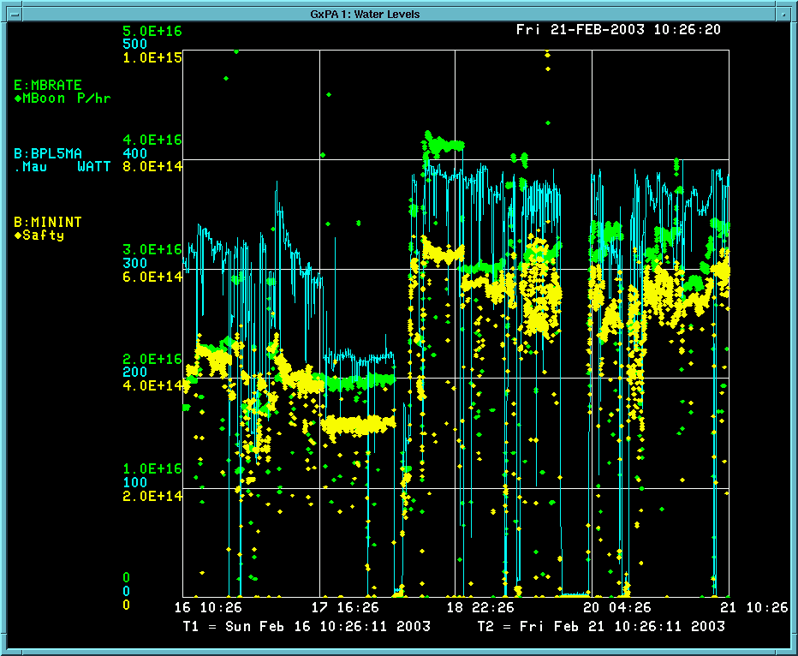
Before and After Shutdown

Slide 2
Letter to BooNE, Dixon, etc.
We shortened the notch in the Booster this morning. The combination
of the that and the high rate, reduced intensity running made possible
by the new MP02 have allowed us to hit unprecedented rates to MiniBooNE.
We've delivered about 3.4E16 protons in the last hour and hit
sustained rates of over 4E16 pph. This shatters all previous records.
We're still a ways from the goal, but at least it's coming into sight.
Among others, the credit goes to Jim Lackey for directing work on the
new MP02 and for realizing we could shorten the notch, and to
Ray Tomlin and Bill Pellico for tuning down the Booster losses. As
always, this level of consistent performance would not be possible
without the tireless efforts of operations, and the 24 hour support
of the people in our group and others.
-Eric

