Slide 1
Proton Source Startup
Eric Prebys, Proton Source Dept. Head

Slide 2
Proton Source Shutdown Projects
Linac:
  New Lambertson: DONE
  Major LCW upgrade: DONE
  Modified “notchable” ion source in H-: DONE
Booster:
  New collimator system: DONE
  Four new MI-8 (EDWA) magnets: DONE
  Rearrangement of Long 3 extraction region to reduce “dogleg problem”: DONE except for final alignment
  New power supply on MP01: DONE
  New Mode 16 damping system: DONE
  “Beam whacker” beam profile monitor: DONE
  Swap planes of ionization profile monitor: DONE
  Replace all hoses on 96 magnet water “candy canes” (unplanned): DONE.
  Booster vertical network: DONE, being processed.
  Complete new vacuum redout system: Being completed
  Install protoype RF cavities: deferred
  Vertical magnet moves: deferred

Slide 3
Startup Plan (pre-Nov 17)
Week of 10/27
  Bring Booster up, verify basic operation.
  Zero trims and re-measure 3-mults with new lattice.
  Studies evenings.
11/1,11/2
  Test extraction to MiniBooNE
Week of 11/3 -> End of shutdown:
  Optimize new lattice.
  Move radial feedback to Long 6 (for collimators).
  Limited collimator tests.
  Begin to establish tight limits on individual loss locations.
  Studies evenings
  Extract on weekends if requested by MI.
11/17: Complex back up. Proton source “better” than before

Slide 4
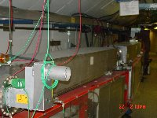
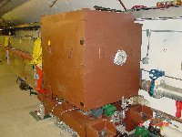
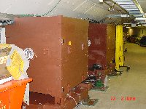
Booster Collimator System
Basic Idea…
A scraping foil deflects the orbit of halo particles…
…and they are absorbed by thick collimators in the next periods.
Problem:
  One of our existing safety systems (B:BPL5MA) calculates beam power loss by counting lost protons.
  This will not work with the collimation system.
  Must tighten up our limits on the individual loss monitors.

Slide 5
Post-shutdown commissioning
Lattice optimization: 2 weeks – 1 month of “ordinary tuning”:
Begin collimator commissioning (1-2 months semi-parasitic):
  Bypass B:BPL5MA limit.
  Run secondaries in until the begin to attenuate the beam, then back off slightly.
  Adjust primary positions to minimize (uncontrolled loss)/(transported beam)
  Re-optimize orbit for each collimator setting.
  Measure loss patterns and establish tight limits.
  Integrate collimators into normal operation.

