Slide 1
Proton Team (“Finley Report”)
Group formed in early 2003 to study proton demands and needs for the “near” future (through ~2012 or so), in the absence of a proton driver.
Work culminated in a report to the director, available at www.fnal.gov/directorate/program_planning/studies/ProtonReport.pdf
No big surprises [see P. Kasper “Getting Protons to NuMI (It’s a worry)”, 2001].
This work will form the basis of “The Proton Plan”.

Slide 2
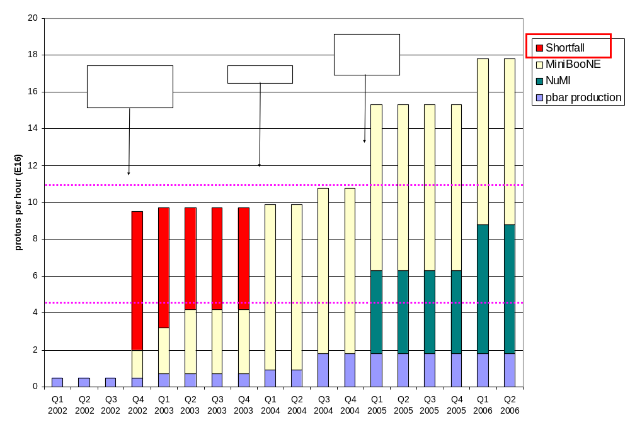
Proton Demand

Slide 3
Demand: Summary
Pbar production
  current: 0.9E16 p/hr
  Max (slipstacking): 1.8E16 p/hr
MiniBooNE
  current: ~3.5E16 p/hr
  Request: 9E16 p/hr [5E20 p/yr]
NuMI
  Baseline: 4.5E16 p/hr [2-2.5 p/yr]
  Exotic loading schemes (~2006): ~7E16 p/hr [4E20 p/yr]
  Occasionally claim: 14E16 p/hr [8E20 p/yr]
2005
  Max pbar + MiniBooNE + baseline NuMI:
  ~16E16 p/hr (~4 times current limit!)
What MINOS believes they are getting

Slide 4
Formulating a Plan
The lab has recognized that the proton demands of the experimental program are significant, if not daunting, and will require substantial efforts to meet.
As the financial burden of Run II begins to ease, it’s envisioned that financial resources will be diverted to these efforts over the next few years.
We are in the process of putting together a plan with the maximum likelihood of reaching these goals.
Ultimate goal is to generate a project similar to Run II
However, because the future (MiniBooNE) is already here, such a plan will necessarily have near and long term components.

Slide 5
Near Term Priorities (Booster)
Optimizing Booster for improved lattice:
  Tuning and characterizing 400 MeV line (Linac to Booster).
  Tuning Booster orbit to minimize losses.
Commission Collimators:
  Once we have Booster optimized to the new lattice, we will begin to exercise the collimator system.
  Estimate about 2 months to bring into standard operation.
Aperture Improvments:
  Alignment
    Complete (magnet) vertical network done over shutdown
    Will analyze and effect moves when opportunities arise
    Working on a systematic method for aligning straight sections.
  Orbit control
    Ramped orbit control program has been written.
    Will be commissioned soon (new personnel)
    Important now that collimator is in place.
  Prototype RF Cavities
    Two large aperture prototype cavities have been built, thanks to the help of MiniBooNE and NuMI universities.
    We will install these as soon as they are ready to replace existing cavities which are highly activated.
It’s hoped this work will allow us to reach the MiniBooNE baseline this year.

Slide 6
Issues over the Next Year
Linac Characterization and Reliability
  Increase instrumentation of old linac to study instabilities.
  Develop set of performance parameters.
Booster improvements.
  Prepare for modification of second extraction region
    New septum
    Modified dogleg magnets
    On track for next year’s shutdown.
  Injection Bump (ORBUMP) Power Supply
    Existing supply a reliability worry.
    Limited to 7.5 Hz
    Building new supply, capable of 15 Hz.
    Aiming for next year’s shutdown.
  Under consideration: New ORBUMP Magnets
    Existing magnets limited by heating to 7.5 Hz
    Working on a design for cooled versions.
    These, with a new power supply, will make the Booster capable of sustained 15 Hz operation.
    Biggest decision for the near future.

Slide 7
Long Term, Big $$ Ideas Under Consideration
New Booster RF system: (~$15M)
  Larger aperture cavities (two prototypes will be installed soon).
  New solid state preamps and modulators (would pay for itself in a few years).
New Linac front end: (~$30M)
  Replace Preac and 200 MHz linac with RFQ feeding 400 MHz klystron-driven linac.
  Addresses 7835 Amplifier Tube Problem
  Possible part of proton driver?
Reduce Main Injector ramp time: (??)
  Still needs time to load protons
  Needs to fit in with stacking.
  Necessary to get the kind of protons that off-axis is talking about.

Slide 8
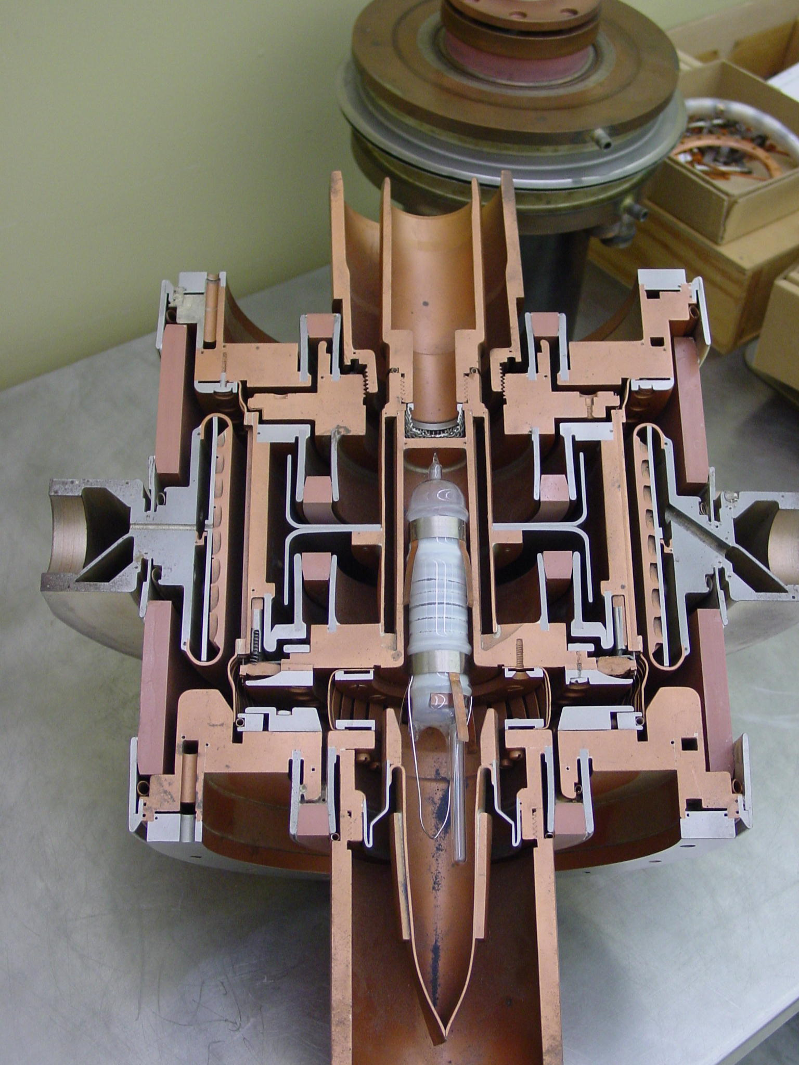
The 7835 Power Triode – Our BIG Worry
Very complex technology
  RF, material science, vacuum, chemistry
Similar to other tubes made by Burle
  4617
7835 only used in the scientific community.
  One military user for 4617
Quality varies from decade to decade
Can we rely on these until proton driver?
Might feed into linac decision.

Slide 9
Budget Guidance (courtesy S. Holmes)
FY04 ~$2M (but I’ve already been told it’s not there)
FY05 ~$6M
FY06 ~$5M
Scale of $5M/yr after that
This money, if it exists, is fairly well tailored to a new Booster RF system.

Slide 10
Formulating a Structure (partial example)
Protons
Linac
Booster
Main Injector
Aperture
RF
Multibatch Schemes
Instrumentation and Characterization
Reliability
RF
Alignment
Beam Control

Slide 11
Some Comments
We need to get started soon on a lot of this stuff, so I don’t want to get bogged down in the “process”.
At least as far as the Booster and Linac are concerned, tasks are divided into no-brainers and big-ticked items which depend on the appearance of large amounts of money.
I’d like to have a reasonably complete WBS by the end of February.
When there is overlap with Run II, leave it in run II (example: Booster cogging).

