Slide 1
Proton Plan
Eric Prebys
FNAL Accelerator Division

Slide 2
“Proton Plan”
The details of proton demand and issues can be found in an official report to the director at:
www.fnal.gov/directorate/program_planning/studies/ProtonReport.pdf
Working assumptions:
  Existing proton source must last at least another 10 years or so in more or less it’s current configuration.
  During that time, a new “proton driver” will be built, which will ultimately replace the existing proton source.
  Proton source improvements should require no significant downtimes beyond those needed for other reasons.
  The maximum total funding for proton source improvements will be of the order of $18M over the next few years.
  Near term projects most important to performance

Slide 3
Scope of Improvements
The level of funding precludes some things which have been discussed:
  Replacement or major upgrade of 200 MHz linac
    Official policy on 7835 PA’s: keep fingers crossed.
  Decrease of Main Injector ramp time
    Unless it is done as part of Proton Driver
For this reason, the proton plan focuses primarily on the Booster
  Decreasing uncontrolled losses.
  Increasing reliable average repetition rate.
  Biggest decisions involve plan for RF system.

Slide 4
What Limits Total Proton Intensity?
Maximum number of Protons the Booster can stably accelerate: 5E12
Maximum average Booster rep. Rate: currently 7.5 Hz, may have to go to 10 Hz for NuMI+ (full) MiniBooNE
(NUMI only) Maximum number of booster batches the Main Injector can hold: currently 6 in principle, possibly go to 11 with fancy loading schemes in the future
(NUMI only) Minimum Main Injector ramp cycle time (NUMI only): 1.4s+loading time (at least 1/15s*nbatches)
Losses in the Booster:
  Above ground radiation
  Damage and/or activation of tunnel components
Our biggest worry at the moment!!!!

Slide 5
Early Efforts
Shielding and reclassifying Booster towers.
More sophisticated loss monitoring methods.
Extraction notch:
  Kick notch in beam early in cycle to reduce loss at extraction.
Install ramped corrector system.
  Used to reduce losses at specific locations.
  Ultimately limited by corrector strength.
Replace Long 3 extraction septum and power supply:
  Increase maximum average rep. rate.
Increase efforts to understand the physics of the Booster.

Slide 6
Booster Modeling Efforts
At the beginning of 2001:
  The transverse lattice model for the Booster was the ideal lattice of TM-405:
    No correctors
    No injection or extraction elements
    No higher order moments
    Etc.
  There was no realistic longitudinal model.
  It was believed that space charge at injection was a significant problem. A group formed to study…
Now:
  Transverse model includes
    All correctors
    All injection and extraction elements
    Body multipoles
    Alignment data
  Detailed longitudinal model, verified by measurement.
  Believable space charge simulations, verified by measurements.

Slide 7
Results of Modeling Efforts
Space charge effects, while present, do not appear to be a huge effect.
Larger Issues:
  Dogleg effect.
    Distortion at injection cause by extraction doglegs.
    Major discovery. Became focus of our efforts.
  Beam motion:
    Misalignment
    Limited correctors
    Horizontal slewing due to underpowered injection bump magnets (ORBUMP).
  RF Power limitations:
    Existing RF marginal to get beam through transition.

Slide 8
Big Improvements in the Last Year
Primary extraction “dogleg fix”
  Increase spacing between magnets in chicane system
  Reduces distortion to injection lattice by ~40%
Vertical alignment
  Eliminate ¼” misalignment at collimator region
  Improve high field orbit
400 MeV line work
  Better understanding
  Improved stability and repeatability
Injection bump (ORBUMP) improvements
  Improved water flow
  New, lower resistance capacitors
  Much more reliable
Collimator installation and commissioning

Slide 9
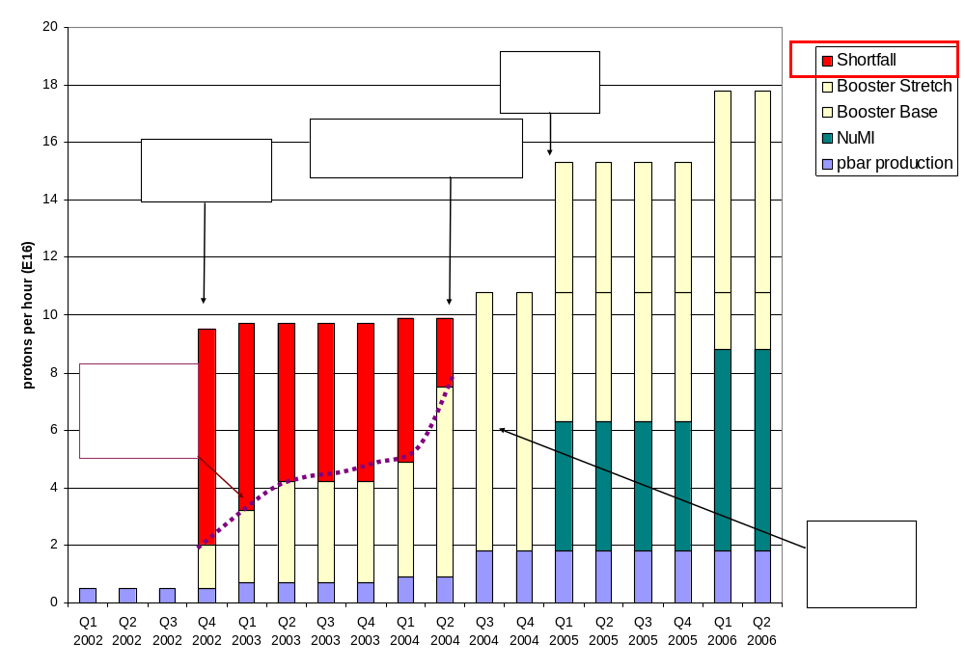
Proton Demand
7.5 Hz
Have now exceeded initial NuMI needs!!!!

Slide 10

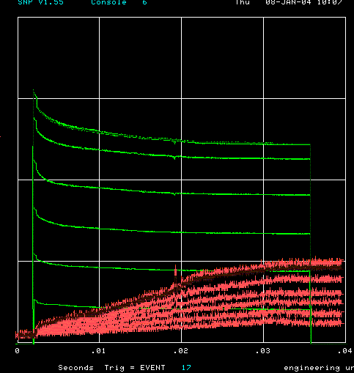
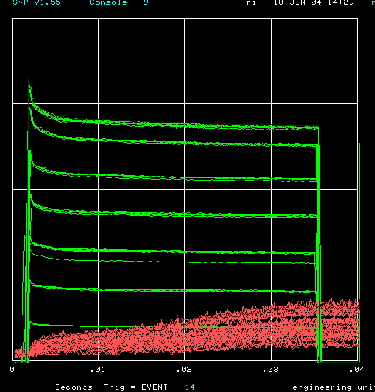
How far have we come?
Oct. 2002 (MB turn-on)
Jan. 2004
Now
Charge through Booster cycle
Energy Lost
Time (s)
Typical:
  5.5E12 protons/batch to stacking (Run II handbook = 5E12)
  >7E16 pph to MiniBooNE (MiniBooNE goal 9E16)
Records:
  6E12 protons/batch to stacking
  8E16 pph to MiniBooNE

Slide 11
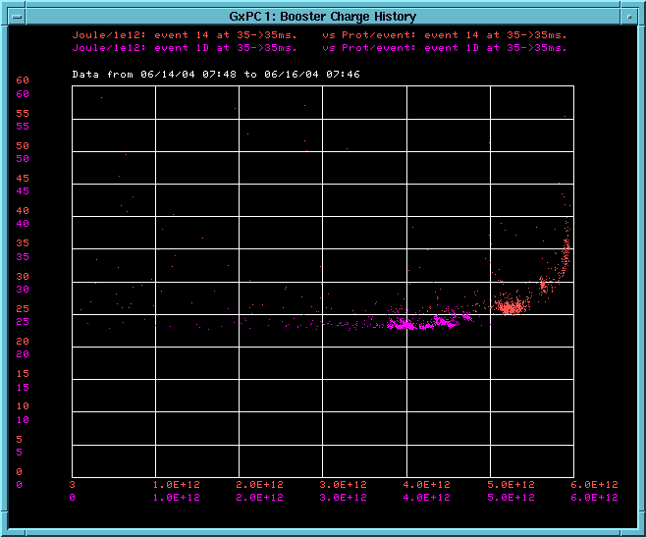
Effect of increased intensity (recent running)
4E12
5E12
~5% more losses (activation) at 5E12
Energy Lost per proton
Protons per pulse
Can really deliver 5E12 efficiently for the first time!!!!!

Slide 12
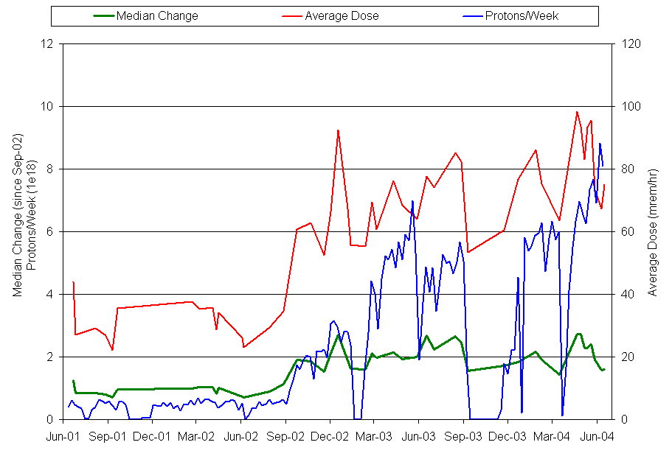
Activation History In Booster
MiniBooNE
x2~3 activation
16x proton increase
Collimators

Slide 13
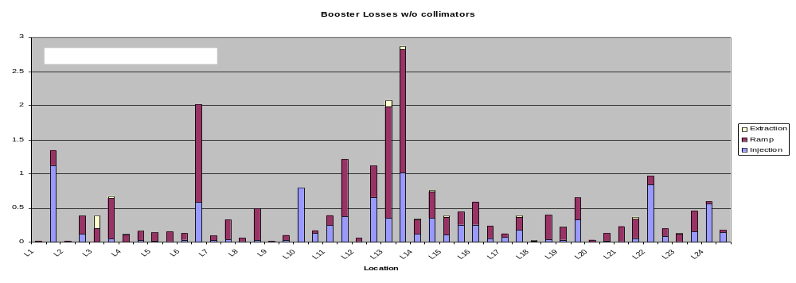
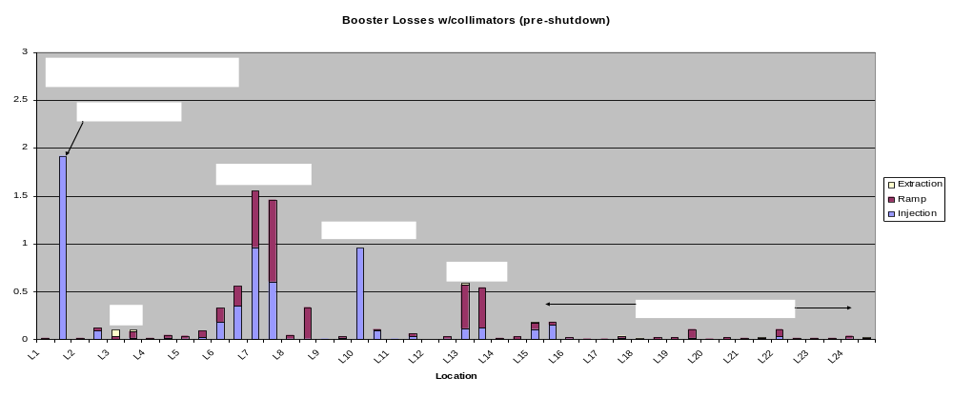
Effect of Collimators

Slide 14
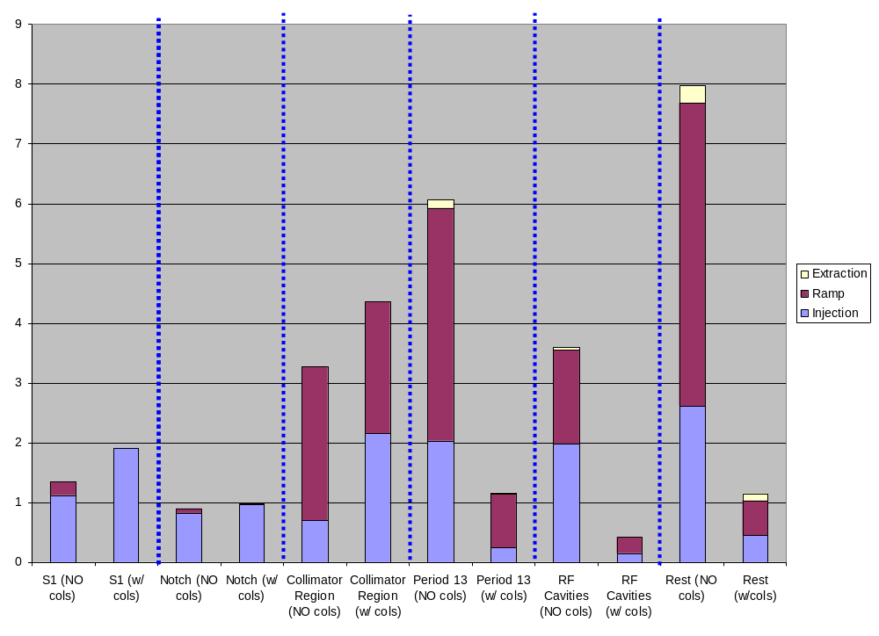
Effect of Collimators by Region

Slide 15
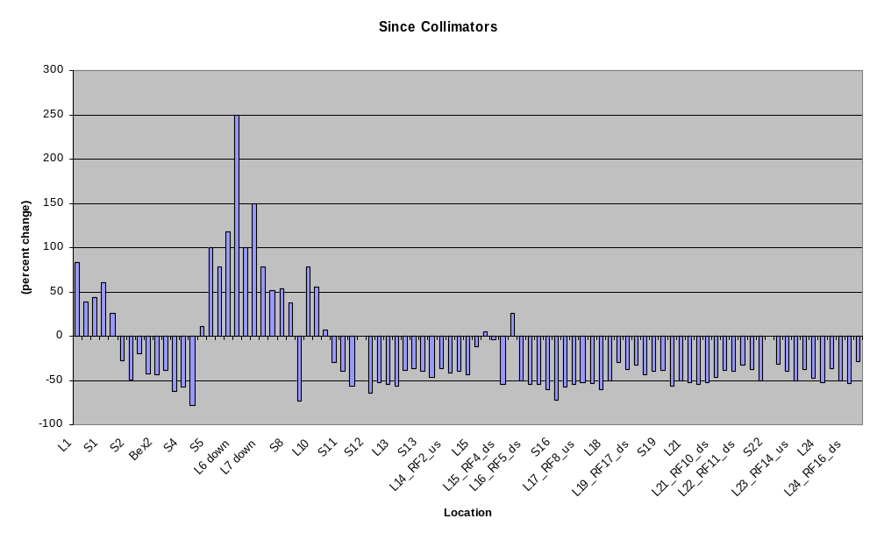
Change In Activation Since Collimators
Collimator
region
L3
Extraction
L13
Extraction
RF Region

Slide 16
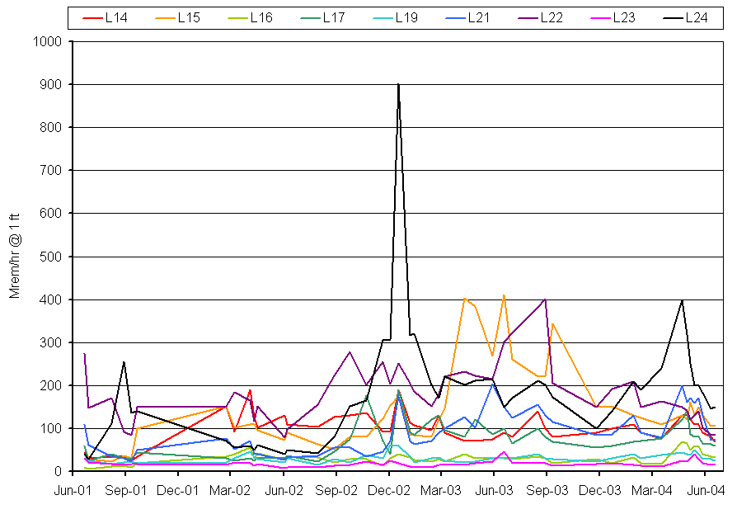
Activation in RF Cavities – Big Success!!
MiniBooNE
Collimators
Pre-MiniBooNE levels!!

Slide 17
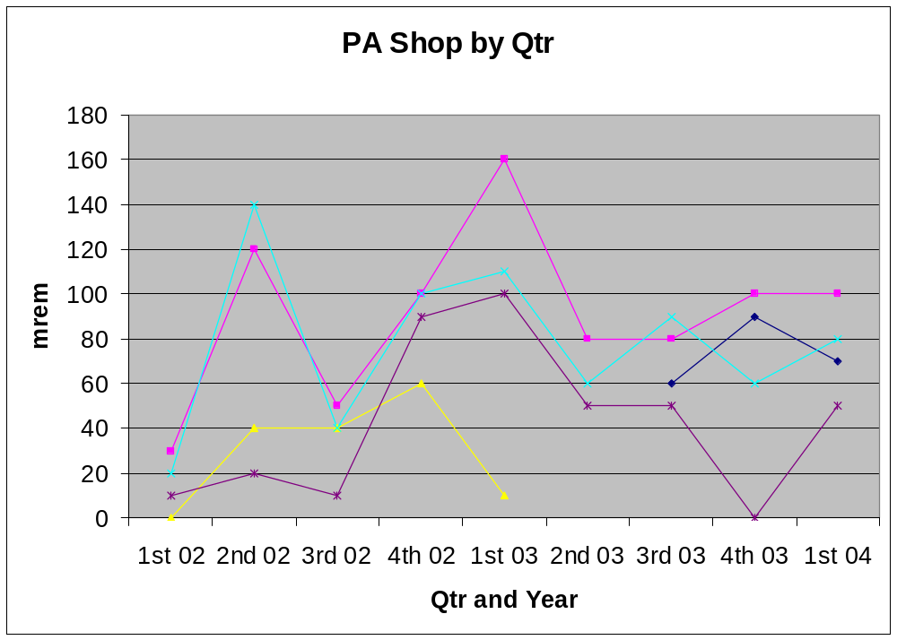
Basis of activation assessment - Dose to Workers
Administrative limit at 300 mRem/qtr
This is “ok”, but we don’t want to get any worse
MiniBooNE

Slide 18
Status before shutdown
Exceeding Run II intensity goals
Can deliver 5E12 protons per batch with good efficiency
Regularly delivering ~80% of MiniBooNE goal
Demonstrated NuMI intensities.
Headroom left for at least some 8 GeV line operation.

Slide 19
Major Performance-related Shutdown Projects
Modify L13 extraction region:
  Overall ~5 reduction in original “dogleg effect”
  Factor of 3 reduction over present effect
Adding 19th RF cavity:
  Use large aperture prototype
  Increase maximum batch size (~6.5E12)
  Increase reliability (can run with one failure)
Prep. for 20th cavity next year
Complete modern laser tracker 3D network and as-found in the Booster and 400 MeV line:
  Will be used to fully align the Booster next year
Move “pinger” girder to period 5:
  Extraction pre-notch will now fire into collimators
  Phased to aid extraction at both extraction regions!

Slide 20
Issues for the Longer Term
Linac
  Quad supplies very old, reliability concern.
  Unstable filament current has been a recurring problem.
  In general, instrumentation is inadequate, particularly in the Low Energy Linac (LEL).
  LEL LLRF in need of an upgrade.
  Nothing planned which will dramatically increase peak performance.

Slide 21
Issues (cont’d)
Booster
  Injection bump system (ORBUMP) must be replaced (discussed shortly).
    Will affect both rep. rate and performance
  Alignment
  RF
    Reliabilty
    Power
  Instrumentation
    Existing system limited, inconsistent, and not compatible with 15 Hz operation

Slide 22
Issues (cont’d)
Main Injector
  Aperture
  RF
    Existing RF not powerful enough for potential protons from Booster

Slide 23
ORBUMP Replacement
The existing injection bump (ORBUMP) system has several major problems:
  Magnet and power supply heating limit the average rep. rate to ~7.5 Hz.
  The system is not powerful enough to bump the beam the required amount, resulting in close to a centimeter of horizontal beam slewing at injection!
  Power supply switch network based on a large number (48) of obsolete SCR’s. Maintenance an issue.
Working on a new magnet and power supply:
  Magnets based on ferrite. Heating not an issue.
  New power supply.
    Higher rate capacitors
    Modern SCR network
    Modern charging controller
  Entire system good for full 15 Hz
  Powerful enough to eliminate injection slewing.
Hope to be ready to install early to mid 2005.

Slide 24
Booster Alignment
It has long been realized that there are significant alignment problems in the Booster.
These cause losses both through aperture reduction and beam motion.
Last year’s vertical as-found uncovered significant problems, which were addressed.
Over the shutdown, we are in the process of a full laser-tracker 3D network and as-found of the Booster.
We will use that information over the next year to come up with an optimum set of horizontal moves.

Slide 25
Booster RF Cavity Options Considered
Move forward with 5” prototype design?
  Design complete and tested
  Could begin procurement and construction immediately in FY05.
  Aggressive schedule could have cavities in place by 2007
  Cost: ~6M
Completely new design?
  Could be designed with higher GE voltage and reduced HOM.
  Frequency range a challenge
  Could have design by end of 2005, cavities in place by 2008
Control losses with alignment and collimators?
  Based on our successes to date, it appears we can
  Don’t replace
This is my preliminary recommendation

Slide 26
Solid State RF drivers
Existing system is by far our biggest maintenance item.
  Usually the older PA’s
  Average 1½ per month out of 17 cavities -> MTBF of 1 year.
  >$400K just for replacement cascode tubes.
  The technicians who service these tubes receive some of the highest average radiation doses at the lab.
Newer solid state tubes much more reliable
  MTBF of at least 3 years.
  More or less identical to MI
  Prototype running in Booster for three years.
  Upgrade can be combined with necessary Main Injector Upgrade.

Slide 27
Corrector Packages
The Booster contains corrector packages at each of the 48 sub-periods.
  Horizontal trim
  Vertical trim
  Quad
  Skew quad
The trims are not powerful enough to control the orbit throughout the cycle
The quads are not powerful enough to fully control the tune/coupling throughout the cycle

Slide 28
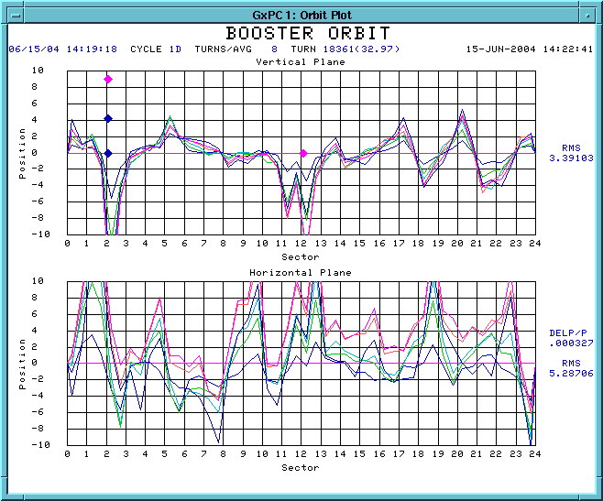
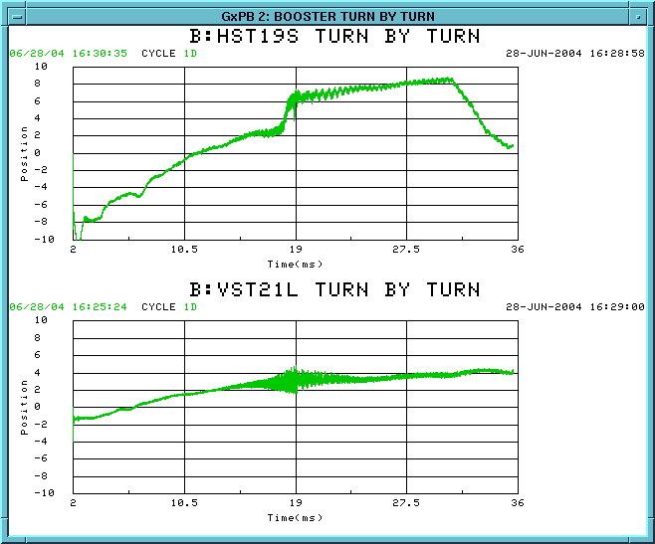
Corrector Package Specifications – Position Control
Observed Beam Motion and Slew Rate
Specification:
  Motion: +- 1 cm of motion at all fields
  Slew rate: 1 mm/ms at all fields

Slide 29
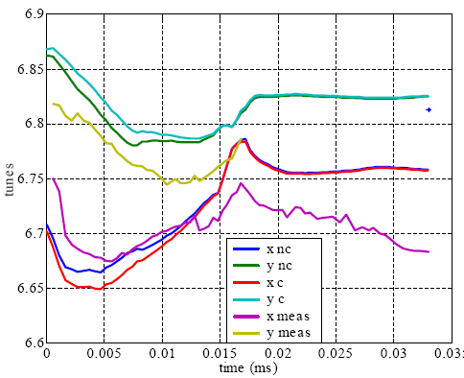
Corrector Specifications – Tune Control
Observed tune variation:
Specification:
  Tune: +- .1 unit of tune at all energies
  Slew rate: .01 unit/ms at all energies

Slide 30
Corrector Specifications
Field specifications:
Roughly 3-4 times present system
Type | Max. Field | Max. Slew Rate
Horizontal Trim | .009 T-m | .5 T-m/s
Vertical Trim | .015 T-m | .8 T-m/s
Quadrupole | .08 T-m/m | 8 (T-m/m)/s
Skew Quadrupole | Same as now | Same as now

Slide 31
Booster Instrumentation
The existing Booster instrumentation is a mish-mash of different technologies
  Most devices are read out through MADC channels
    Limited by C190 multiplexing
    Not capable of reliable 15 Hz operation.
  The BPM’s are read out through a dedicated digitization system;
    Capable of turn-by-turn readout of the entire system, BUT
    Very slow to read out entire system.
    Non-standard data interface complicates analysis.
    Existing digitizers no longer available.
  BLM system read out by IRM system:
    Good to full 15 Hz.
    No channel limit.
    Is there something better now?
Plan
  Work with instrumentation this year to determine the best solution for Booster readout, capable of snapshotting the entire Booster on and event-by-event basis.

Slide 32
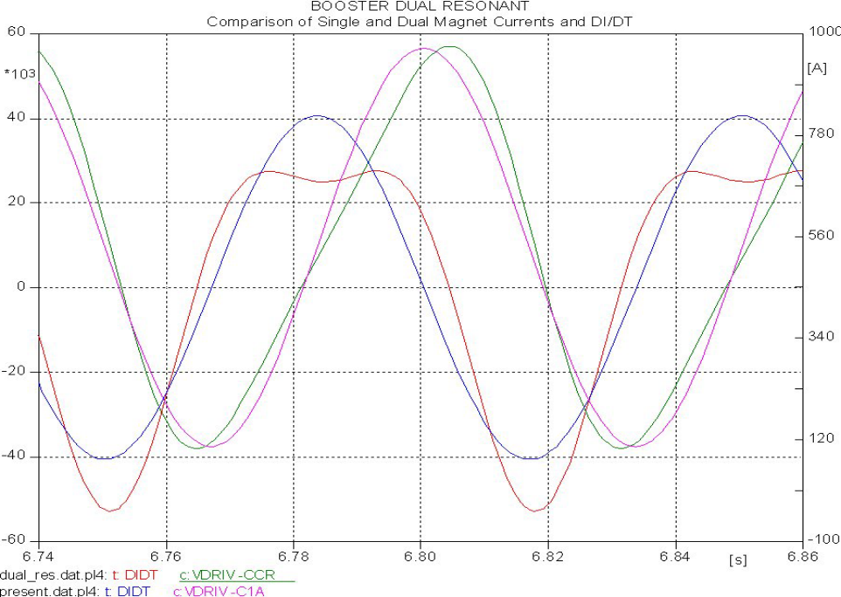
Higher Harmonic Operation
By adding a 30 Hz compononent to the Booster magnetic lattice, we could reduce the maximum dp/dt by ~35%, effectively increasing the RF power.
Pursue prototype in 2005
If successful, implement in 2006

Slide 33
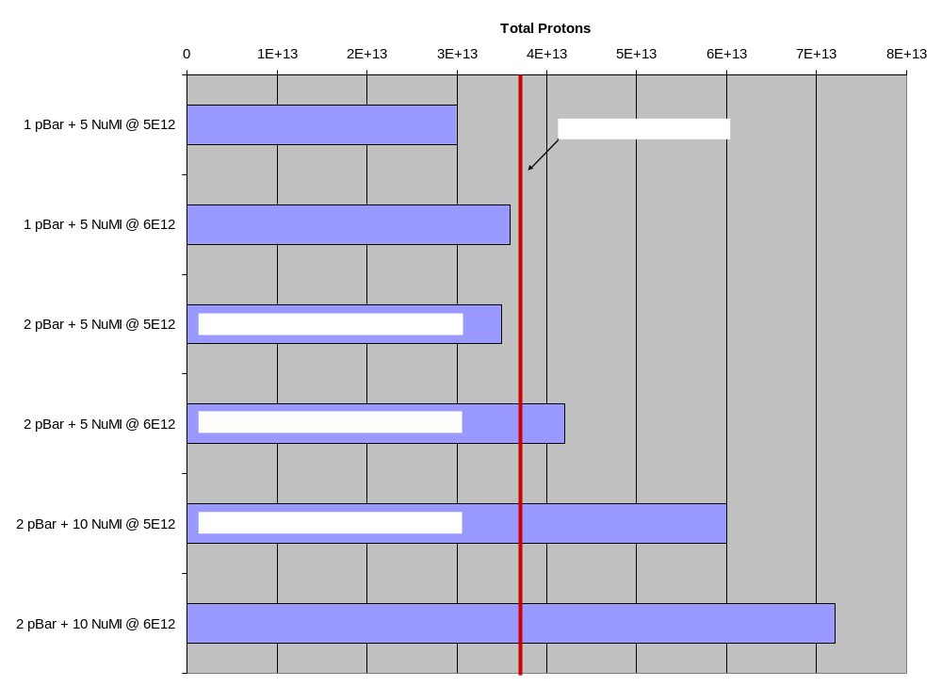
Main Injector RF Power Issues

Slide 34
Booster/MI RF Upgrade Project
Goals:
  Replace Booster PA’s with solid state versions, of the type used in the Main Injector.
  Add a second PA to each Main Injector cavity.
Plan:
  Construct new PA’s and solid state drivers
    20 for Booster
    20 for second MI port.
  Build new modulators for MI dual PA cavities:
  Move old MI modulators to Booster.

Slide 35
Money – Combined RF Upgrade
Solid State RF Upgrade (Main Injector + Booster)
These are the projected total costs, and the maximum useful procurement money in FY05.
This spending profile could have a complete system in place in both machines at the end of FY06.
Element | Unit Cost | Total | Max FY05 Procurement
Solid State Drivers (40) | 110 | 4400 | 3200
PA's (40) | 100 | 4000 | 4000
Modulator (20) | 125 | 2500 | 1740
Totals: |  | 10900 | 8940

Slide 36
Other Projects
Linac
  Quad Supplies: 250K
  Improved Instrumentation: 100K
  Filament Stabilization: 100K
  Laser chopping R&D: 100K
  Source R&D: 50K
  Subtotal: 600K
Booster
  ORBUMP Power Supply: 200K
  30Hz Harmonic prototype: 50K
  Corrector Upgrade: 200K
  New Pinger System: 100K
  Instrumentation R&D: 100K
  Subtotal 650K
Total: 1250K
Proposal: Fund these projects and as much of the RF Upgrade as we can.

Slide 37
Approximate Timeline
2004
  Collimators commissioned and fully operational
  L13 Modification
  Vertical and RF cavity alignment
  Complete alignment network and as-found
  19th RF cavity added to Booster
2005
  New ORBUMP magnets and Power supplies.
  Horizontal alignment
  Procurement for solid state PA’s
  Design and procurement for new corrector system
  Begin new quad supplies for linac
  Design and procurement for new Booster instrumentation
2006
  Complete installation of solid state PA’s (fast track)
  Fabricate new corrector system
  Install 30 Hz harmonic, if recommended
2007
  Complete new corrector system

Slide 38
High Rate Booster Operation
Once the ORBUMP is upgraded, the entire Booster will be capable of running at 15Hz, with the exception of the RF system.
Drift tube cooling and general maintenance should allow the RF system to reach 10 Hz.
  This is enough for:
    2 pBar batches + 5 NuMI batches every 2 seconds +
    FULL 5Hz MiniBooNE operation.
After that, we become limited by power from the mains, so if we decide to address it, it would naturally become part of the overall feeder upgrade plan.

Slide 39
Proton Projections - Booster
Losses in the Booster continue to be the major limitation to total proton throughput.
It is extremely difficult to make quantitative projections, so most projections are based on historical performance.
We have now come to a point where we believe we understand the performance well enough that quantitative projections will be possible in the not-too-distant future.
A lot of ground work has been done:
  In particular, the work to correlate activation to beam loss.

Slide 40
Completion of Dogleg Work
Caused by parasitic focusing of dogleg magnet
  Goes like square of bend angle.
  Both extraction regions ~ add.
Original magnitude:
  Max horizontal beta goes from 33 -> 47 m
  Max horizontal dispersion goes from 3.1 -> 6m
Solution
  Spread out dogleg magnets separation by >2.
Effect of L3 fix
  Decrease distortion from that side by ~5.
  Total distortion 60% of original (50% + 50%/5)
Effect of L13 fix
  Decrease remaining distortion by ~5
  Total effect 20% of original.
  Factor of three better than prior to shutdown.
Conclusion: After this shutdown, the Booster will be much closer to an ideal machine.

Slide 41
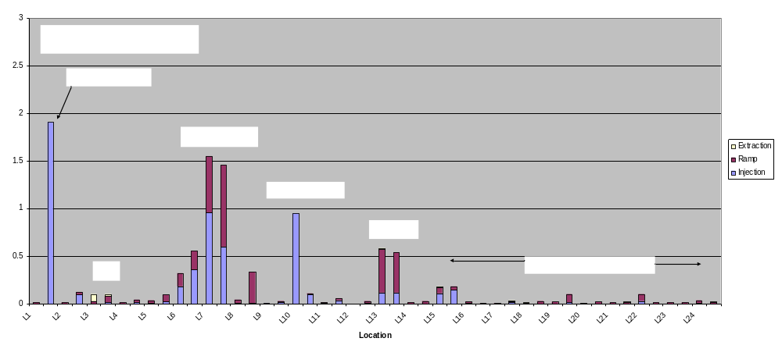
Understanding Booster Losses

Slide 42
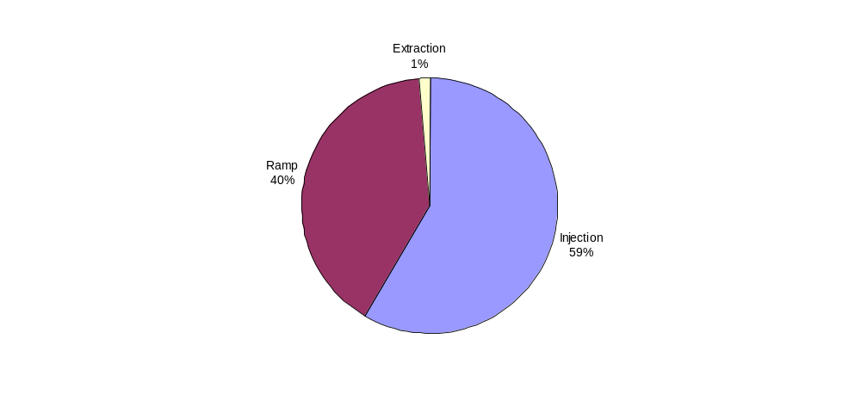
Understanding Booster Losses
Misalignment
  Will align this year
Lattice slewing
  Will improve after L13 work
Intentional L13 scraping
  Will move to collimators after lattice is improved
Misalignment
  Will align this year
Injection mismatch:
  400 MeV line work
Lattice distortion
  Improved after L13 work
Horizontal Slewing
  Eliminated with new ORBUMP
Notch
  Will move to collimators after shutdown

Slide 43
Quantifying Booster Loss
Main areas to understand:
  Operation of the collimators
    Helping, but still at least a factor of five away from initial predictions.
    It’s clear that up until now, the Long 13 aperture has complicated collimator operation.
    We are working to model this.
  Beam loss related to beam position and size.
    Because we don’t have a good model of Booster beam halo, it’s difficult to quantitatively relate beam loss to things like beam position and beam size.
    Now that the loss pattern has become simplified, we should be able to quantify this through a series of straightforward aperture studies, beginning with the end of the shutdown.
  Potential for 30Hz harmonic:
    Can study by running at a lower energy.
    Planned for shutdown.

Slide 44
Summary and Conclusions
The Proton Source has made remarkable progress thanks to the work of countless people.
We believe we have a realistic plan to optimize the reliability and performance of the system over the next few years.
The main part of this plan involves the RF systems of the Booster and Main Injector, and the timescale of these projects is completely determined by how fast we spend money on them.

