Slide 1
Proton Plan
Eric Prebys
FNAL Accelerator Division

Slide 2
Outline
Scope of the Plan
Proton Economics and Limiting Factors
Key Issues
Elements of the Plan
Timeline
Cost
Proton Projections

Slide 3
“Proton Plan”
The details of proton demand and issues can be found in an official report to the director at:
www.fnal.gov/directorate/program_planning/studies/ProtonReport.pdf
Working assumptions:
  Existing proton source must last at least another 10 years or so in more or less it’s current configuration.
  During that time, a new “proton driver” will be built, which will ultimately replace the existing proton source.
  Proton source improvements should require no significant downtimes beyond those needed for other reasons.
  The maximum total funding for proton source improvements will be of the order of $18M over the next few years.
  Near term projects most important to performance

Slide 4
What Limits Total Proton Intensity?
Maximum number of Protons the Booster can stably accelerate: 5E12
Maximum average Booster rep. Rate: currently 7.5 Hz, may have to go to 10 Hz for NuMI+ (full) MiniBooNE
(NUMI only) Maximum number of booster batches the Main Injector can hold: currently 6 in principle, possibly go to 11 with fancy loading schemes in the future
(NUMI only) Minimum Main Injector ramp cycle time (NUMI only): 1.4s+loading time (at least 1/15s*nbatches)
Losses in the Booster:
  Above ground radiation
  Damage and/or activation of tunnel components
Our biggest worry at the moment!!!!

Slide 5
Key Issues
Linac
  Not a performance bottleneck, but historically a reliability concern
  Pulsed quad power supplies
  Increased instrumentation
Booster:
  Hardware improvements to increase maximum average repetition rate
  A multi-pronged approach to increase aperture and efficiency
Main Injector
  Aperture increases to accommodate multi-batch loading.
  Increased RF to accommodate slip-stacked NuMI loading.
Biggest $$$

Slide 6
Plan Elements
Linac
  Maintenance, Reliability, and Monitoring
    Increased Instrumentation
    Replace Pulsed Quadrupole power supplies
Booster
  Aperture
    Long 13 Modification (complete)
    ORBUMP replacement
    Improved Corrector System
    Alignment
  Longitudinal Bucket Area
    Gamma-t system
    Extra RF cavities
    30 Hz Harmonic
  Repetition rate
    RF Drift tube cooling
    Feeder upgrade (deferred)
  Operational advances
    Beam cogging
  Maintenance, Reliability, and Monitoring
    Solid state RF PA’s
    Improved instrumentation

Slide 7
Plan Elements (cont’d)
Main Injector
  Aperture
    Large aperture quads
  Longitudinal Bucket Area
    Dual PA RF upgrade
  Operational Advances
    Initial NuMI commissioning
    Mixed mode operation
    Full mixed mode (2+5) operation
    Full slipstacked (2+9) NuMI operation
  Maintenance, Reliability, and Monitoring
    BPM Upgrade
    BLM Upgrade

Slide 8
Important Milestones in Proton Delivery
12/2004 – Slipstacked pBar production
1/2005 – NuMI operation begins
4/2005 – “2+5” pBar+NuMI operation
11/2005 – Booster capable of 9Hz operation
11/2006 – Main Injector RF Upgrade Complete
4/2007 – NuMI+pBar at full 2+9 operation

Slide 9
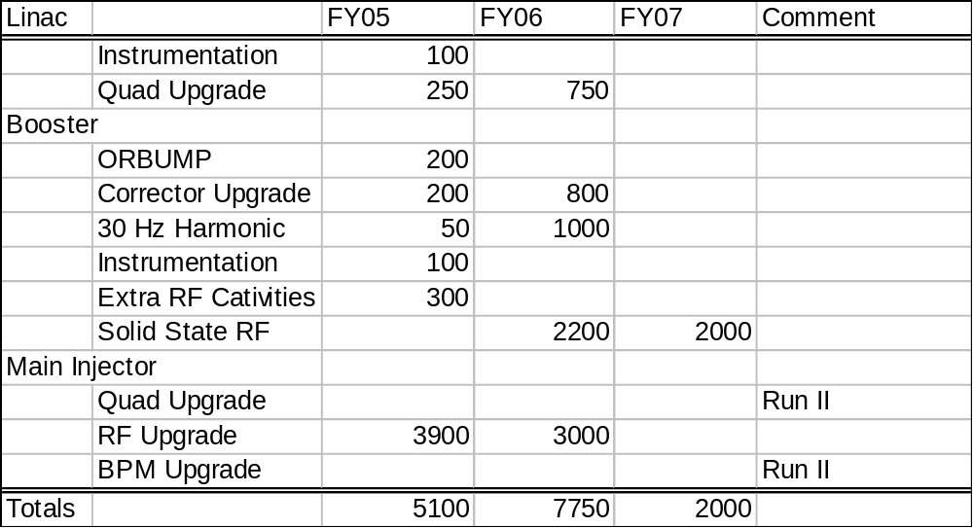
Major Costs

Slide 10
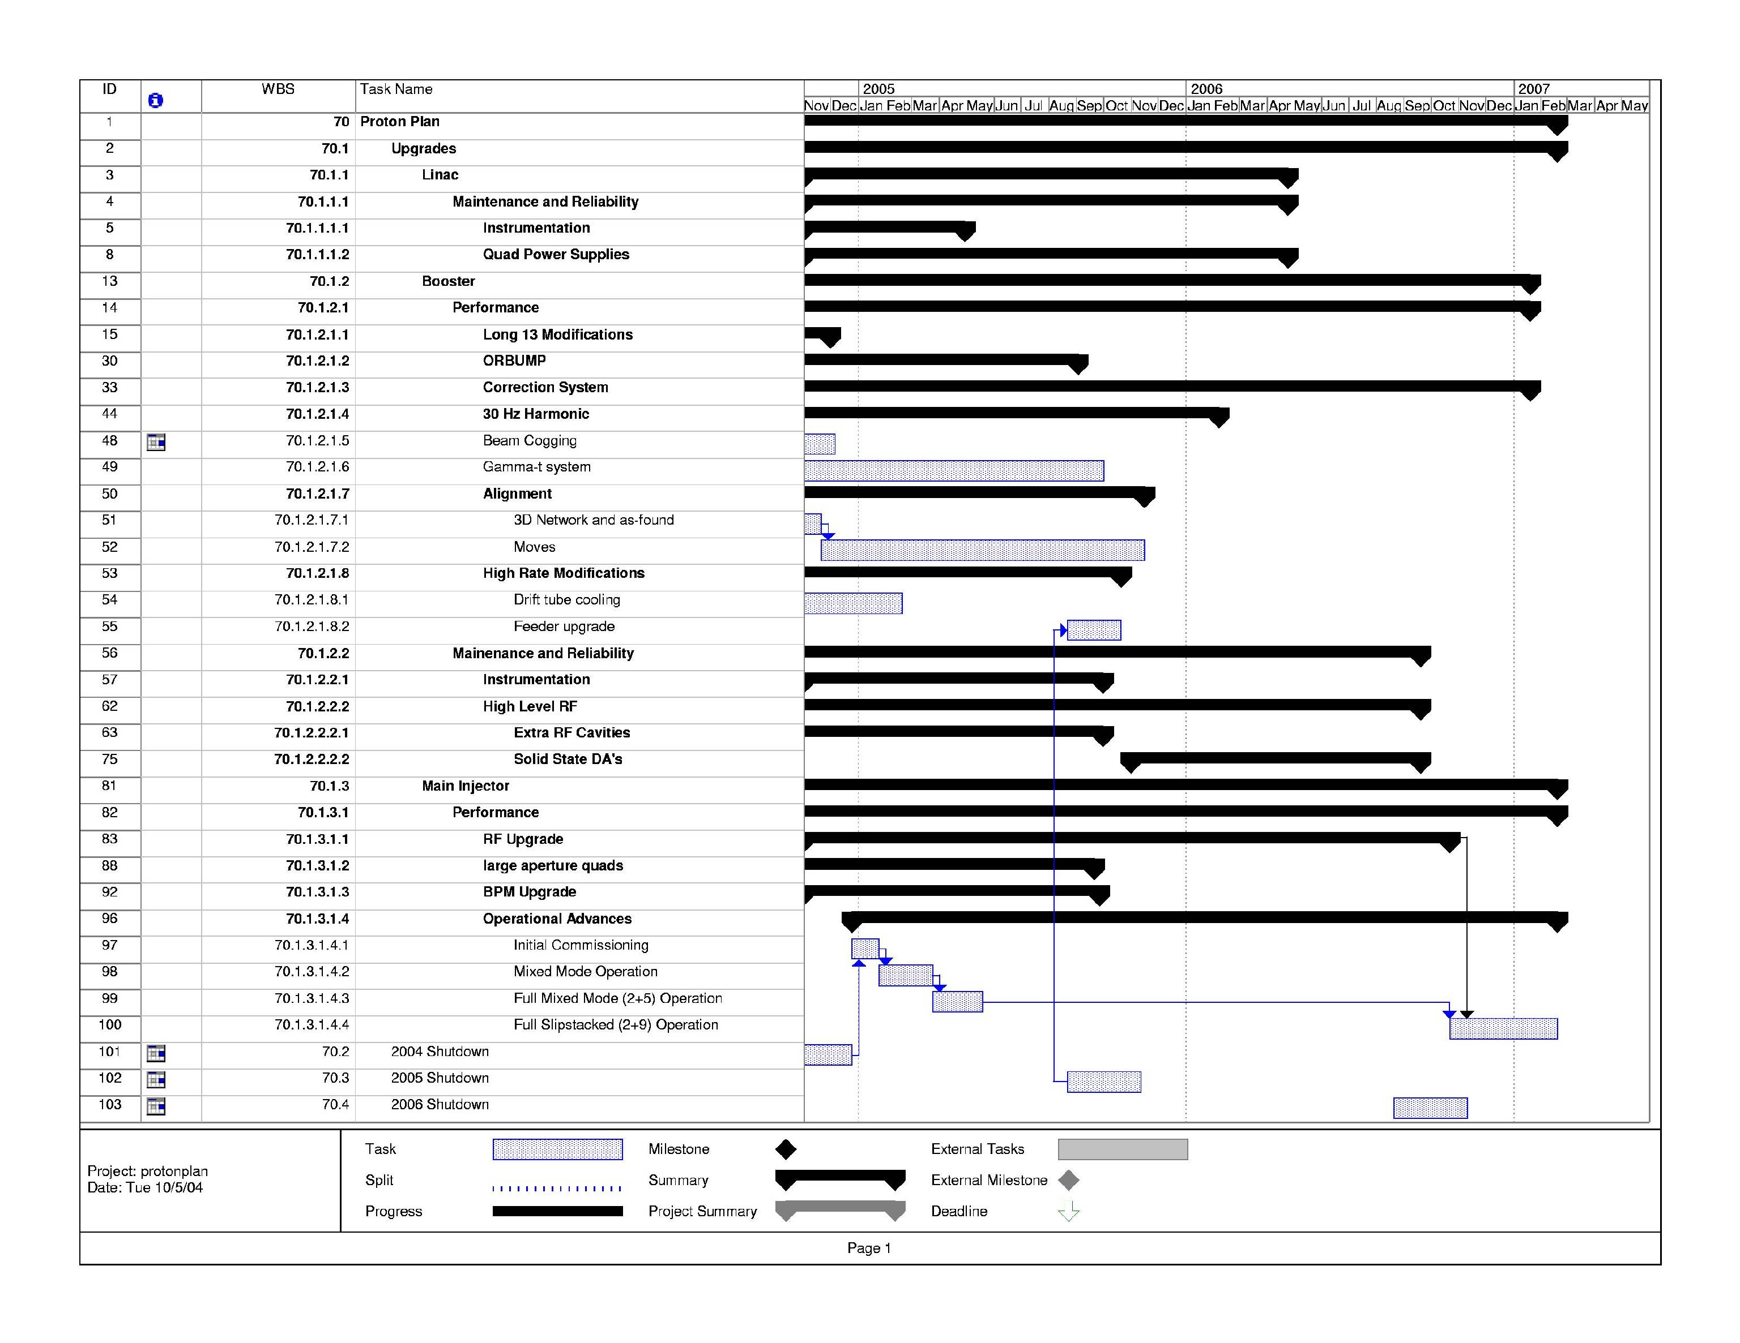
Timeline of Key Elements

Slide 11
Estimating Proton Delivery
Assumptions
  The hardware improvements to Booster and Main Injector take place on the time scale I have presented.
  Booster loss reduction more or less keeps pace with the repetition rate increases.
  There are no severe roadblocks to the operational advances in the Main Injector (multi-batch, etc)
  Maximum efficient Booster batch remains 5E12
    Hopefully conservative
  Total Main Injector acceleration time also remains constant
    Cycle time will go to 2.3s at full NuMI operation.

Slide 12
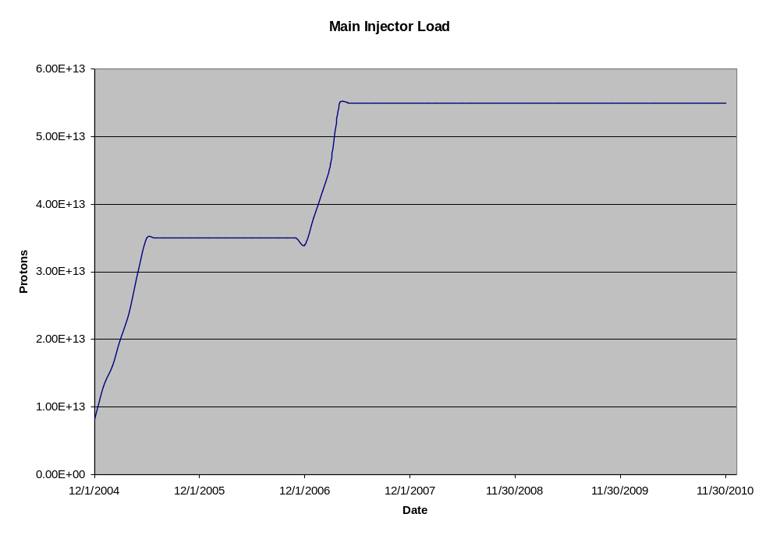
Machine Capacities
RF Upgrade

Slide 13
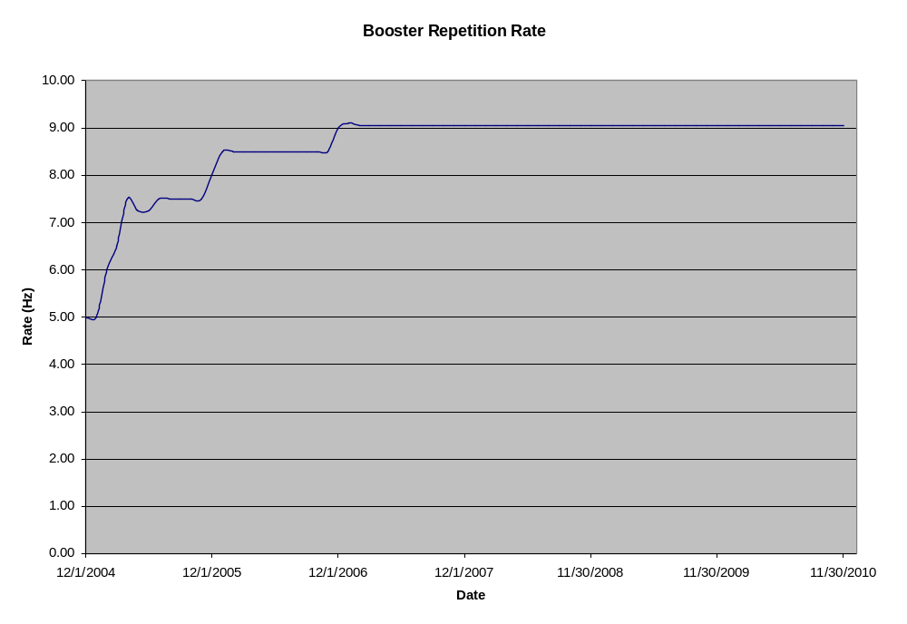
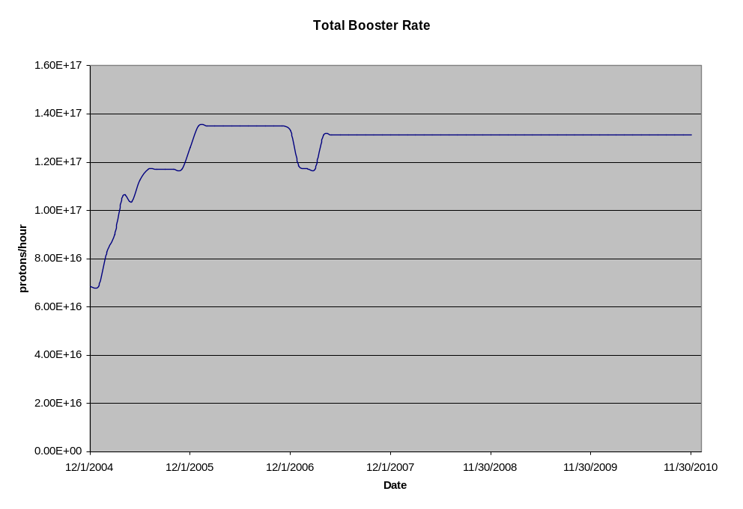
Machine Capacities (cont’d)
ORBUMP Upgrade

Slide 14
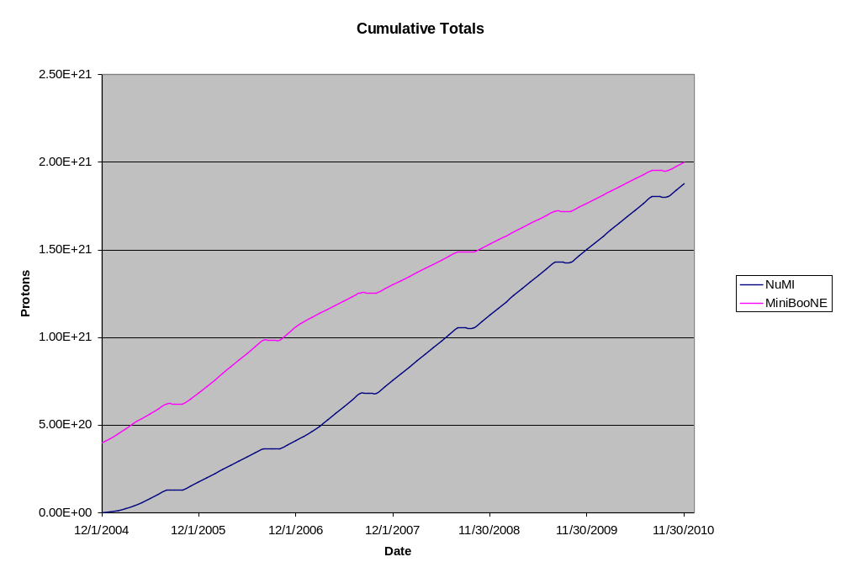
Proton Projections

Slide 15
Improvements suggested by Alberto
Include MI BLM upgrade (currently under Run II plan).
Explicitly include larger booster batches (5.5-6E12)
  Can MI accelerate 11 6E12 batches??
Believe that after RF upgrade, MI acceleration ramp can be reduced to maintain 2 seconds rep. rate even with slipstacking (15% increase to NuMI).

