Slide 1
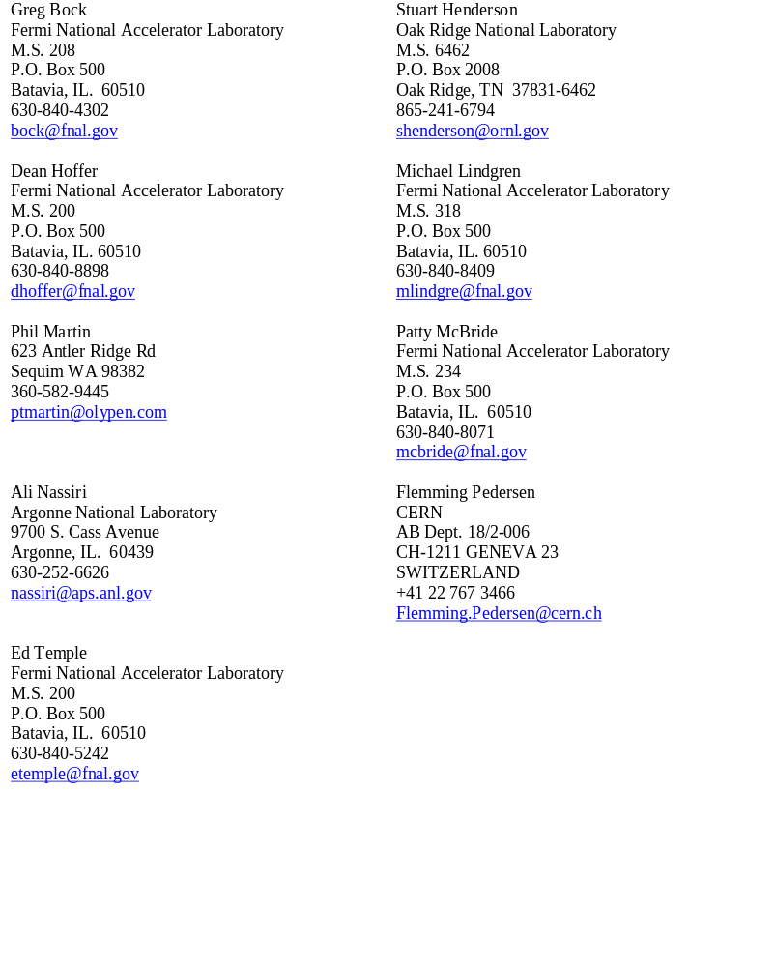
Review Committee

Slide 2
What to Expect
Generally very little familiarity with accelerator complex
  All topics should be fully explained and justified.
By and large, a good tempered crowd
  I wouldn’t expect much badgering, but…
  These are good people who may ask tough questions.

Slide 3
General Advice from Last Time
Need more justification
  Expand introductory talk
  Each talk must contain motivation (even if the speaker doesn’t write that part of the talk)
Need to practice
Work out our differences beforehand

Slide 4
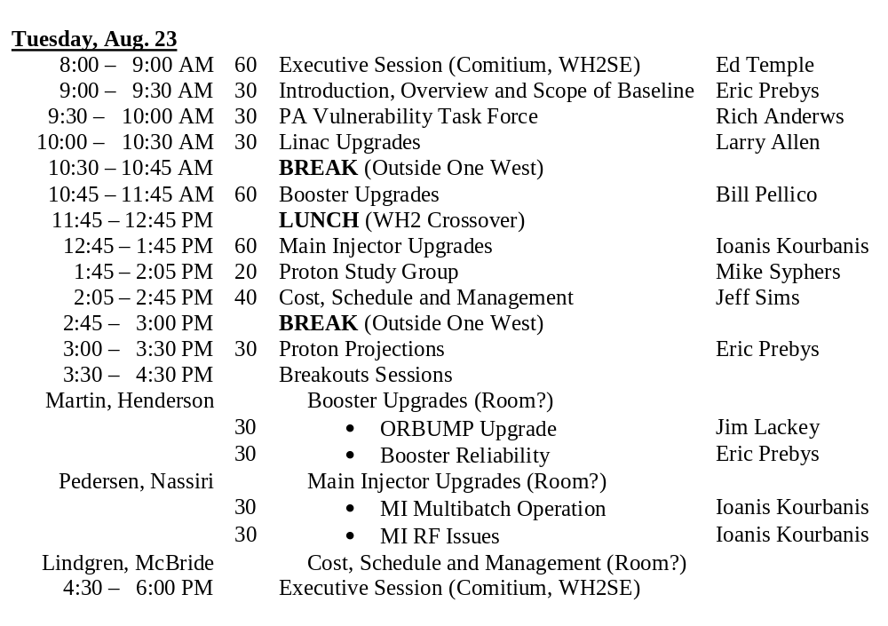
Schedule: Day 1

Slide 5
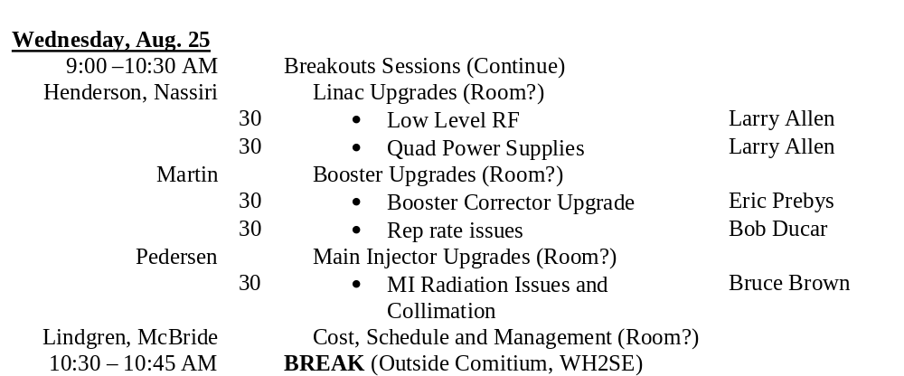
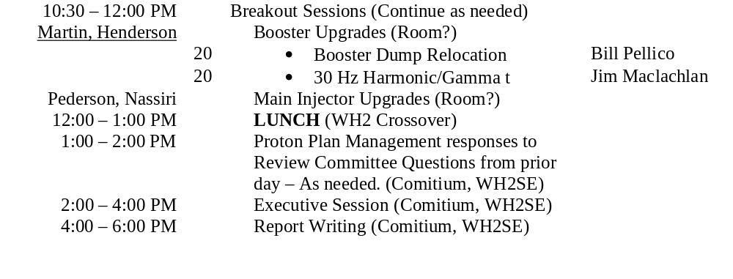
Schedule: Day 2

Slide 6
Approaching Review
Wednesday, August 17th:receive final talks
Thursday, August 18th: rehearse

