Slide 1
Proton Plan Agenda
Review Update – E. Prebys
MI Collimation Review Summary – B. Brown and/or I. Kourbanis
Draft Parameter Lists
  Linac – L. Allen
  Booster – E. Prebys
  Main Injector – I. Kourbanis

Slide 2
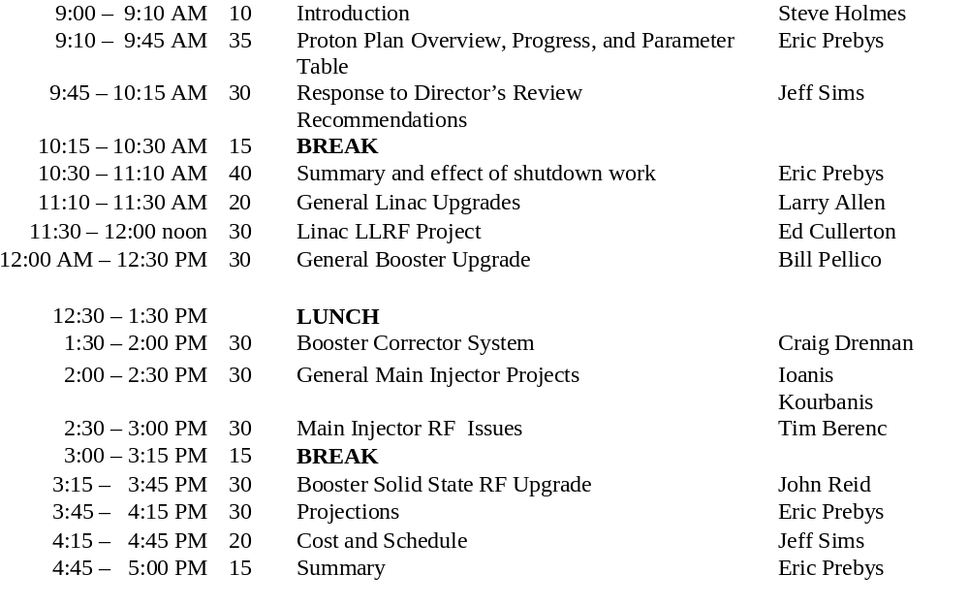
Review (August 15-16) Draft Agenda

Slide 3
Practice Talks
Review is August 15-16
Unfortunately, I’ll be out of town August 4-11.
I’d like to get through some of the practice talks at our regular meeting on 8/2 and perhaps an extra meeting 8/3.
Rest of practice talks morning of 8/14.

Slide 4
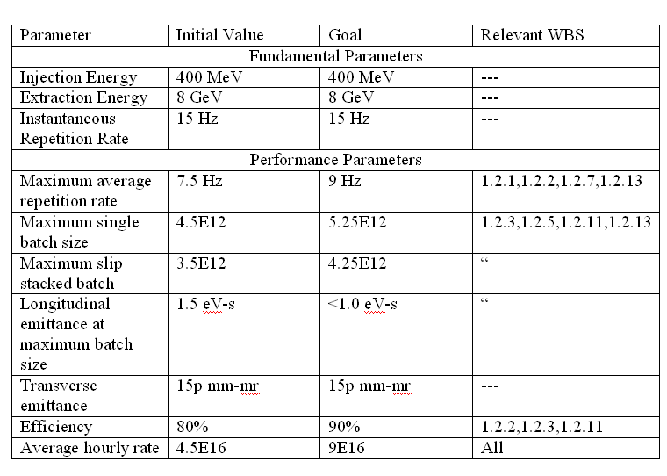
Booster Draft Parameter List

