Slide 1
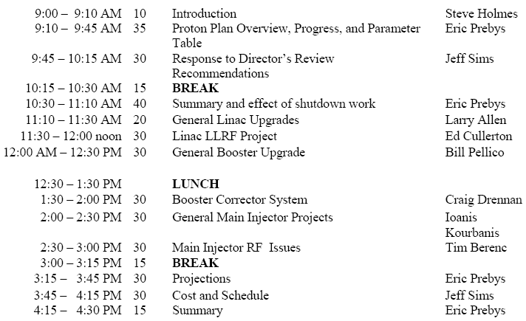
Review (August 15-16) Draft Agenda

Slide 2
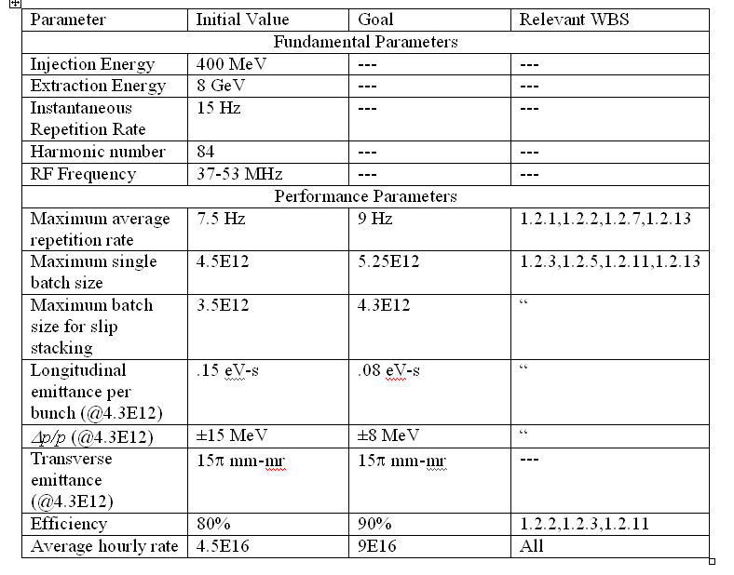
Booster Draft Parameter List

Slide 3
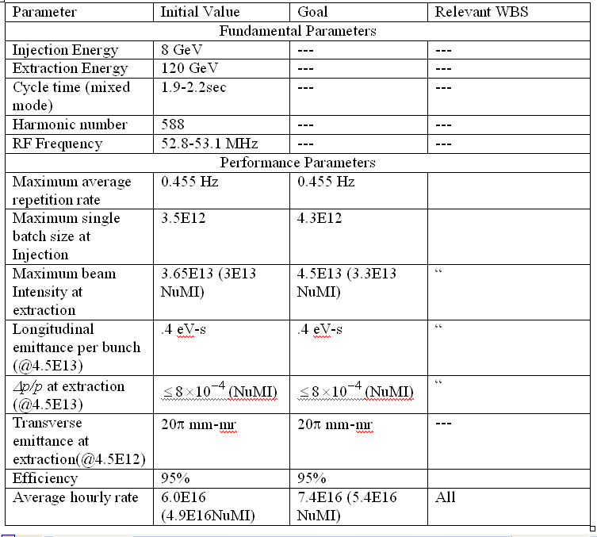
MI Parameter Table (from Ioanis)

Slide 4
Possible new scope?
Add Booster bunch rotation
  RF group balancing
  Amplitude control
Could logically fall under 1.2.13 (RF reliability improvements)
  Has been demonstrated
  Presently takes lots of hand tuning to keep it working

